Slide 1
阅读理解微技巧1
Why？
转折之后必有重点
老外在写文章喜欢用转折引出重点内容，命题专家就喜欢在转折处出题，因此文章中有转折的地方，重视转折之后的内容，可能这里就是出题处！

Slide 2

阅读系列1→转折之后必有重点
Mini reading 1
We all know that science plays an important role in the societies in which we live. Many people believe, however, that our progress depends on two different aspects of science. The first of these is the application of the machines and products that scientists and technologists develop. New drugs, faster and safer means of transport, new systems of applied knowledge are some examples of this aspect of science.
1. Many people believe that science helps society to progress through __________.
A. Applied knowledge B. More than one aspect
C. Technology only D. The use of machines
our progress depends on two different aspects

Slide 3

designate命名,指定,认定
with flying colors成功地,出色地
Mini reading 3
After the student has passed the driver’s education course and reached the appropriate age to drive(this age differs in every state but in most cases the person must be 16 years old), they can go to a designated state office to take their driver’s test, which is made up of an eye examination, a written test, and a road test. The person must pass all three tests in order to be given a driver’s license. If the person did well in his or her driver’s education class, he or she will pass the test with flying colors and get a driver’s license.
1. Which of the following does not agree with the requirements for the students wanting to get their driver’s license?
A. They must be 16 years of age. B. They should go to have their driver’s test.
C. They must have their eyes examined. D. They ought to do well in their driver’s course.

Slide 4
2020年全国1卷B篇
Returning to a book you’ve read many times can feel like drinks with an old friend. There’s a welcome familiarity - but also sometimes a slight suspicion that time has changed you both, and thus the relationship. But books don’t change, people do. And that’s what makes the act of rereading so rich and transformative.
24. Why does the author like rereading?
A. It evaluates the writer-reader relationship.
B. It’s a window to a whole new world.
C. It’s a substitute for drinking with a friend.
D. It extends the understanding of oneself.
人改变了
mentlly and physically

Slide 5
2020年全国2卷B篇
The parents were asked to interact with their children as they normally would, and about half of children in the study played with puzzles at one time. Higher-income parents tended to have children play with puzzles more frequently, and both boys and girls who played with puzzles had better spatial skills. However, boys tended to play with more complex puzzles than girls, and the parents of boys provided more spatial language and were more active during puzzle play than parents of girls.
26. How do boy differ from girls in puzzle play?
A. They play with puzzles more often.
B. They tend to talk less during the game.
C. They prefer to use more spatial language.
D. They are likely to play with tougher puzzles.

Slide 6
阅读理解微技巧1
转折之后出主旨
特别是首段比较长，有转折词出现时，转折后可能就是全文主旨！

Slide 7
迁移 (主旨题)
remedy n./v.纠正,改正,改进
When something goes wrong，it can be very satisfying to say，”Well, it’s so-and-so’s fault.” or “I know I’m late，but it’s not my fault；the car broke down.” It is probably not your fault，but once you form the habit of blaming somebody or something else for a bad situation，you are a loser. You have no power and could do nothing that helps change the situation. However, you can have great power over what happens to you if you stop focusing on whom to blame and start focusing on how to remedy the situation. This is the winner’s key to success.
Winners are great at overcoming problems. For example, if you were late because your car broke down, maybe you need to have your car examined more regularly. Or, you might start to carry along with you the useful phone numbers, so you could call for help when in need. For another example, if your colleague causes you problems on the job for lack of responsibility or ability, find ways of dealing with his irresponsibility or inability rather than simply blame the person. Ask to work with a different person, or don’t rely on this person. You should accept that the person is not reliable and find creative ways to work successfully regardless of how your colleague fails to do his job well….
50. Which of the following is the best title for the passage?
A. A Winner’s Secret. B. A Winner’s Problem.
C. A Winner’s Opportunity. D. A Winner’s Achievement.
topic?

Slide 8
迁移 (主旨题)
Sometimes you’ll hear people say that you can’t love others until you love yourself. Sometimes you’ll hear people say that you can’t expect someone else to love you until you love yourself. Either way, you’ve got to love yourself first and this can be tricky. Sure we all know that we’re the apple of our parents’ eyes, and that our Grandmas think we’re great talents and our Uncle Roberts think that we will go to the Olympics, but sometimes it’s a lot harder to think such nice thoughts about ourselves. If you find that believing in yourself is a challenge， it is time you build a positive self-image and learn to love yourself.
Self-image is your own mind’s picture of yourself. This image includes the way you look, the way you act, the way you talk and the way you think. Interestingly, our self-images are often quite different from the images others hold about US. Unfortunately, most of these images are more negative than they should be. Thus changing the way you think about yourself is the key to changing your self-image and your whole world.
49. What is the passage mainly about?
A. How to prepare for your success.
B. How to face challenges in your life.
C. How to build a positive self-image.
D. How to develop your good qualities.
What will be probably discussed
in the third para?
How to defeat the passive self-image?

Slide 9
迁移 (主旨题)
In the animal kingdom, weakness can bring about aggression in other animal. This sometimes happens with humans also. But I have found that my weakness brings out the kindness in people. I see it every day when people hold doors for me, pour cream into my coffee, or help me to put on my coat. And I have discovered that it makes them happy.
From my wheelchair experience, I see the best in people, but sometimes I feel sad because those who appear independent miss the kindness I see daily. They don’t get to see this soft side of others. Often, we try every way possible to avoid showing our weakness, which includes a lot of pretending. But only when we stop pretending we’re brave or strong do we allow people to show the kindness that’s in them.
Last month, when I was driving home on a busy highway, I began to feel unwell and drove more slowly than usual. People behind me began to get impatient and angry, with some speeding up alongside me, horning (按喇叭) or even shouting at me. At the moment, I decided to do something I had never done in twenty-four years of driving. I put on the car flashlights and drove on at a really low speed.
30. Which of the following is the best title for the passage?
A. A Wheelchair Experience.
B. Weakness and Kindness.
C. Weakness and Strength
D. A Driving Experience

Slide 10
People behind me began to get impatient and angry, with some speeding up alongside me, horning (按喇叭) or even shouting at me.
They don’t stop; they speed up. Or the driver would roll car-window down, looking at us in alarm. Every time I’d ask if he would drive us to Harlem so we could help some people, the driver would look away quickly, furiously roll up the window and pull away without saying anything
However, as if exerted a curse, welcoming us were either vans zooming-away with thunderous roars, some drivers’ scornful words, or others’ loudly and impatiently pressing their horns, leaving us jaw-dropping.

Slide 11
课后巩固练习
Mini reading 1
Most of us have quite good memories, but our memories are limited. For example, we cannot remember everyone we have ever met or what we did on every single day of our lives. However, there are some people who do have prodigious memories. These people have a rare condition known as savant syndrome( 学 者 症 候 群).Savants suffer from a developmental disorder, but they also exhibit great talents that contrast (显 出 差异)sharply with their physical and mental disabilities.
Kim Peek (1951-2009) was a savant who lived in Salt Lake City, Utah, in the United States. He was born with damage to parts of his brain, but it seemed that other parts of his brain----particularly those relating to memory ----became overdeveloped.
1. According to the passage, Peek_________
A. could take care of himself
B. was born with a good memory
C. was the student of Dr. David Treffert
D. became brain-damaged at 20-months old
savant学者,专家
prodigious: very large or powerful and causing surprise or admiration巨大的,伟大的

Slide 12
Mini reading 2
The longest day of the month is the day after my younger brother T.J. gets his new issue of Just Joking , a magazine filled with all kinds of jokes. When the new issue arrives, T.J tells me every riddle in it. But a constant stream of riddles can get annoying.
"Hey，Keith！What did the hamburger name his daughter？" "T．J!"I shout．"Enough riddles!" He is suddenly quiet．
64. Keith shouts at T.J.because ____.
A. he is a cruel boy
B. he doesn’t like T.J
C. He is tired of the riddles told by T.J
D. He doesn’t know the answer to the riddle

Slide 13
高考真题讲解

Slide 14
2015年全国卷一 B篇阅读
【1】The freezing Northeast hasn’t been a terribly fun place to spend time this winter, so when the chance came for a weekend to Sarasota, Florida, my bags were packed before you could say “sunshine”. I left for the land of warmth and vitamin C (维生素C), thinking of beaches and orange trees. When we touched down to blue skies and warm air, I sent up a small prayer of gratefulness. Swimming pools, wine tasting, and pink sunsets (at normal evening hours, not 4 in the afternoon) filled the weekend, but the best part — particularly to my taste, dulled by months of cold-weather root vegetables — was a 7 a.m. adventure to the Sarasota farmers market that proved to be more than worth the early wake- up call.
【2】The market, which was founded in 1979, sets up its tents every Saturday from7 a.m. to 1 p.m., rain or shine, along North Lemon and State streets. Baskets of perfect red strawberries; the red-painted sides of the Java Dawg coffee truck, and most of all, the tomatoes; amazing, large, soft and round red tomatoes.
【3】Disappointed by many a broken vine-ripened (蔓上成熟的) promise, I’ve refused to buy winter tomatoes for years. No matter how attractive they look in the store, once I get them home they are unfailingly dry, hard, and tasteless. But I homed in, with uncertainty, on one particular table at the Brown’s Grove Farm’s stand, full of fresh and soft tomatoes the size of my fist. These were the real deal — and at that moment, I realized that the best part of Sarasota in winter was going to be eating things that back home in New York I wouldn’t be experiencing again for months.
【4】Delighted as I was by the tomatoes in sight, my happiness deepened when I learned that Brown’s Grove Farm is one of the suppliers for Jack Dusty, a newly opened restaurant at the Sarasota Ritz Carlton, where — luckily for me — I was planning to have dinner that very night. Without even seeing the menu, I knew I’d be ordering every tomato on it.

Slide 15
【1】The freezing Northeast hasn’t been a terribly fun place to spend time this winter, so when the chance came for a weekend to Sarasota, Florida, my bags were packed before you could say “sunshine”. I left for the land of warmth and vitamin C (维生素C), thinking of beaches and orange trees. When we touched down to blue skies and warm air, I sent up a small prayer of gratefulness. Swimming pools, wine tasting, and pink sunsets (at normal evening hours, not 4 in the afternoon) filled the weekend, but the best part — particularly to my taste, dulled by months of cold-weather root vegetables — was a 7 a.m. adventure to the Sarasota farmers market that proved to be more than worth the early wake- up call.
….
【3】Disappointed by many a broken vine-ripened (蔓上成熟的) promise, I’ve refused to buy winter tomatoes for years. No matter how attractive they look in the store, once I get them home they are unfailingly dry, hard, and tasteless. But I homed in, with uncertainty, on one particular table at the Brown’s Grove Farm’s stand, full of fresh and soft tomatoes the size of my fist. These were the real deal — and at that moment, I realized that the best part of Sarasota in winter was going to be eating things that back home in New York I wouldn’t be experiencing again for months.
…
从美国的地图来看，纽约就是在东北部

Slide 16
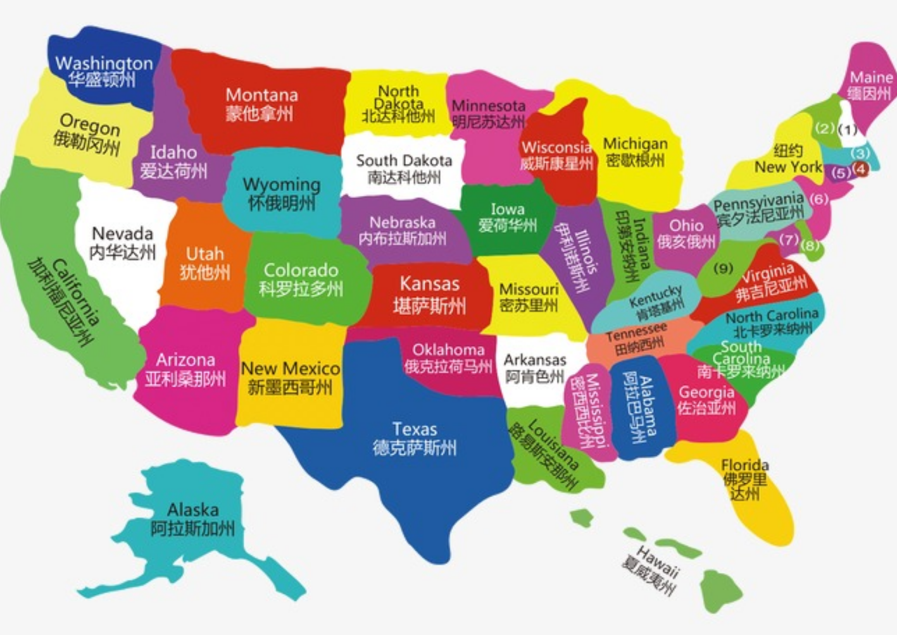
作者家在纽约
到南部的佛罗里达州度过周末

Slide 17
【1】The freezing Northeast hasn’t been a terribly fun place to spend time this winter, so when the chance came for a weekend to Sarasota, Florida, my bags were packed before you could say “sunshine”. I left for the land of warmth and vitamin C (维生素C), thinking of beaches and orange trees. When we touched down to blue skies and warm air, I sent up a small prayer of gratefulness. Swimming pools, wine tasting, and pink sunsets (at normal evening hours, not 4 in the afternoon) filled the weekend, but the best part — particularly to my taste, dulled by months of cold-weather root vegetables — was a 7 a.m. adventure to the Sarasota farmers market that proved to be more than worth the early wake- up call.
24. What did the author think of her winter life in New York?
A. Exciting. B. Boring. C. Relaxing. D. Annoying.

Slide 18
【3】Disappointed by many a broken vine-ripened (蔓上成熟的) promise, I’ve refused to buy winter tomatoes for years. No matter how attractive they look in the store, once I get them home they are unfailingly dry, hard, and tasteless. But I homed in, with uncertainty, on one particular table at the Brown’s Grove Farm’s stand, full of fresh and soft tomatoes the size of my fist. These were the real deal — and at that moment, I realized that the best part of Sarasota in winter was going to be eating things that back home in New York I wouldn’t be experiencing again for months.
转折前是纽约的西红柿，形成鲜明对比
home in on sth朝向,移向；把（思想,注意力）集中于
26. What can we learn about tomatoes sold in New York in winter?
A. They are soft. B. They look nice
C. They taste great. D. They are juicy.
转折后是讲述弗罗里达州—布朗斯格罗农场的西红柿
unfailingly adv. 无一例外地

Slide 19
【4】Delighted as I was by the tomatoes in sight, my happiness deepened when I learned that Brown’s Grove Farm is one of the suppliers for Jack Dusty, a newly opened restaurant at the Sarasota Ritz Carlton, where — luckily for me — I was planning to have dinner that very night. Without even seeing the menu, I knew I’d be ordering every tomato on it.
27. What was the author going to do that evening?
A. Go to a farm. B. Check into a hotel.
C. Eat in a restaurant. D. Buy fresh vegetable.

Slide 20
词汇积累
1. dull [dʌl] adj. ________________；vt. _________________
2. annoying [ə'nɔiiŋ] adj. ___________________
3. worthwhile ['wə:θwail] adj. ____________________
4. adventure [əd'ventʃə] n. ____________________
5. attractive [ə'træktiv] adj. ___________________
6. unfailingly [ʌn'feiliŋli] adv. __________________
7. hard adj. ___________；艰难的
沉闷的
使无聊
令人生气的
值得的
冒险
吸引人的
无一例外地
坚硬的

Slide 21
The relationship between humans and animals has always been complex. Some cultures have developed entire belief systems around favored animals. Even in cultures with less formal belief systems, connections between people and animals still lead to commonly accepted opinions about animals.
These belief systems usually develop around the animals that interact (互动) with humans most frequently. Therefore, it should not be surprising that so many stories surround the most common of animals: rats. Rats live side by side with humans all over the world and regularly interact with people. Human-rat coexistence may be common all around the world, but different cultures respond to that closeness in different ways.

Slide 22
In many Latin American countries, the rat is described in a very different way. The story of the tooth fairy (a fairy believed by children to leave money while they sleep in exchange for a tooth that has come out) is common all over the world, but in Latin America, the “fairy” is a rat! Rats do have very strong teeth, which could explain the association. Clearly, this shows another attitude toward rats that is much more positive.

Slide 23
As many people are discovering these days, rats can even make excellent pets, so long as you remember to close the cage carefully!

Slide 24
巩固练习题答案：
BACCC

Slide 25
Thank you for listening

