Slide 1
B25
Nearly two hundred years later, Leeuwenhoek's discovery of microbes helped French chemist and biologist Louis Pasteur to develop his "theory of disease". This concept suggested that disease originates from tiny organisms attacking and weakening the body. Pasteur’s theory later helped doctors to fight infectious diseases including anthrax, diphtheria, polio, smallpox, tetanus, and typhoid. All these breakthroughs were the result of Leeuwenhoek's original work. Leeuwenhoek did not foresee this legacy.

Slide 2
In the late 1600s, Leeuwenhoek, inspired (inspire) by the magnifying lenses(放大镜) he used to examine cloth, built (build) some of the first microscopes.
He developed a technique to improve the quality of tiny, rounded lenses, some of which could magnify an object up to 270 times.
This concept suggested that disease originates (originate)from tiny organisms attacking and weakening攻击并削弱身体the body。
And therefore, whenever I found out anything remarkable, I have thought it my duty to put down my discovery on paper, so that the scientific community might be informed thereof.”

Slide 3
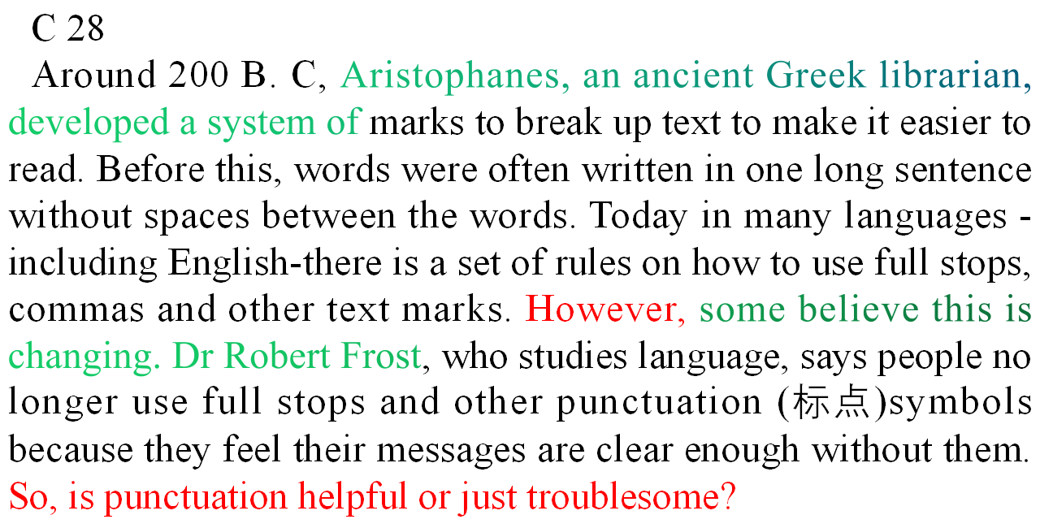

Slide 4
31
Punctuation. Even, if a sentence is badly punctuated. like this one: It can still be, understood. This short piece of text shows that it is the words that are the important part of the sentence, not the symbols between them. Oxford-based linguist Kelly Jones says, "It is the order in which the words appear that conveys the meaning, not the punctuation marks. If there is any doubt in the meaning of the sentence, people are clever enough to work out what the person is really trying to say. For instance, when people speak, they do not use punctuation and yet we can still understand each other.” Also, punctuation can be confusing -there are lots of complex rules to observe, and if it is used incorrectly it can cause more problems than if there were none, Punctuation simply isn't needed.628

Slide 5
31
The author Jonathan Pierce argues that punctuation can be used to add drama, to break up the sequence of words and change the rhythm of a sentence. "It allows writers to make sentences more interesting so the readers do not get bored, Pierce claims. “Otherwise, the words run into each other and lose their impact. " Besides, learning the different ways punctuation marks can be used is fun. It can add a lot to the style of writing and make it clearer.

Slide 6


Besides, learning the different ways that/ in which /省略punctuation marks can be used is fun.
This short piece of text shows that it is the words that are the important part of the sentence, not the symbols between them.
It is the order in which the words appear that conveys the meaning, not the punctuation marks.

Slide 7
D 32
To many people, honey bees symbolize wealth, sustainability and environmentalism. But as a honey bee researcher, I have to tell you that only the first item on that list is defensible. Although they are important for agriculture, honey bees, which are usually imported from outside the local area, also disturb natural ecosystems by competing with native bees.

Slide 8
D 33
For several years the media has told us that bee populations are under threat. In response to this media campaign to "save the bees", raising honey bees has become a popular hobby. But as a species, honey bees are least in need of saving. Much media attention is given to honey bees at the expense of native bees, and this has led many citizens—myself once included—to mistakenly believe they are doing a good thing for the environment by raising honey bees. Unfortunately, they are probably doing more harm than good.628

Slide 9
D 35
The introduction of honey bees increases competition with native bee populations for food, putting even more pressure on the wild species that are already in decline. Honey bees are extremely efficient food gatherers and take over almost all local flower resources, thus leading to damaging competition—that is, where one species uses up a resource, not leaving enough to go around.

