Slide 1
CSE7302 - INTERNSHIP Review-5 Presentation Software Development Intern
Student Details
Name | DEEPAK M
Roll No | 20221CAI0135
Section | 8CAI-03
Under the Supervision of,
Mr. D. Venkatesan
Assistant Professor
Presidency School of Computer Science and Engineering
Presidency University
Name of the Program: B Tech Computer Science and Engineering (AI and ML)
Name of the HoD: Dr. Zafar Ali Khan
Name of the Program Internship Coordinator: Mr. Anandan Bellie
Name of the School Internship Coordinator: Dr. Md Ziaur Rahman

Slide 2
Content
About Company or Organization
Working domain or the technology
About your team and reporting Manager
Challenges Faced in Internship
Objectives of the work
Literature Review
Proposed System
System Requirements
Advantages of Proposed System/Work
Internship Roadmap
Github Link

Slide 3
About Company
TAP Academy is a Bengaluru-based professional training and placement organisation that focuses on transforming engineering students into industry-ready software professionals. The institution provides structured training programs in software development, real-time project exposure, and placement preparation.
TAP Academy works closely with corporate partners and IT companies to bridge the gap between academic knowledge and industrial requirements. Their Campus to Corporate (C2C) Internship Program equips students with both technical skills and workplace discipline, ensuring better employability after graduation.
The organisation also emphasises emerging technologies such as AI-assisted development and modern software frameworks, making students future-ready.

Slide 4
Working domain
My internship domain is Software Development with specialisation in Full Stack Web Development and AI-Agentic Coding.
The domain includes working on:
Core Java programming
Front-end development using HTML, CSS, and JavaScript
Database handling using SQL
Understanding software life cycle models
Introduction to AI-assisted development tools
This domain is important because it trains students to build real-time web applications, follow coding standards, and understand how professional development teams work in the IT industry.

Slide 5
About your team and reporting Manager
I am part of the Campus to Corporate Internship Batch at TAP Academy. The team consists of interns from different engineering streams working under experienced technical trainers and mentors.
My reporting authority includes senior trainers who guide us in daily tasks, code reviews, module assessments, and project activities. All learning modules and projects are monitored regularly to ensure quality and consistency in performance.

Slide 6
Challenges Faced in Internship
The major challenges faced during the internship include:
Understanding industry-level coding standards
Adjusting to a disciplined corporate training schedule
Managing multiple technical modules within limited time
Learning new tools and development environments
Maintaining consistency in daily evaluations
These challenges helped me develop time-management skills, adaptability, and professional discipline.

Slide 7
Objectives of the work
The main objectives of my internship are:
To gain real-world software development experience
To improve logical thinking and coding practices
To understand the software development life cycle
To build full-stack web applications
To become placement-ready for corporate IT roles

Slide 8
Literature Review
The study of existing learning platforms, internship-based training programs, and web development practices shows that many students lack hands-on exposure to real-world software development. Traditional academic learning focuses more on theory, while industry demands practical skills such as coding standards, version control, UI design, and problem-solving.
Existing systems often provide fragmented learning—either theory-heavy courses or unstructured online tutorials. This gap highlights the need for an internship-driven, project-based learning approach that integrates HTML, CSS, JavaScript, and Core Java with real-time evaluation and mentorship.

Slide 9
Proposed System / Work
The proposed system focuses on a structured internship-based learning model where students gain practical experience in web development and software engineering. The work includes:
Designing web pages using HTML
Styling and layout creation using CSS
Applying best coding practices
Building small modules and real-time mini projects
Using GitHub for code management and version control
This system bridges the gap between academic knowledge and industry expectations.

Slide 10
System Requirements
Hardware Requirements
Laptop/Desktop with a minimum 4 GB RAM
Stable internet connection
Software Requirements
Operating System: Windows / Linux / macOS
Code Editor: VS Code
Browser: Chrome / Edge
Git & GitHub
Basic tools for web development

Slide 11
Advantages of Proposed System / Work
Improves hands-on coding skills
Enhances understanding of real-world software development
Builds strong foundation in HTML and CSS
Encourages disciplined coding practices
Makes students industry-ready
Improves confidence for placements and interviews

Slide 12
Internship Road Map
Review 1
Core Java, HTML, CSS basics
Review 2
Review 3
Review 4
Final Review
JavaScript, SQL, Database Handling
Full Stack Project Development
AI-Agentic Coding and Advanced Modules
Final Project, Placement Readiness & Evaluation

Slide 13
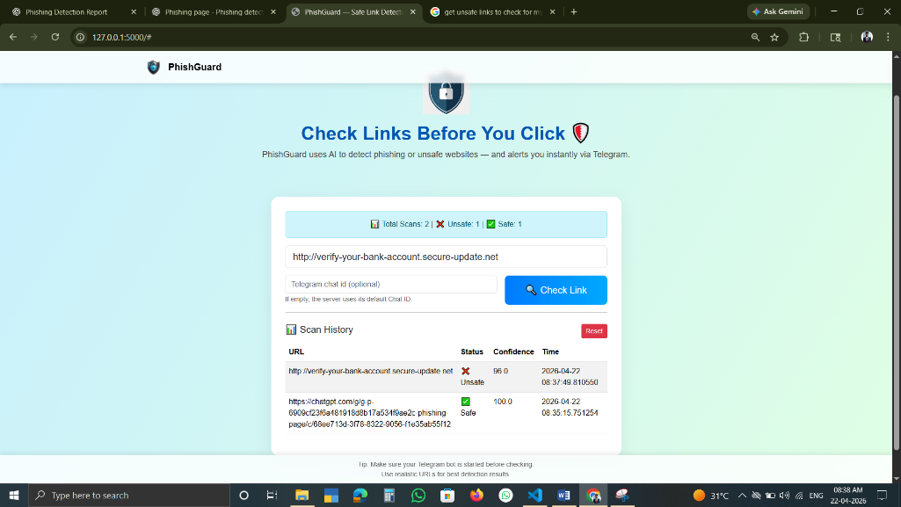

Phishing Detection Project (Overview)
Title: Phishing URL Detection System
Detects whether a URL is Safe or Unsafe
Protects users from phishing attacks
Built using HTML, CSS, JavaScript
Uses rule-based URL analysis
Displays result with confidence score

Slide 14
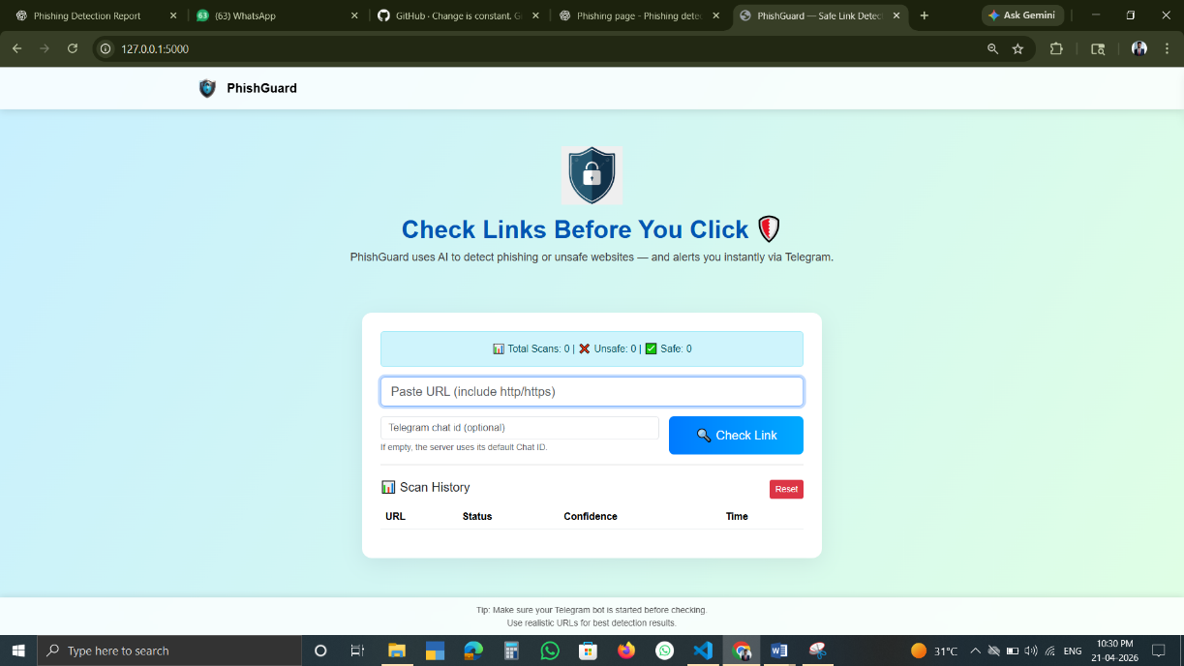
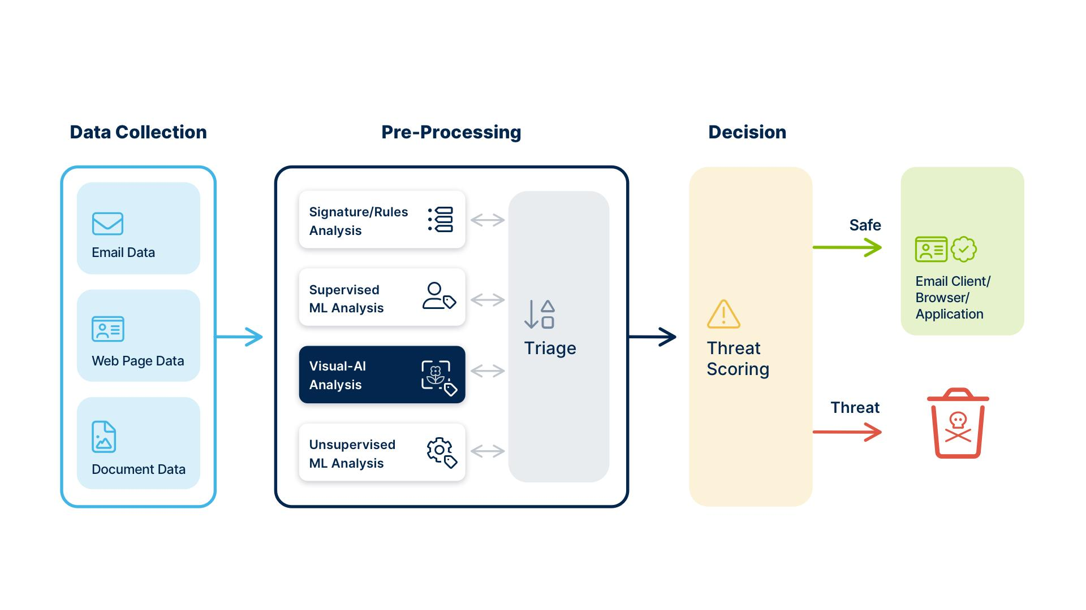
Working & Features
Title: System Working
User enters URL
System checks suspicious patterns
Analyses URL structure & keywords
Classifies: Safe / Suspicious / Unsafe
Stores scan history
Features:
Real-time detection
Confidence level display
Reset scan history option
Simple UI

Slide 15
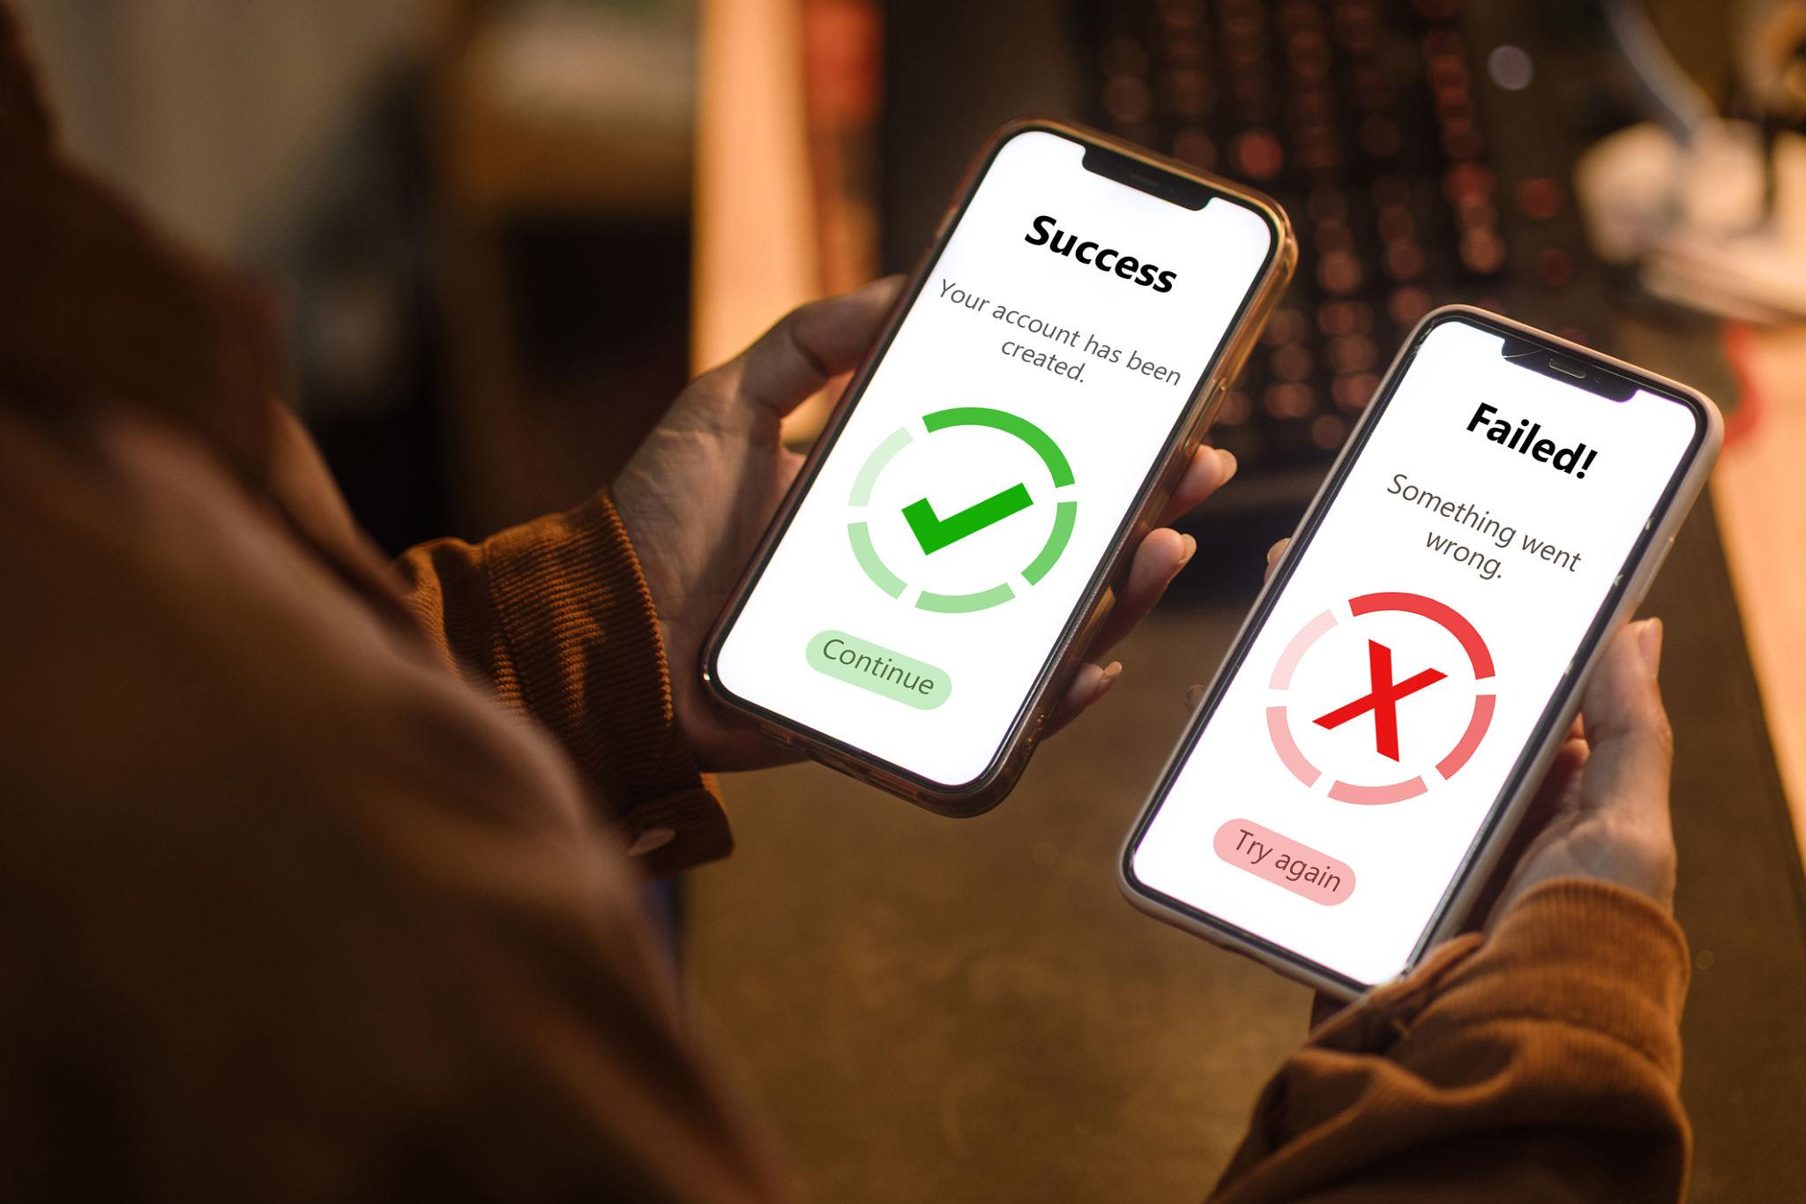
Results & Advantages
Results and Benefits
Successfully detects unsafe links
Helps prevent data theft
Easy to use interface
No technical knowledge required
Can be extended using AI/ML

Slide 16
Github Link
https://github.com/135Deepak/Internship-report

Slide 17
Q&A

Slide 18
Thank you !!

