Slide 1
Deep Learning 101

Slide 2
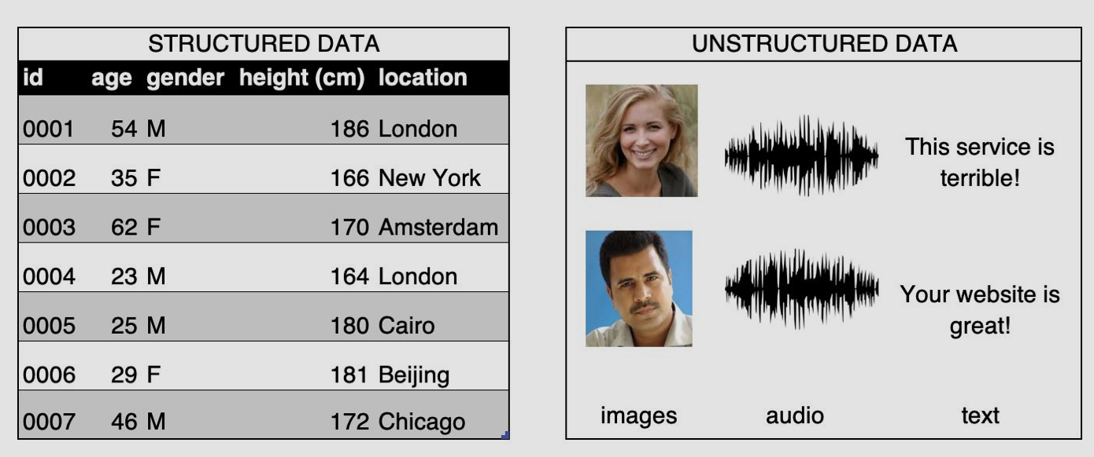
Structured vs. Unstructured
Structured: Arranged in columns of features
Unstructured: no structure

Slide 3
What is Deep Learning?
Layers of Neural Networks

Slide 4
Tensors, TensorFlow, and Keras
Tensor: multi-dimensional arrays
TensorFlow: an open-source Python library for machine learning
Manipulates tensors
Keras: high level API for machine learning libraries
Supports TensorFlow, Microsoft Cognitive Toolkit, R, Theano, and PlaidML

Slide 5
How to build a model in Keras
Sequential:
One layer follows immediately from the previous without any branching
Functional API:
To create a model with multiple input and output layers

