Slide 1
Deep Learning 101
The Basics

Slide 2
Schedule
week | Date | Topic
9 | 10.27 | The Setup, Python & TensorFlow overview
10 | 11.03 | Training and testing
11 | 11.11 | CNN
12 | 11.18 | RNN
13 | 11.24 | Autoencoder & GAN

Slide 3
Today’s Agenda
Goals
Concepts:
AI, Machine Learning, Deep Learning
Supervised, Unsupervised, and Reinforcement
Structured vs. Unstructured
Deep Learning vocabulary
Setup
Lab time

Slide 4
Goals
Conceptual understanding of Deep Learning: to understand how an AI system works ‘under the hood’
Model, training, inference, etc.
Knowledge about various Deep Learning algorithms
Regression, Artificial Neural Networks, CNN, RNN, GAN, etc.
Basic technical skills for developing AI models
Python, Jupyter notebooks, TensorFlow

Slide 5
What is AI?
AI (인공지능): 기계로 하여금 사람 같은 지능으로 인지하고 행동
Machine Learning (기계 학습): 경험을 통해 자동으로 학습
Deep Learning (심층 학습): Artificial Neural Network 기반 학습

Slide 6
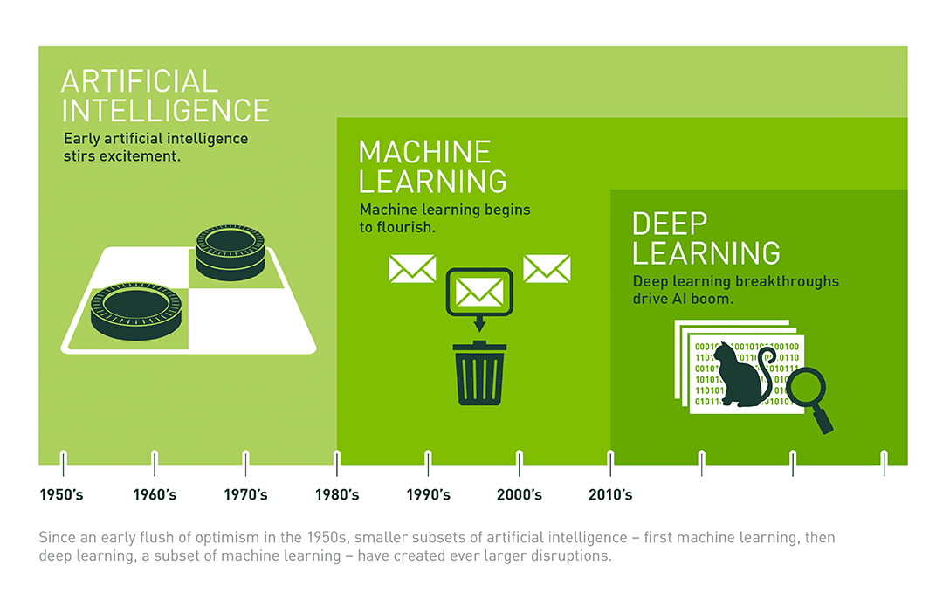
AI, Machine Learning, & Deep Learning
https://blogs.nvidia.com.tw/2016/07/29/whats-difference-artificial-intelligence-machine-learning-deep-learning-ai/
Notes:
https://blogs.nvidia.com.tw/2016/07/29/whats-difference-artificial-intelligence-machine-learning-deep-learning-ai/

Slide 7

AI in the wild

Slide 8
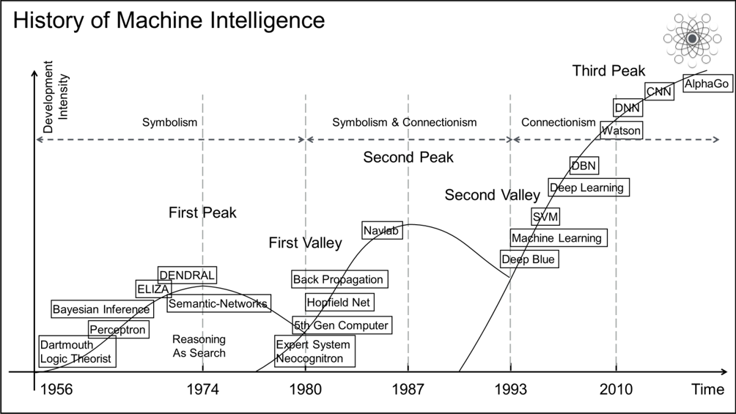
A Brief History of Machine Intelligence
https://www.alibabacloud.com/blog/looking-forward-will-machine-intelligence-be-able-to-outsmart-hackeers_595907

Slide 9
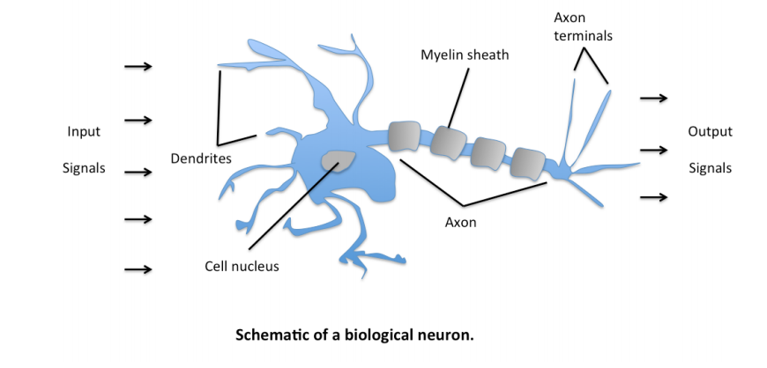
Neural Network

Slide 10
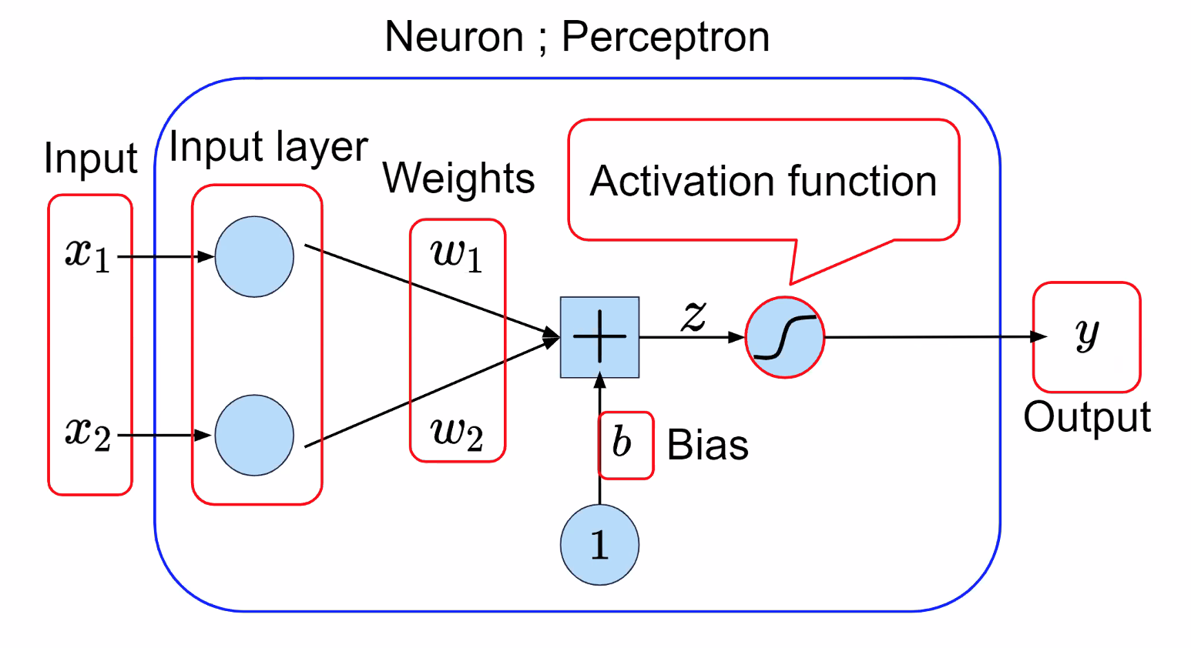
Perceptron
Developed by Frank Rosenblatt at the Cornell Aeronautical Laboratory in 1958
(https://en.wikipedia.org/wiki/Perceptron)

Slide 11
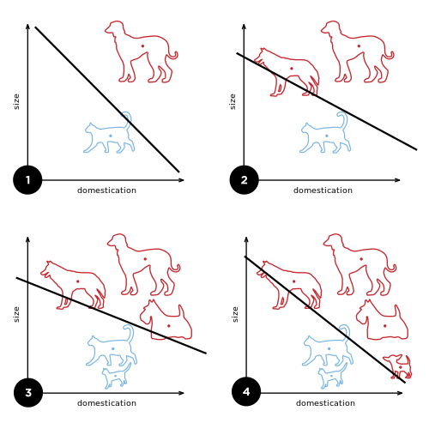
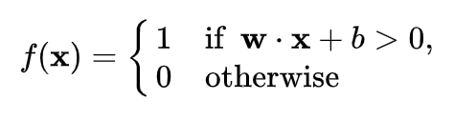
Perceptron for classification problems

Slide 12
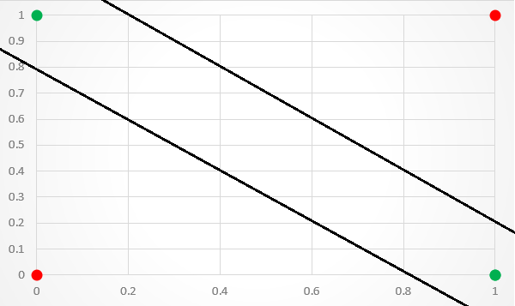
XOR problem
Minksy and Papert (1969)
Solution: Multilayer NN + Backpropagation
Input1 | input2 | Output
0 | 0 | 0
1 | 0 | 1
0 | 1 | 1
1 | 1 | 0

Slide 13
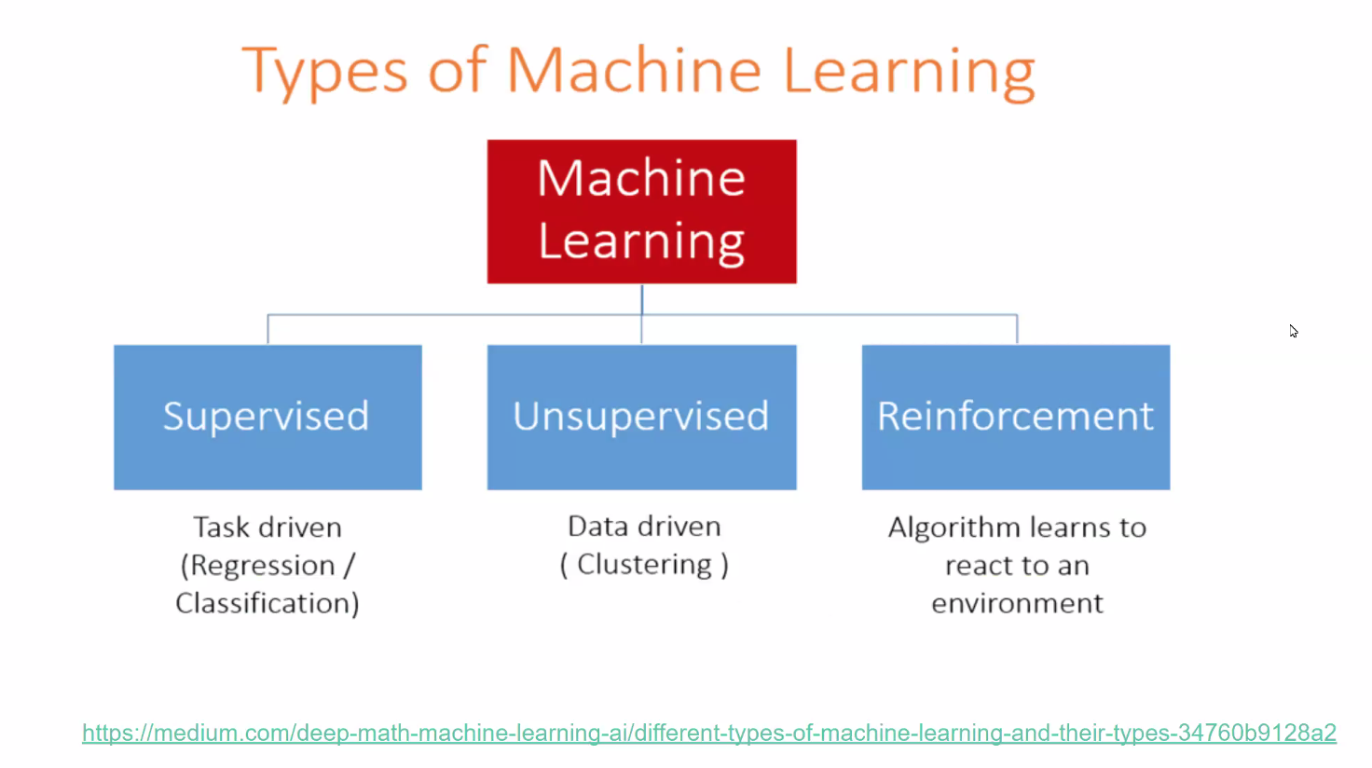

Slide 14
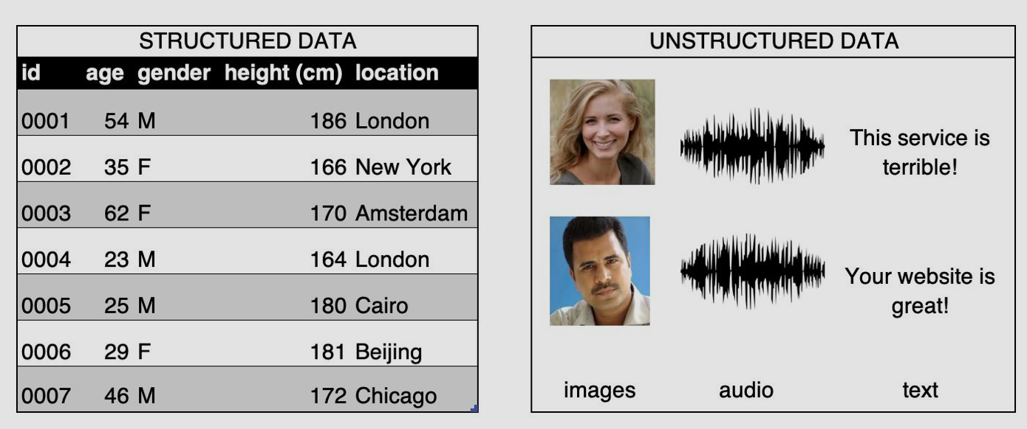
Structured vs. Unstructured
Structured: Arranged in columns of features
Unstructured: no structure

Slide 15
What is Deep Learning?
Layers of Neural Networks

Slide 16
Scalar, Vector, Matrix, & Tensor
Scalar: a single number
7, -2.4
Vector: a list of numbers
Matrix: a 2-dimensional array of numbers
Tensor: an n-dimensional array of objects
* These are practical definitions.

Slide 17
Tensors, TensorFlow, and Keras
Tensor: multi-dimensional arrays with a uniform type (called a dtype)
TensorFlow: an open-source Python library for machine learning
Manipulates tensors
Keras: high level API for machine learning libraries
Supports TensorFlow, Microsoft Cognitive Toolkit, R, Theano, and PlaidML
Reference: https://www.tensorflow.org

Slide 18
Rank, dimension, axes, and shape
Rank: number of dimensions
Dimension: 2D, 3D, etc.
Axes: indices of a dimension
Shape: number of elements in each dimension
a scalar has a rank 0 and an empty shape ()
a vector has rank 1 and a shape of (D0)
a matrix has rank 2 and a shape of (D0, D1) and so on

Slide 19
What is Keras?
Keras is an open source library that provides python interface for machine learning libraries
TensorFlow is one of the libraries supported by Keras
Easier and simpler to use than TensorFlow
Will learn both
Sequential:
One layer follows immediately from the previous without any branching
Functional API:
To create a model with multiple input and output layers

Slide 20
Setup
Chrome browser
PyCharm
(optional) Google account: to run the code in colab

Slide 21

Development Environment
Programming Language: Python
Editor: IDE (Integrated Development Environment)
PyCharm Community Version
Jupyter notebook
https://github.com/changsin/DeepLearning-101

Slide 22
Resources
AI with Python tutorial:
https://www.tutorialspoint.com/artificial_intelligence_with_python/index.htm
모두를 위한 머신러닝 (in Korean):
https://hunkim.github.io/ml/
And many more…

Slide 23
Lab time
To clone: from your terminal
>git clone https://github.com/changsin/DeepLearning-101.git
Or use google colab to point to the git hub repository
Git is an open source version control system
Github is a host service using git.

