Slide 1
Deep Learning 101
The Setup

Slide 2
Schedule
week | Date | Topic
9 | 10.27 | Environment setup, python, Jupyter, PyCharm, TensorFlow, & regression
10 | 11.03 | Training and testing
11 | 11.11 | CNN
12 | 11.18 | RNN
13 | 11.24 | Autoencoder & GAN

Slide 3
Goals
Conceptual understanding of Deep Learning: to understand how an AI system works ‘under the hood’
Model, training, inference, etc.
Knowledge about various Deep Learning algorithms
Regression, Artificial Neural Networks, CNN, RNN, GAN, etc.
Basic technical skills for developing AI models
Python, Jupyter notebooks, TensorFlow

Slide 4
Setup
Chrome browser
PyCharm
(optional) Google account: to run the code in colab

Slide 5

Development Environment
Programming Language: Python
Editor: IDE (Integrated Development Environment)
PyCharm Community Version
Jupyter notebook
Learn the language & get familiar with the environment

Slide 6
실습 참고 자료
AI with Python tutorial:
https://www.tutorialspoint.com/artificial_intelligence_with_python/index.htm
모두를 위한 머신러닝:
https://hunkim.github.io/ml/
Jupyter notebook/Python code 로 된 실습 교재는 별도로 배포

Slide 7
What is AI?
AI (인공지능): 기계로 하여금 사람 같은 지능으로 인지하고 행동
Machine Learning (기계 학습): 경험을 통해 자동으로 학습
Deep Learning (심층 학습): Artificial Neural Network 기반 학습

Slide 8
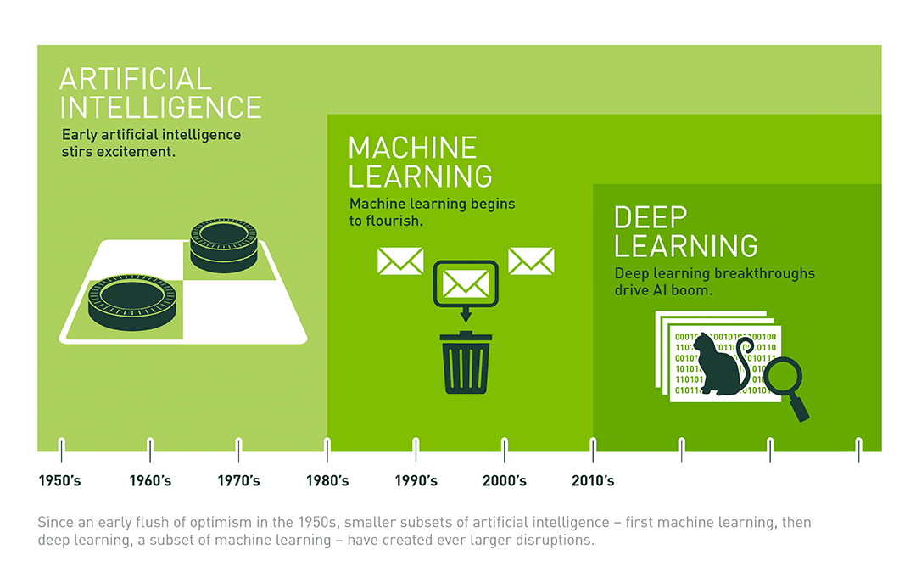
AI, Machine Learning, & Deep Learning
https://blogs.nvidia.com.tw/2016/07/29/whats-difference-artificial-intelligence-machine-learning-deep-learning-ai/
Notes:
https://blogs.nvidia.com.tw/2016/07/29/whats-difference-artificial-intelligence-machine-learning-deep-learning-ai/

Slide 9
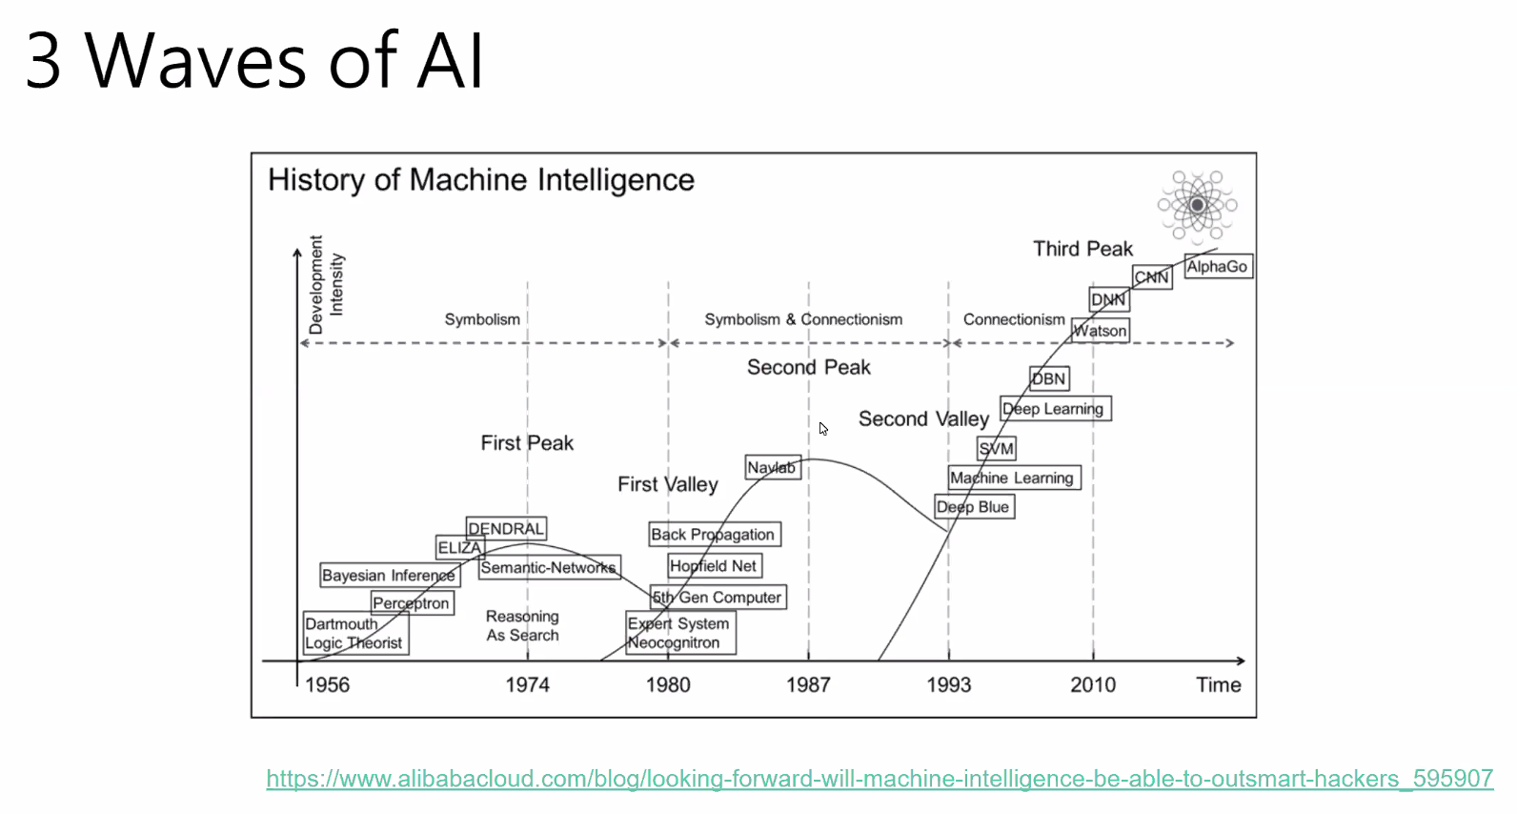

Slide 10
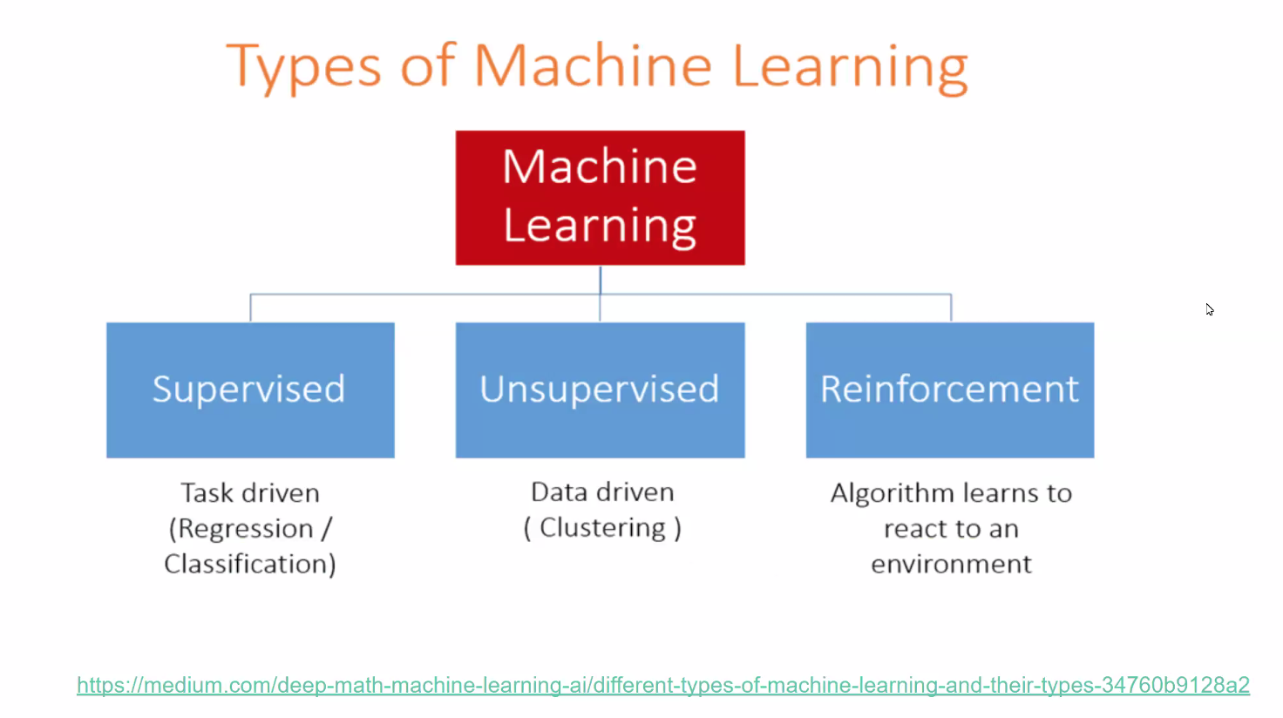

Slide 11

AI in the wild

Slide 12
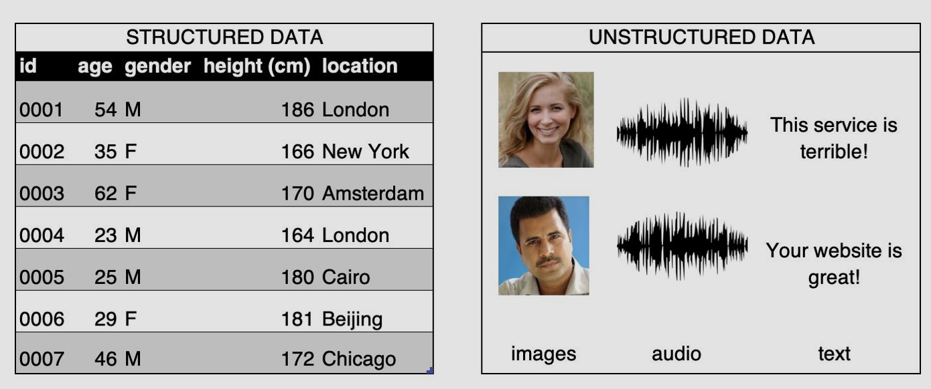
Structured vs. Unstructured
Structured: Arranged in columns of features
Unstructured: no structure

Slide 13
What is Deep Learning?
Layers of Neural Networks

Slide 14
Scalar, Vector, Matrix, & Tensor
Scalar: a single number
7, -2.4
Vector: a list of numbers
Matrix: a 2-dimensional array of numbers
Tensor: an n-dimensional array of objects
* These are practical definitions.

Slide 15
Tensors, TensorFlow, and Keras
Tensor: multi-dimensional arrays with a uniform type (called a dtype)
TensorFlow: an open-source Python library for machine learning
Manipulates tensors
Keras: high level API for machine learning libraries
Supports TensorFlow, Microsoft Cognitive Toolkit, R, Theano, and PlaidML
Reference: https://www.tensorflow.org

Slide 16
Rank, dimension, axes, and shape
Rank: number of dimensions
Dimension: 2D, 3D, etc.
Axes: indices of a dimension
Shape: number of elements in each dimension
a scalar has a rank 0 and an empty shape ()
a vector has rank 1 and a shape of (D0)
a matrix has rank 2 and a shape of (D0, D1) and so on

Slide 17
How to build a model in Keras
Sequential:
One layer follows immediately from the previous without any branching
Functional API:
To create a model with multiple input and output layers

