Slide 1


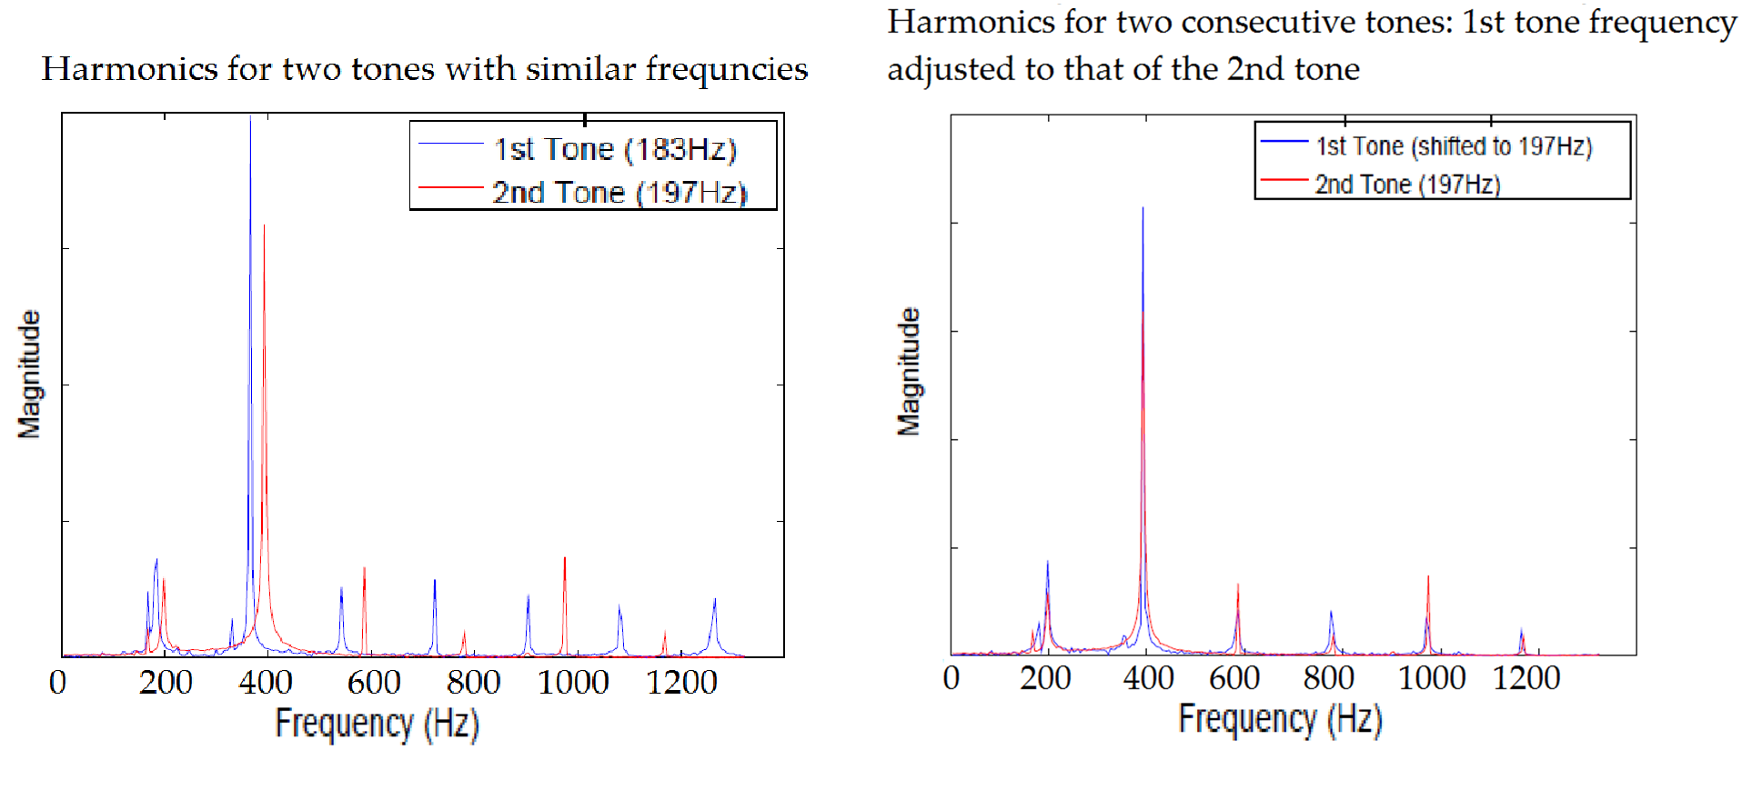
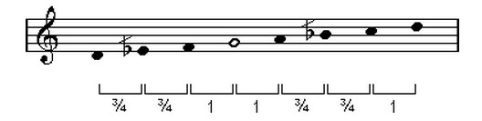
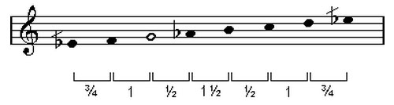
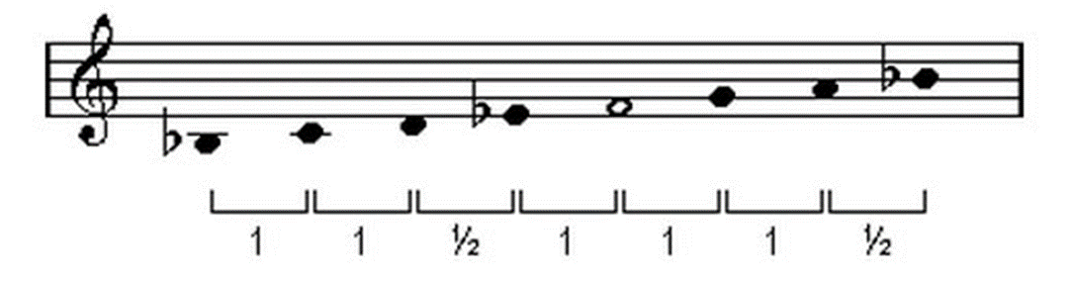
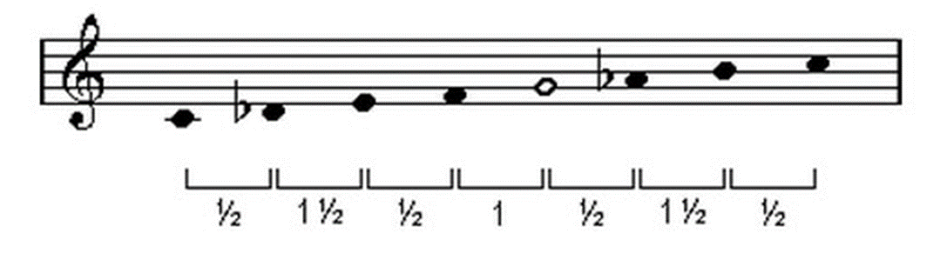
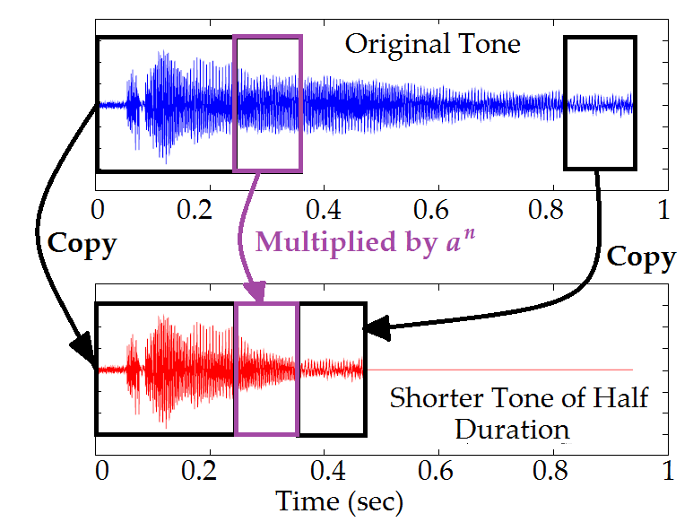
Automated music composition using random segments in the Arabic maqam system
Department of Mathematics and Computer Science
Julian Dasilva, Luis Khawly, and James Haralambides, Ph.D.
Barry University, Miami Shores, FL, 33161
Abstract
Methods
Results
We are designing a system to auto-generate realistic music compositions in the Arabic maqam modal system. This system is selected as it is suitable for musical compositions that encourage improvisation. The design is implemented in the Microsoft Visual Studio Integrated Development Environment. Musical notes are recorded for instruments that can realize compositions in the Arabic maqam modal systems such as an oud or a violin. In such systems, notes may fall in frequencies beyond the full tone and semitone equivalents. Such tones can be generated natively or produced through synthesis of representable neighboring nodes. Synthesis is carried through the use of signal processing methods as part of a software application called Octave. Maqams selected for experiments include: ajam, husseini, and kurd. Compositions are limited to two consecutive octaves and are synthesized according to the frequency ranges produced by that instrument. Music note sequencing is realized with the use of a random number generator. A large collection of music compositions, called segments, is available in the form of a library. These segments are realistic representations of maqam tetrachords and allow for the expansion of compositions to multiple maqams. Segments are selected randomly and “stitched” together to form longer compositions. To avoid repetitive structures, random fine-tuning of notes within a segment is allowed. Segment notes vary in frequency as well as duration. Specifics durations used are subdivisions of a full note. These represent durations of one half, one quarter and one eight of a note. Additional recordings introducing desirable instrument playing effects and synthesis effects such as delay, reverb, and so on. The graphical user interface of the program includes options for the selection of musical instruments, the range of octaves, the stitching method, and the duration of the composition. Compositions are evaluated with respect to realism, appeal, and degree of randomness.
The system comprises two main components, each with a different objective. The objective of the first system component is to be able to synthesize various tones at different frequencies and of various lengths (full, half, quarter), given a few signal segments of full tones. These full tones have been recorded from an actual instrument in its natural frequency range. The objective of the second system component is to be able to stitch together different randomly generated tetrachords associated with a particular maqam, in order to generate a realistic music composition.
More specifically, the first component needs to accomplish two distinct goals: (a) to be able to synthesize a tone at a particular frequency using a different frequency for a particular instrument, and (b) to be able to modify the length of a tone without changing its frequency, while still retaining the natural and realistic timbre of the instrument’s sound. Goal (a) can be achieved by simply resampling the original tone. If the two tone frequencies are not significantly different from each other, resampling produces natural sounds. An example is shown in Figure 2. Figure 2(a) shows the frequency characteristics of two different tones at frequencies 183Hz and 197Hz. Each peak is associated with a different harmonic. It is apparent from the location of the harmonics that the two tones are characterized by a different frequency. Figure 2(b) shows the tones after the frequency of the first tone has been shifted to the frequency of the second tone. The harmonics of the two tones are now located at the same frequencies. It should be noted that the energy associated with each harmonic is not only dependent on the height of the peak, but also on the width of the peak. Therefore, it is not necessary for the heights of corresponding harmonics to match exactly.
(a) (b)
Figure 2. Synthesizing a tone at 197Hz from a tone at 183Hz: (a) the two original tones, (b) the two tones after the first tone has been shifted to the frequency of the second tone.
Goal (b) can be achieved in the following manner for a stringed instrument. First, it is logical to assume that regardless of the duration of the tone, the first portion of the signal may be expected to be similar. The first portion of the signal consists of the impulsive sound generated by plucking the string, plus the sound generated by the freely oscillating string. The last part of the signal may include either a naturally decaying and terminating sound, or a sound produced due to the forced termination of string oscillation by the instrument player. In this project, we assume that we are dealing with relatively short sounds. Therefore, we assume that the sounds are terminated by the instrument player. In this case, the ending portion of different tones is also expected to be similar, regardless of the signal duration. In other words, to generate a tone from a longer tone, we can concatenate three portions of the longer tone. The first and last portions are identical to those of the longer tone. The middle portion of the tone is expected to be shorter compared to that of the longer tone. For a longer tone, the signal decays for a longer period of time, while for a shorter tone the signal decays only because the instrument player stops the oscillation. To simulate this effect for a shorter tone, part of the longer tone is copied as the middle portion of the shorter tone after it has been modified as follows: s(n) = s(n) a^{n} where a is a constant close to 1 (e.g., 0.9998), and n is the time index. The purpose of this forced decay is to smoothly stitch the first and last portion of the signal, so that there are no significant unnatural magnitude variations. An example of this process is illustrated in Figure 3.
Figure 3. Obtaining a shorter tone of the same frequency as the original longer tone.
Combining these two steps (i.e., shifting the frequency of the tone, and changing the length of the tone without changing the tone’s frequency) can essentially produce naturally sounding tones of various frequencies and lengths.
H₂O
Pre-constructed music segments are stored in the system library. They are tetrachord compositions of varying lengths, note durations, and signal strengths. Additionally, all notes of the maqam are available individually as full, half, and quarter notes. Melodic sequences are generated using a random number generator. Segments are picked randomly from the library and are stitched together based on suitability (note continuity and frequency direction). Individual notes are interjected in segment sequences to add randomness, and smooth transitions. Both segment notes and individual notes are open to adjustment. Segment notes may be replaced by neighboring notes of bounded tonal distance. All notes may be tweaked with respect to duration and signal strength.
Introduction
The idea of composing music algorithmically has existed for centuries. More recently, efforts focus on automated music generation without the involvement of the human element. Compositions may follow a musical style. For example, software may generate classical musical compositions that follow the style of composers such as Mozart or Beethoven [1].
Other algorithmic designs focus on improvisations such as those that relate to jazz music. In this case, compositions must incorporate the creativity element, remembering conceptual musical themes, and maintaining these over time.
A number of systems has been developed over the last few years that make use of Artificial Intelligence methods and various computational models in order to generate music. Some of the most important categories include mathematical models, knowledge based systems, grammars, and evolutionary methods [4]. A survey of these systems can be found in [2].
Additional algorithmic designs can be found for automatic accompaniments, melody composition, and lyric composition [5]. Accompaniments may be generated automatically for a vocal melody using hidden Markov models. The same models may be used to generate melodies. Probabilities are assigned to notes and note sequencing. Systems even exist to produce lyrics matching syllables to notes and stressing words in alignment with the strength of the melodic segment.
The work presented here focuses on automated music composition for the Arabic modal systems called maqams. The inherent randomness of note sequencing, note duration, and chromatic variation is well-suited for the maqam style of improvisation. In addition, it presents an opportunity to extend musical compositions beyond the traditional western scales. Arabic maqams make use of tones that are smaller subdivisions of tones and half-tones reaching fractions of one ninth of a tone (comma).Such subdivisions may be generated algorithmically for instruments not capable of producing the corresponding frequencies. This will allow synthesized instruments like a piano or a guitar to participate in musical compositions of maqams. Octaves for sample maqams husseini, huzam, ajam, and hijaz kar are shown below. Additional information is available online [3]. Maqams are made of two sequences of four or five tones called tetrachords. Looking closer at maqam husseini, for example, one can identify the second note of the first tetrachord at a tonal distance of three quarters of a tone from note D (it holds the same distance from note F).
Figure 4. Segmented music composition.
Figure 4 illustrates the algorithmic process. Segments S₁ to S_{n} represent pre-defined music compositions on tetrachords residing in memory. Segment S₁ contains five notes (named n_{a}, n_{b}, n_{c}, n_{d}, and n_{e}) while segment S_{n} contains four notes (named n_{t}, n_{u}, n_{v}, and n_{w)}. The stream below the segment structure represents the collection of segments and individual notes that belong in the synthesis. The synthesis begins with the random selection of segment S₁ followed by a stream of three individual notes (named n_{p}, n_{q}, and n_{r}). Segment S_{n}, also selected randomly follows. The sequence continues in similar fashion. Arrows below specific notes in the sequence indicate the presence of tweaking. Notes n_{b}, n_{e}, n_{r}, n_{u}, and n_{v}, may be replaced or altered in terms of duration and strength.
Suitability of segments is mainly determined by two parameters: a) starting and ending notes, and b) tetrachord classification. Starting and ending notes are examined to ensure that the frequency range between neighboring segments or between segments and individual notes is bounded above by a predetermined threshold. Both notes need be examined as stitching may explore both an increasing or decreasing in frequency tonal direction.
Due to the fact that there is a large number of maqams to be implemented, creating a large variety of predefined segments for each of those maqams may require increased space requirements. Fortunately, many maqams share either the first or the second tetrachord with other maqams. For example, both the bayati and husseini maqams share the first tetrachord, a bayati, while they vary on the second (ajam and nahawand, respectively. A careful classification of segments with respect to tetrachords reduces these requirements substantially.
(a) husseini
(b) huzam
Discussion
It is not difficult for one to realize that automatic music composition is a rather complex process. While music synthesis that results from algorithmic designs is open to subjective evaluations, a large number of parameters that need to be used to provide randomness, smoothness, and chromatic variations make the problem quite challenging. Artificial intelligence or evolutionary methods attempt to train the algorithm to adapt to styles that depend on pre-evaluated and stored themes of esthetic quality or direct the synthesis process to a rule-based mechanism that plans future compositions according to the set of rules used. Such rules may incorporate musical style and genre.
(c) ajam
(d) hijaz kar
Future Implications
Figure 1. Sample maqams.
The designed system deals with three issues: a) note synthesis, b) melody segmentation, and c) sequencing. Note synthesis is necessary to produce tonal variations for instruments not capable of producing them naturally (fretted instruments like a guitar or keyed instruments like a piano). Realistic representations of such tones is possible since the frequency intervals are smaller than a full tone. Basic instrument notes have been recorded for a minimum of two octaves and they can be easily expanded to include larger ranges. Generation of melodies takes place by combining pre-defined musical segments that are compositions within a maqam’s tetrachord structure with individual tones using a probabilistic model. Segments are randomly selected and stitched together with individual notes to eliminate the sense of repeated patterns. Segments themselves are tweaked in terms of tone frequencies and tone durations. Segment themes follow familiar or favorite melodic pieces and their variations. The same tweaking occurs for individual tones in term of their duration. Additional parameters include inter-tonal delays and signal strengths.
This system built is a hybrid model using segmented musical components that are stitched to randomly selected notes. All elements of the composition may undergo dynamic transformations including substitution, modification of duration, and amplification or attenuation. It will be interesting to adapt the system parameters for musical compositions of different genres. For example pop, rock, or classical music. It is evident from the present results that randomly generated note sequences are more esthetically pleasing on creative rather than rule-based or structured themes.
A question that is naturally raised is how one can integrate multiple compositions into orchestral or band pieces. The use of multiple instruments makes composition a quite challenging yet very appealing endeavor. Issues that have to be addressed include instrument synchronization and contribution both in terms of duration and amplitude.
In terms of execution times and processing in general, the algorithm exhibits a high degree of parallelism and can, therefore, be implemented quite nicely using programmable logic and FPGAs. The processes of random number generation, segment selection, note integration, and note tweaking can be interleaved resulting in substantially lower execution times. Today’s boards offer high quality of digital to analog converters for a seamless representation and transformation of audio signals.
Purpose
References
The objective of this project is to create realistic, automated music compositions using programmatic designs. Arabic maqams are selected for two reasons: a) suitability to improvisation and b) extended music scales. Although the appeal of automated music is subjective, specific styles are more open to creative experimentation while others are expected to follow more structured designs. Arabic maqams give artists the freedom to produce musical variations dynamically while maintaining a specific framework, the maqam scale. The inherent randomness of note sequences in automated compositions fits quite nicely with the improvisation style of the maqams. Furthermore, Arabic maqams extend music scales beyond tome and semitone note intervals used in Western music, thus increasing the flexibility of music production. In addition to natural recordings of notes in traditional octaves, a wider range of tones needs be generated in non-traditional tone intervals such as a comma (1/9 of a tone), or three quarters of a tone. While many of these intervals can be recorded naturally, others can be synthesized programmatically and for a wider range of musical instruments otherwise not capable of producing such sounds naturally (for example, fretted or keyed instruments).
Cope, David (2006), Computer Models of Musical Creativity, Cambridge, MA: MIT Press
George Papadopoulos: AI Methods for Algorithmic Composition : A survey, a Critical View and Future Prospects. AISB Symposium on Musical Creativity, 1999.
http://www.maqamworld.com/
Matthew John Yee-King. 2009. An Automated Music Improviser Using a Genetic Algorithm Driven Synthesis Engine. In Proceedings of the 2007 EvoWorkshops 2007 on EvoCoMnet, EvoFIN, EvoIASP,EvoINTERACTION, EvoMUSART, EvoSTOC and EvoTransLog: Applications of Evolutionary Computing, Mario Giacobini (Ed.). Springer-Verlag, Berlin, Heidelberg, 567-576.
Gonçalo Oliveira, Hugo; et al. (2007), Tra-la-lyrics: an approach to generate text based on rhythm, Proceedings of the 4th International Joint Workshop on Computational Creativity, pp. 47–55, London, UK, (June 2007).

