Slide 1

Huazhong University of Science and Technology
The Department of Electronics and Information Engineering
Electronic Circuit Analysis and Design
Dr. Tianping Deng
Email: dengtp@hust.edu.cn

Slide 2
Contents
PART 1 SEMICONDUCTOR DEVICES AND BASIC APPLICATIONS
Chapter 1 Semiconductor Materials and Diodes
Chapter 2 Diode Circuits
Chapter 3 The Field-Effect Transistor
Chapter 4 Basic FET Amplifiers
Chapter 5 The Bipolar Junction Transistor
Chapter 6 Basic BJT Amplifiers
Chapter 7 Frequency Response
Chapter 8 Output Stages and Power Amplifiers
PART 2 ANALOG ELECTRONICS
Chapter 9 Ideal Operational Amplifiers and Op-Amp Circuits
Chapter 10 Integrated Circuit Biasing and Active Loads
Chapter 11 Differential and Multistage Amplifiers
Chapter 12 Feedback and Stability
Chapter 13 Operational Amplifier Circuits
Chapter 14 Nonideal Effects in Operational Amplifier Circuits
Chapter 15 Applications and Design of Integrated Circuits
Chapter 6 Basic BJT Amplifiers

Slide 3
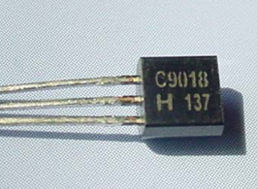
Ch6. Basic BJT Amplifiers
6.0 Preview
6.1 Analog Signals and Linear Amplifiers
6.2 The Bipolar Linear Amplifier
6.3 Basic Transistor Amplifier Configurations
6.4 Common-Emitter Amplifiers
6.5 AC Load Line Analysis
6.6 Common-Collector (Emitter-Follower) Amplifier
6.7 Common-Base Amplifier
6.8 The Three Basic Amplifiers: Summary and Comparison
6.9 Multistage Amplifiers
6.10 Power Considerations
6.11 Design Application
6.12 Summary

Slide 4
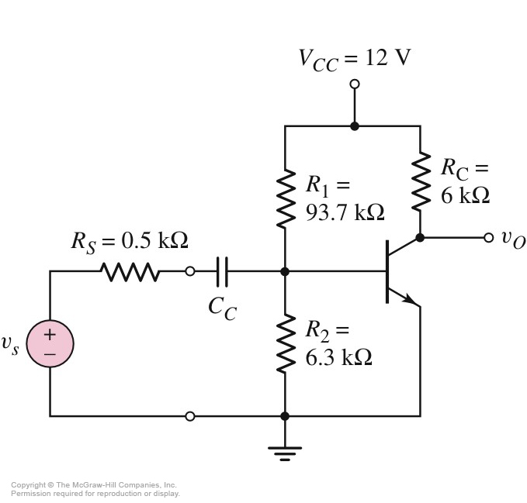





6.4 Common-Emitter Amplifiers
6.4.1 Common-Emitter Amplifier Circuit
2-port Networks equivalent input impedance
CE

Slide 5


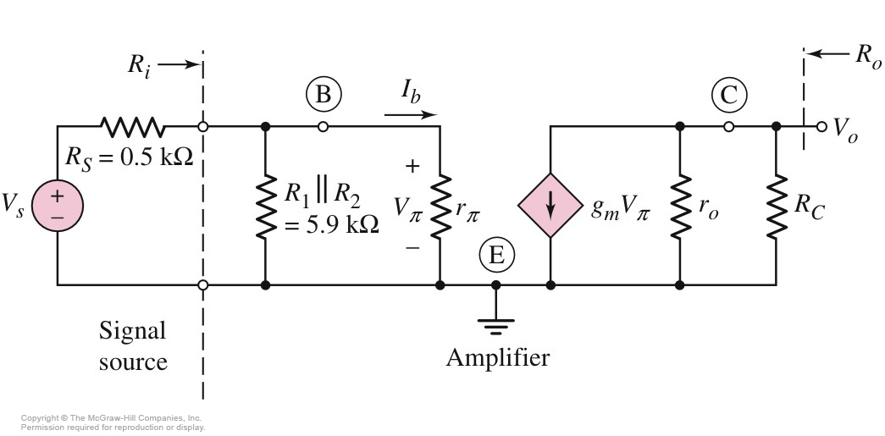
6.4 Common-Emitter Amplifiers
6.4.1 Common-Emitter Amplifier Circuit

Slide 6
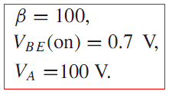









6.4 Common-Emitter Amplifiers
6.4.1 Common-Emitter Amplifier Circuit
？

Slide 7
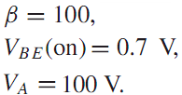




6.4 Common-Emitter Amplifiers
6.4.1 Common-Emitter Amplifier Circuit
Find A_{VS}=v_{o}/v_{s}, R_{i}, R_{o}

Slide 8




6.4 Common-Emitter Amplifiers
6.4.1 Common-Emitter Amplifier Circuit

Slide 9
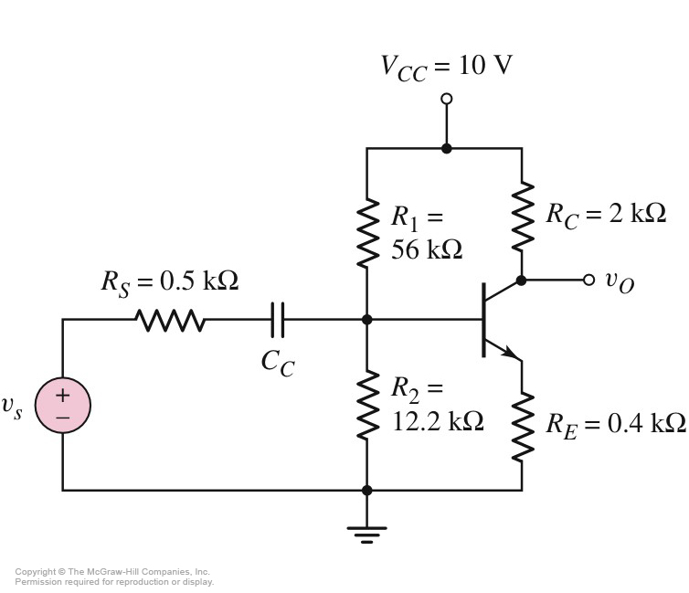
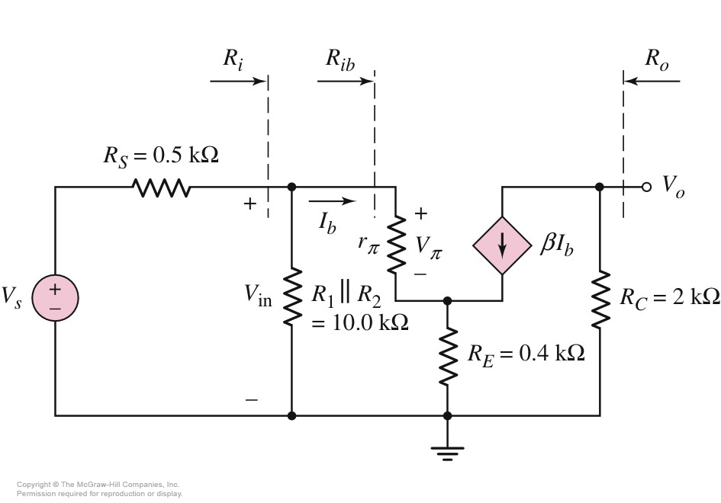



6.4 Common-Emitter Amplifiers
6.4.2 Circuit with Emitter Resistor
A_{V}=v_{o}/v_{in}, R_{i}, R_{o}
Become smaller or larger?

Slide 10
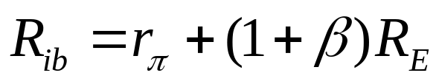



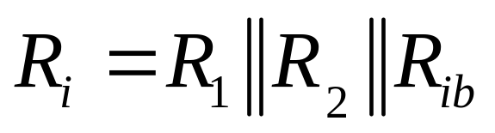

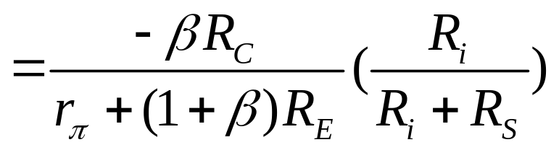
6.4 Common-Emitter Amplifiers
6.4.2 Circuit with Emitter Resistor

Slide 11
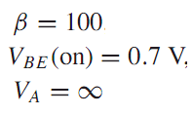



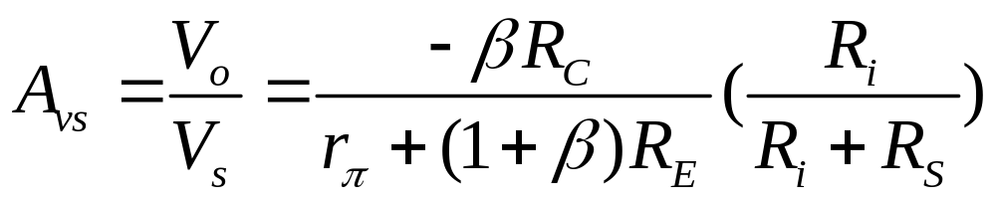
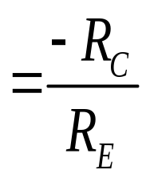

6.4 Common-Emitter Amplifiers
6.4.2 Circuit with Emitter Resistor
# Voltage-divider biasing stabilizes Q，but degrade ac voltage gain, how can we improve it？

Slide 12

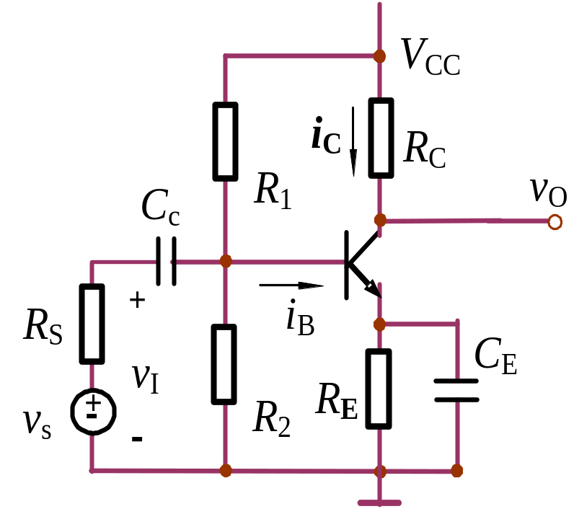
6.4 Common-Emitter Amplifiers
6.4.2 Circuit with Emitter Resistor
Bypass Capacitor

Slide 13
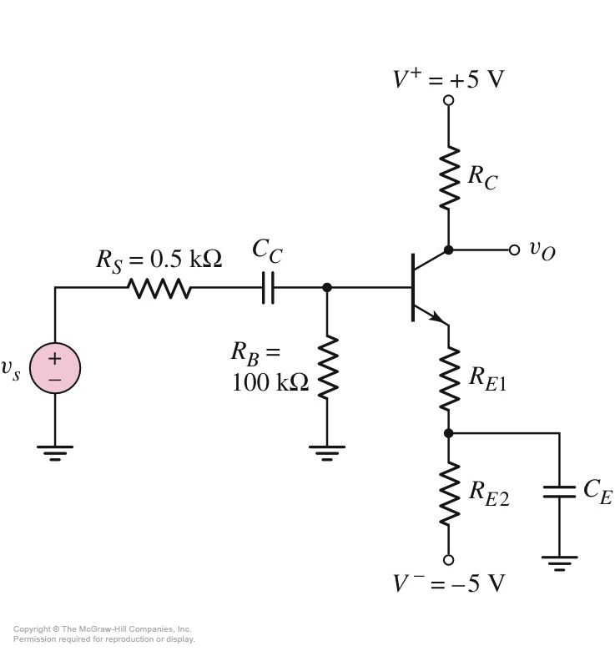
















6.4 Common-Emitter Amplifiers
6.4.3 Circuit with Emitter Bypass Capacitor
DC：open
AC：short

Slide 14

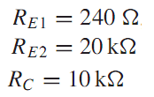
6.4 Common-Emitter Amplifiers
6.4.3 Circuit with Emitter Bypass Capacitor

Slide 15

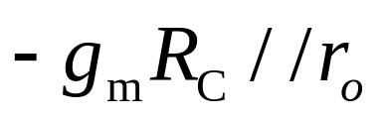
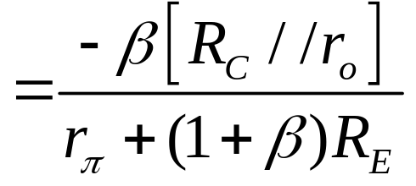
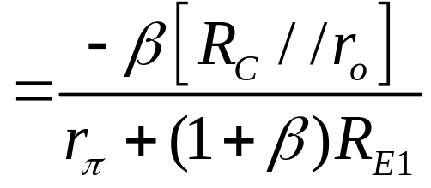

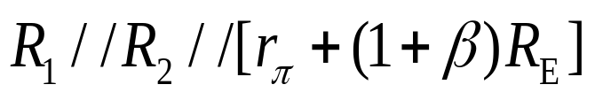
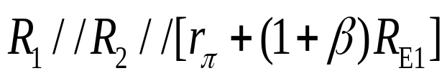
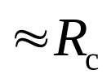
6.4 Common-Emitter Amplifiers
Small Signal
Voltage Gain
Input
impedance
Output
impedance

Slide 16


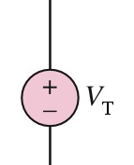
Find R_{o}

Slide 17
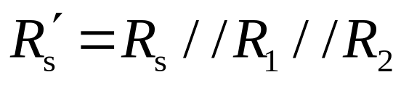
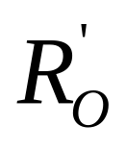
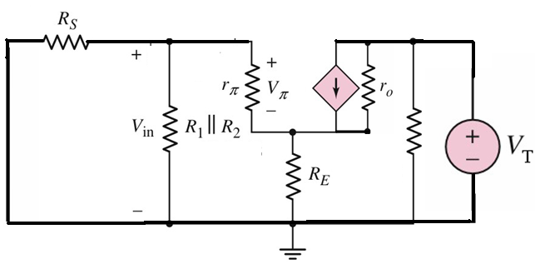
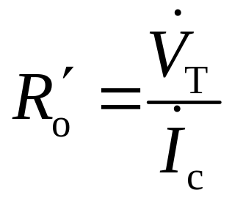

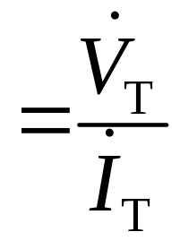
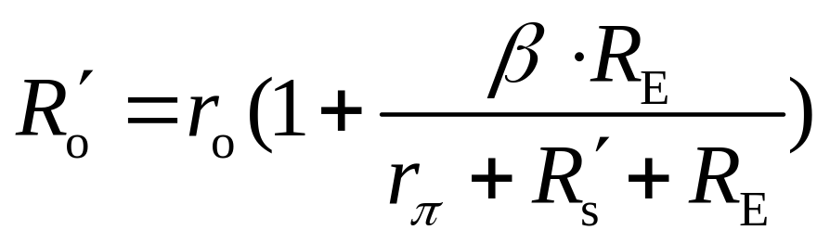
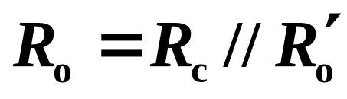
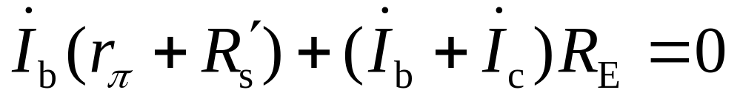
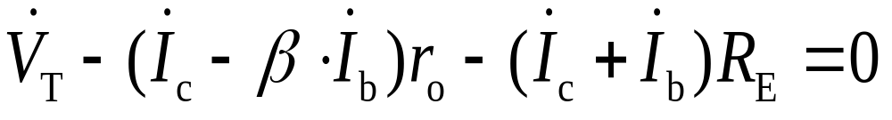
R_{o}
Find R_{o}
I_{C}
I_{T}

Slide 18
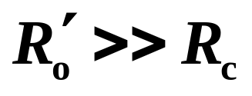
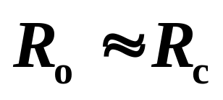

Slide 19
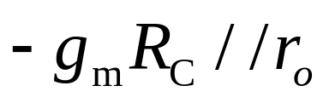
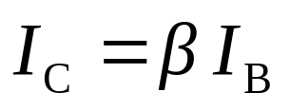
6.4 Common-Emitter Amplifiers
Summary of CE amplifier
Large voltage gain
Inverting amplifier
Large current gain
Input resistance is relatively low.
Output resistance is relatively high.
R_{C}

Slide 20

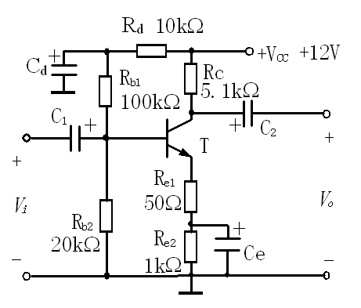
1、Calculate（I_{B}、I_{C}、V_{CE}）；
2、Sketch the small signal equivalent circuit；
3、Find R_{i} and R_{o} ；
4、Find A_{v} = V_{o} / V_{i} ；

Slide 21

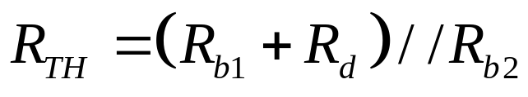
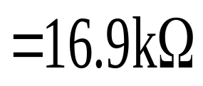
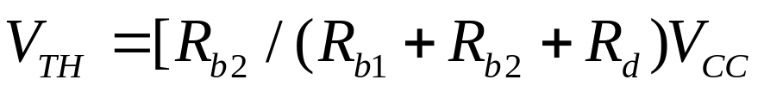
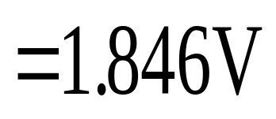
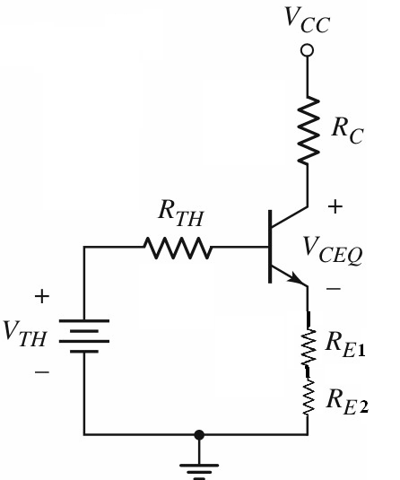

Slide 22
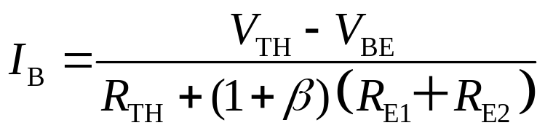
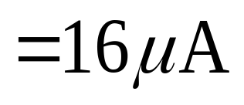

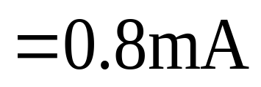
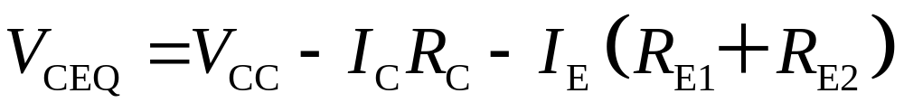
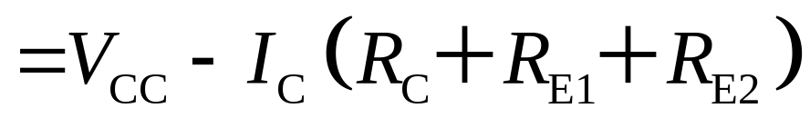
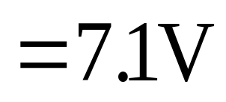

Slide 23







AC CIRCUIT

Slide 24
Questions
and
Answers

