Slide 1

Huazhong University of Science and Technology
The Department of Electronics and Information Engineering
Electronic Circuit Analysis and Design
Dr. Tianping Deng
Email: dengtp@hust.edu.cn

Slide 2
Contents
PART 1 SEMICONDUCTOR DEVICES AND BASIC APPLICATIONS
Chapter 1 Semiconductor Materials and Diodes
Chapter 2 Diode Circuits
Chapter 3 The Field-Effect Transistor
Chapter 4 Basic FET Amplifiers
Chapter 5 The Bipolar Junction Transistor
Chapter 6 Basic BJT Amplifiers
Chapter 7 Frequency Response
Chapter 8 Output Stages and Power Amplifiers
PART 2 ANALOG ELECTRONICS
Chapter 9 Ideal Operational Amplifiers and Op-Amp Circuits
Chapter 10 Integrated Circuit Biasing and Active Loads
Chapter 11 Differential and Multistage Amplifiers
Chapter 12 Feedback and Stability
Chapter 13 Operational Amplifier Circuits
Chapter 14 Nonideal Effects in Operational Amplifier Circuits
Chapter 15 Applications and Design of Integrated Circuits
Chapter 6 Basic BJT Amplifiers

Slide 3
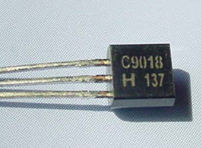
Ch6. Basic BJT Amplifiers
6.0 Preview
6.1 Analog Signals and Linear Amplifiers
6.2 The Bipolar Linear Amplifier
6.3 Basic Transistor Amplifier Configurations
6.4 Common-Emitter Amplifiers
6.5 AC Load Line Analysis
6.6 Common-Collector (Emitter-Follower) Amplifier
6.7 Common-Base Amplifier
6.8 The Three Basic Amplifiers: Summary and Comparison
6.9 Multistage Amplifiers
6.10 Power Considerations
6.11 Design Application
6.12 Summary

Slide 4

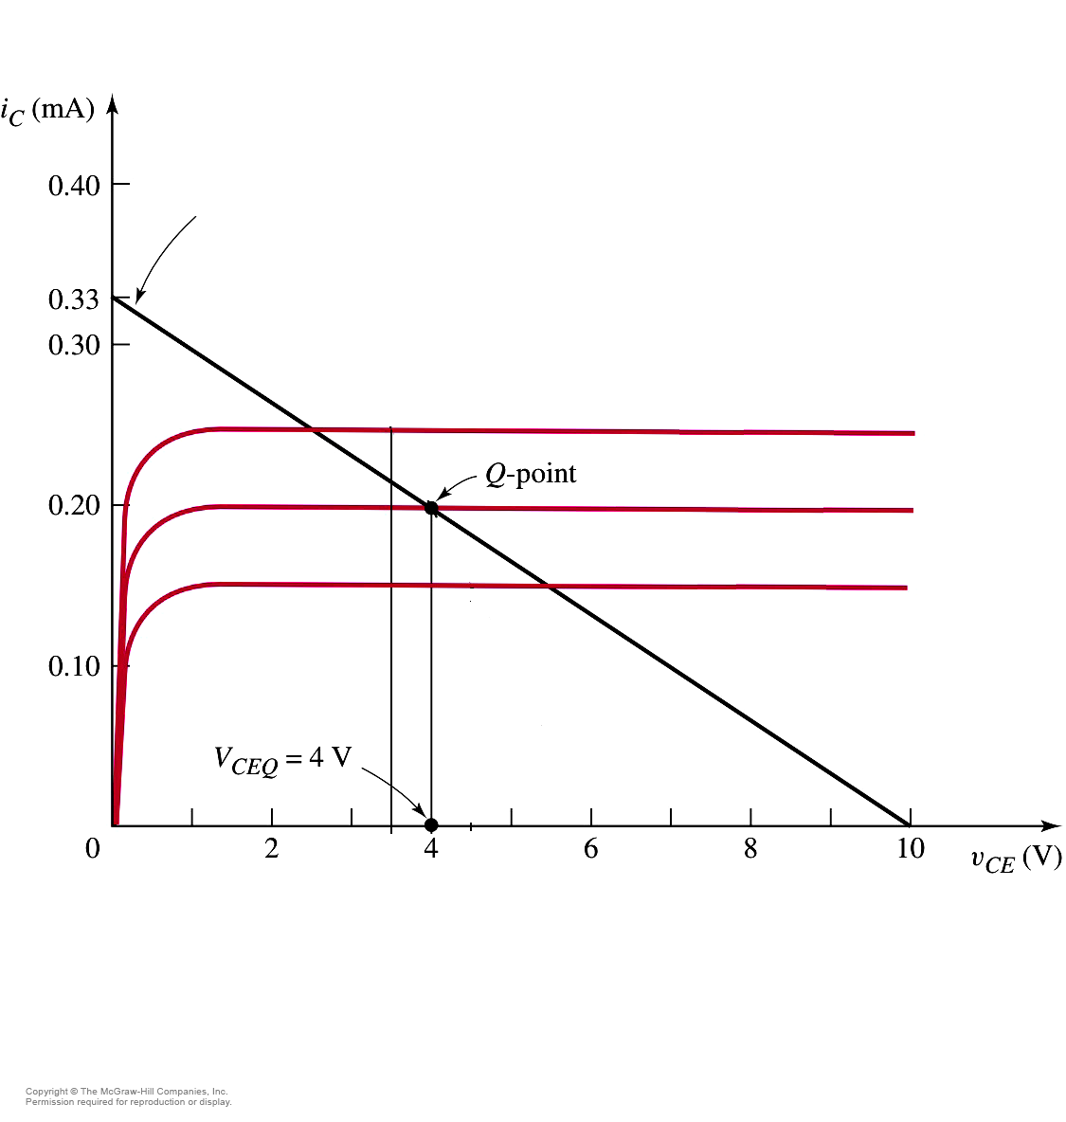


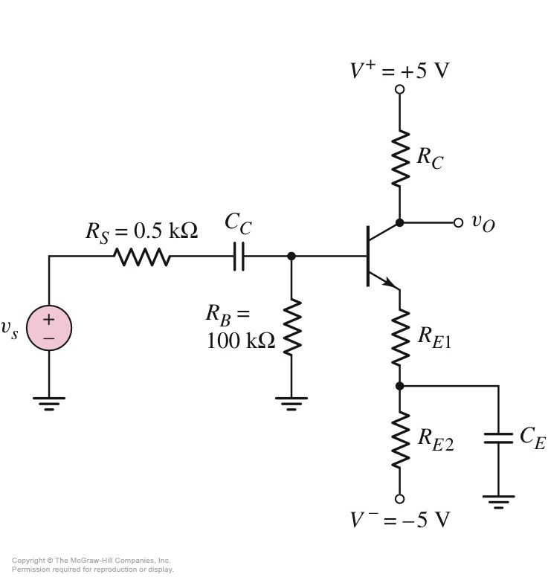

6.5 AC Load line Analysis
6.5.1 AC load line
Review
DC load line

Slide 5

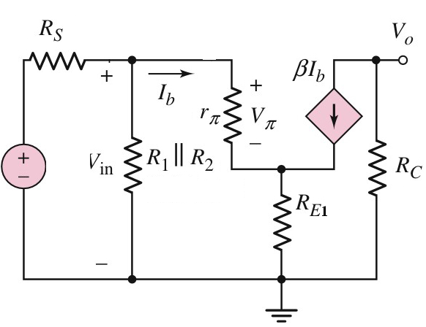



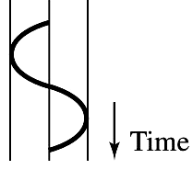

6.5 AC Load line Analysis
v_{ce}= v_{CE} - V_{CEQ}
i_{c}= i_{C} - I_{CQ}
6.5.1 AC load line
The small-signal equivalent circuit
i_{C} = [-1/(R_{C}+R_{E1})]⋅ v_{CE} + [1/(R_{C}+R_{E1}))]V_{CEQ}+ I_{CQ}

Slide 6
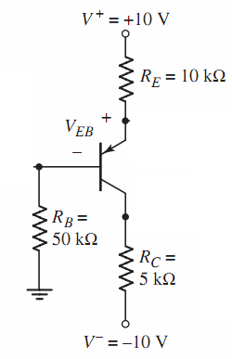
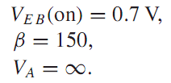
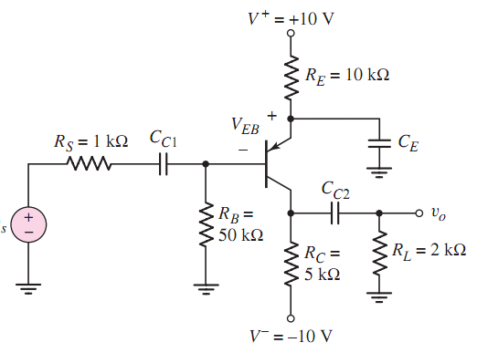
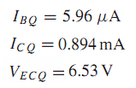

6.5 AC Load line Analysis
6.5.1 AC load line
DC Circuit

Slide 7

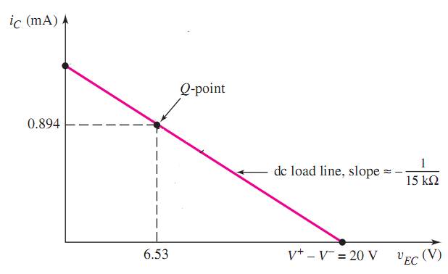
6.5 AC Load line Analysis
6.5.1 AC load line

Slide 8
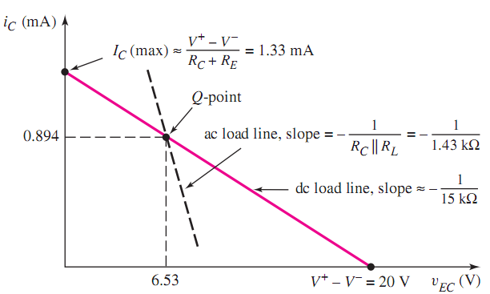
6.5 AC Load line Analysis
6.5.1 AC load line

Slide 9
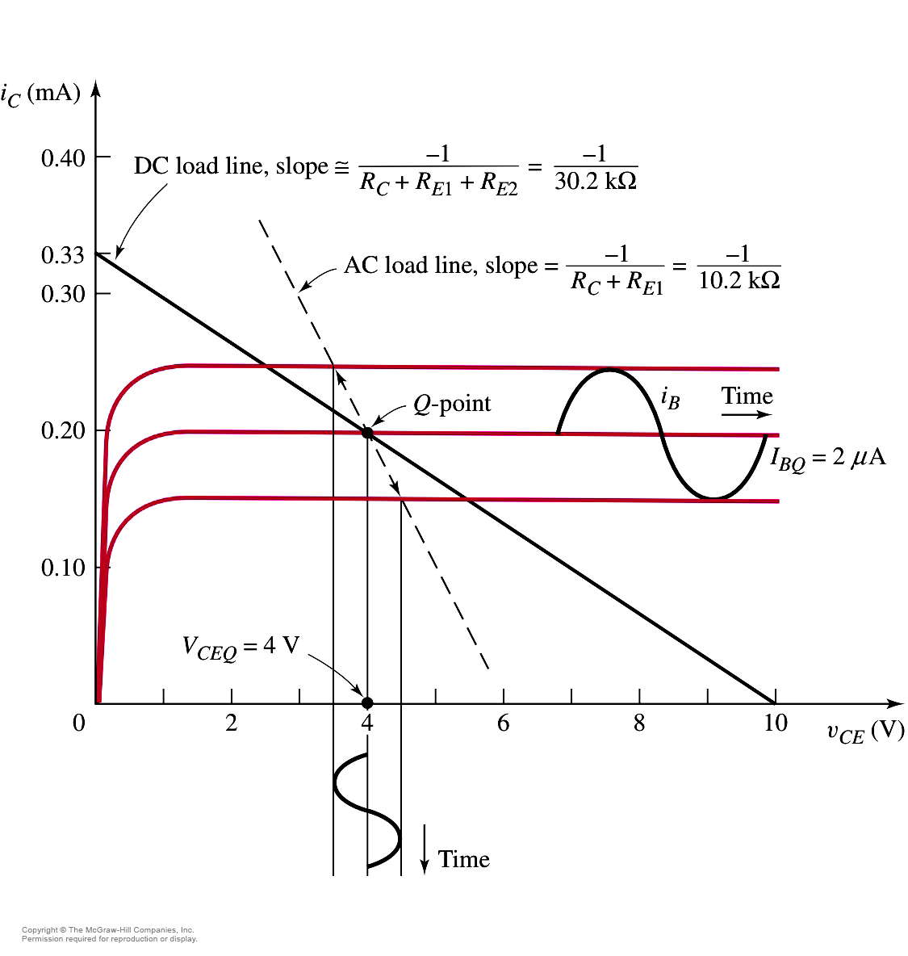
6.5 AC Load line Analysis
6.5.2 Maximum Symmetrical Swing
Cut off
Maximum Symmetrical Swing

Slide 10

6.5 AC Load line Analysis
6.5.2 Maximum Symmetrical Swing
Figure 6.46

Slide 11
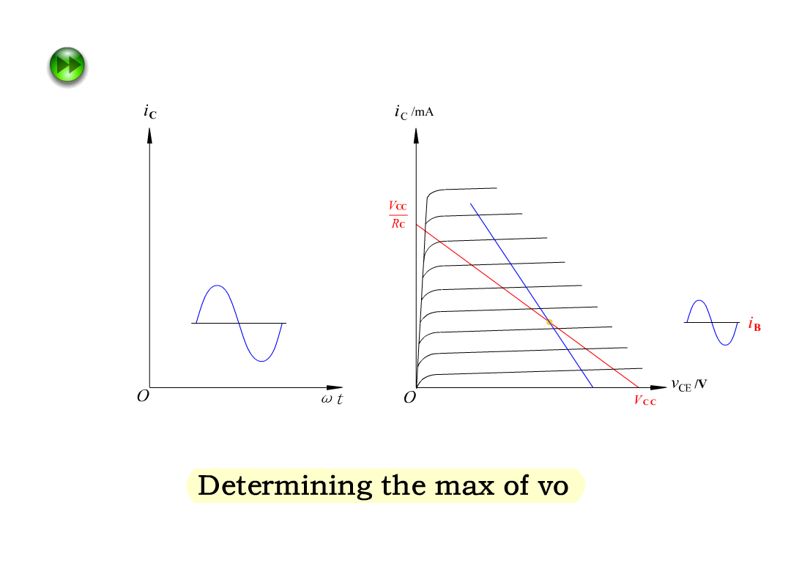
The max of v_{o}

Slide 12
6.5 AC Load line Analysis
6.5.2 Maximum Symmetrical Swing
Problem-Solving Technique: Maximum Symmetrical Swing
Write dc load line equation that relates I_{CQ} and V_{CEQ}.
Write ac load line equations that relates i_{c} and v_{ce}
In general, i_{c} = I_{CQ} – I_{C}(min), where I_{C}(min) is zero or other minimum collector current.
In general, v_{ce} = V_{CEQ} – V_{CE}(min), where V_{CE}(min) is some specified minimum collector-emitter voltage.
Combine above 4 equations to find optimum I_{CQ} and V_{CEQ}.

Slide 13
Questions
and
Answers

