Slide 1

Huazhong University of Science and Technology
The Department of Electronics and Information Engineering
Electronic Circuit Analysis and Design
Dr. Tianping Deng
Email: dengtp@hust.edu.cn

Slide 2
Contents
PART 1 SEMICONDUCTOR DEVICES AND BASIC APPLICATIONS
Chapter 1 Semiconductor Materials and Diodes
Chapter 2 Diode Circuits
Chapter 3 The Field-Effect Transistor
Chapter 4 Basic FET Amplifiers
Chapter 5 The Bipolar Junction Transistor
Chapter 6 Basic BJT Amplifiers
Chapter 7 Frequency Response
Chapter 8 Output Stages and Power Amplifiers
PART 2 ANALOG ELECTRONICS
Chapter 9 Ideal Operational Amplifiers and Op-Amp Circuits
Chapter 10 Integrated Circuit Biasing and Active Loads
Chapter 11 Differential and Multistage Amplifiers
Chapter 12 Feedback and Stability
Chapter 13 Operational Amplifier Circuits
Chapter 14 Nonideal Effects in Operational Amplifier Circuits
Chapter 15 Applications and Design of Integrated Circuits
Chapter 5 The Bipolar Junction Transistor

Slide 3
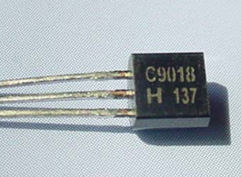
Ch5. The Bipolar Junction Transistor
5.1 Basic Bipolar Junction Transistor
5.2 DC Analysis of Transistor Circuits
5.3 Basic Transistor Application
5.4 Basic Transistor Biasing
5.5 Multistage Circuits

Slide 4
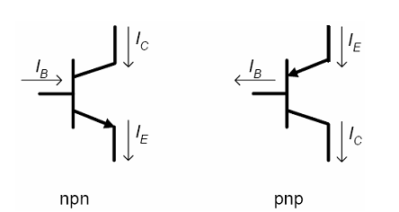
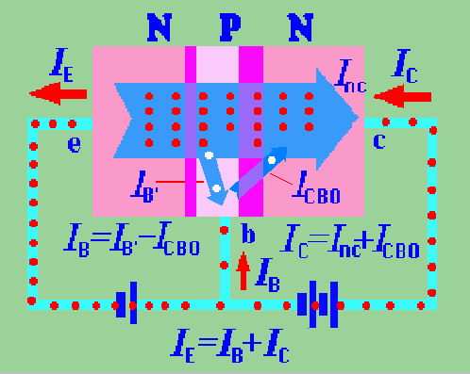
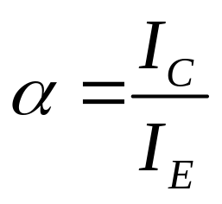
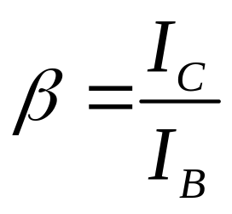
I_{E}=I_{B}+ I_{C}
Transfer process of carriers

Slide 5
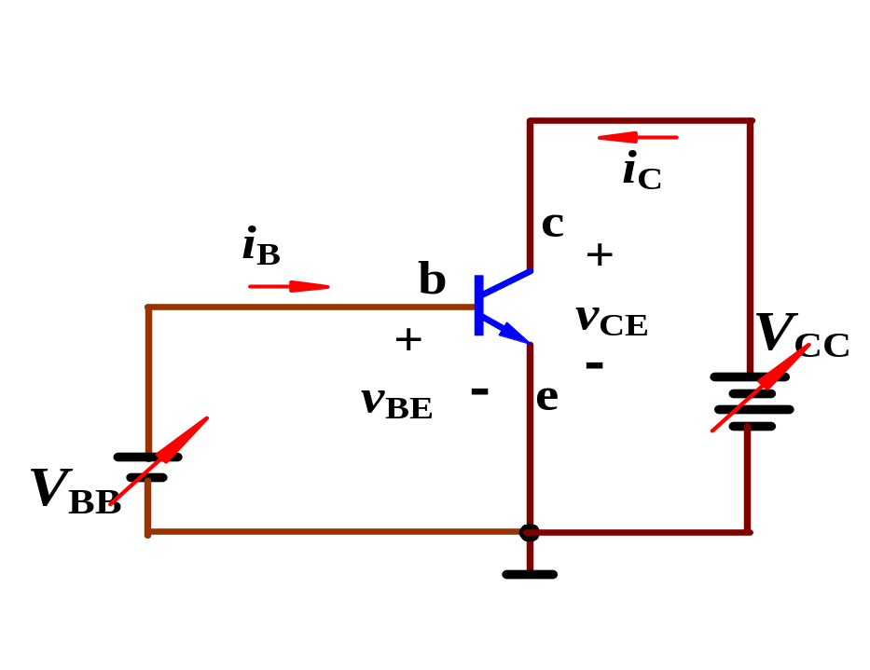
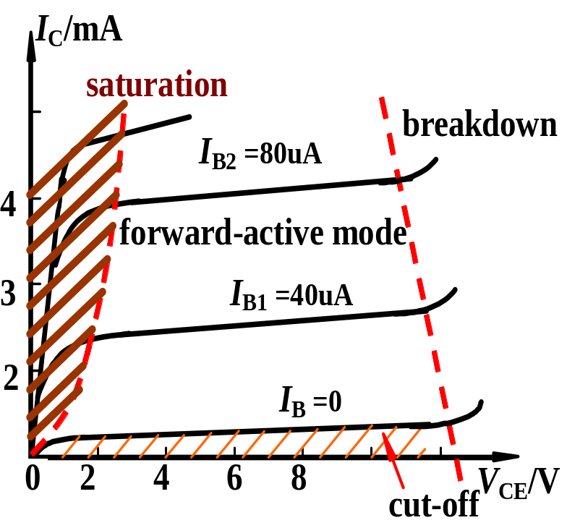
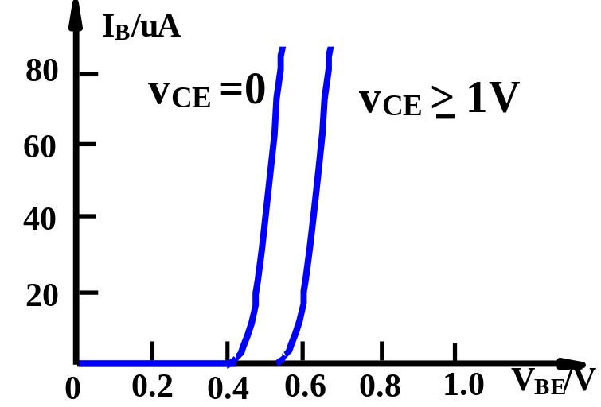
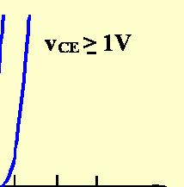


Slide 6
Ch5. The Bipolar Junction Transistor
5.2 DC Analysis of Transistor Circuits(P303)
5.2.1 Common Emitter Circuit
5.2.2 Load Line and Modes of Operation
5.2.3 Voltage Transfer Characteristics
5.2.4 Commonly Used Bipolar Circuit : DC Analysis

Slide 7
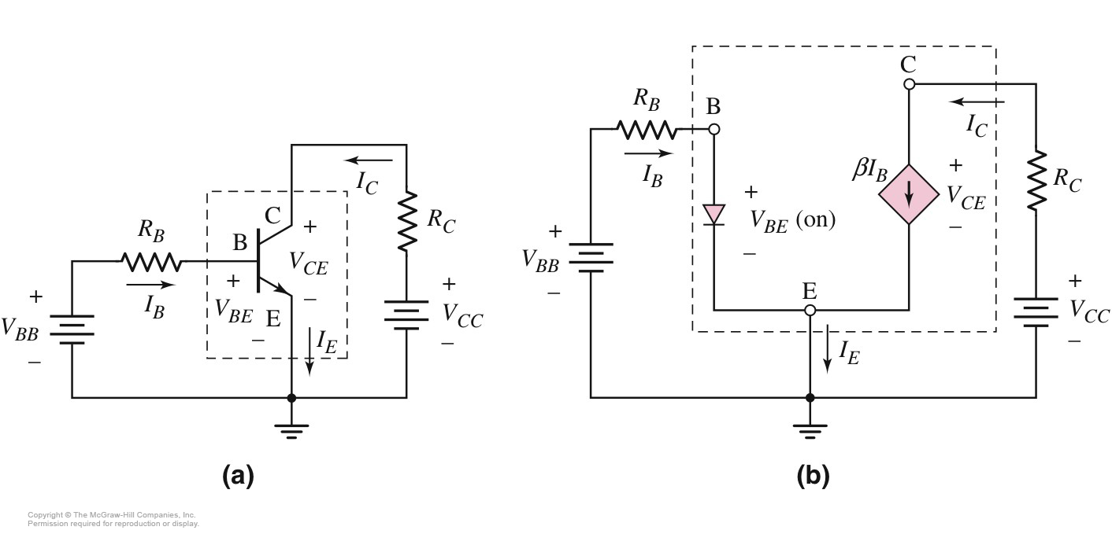

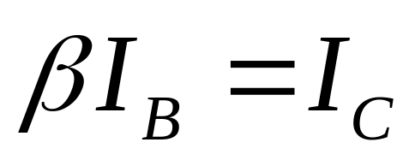
5.2.1 Common Emitter Circuit
DC Equivalent Circuit
Figure 5.19
Common Emitter Circuit

Slide 8
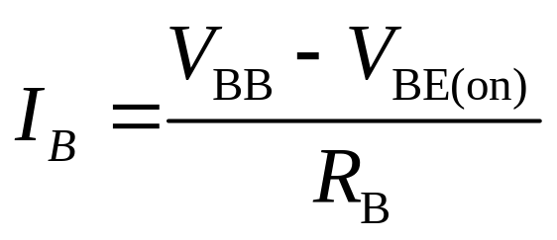

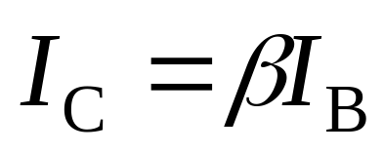
5.2.1 Common Emitter Circuit
Figure 5.19

Slide 9
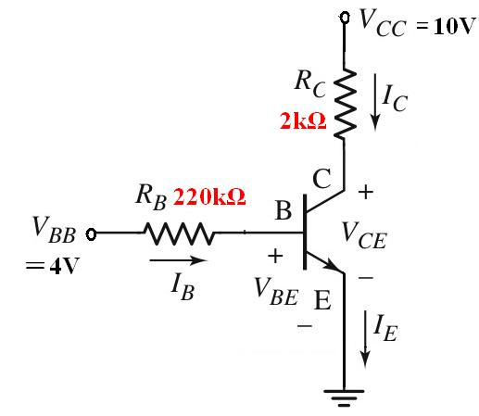
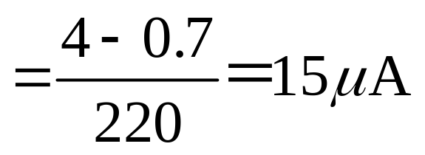
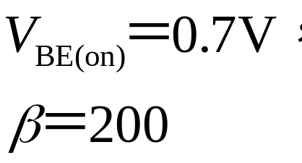
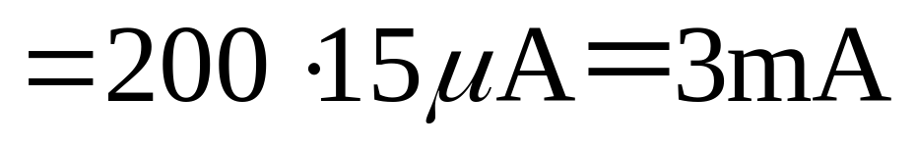
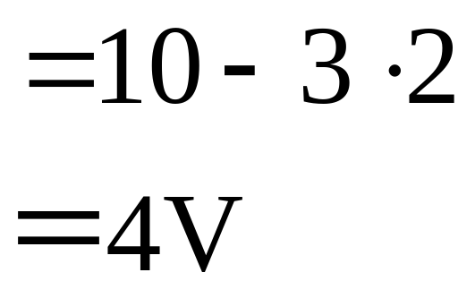
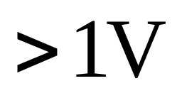
5.2.1 Common Emitter Circuit
Figure 5.20
Simulation

Slide 10
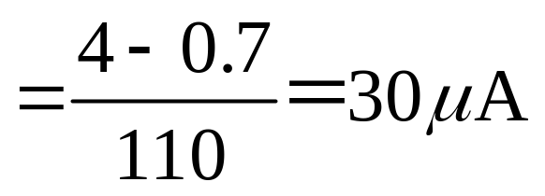
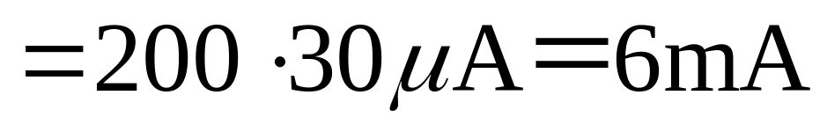
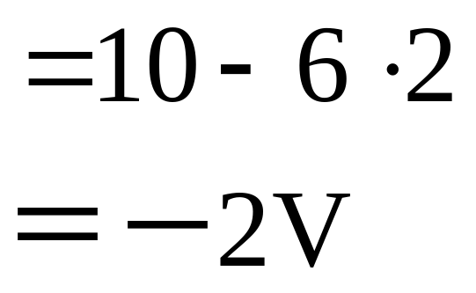

5.2.1 Common Emitter Circuit
Figure 5.20

Slide 11
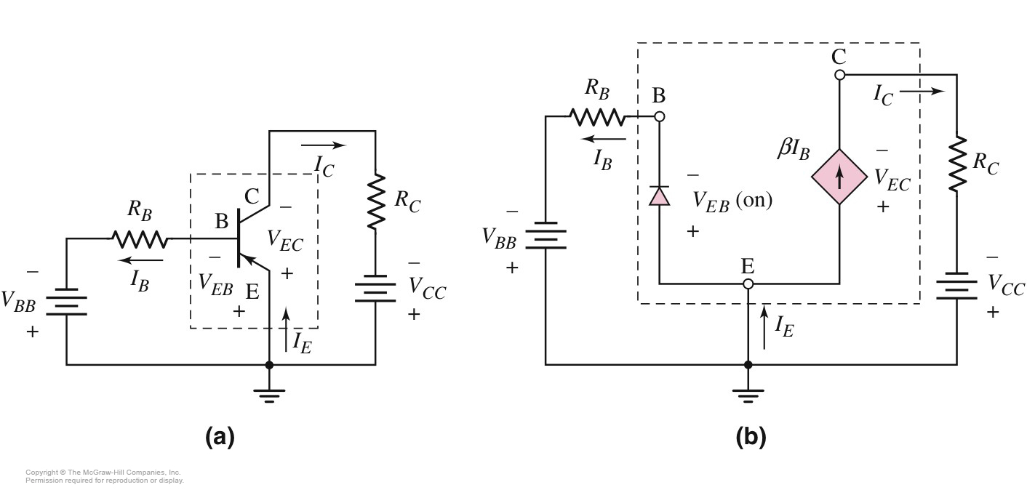

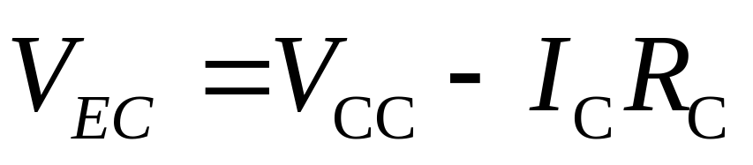
5.2.1 Common Emitter Circuit
Figure 5.21

Slide 12
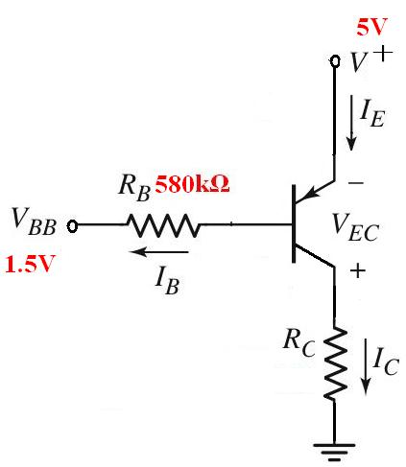
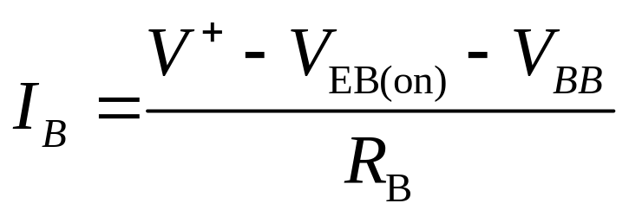
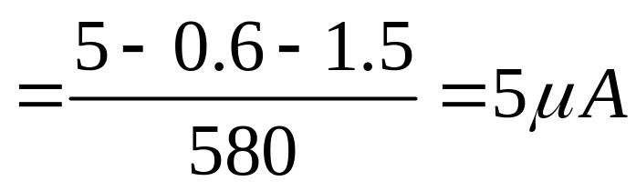
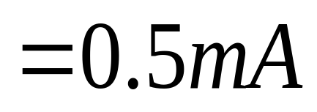
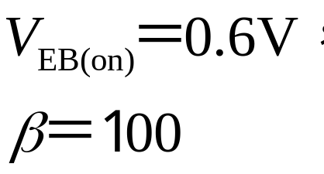
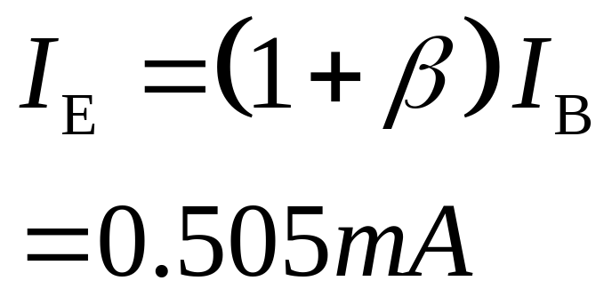
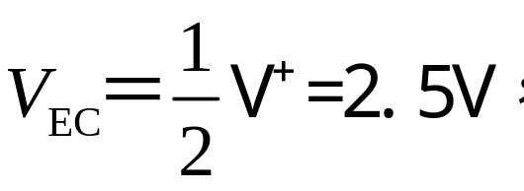
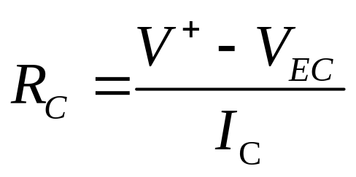
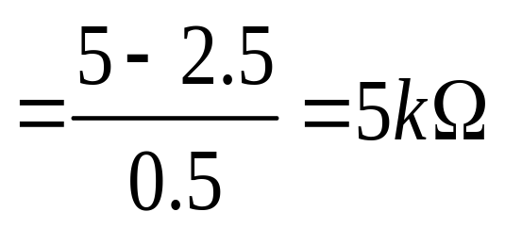
5.2.1 Common Emitter Circuit
Figure 5.22
Find I_{B}，I_{C}，I_{E}，R_{C}.

Slide 13
5.2.1 Common Emitter Circuit
Figure 5.20

Slide 14
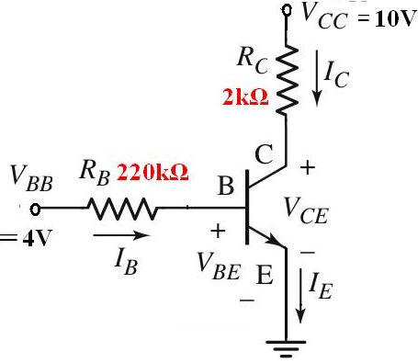
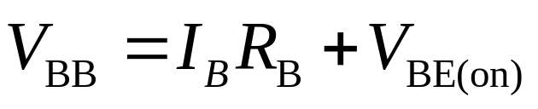
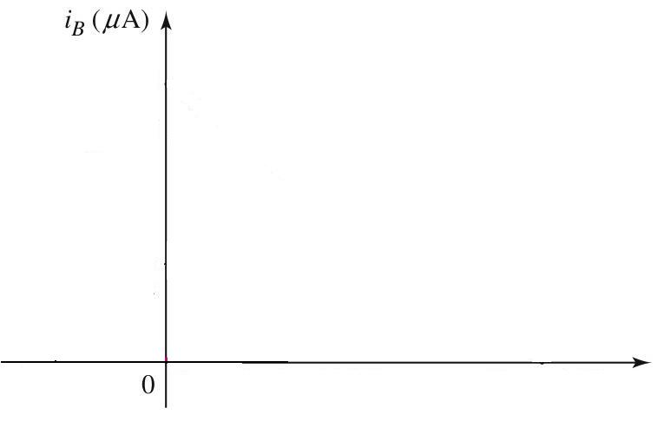
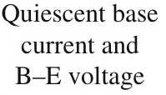






5.2.2 Load Line and Modes of Operation
Figure 5.20

Slide 15
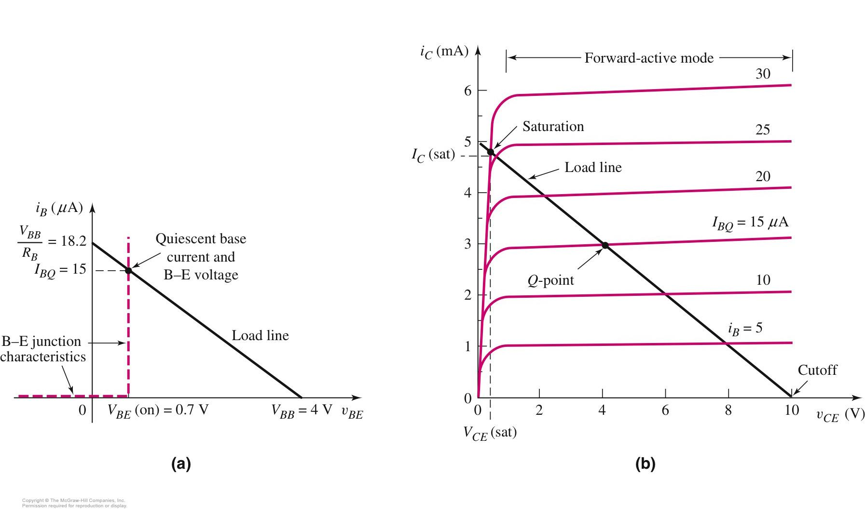

5.2.2 Load Line and Modes of Operation
Figure 5.20

Slide 16

5.2.2 Load Line and Modes of Operation

Slide 17
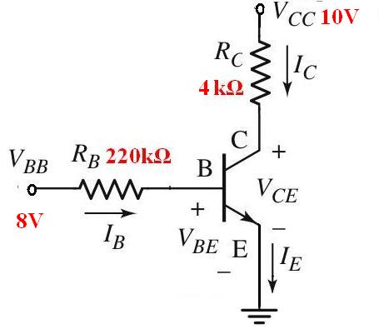
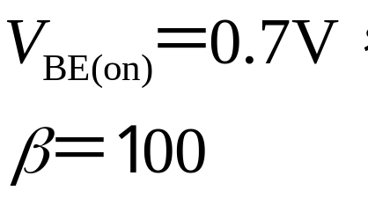
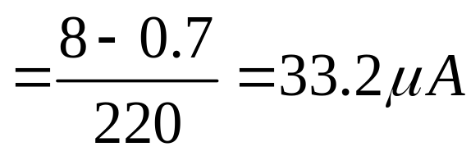
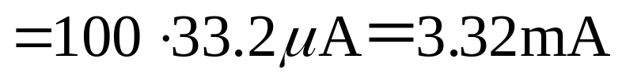
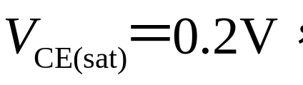
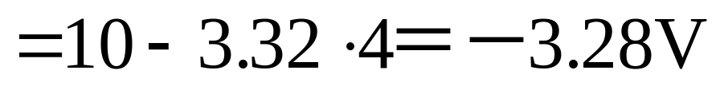
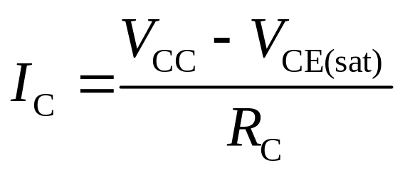
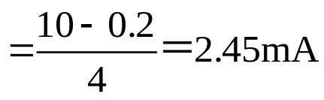
5.2.2 Load Line and Modes of Operation
When the transistor is in the
Saturation region, calculate the
Currents and voltages.

Slide 18
Problem-Solving Technique:
Bipolar DC Analysis
Assume that the transistor is biased in forward active mode
  V_{BE} = V_{BE}(on), I_{B} > 0, & I_{C} = βI_{B}
Analyze ‘linear’ circuit.
Evaluate the resulting state of transistor.
  If V_{CE} > V_{CE}(sat), assumption is correct
  If I_{B} < 0, transistor likely in cutoff
  If V_{CE} < 0, transistor likely in saturation
If initial assumption is incorrect, make new assumption and return to Step 2.

Slide 19
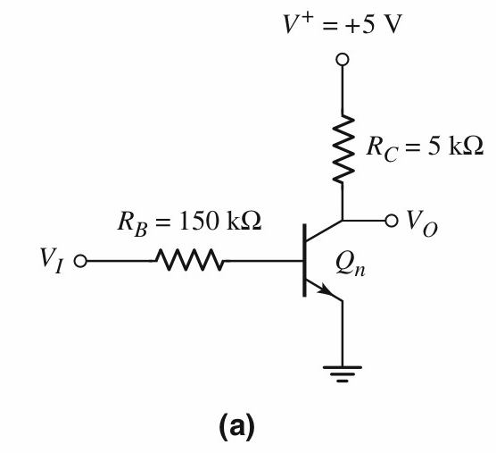
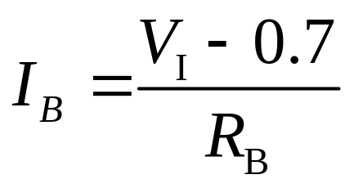
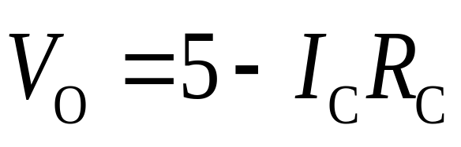
Voltage Transfer Characteristic for npn Circuit
V_{I}≤0.7V
Which region?
Cut off
I_{B}= I_{C} =0
V_{O}=?
V_{O}= V⁺ =5V
V_{I}>0.7V
Which region?
Forward active or
Saturation region
Forward active region

Slide 20
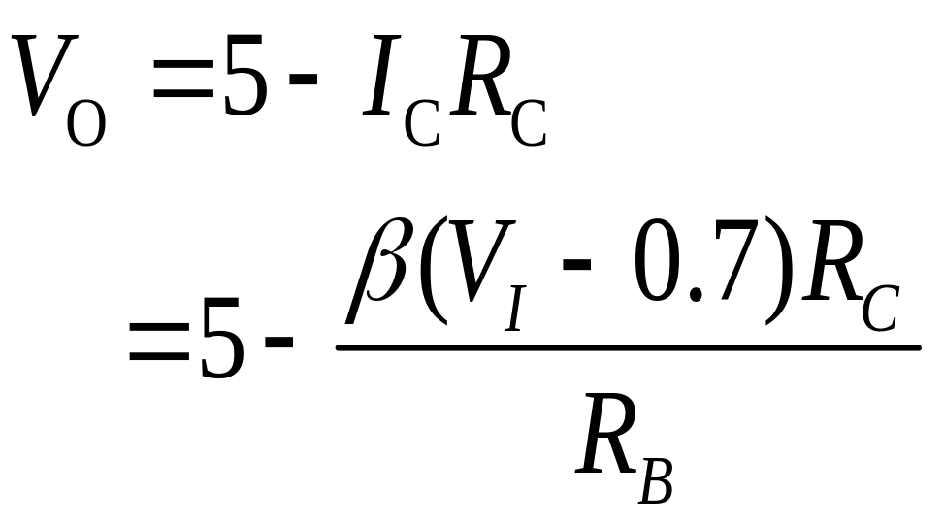

Voltage Transfer Characteristic for npn Circuit
Forward active region

Slide 21


Voltage Transfer Characteristic for npn Circuit
Which region?
Saturation region
V_{I}＝？
V_{I}＝1.9V
V_{I}≥1.9V
Saturation region

Slide 22


Voltage Transfer Characteristic for npn Circuit
V_{I}≤0.7V
V_{O}= V⁺ =5V
V_{O}= 0.2V
V_{I}≥1.9V
0.7V<V_{I}<1.9V
Simulation
DC Sweep

Slide 23


Voltage Transfer Characteristic for npn Circuit
Which logic?
5V
NOT
0.2V
Simulation
Transient

Slide 24

Voltage Transfer Characteristic for pnp Circuit

Slide 25




Review Questions
？

Slide 26
Questions
and
Answers

