Slide 1


Huazhong University of Science and Technology
The Department of Electronics and Information Engineering
Electronic Circuit Analysis and Design
Dr. Tianping Deng
Email: dengtp@hust.edu.cn

Slide 2
Contents
PART 1 SEMICONDUCTOR DEVICES AND BASIC APPLICATIONS
Chapter 1 Semiconductor Materials and Diodes
Chapter 2 Diode Circuits
Chapter 3 The Field-Effect Transistor
Chapter 4 Basic FET Amplifiers
Chapter 5 The Bipolar Junction Transistor
Chapter 6 Basic BJT Amplifiers
Chapter 7 Frequency Response
Chapter 8 Output Stages and Power Amplifiers
PART 2 ANALOG ELECTRONICS
Chapter 9 Ideal Operational Amplifiers and Op-Amp Circuits
Chapter 10 Integrated Circuit Biasing and Active Loads
Chapter 11 Differential and Multistage Amplifiers
Chapter 12 Feedback and Stability
Chapter 13 Operational Amplifier Circuits
Chapter 14 Nonideal Effects in Operational Amplifier Circuits
Chapter 15 Applications and Design of Integrated Circuits
Chapter 4 Basic FET Amplifiers

Slide 3
Ch4 Basic FET Amplifiers
4.1 The MOSFET Amplifier
4.2 Basic Transistor Amplifier Configurations
4.3 The Common Source Amplifier
4.4 The Common Drain（Source Follower） Amplifier
4.5 The Common Gate Configuration
4.5.1 Small voltage and current gains
4.5.2 Input and output Impedance
4.6 The Three Basic Amplifier Configuration:
Summary and comparison

Slide 4
Ch4 Basic FET Amplifiers
4.1 The MOSFET Amplifier
4.1.1 Graphical Analysis, Load line, and small signal parameters
4..1.2 small signal equivalent circuit
P207-P214

Slide 5
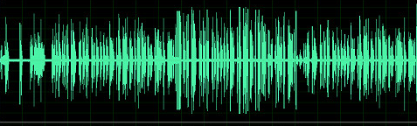
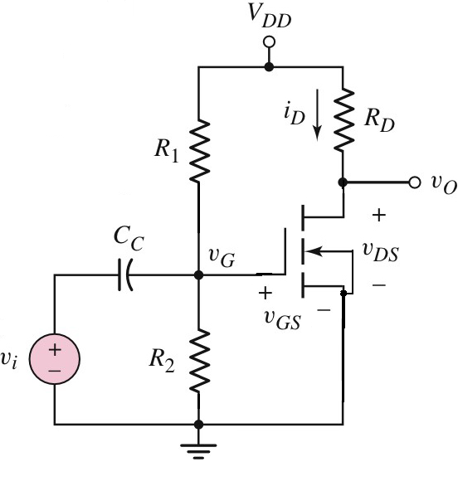
4.1 The MOSFET Amplifier
signals
sound
Analog circuits
amplifiers

Slide 6
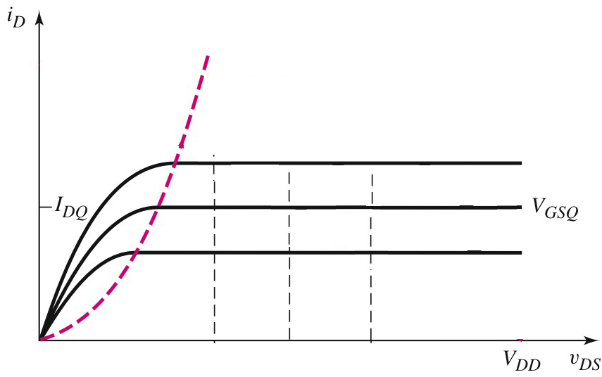
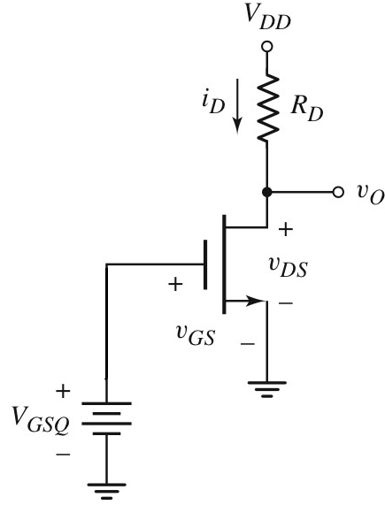


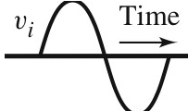
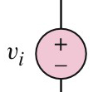

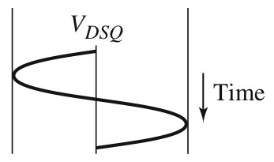
4.1.1 Graphical Analysis, Load line, and small signal parameters
DC load line
V_{DS} =V_{DD}- I_{D} R_{D}
CS

Slide 7
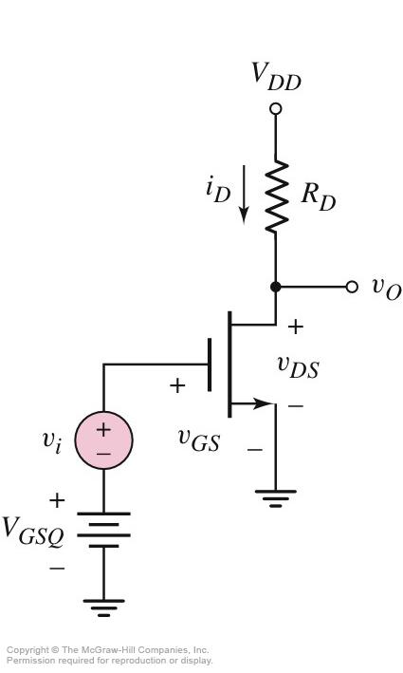
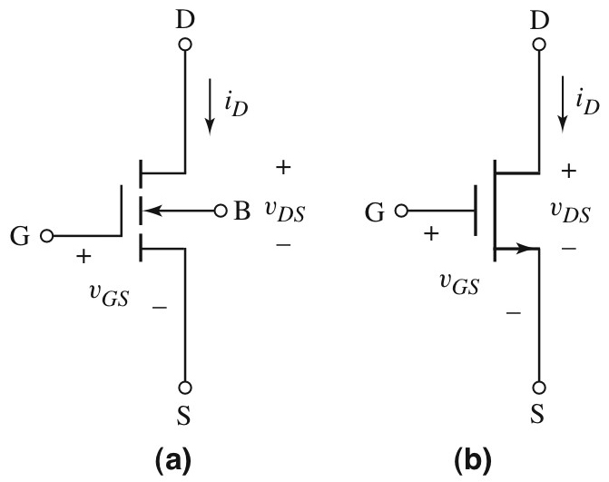
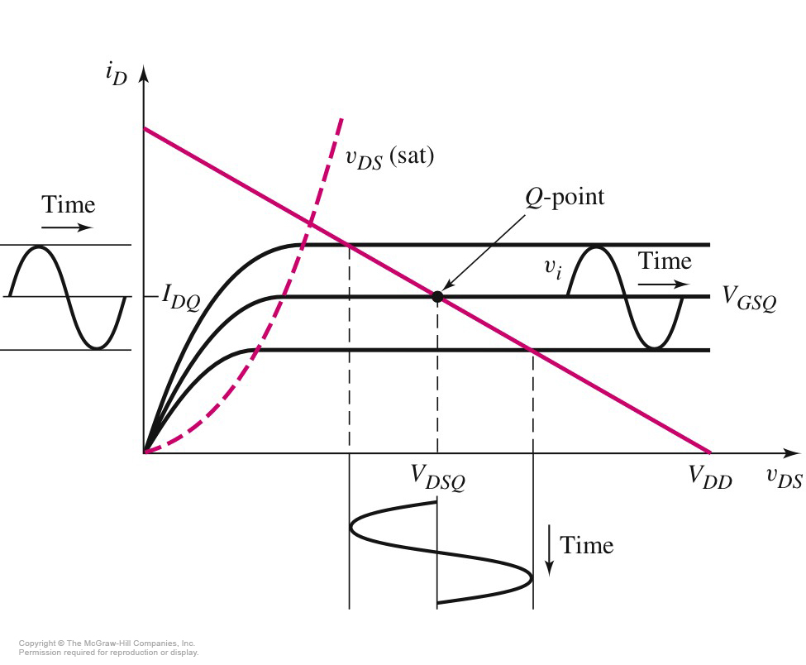
4.1.1 Graphical Analysis, Load line, and small signal parameters
DC load line
CS

Slide 8
4.1.1 Graphical Analysis, Load line, and small signal parameters
Summary of notation Variable Meaning
i_{D}, v_{GS} Total instantaneous values I_{D},V_{GS} DC values i_{d}, v_{gs} instantaneous ac values I_{d}, V_{gs} Phase values

Slide 9







4.1.1 Graphical Analysis, Load line, and small signal parameters
v_{GS}=V_{GSQ}+ v_{i}=V_{GSQ}+ v_{gs}

Slide 10
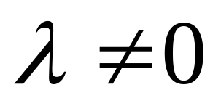
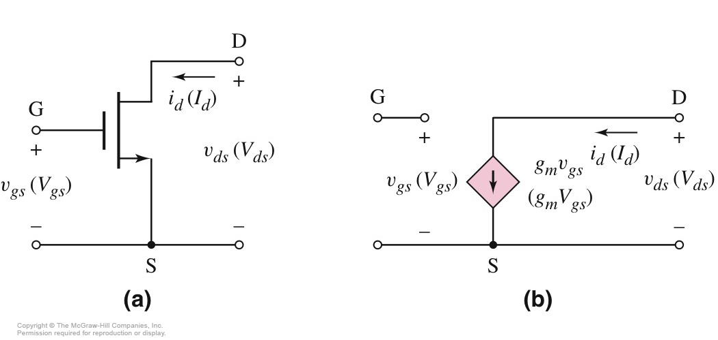

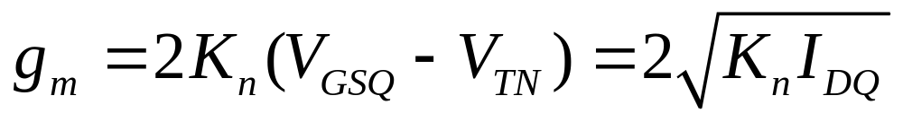
4..1.2 small signal equivalent circuit

Slide 11
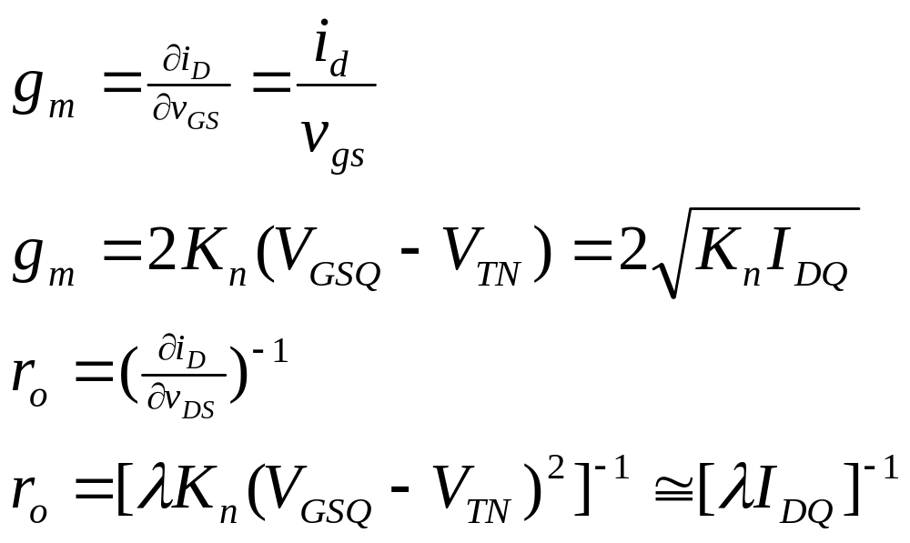
4.1.1 Graphical Analysis, Load line, and small signal parameters
Values depends on Q-point

Slide 12

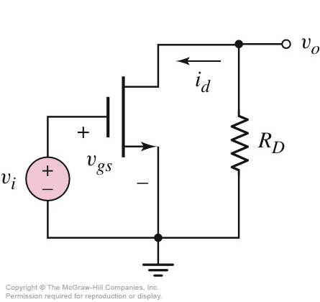

4.1.1 Graphical Analysis, Load line, and small signal parameters
Set zero
Set zero
AC circuit

Slide 13
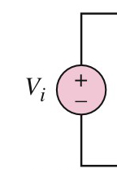
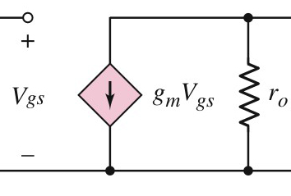
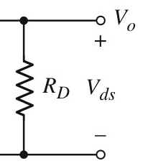
4..1.2 small signal equivalent circuit
small signal equivalent circuit

Slide 14
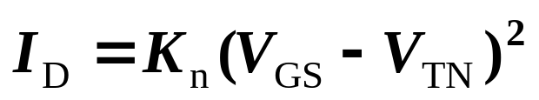
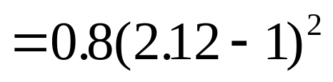

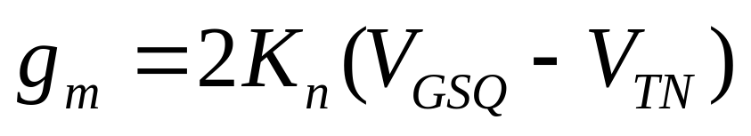
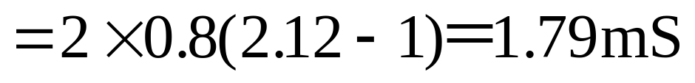
4..1.2 small signal equivalent circuit
V_{GSQ}=2.12V
V_{DD}=5V
R_{D}=2.5kΩ
V_{TN}=1V
K_{n}=0.80mA/V²
λ=0.02V^{－1}
Determine small voltage gain.
Sol：
V_{DS} =V_{DD}- I_{D} R_{D}
=5- 1*2.5 =2.5V
V_{DSQ} =2.5V> V_{GS}-V_{TN}
=2.12-1=1.12V
Which region?
Saturation region

Slide 15
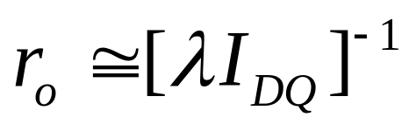
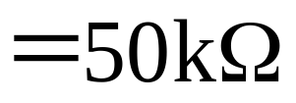
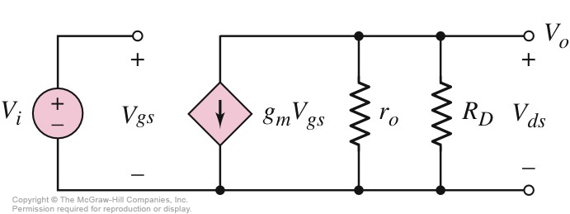
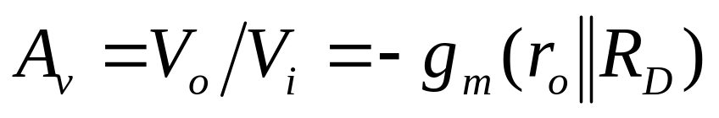
4..1.2 small signal equivalent circuit
Determine small voltage gain.
V_{GSQ}=2.12V
V_{DD}=5V
R_{D}=2.5kΩ
V_{TN}=1V
K_{n}=0.80mA/V²
λ=0.02V^{－1}
Sol：
V_{i} =V_{gs}
V_{o} =－g_{m} •V_{gs} •(r_{o}//R_{D})
=－4.26

Slide 16
4..1.2 small signal equivalent circuit
Problem-Solving Technique: MOSFET AC Analysis
Analyze circuit with only the dc sources to find quiescent solution. Transistor must be biased in saturation region for linear amplifier.
Replace elements with small-signal model.
Analyze small-signal equivalent circuit, setting dc sources to zero, to produce the circuit to the time-varying input signals only.

Slide 17
Questions
and
Answers

