Slide 1


Huazhong University of Science and Technology
The Department of Electronics and Information Engineering
Electronic Circuit Analysis and Design
Dr. Tianping Deng
Email: dengtp@hust.edu.cn

Slide 2
Contents
PART 1 SEMICONDUCTOR DEVICES AND BASIC APPLICATIONS
Chapter 1 Semiconductor Materials and Diodes
Chapter 2 Diode Circuits
Chapter 3 The Field-Effect Transistor
Chapter 4 Basic FET Amplifiers
Chapter 5 The Bipolar Junction Transistor
Chapter 6 Basic BJT Amplifiers
Chapter 7 Frequency Response
Chapter 8 Output Stages and Power Amplifiers
PART 2 ANALOG ELECTRONICS
Chapter 9 Ideal Operational Amplifiers and Op-Amp Circuits
Chapter 10 Integrated Circuit Biasing and Active Loads
Chapter 11 Differential and Multistage Amplifiers
Chapter 12 Feedback and Stability
Chapter 13 Operational Amplifier Circuits
Chapter 14 Nonideal Effects in Operational Amplifier Circuits
Chapter 15 Applications and Design of Integrated Circuits
Chapter 8 Output Stages and Power Amplifiers

Slide 3
Ch8 Output Stage and Power Amplifiers
8.1 Power Amplifiers
8.2 Power Transistor
8.3 Class of Amplifiers
8.4 Class-A Power Amplifiers
8.5 Class-AB Push-Pull Complementary Output Stage
P561－586

Slide 4
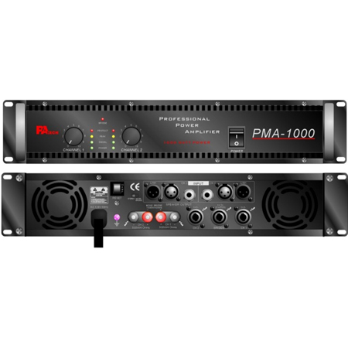
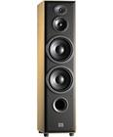

Slide 5
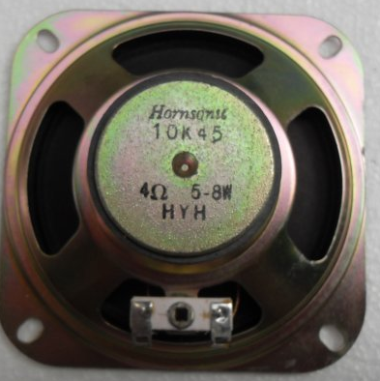
8.1 Power Amplifiers
Deliver a large amount of power
a large voltage
a large current
Small load resistance
R_{O}
small
High efficiency
Transistor Power Dissipation
small

Slide 6
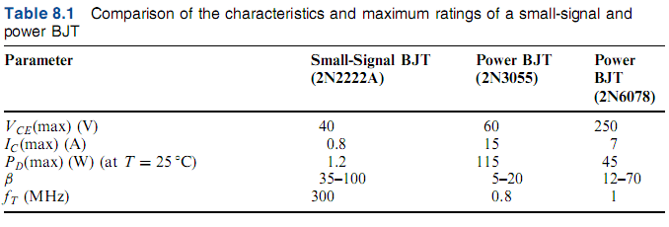
8.2 Power Transistor
8.2.1 Power BJTs

Slide 7
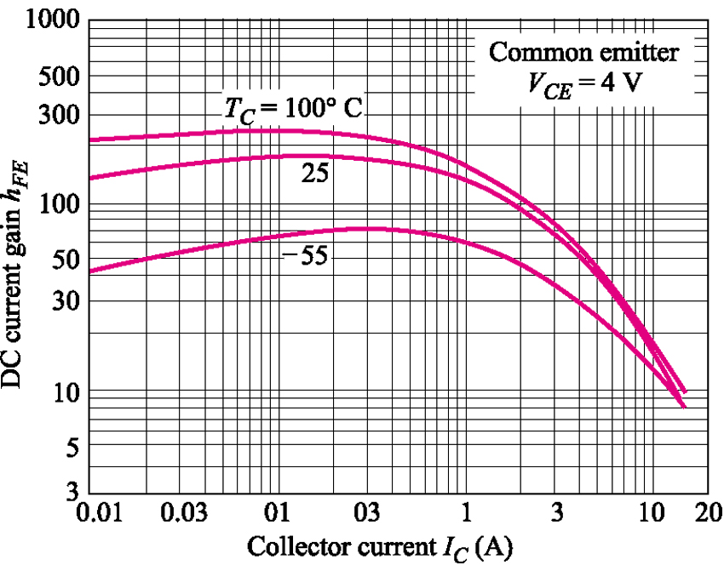
8.2 Power Transistor
8.2.1 Power BJTs
Typical dc beta characteristics (h_{FE} versus l_{c}) for 2N3055

Slide 8

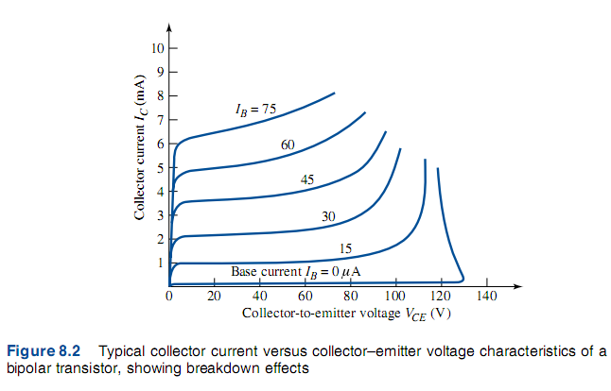



8.2 Power Transistor
8.2.1 Power BJTs

Slide 9
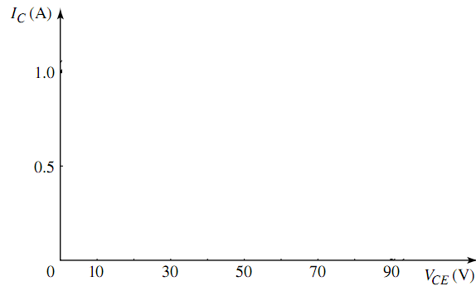

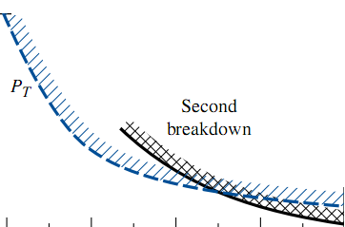
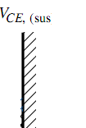
8.2 Power Transistor
8.2.1 Power BJTs

Slide 10
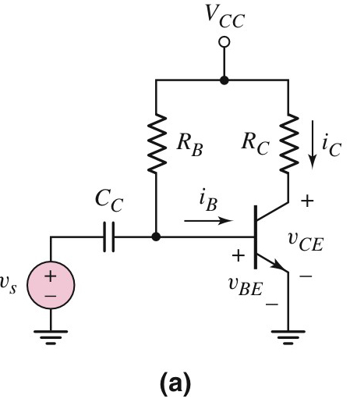
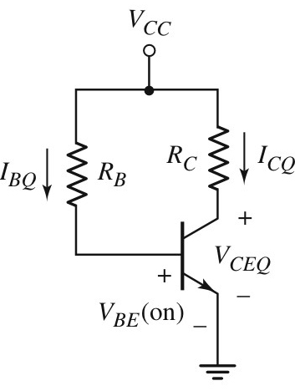
8.2 Power Transistor

Slide 11
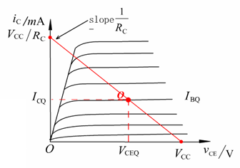

8.2 Power Transistor

Slide 12
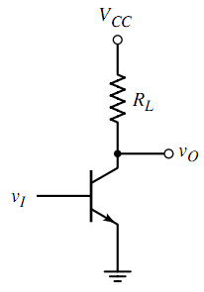


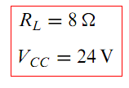


8.2 Power Transistor
8.2.1 Power BJTs
Which region?
Saturation
Which region?
Cutoff

Slide 13



8.2 Power Transistor
8.2.1 Power BJTs

Slide 14
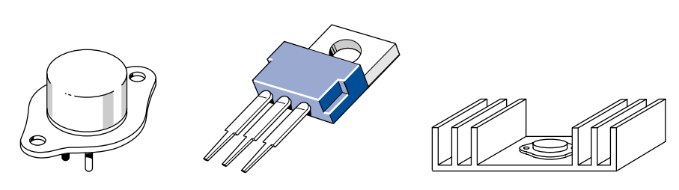
8.2 Power Transistor
8.2.2 Power MOSFETs
8.2.3 Comparison of Power MOSFETs and BJTs
8.2.4 Heat Sinks

Slide 15
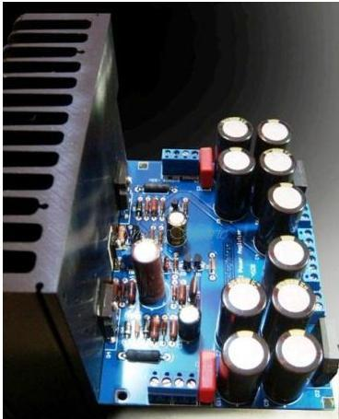
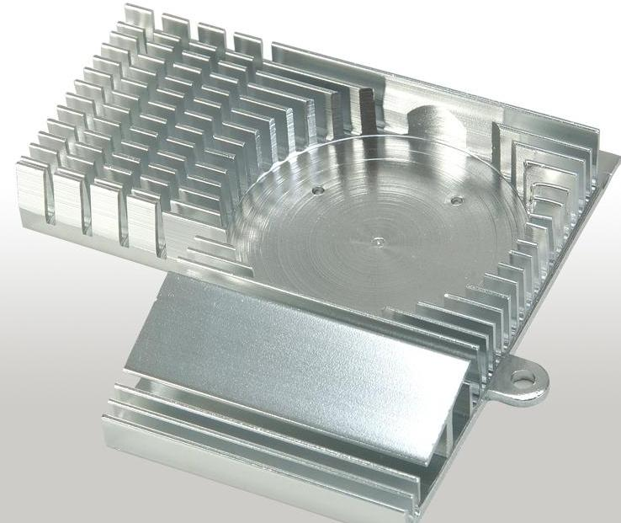
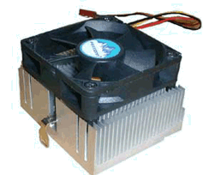
8.2 Power Transistor
8.2.4 Heat Sinks (P570)

Slide 16
Questions
and
Answers

