Slide 1


Huazhong University of Science and Technology
The Department of Electronics and Information Engineering
Electronic Circuit Analysis and Design
Dr. Tianping Deng
Email: dengtp@hust.edu.cn

Slide 2
Contents
PART 1 SEMICONDUCTOR DEVICES AND BASIC APPLICATIONS
Chapter 1 Semiconductor Materials and Diodes
Chapter 2 Diode Circuits
Chapter 3 The Field-Effect Transistor
Chapter 4 Basic FET Amplifiers
Chapter 5 The Bipolar Junction Transistor
Chapter 6 Basic BJT Amplifiers
Chapter 7 Frequency Response
Chapter 8 Output Stages and Power Amplifiers
PART 2 ANALOG ELECTRONICS
Chapter 9 Ideal Operational Amplifiers and Op-Amp Circuits
Chapter 10 Integrated Circuit Biasing and Active Loads
Chapter 11 Differential and Multistage Amplifiers
Chapter 12 Feedback and Stability
Chapter 13 Operational Amplifier Circuits
Chapter 14 Nonideal Effects in Operational Amplifier Circuits
Chapter 15 Applications and Design of Integrated Circuits
Chapter 9 Ideal Operational Amplifiers and Op-Amp Circuits

Slide 3
Ch9 The Ideal Operational Amplifier
9.0 Preview
9.1 The Operational Amplifier
9.2 Inverting Amplifier
9.3 Summing Amplifier
9.4 Noninverting Amplifier
9.5 Op-Amp Application

Slide 4
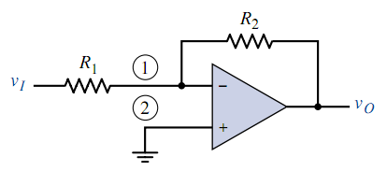
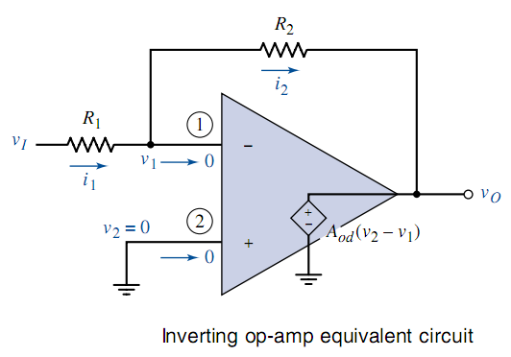
9.2 Inverting Amplifier

Slide 5

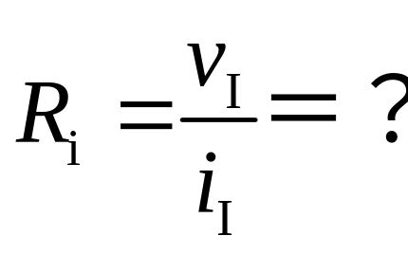
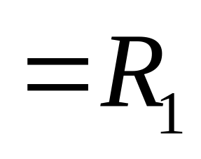
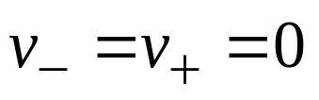
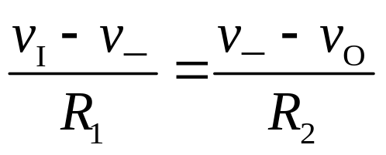
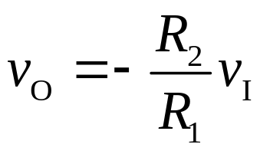
9.2 Inverting Amplifier
v₊ = 0
Virtual short.
v₊ =v₋
v₋ = 0
Virtual ground
Virtual open
Simulation
v_{O} is out of phase with respect to v_{I} by 180º.

Slide 6
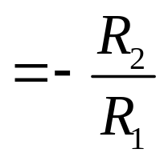
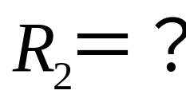
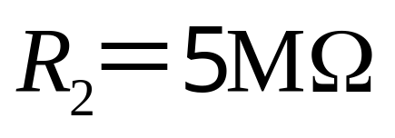
9.2 Inverting Amplifier

Slide 7
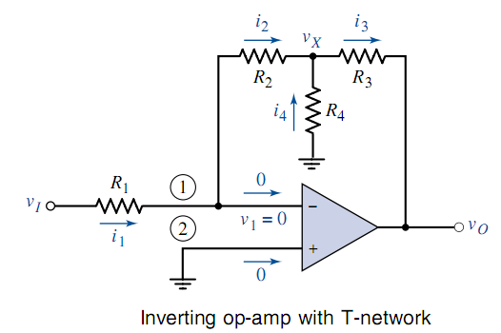



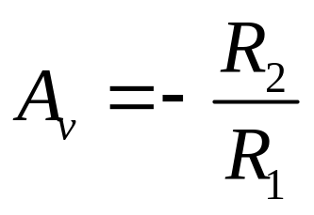

9.2 Inverting Amplifier
Virtual short.
Virtual open

Slide 8
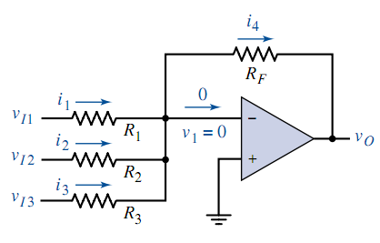
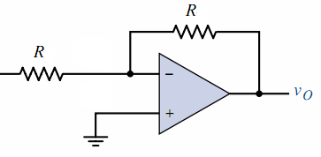
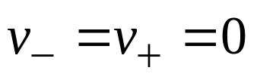
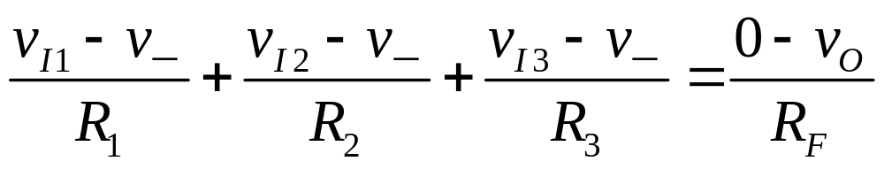
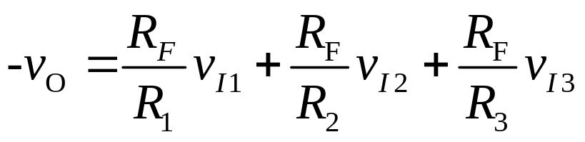
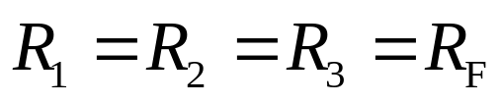

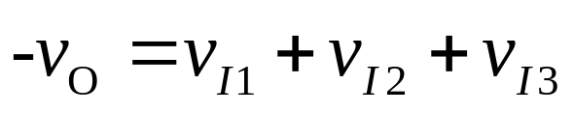
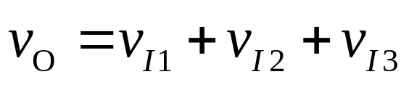
9.3 Summing Amplifier
If

Slide 9
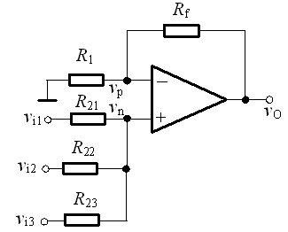


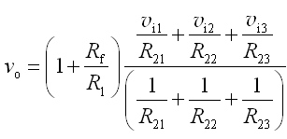

9.3 Summing Amplifier

Slide 10
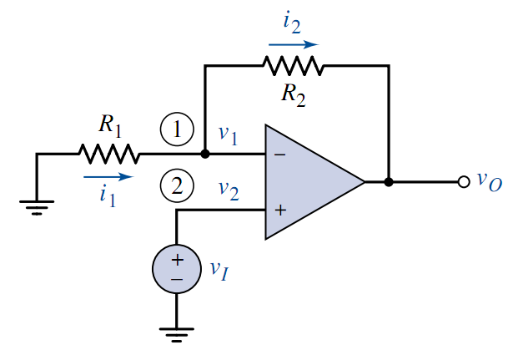
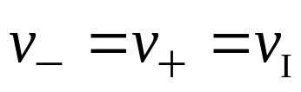
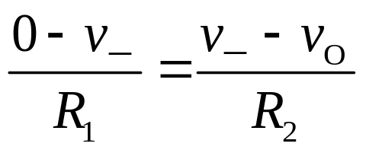
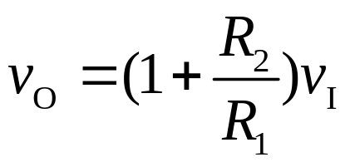
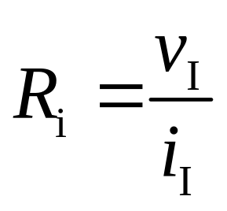
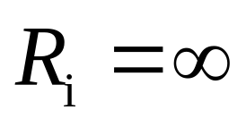
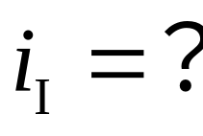
9.4 Noninverting Amplifier
According to virtual short
We get
v_{O} is in phase with v_{I}.
When R_{f} =0, v_{O} follows v_{I} .
Simulation

Slide 11



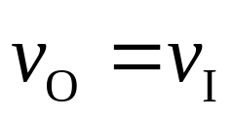
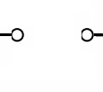
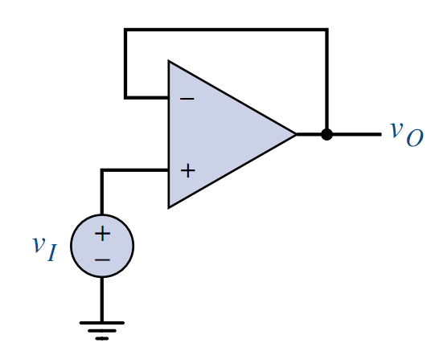
9.4 Noninverting Amplifier

Slide 12

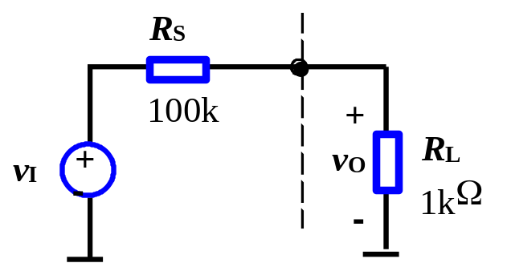
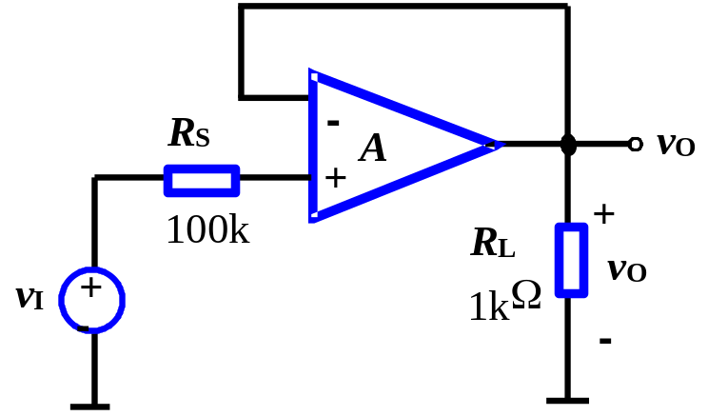
9.4 Noninverting Amplifier
Impedance transformer or buffer
The properties of voltage follower are:
Input resistance is essentially infinite.
Output resistance is essentially zero.
When output impedance of source is large, buffer is used to prevent loading effect.
Buffer

Slide 13
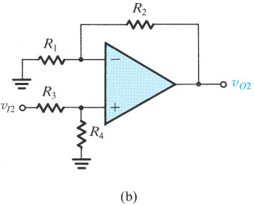

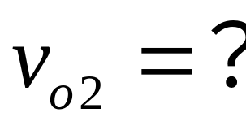
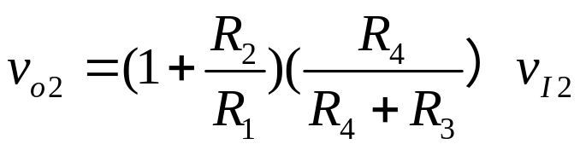
9.4 Noninverting Amplifier

Slide 14


The inverting amplifier and the noninverting amplifier
noninverting amplifier
inverting amplifier
circuit
A_{v}
R₁
R_{i}
0
0
R_{o}

Slide 15
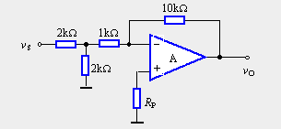
Example
Assume the operational amplifiers is ideal。
If the input voltage is +2V，
Determine V_{O}=?

Slide 16
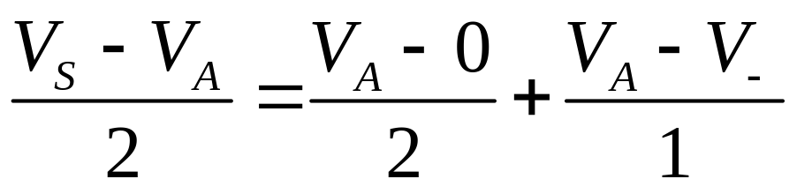
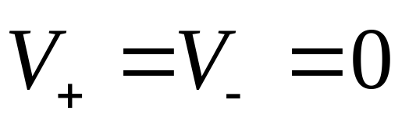
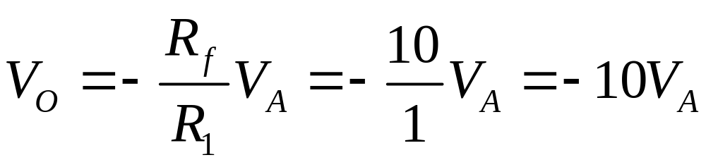
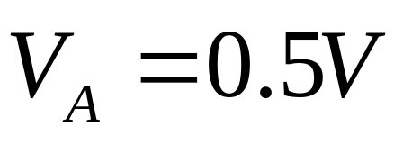
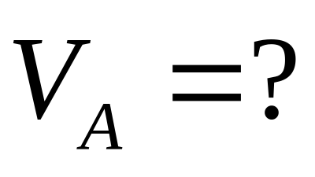
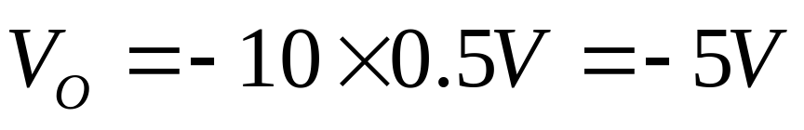
V_{A}

Slide 17
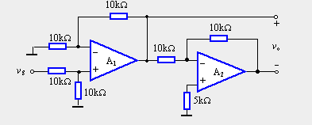
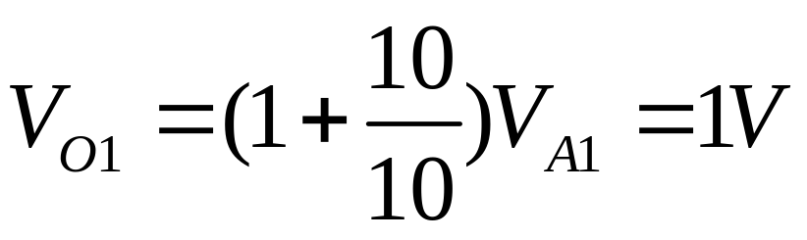
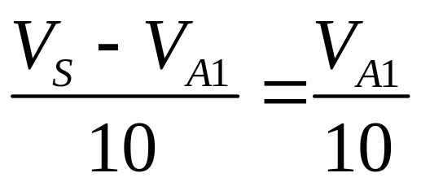
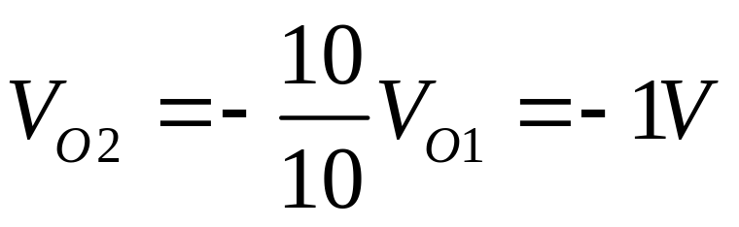
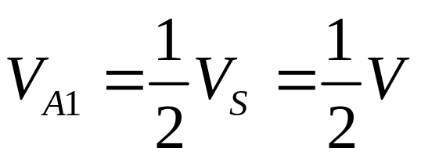
Example
Assume the operational amplifiers is ideal。
If the input voltage is +1V，Determine V_{O}=?
=V₀₁-V_{O2}=2V
V_{A1}
V_{O1}
V_{O2}

Slide 18
Questions
and
Answers

