Slide 1

Huazhong University of Science and Technology
The Department of Electronics and Information Engineering
Electronic Circuit Analysis and Design
Electronic Circuit Analysis and Design
Dr. Tianping Deng
Email: dengtp@hust.edu.cn

Slide 2
Contents
PART 1 SEMICONDUCTOR DEVICES AND BASIC APPLICATIONS
Chapter 1 Semiconductor Materials and Diodes
Chapter 2 Diode Circuits
Chapter 3 The Field-Effect Transistor
Chapter 4 Basic FET Amplifiers
Chapter 5 The Bipolar Junction Transistor
Chapter 6 Basic BJT Amplifiers
Chapter 7 Frequency Response
Chapter 8 Output Stages and Power Amplifiers
PART 2 ANALOG ELECTRONICS
Chapter 9 Ideal Operational Amplifiers and Op-Amp Circuits
Chapter 10 Integrated Circuit Biasing and Active Loads
Chapter 11 Differential and Multistage Amplifiers
Chapter 12 Feedback and Stability
Chapter 13 Operational Amplifier Circuits
Chapter 14 Nonideal Effects in Operational Amplifier Circuits
Chapter 15 Applications and Design of Integrated Circuits
Chapter 1 Semiconductor Materials and Diodes

Slide 3
Ch1. Semiconductor Materials and Diodes
1.1 Semiconductor Materials and Properties
1.2 The PN Junction
1.3 Diode Circuits DC Analysis and Models
1.4 Diode Circuits AC Equivalent Circuit
1.5 Other Diode Types
1.6 Design Application: Diode Thermometer
1.7 Summary

Slide 4
1.1 Semiconductor Materials and Properties
1.1.1 Intrinsic Semiconductor
1.1.2. Extrinsic Semiconductor
N-type semiconductor
P-type semiconductor

Slide 5
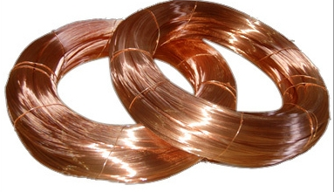

Ch1. Semiconductor Materials and Diodes
1.1 Semiconductor Materials and Properties
1.1.1. Intrinsic Semiconductor
Materials
electric current can flow freely
Conductor
Insulator
Semiconductor
:Low resistivity
Metals such as copper
:High resistivity
Glass, plastics, ceramics
: silicon, germanium, gallium arsenide
Conductivity lies between that of conductors and insulators
An integrated circuit (IC) or other electronic component
containing a semiconductor as a base material.

Slide 6

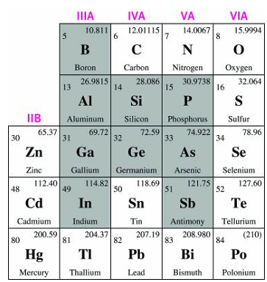





Silicon Valley
Periodic Table of the Elements

Slide 7
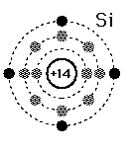
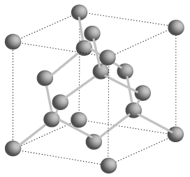
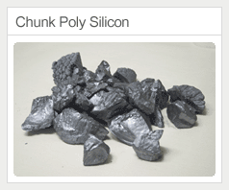
1.1.1 Intrinsic Semiconductor
1. Silicon, germanium__single-crystal structure
At temperature T=0ºK, silicon is an insulator.
valence electrons
The electrons in the outermost shell

Slide 8
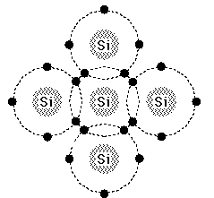


1.1.1 Intrinsic Semiconductor
Each S_{i} atom shares one
electron with each of its
four nearest neighbors
so that its valence band
will have a full 8 electrons.

Slide 9
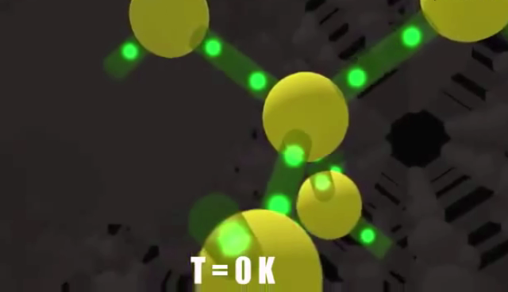
1.1.1 Intrinsic Semiconductor

Slide 10
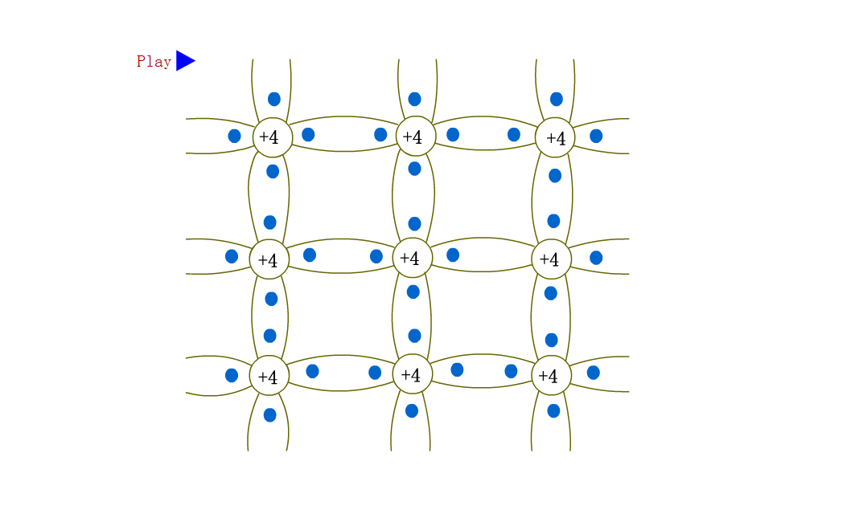
1.1.1 Intrinsic Semiconductor
When T increases, free electrons and “holes”are created

Slide 11
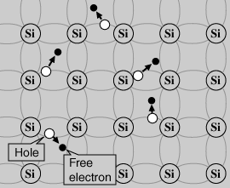
1.1.1 Intrinsic Semiconductor
In pure semiconductor, the concentration of electrons and holes are equal, and very small, so it has very small conductivity.
electron-hole pairs

Slide 12
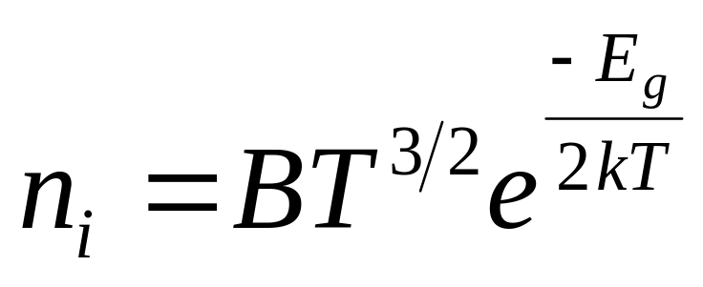
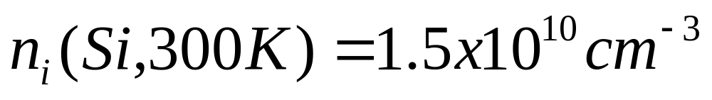
1.1.1 Intrinsic Semiconductor
Intrinsic Carrier Concentration
B – coefficient related to specific semiconductor
T – temperature in Kelvin
E_{g} – semiconductor band gap energy
k – Boltzmann constant

Slide 13






1.1.1 Intrinsic Semiconductor

Slide 14
Two types of Carriers
Free electron---
produced by thermal ionization.
It can move freely in the lattice structure so as to form current.
Hole---
empty position in broken covalent bond.
It can be filled by free electron (recombination).
A free electron is negative charge and a hole is positive charge.

Slide 15

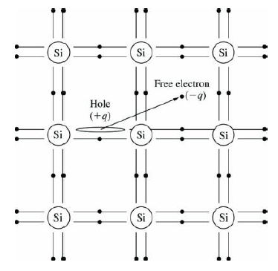
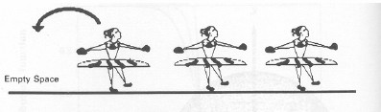

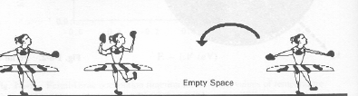


1.1.1 Intrinsic Semiconductor
Empty
space
Empty
space
Empty
space
Empty
space
A hole can be regarded as a positive charge carrier
Does the hole can move through the crystal freely?

Slide 16
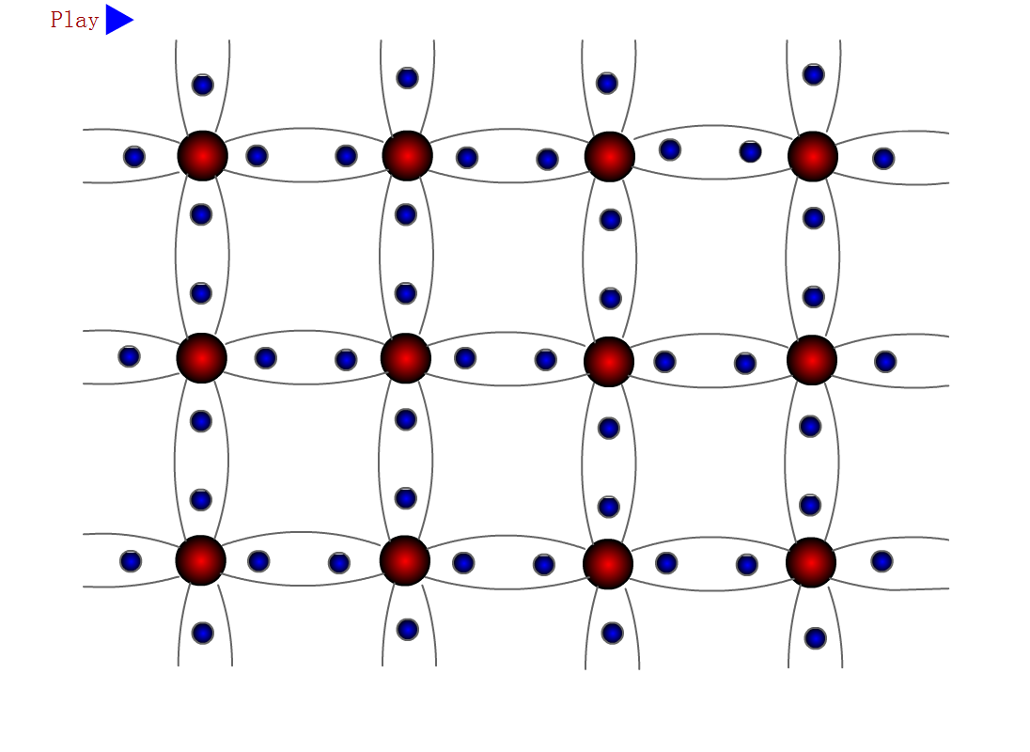

Slide 17

1.1.1 Intrinsic Semiconductor

Slide 18
1.1.2. Extrinsic Semiconductor
●The electron and hole concentrations in an intrinsic
semiconductor are relatively small.
●The concentrations can be greatly increased by adding
controlled amounts of certain impurities.

Slide 19
1.1.2. Extrinsic Semiconductor
Doped Semiconductor——n type
Si
Si
Si
Donor
Free E
＋
P
Si
Si
Si
bound charge
Si
Si
Si

Slide 20
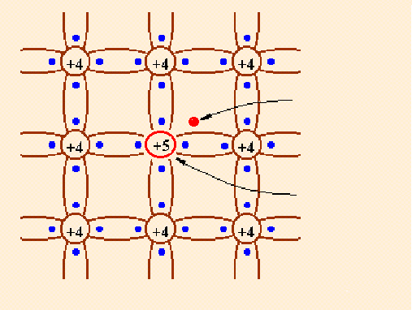
1.1.2. Extrinsic Semiconductor
1. phosphorus+silicon=N-type semiconductor
Holes present because of thermal energy
What are the majority carriers in n-type materials?
What are the minority carriers in n-type materials?
N-type semiconductor material
(phosphorus)
  donor: provide free electrons
  majority carrier – electrons
  minority carrier – holes
electron
Donor Impurity
Positive charge
N-type semiconductor

Slide 21
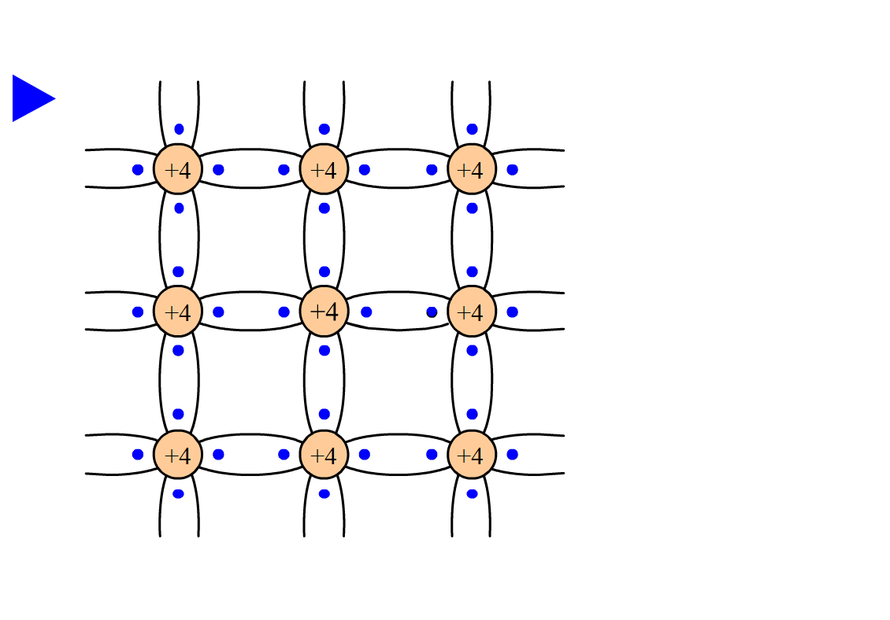

Slide 22
n type Semiconductor
Donor--- pentavalent impurity provides free electrons, usually entirely ionized.
Positive bound charge---impurity atom donating electron gives rise to positive bound charge.
Majority carriers---free electrons (mostly generated by ionized donor and a very tiny portion by thermal ionization) .
Minority carriers---holes (only generated by thermal ionization) .

Slide 23
1.1.2. Extrinsic Semiconductor
Doped Semiconductor——p type
Si
Si
Si
Acceptor
Si
Si
Al
Si
Al
––
Bound
charge
Si
Si
Si
Hole

Slide 24
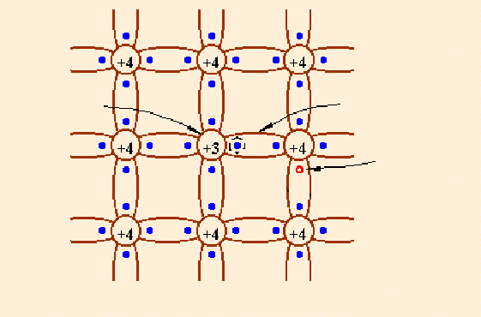
1.1.2. Extrinsic Semiconductor
2. boron+silicon=P-type semiconductor
What are the majority carriers in P-type materials?
What are the minority carriers in P-type materials?
P-type semiconductor
material (Boron)
  acceptor: accept an extra electrons
  majority carrier – holes
  minority carrier – electrons
P-type semiconductor

Slide 25
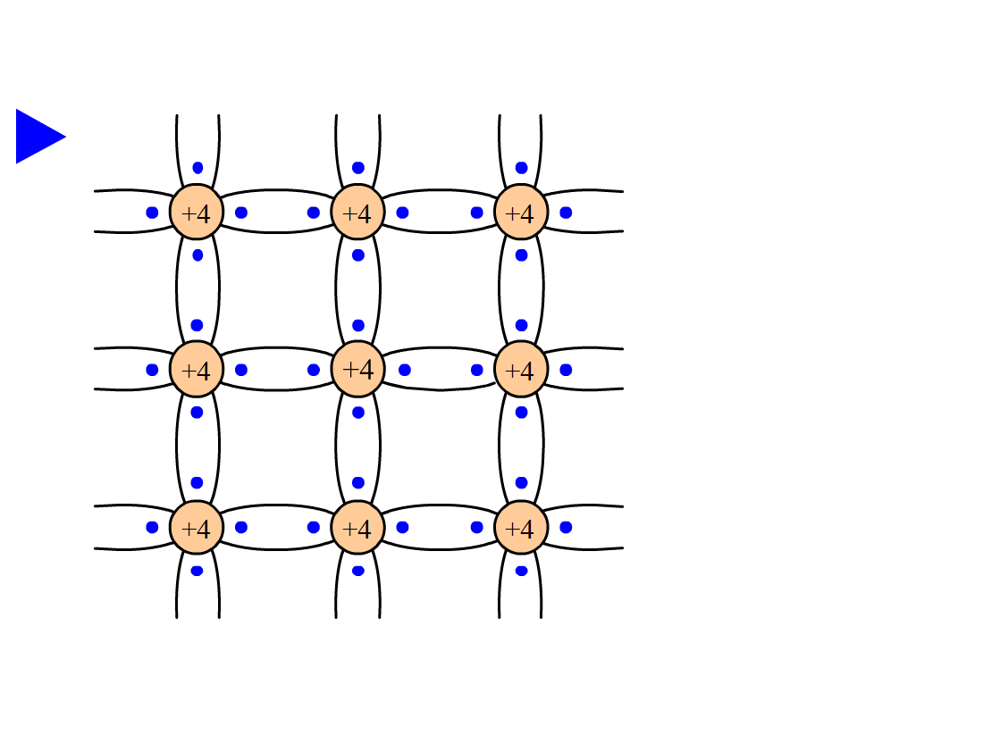

Slide 26
p type Semiconductor
Acceptor--- trivalent impurity provides holes, usually entirely ionized.
Negative bound charge--- impurity atom accepting hole give rise to negative bound charge
Majority carriers---holes (mostly generated by ionized acceptor and a tiny small portion by thermal ionization)
Minority carriers--- free electrons (only generated by thermal ionization.)

Slide 27
1.1.2. Extrinsic Semiconductor
1. phosphorus+silicon=N-type semiconductor
Positive Charges + holes =electrons
minority carrier
majority carrier
Doping
Temperature
2. boron+silicon=P-type semiconductor
Negative Charges + electrons = holes
majority carrier
minority carrier
Temperature
Doping

Slide 28
Conclusion on the doped semiconductor
Majority carrier is only determined by the impurity, but independent of temperature.
Minority carrier is strongly affected by temperature.

Slide 29
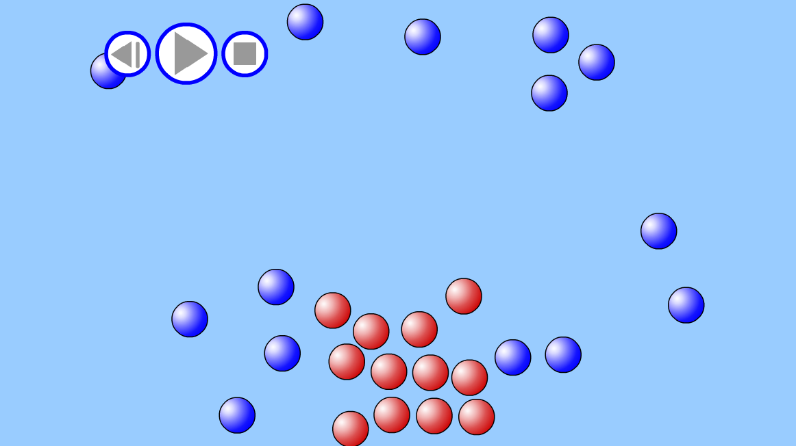
1.1.3. Drift and Diffusion Currents
Diffusion: a concentration of charge carriers tends to spread with time

Slide 30

1.1.3. Drift and Diffusion Currents
Diffusion: a concentration of charge carriers tends to spread with time
Drift: The average motion of the charge carriers due to an applied
electric field.

Slide 31
Questions
and
Answers

