Slide 1

Huazhong University of Science and Technology
The Department of Electronics and Information Engineering
Electronic Circuit Analysis and Design
Dr. Tianping Deng
Email: dengtp@hust.edu.cn

Slide 2
Contents
PART 1 SEMICONDUCTOR DEVICES AND BASIC APPLICATIONS
Chapter 1 Semiconductor Materials and Diodes
Chapter 2 Diode Circuits
Chapter 3 The Field-Effect Transistor
Chapter 4 Basic FET Amplifiers
Chapter 5 The Bipolar Junction Transistor
Chapter 6 Basic BJT Amplifiers
Chapter 7 Frequency Response
Chapter 8 Output Stages and Power Amplifiers
PART 2 ANALOG ELECTRONICS
Chapter 9 Ideal Operational Amplifiers and Op-Amp Circuits
Chapter 10 Integrated Circuit Biasing and Active Loads
Chapter 11 Differential and Multistage Amplifiers
Chapter 12 Feedback and Stability
Chapter 13 Operational Amplifier Circuits
Chapter 14 Nonideal Effects in Operational Amplifier Circuits
Chapter 15 Applications and Design of Integrated Circuits
Chapter 1 Semiconductor Materials and Diodes

Slide 3
Ch1. Semiconductor Materials and Diodes
1.1 Semiconductor Materials and Properties
1.2 The PN Junction
1.3 Diode Circuits DC Analysis and Models
1.4 Diode Circuits AC Equivalent Circuit
1.5 Other Diode Types
1.6 Design Application: Diode Thermometer
1.7 Summary

Slide 4
1.2 The PN Junction
1.2.1 The Equilibrium PN Junction
1.2.2 Reverse-Biased PN Junction
1.2.2 Forward-Biased PN Junction
1.2.4 Ideal current –voltage relationship
1.2.5 PN Junction Diode

Slide 5
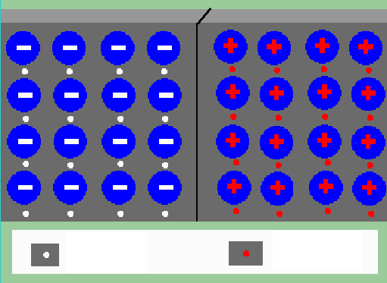
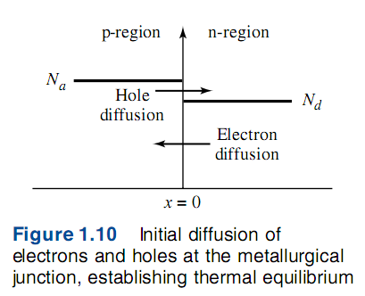
1.2 The PN Junction
1.2.1 The Equilibrium PN Junction
Holes diffuse from P- to N-region.
Electrons diffuse from N- to P-region
P
N
hole
Electron

Slide 6
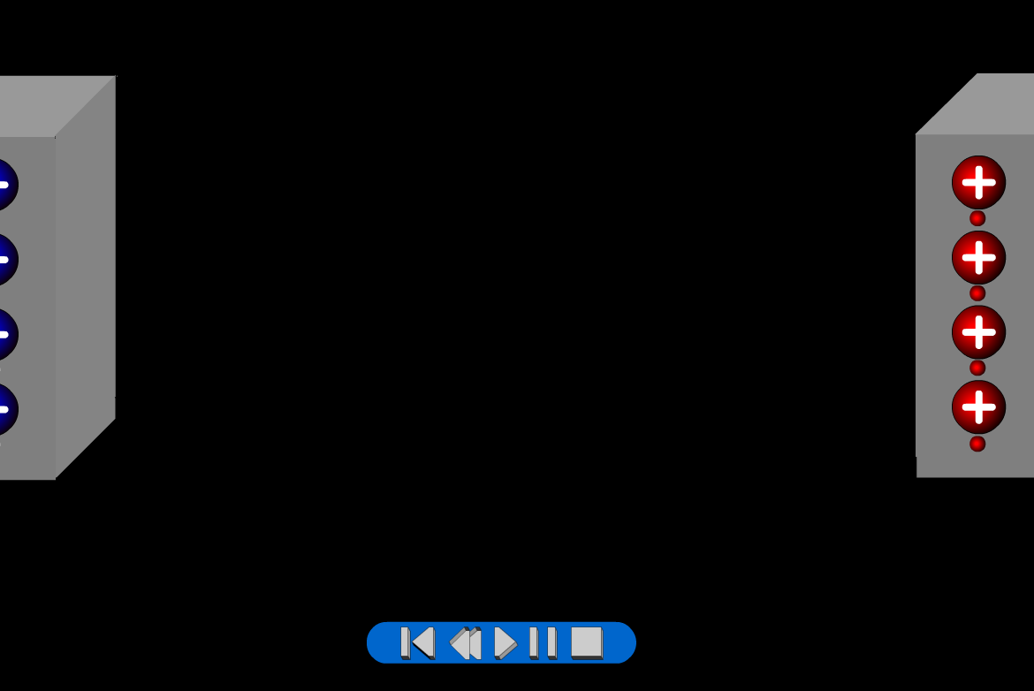
1.2 The PN Junction

Slide 7
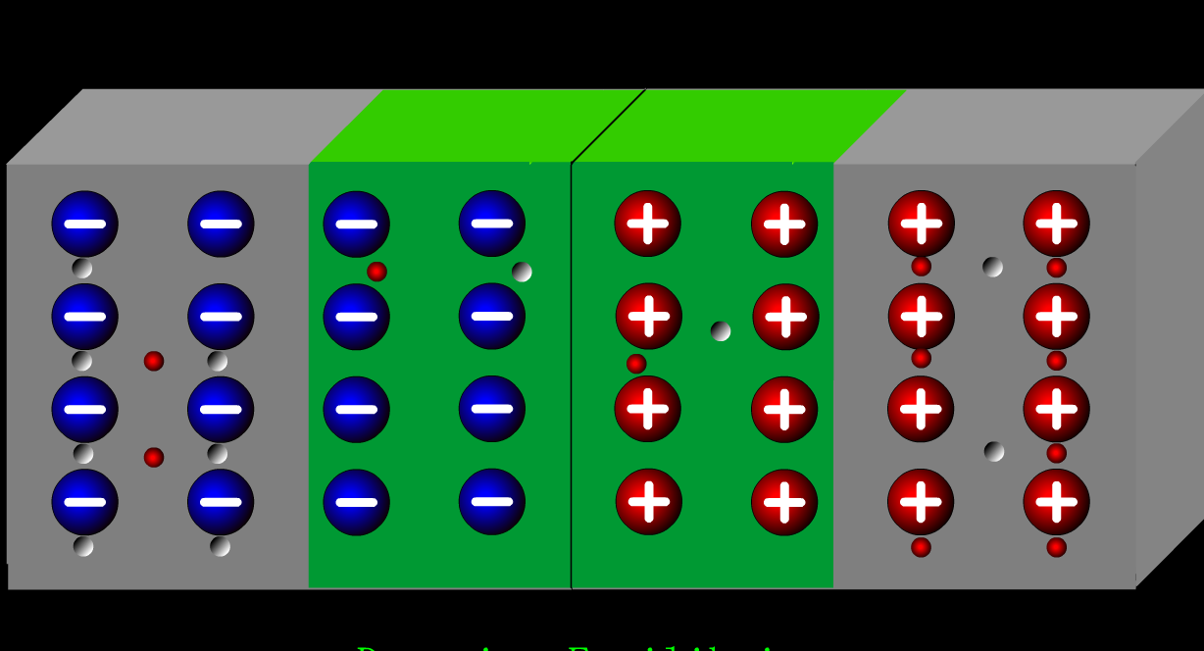
1.2.1 The Equilibrium PN Junction
1. Depletion region(space-charge region)_PN junction
2. Electric field
PN Junction

Slide 8
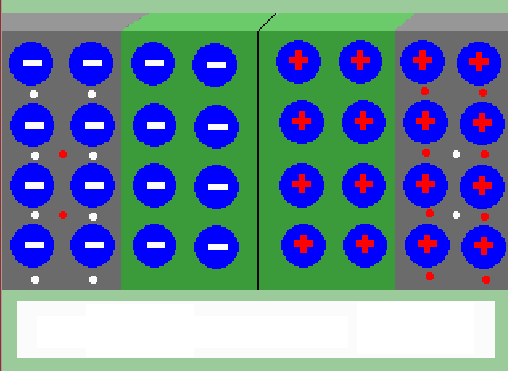
1.2.1 The Equilibrium PN Junction
1. Depletion region(space-charge region)_PN junction
2. Electric field
3. Drift current I_{DR} = diffusion current I_{DF} _Balance
P
N
I_{DF}
I_{DR}

Slide 9
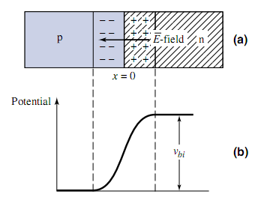
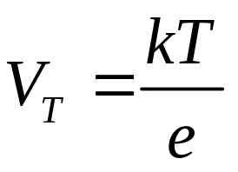



1.2.1 The Equilibrium PN Junction

Slide 10
1.2.1 The Equilibrium PN Junction
The procedure of forming pn the dynamic equilibrium of drift and diffusion movements for carriers in the silicon.
In detail, there are 4 steps:
  Diffusion
  Space charge region
  Drift
  Equilibrium

Slide 11
1.2.2 Reverse-Biased PN Junction
Positive voltage is applied to N, reverse-biased PN.
The two fields are in the same direction. The results are:

Slide 12
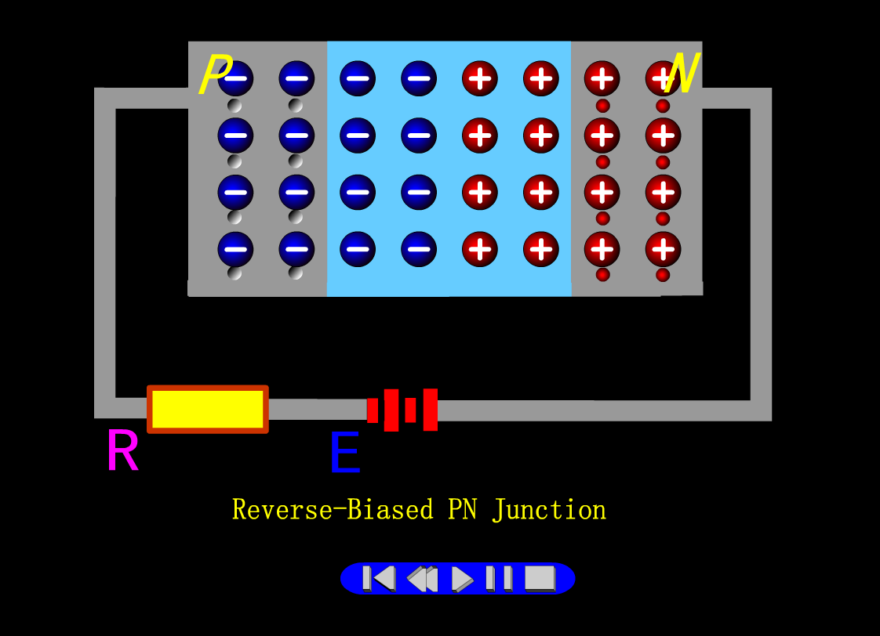

Slide 13
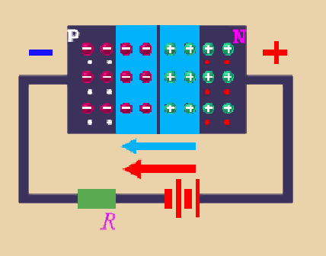
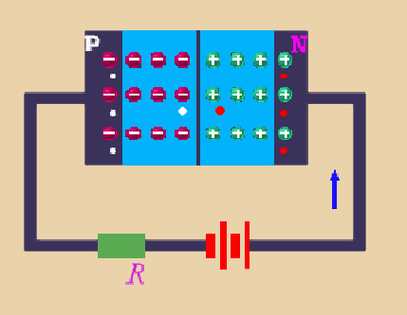
1.2.2 Reverse-Biased PN Junction
Positive voltage is applied to N, reverse-biased PN.
The two fields are in the same direction. The results are:
1. Depletion region is increased, high resistance.
2. Majority carriers cannot cross the junction. Minority carriers sweep across
PN easily.
I_{DF}<<I_{DR} , i_{D}=I_{DR}
D-region electric field
i_{D}
Applied electric field
v_{D}
v_{D}

Slide 14
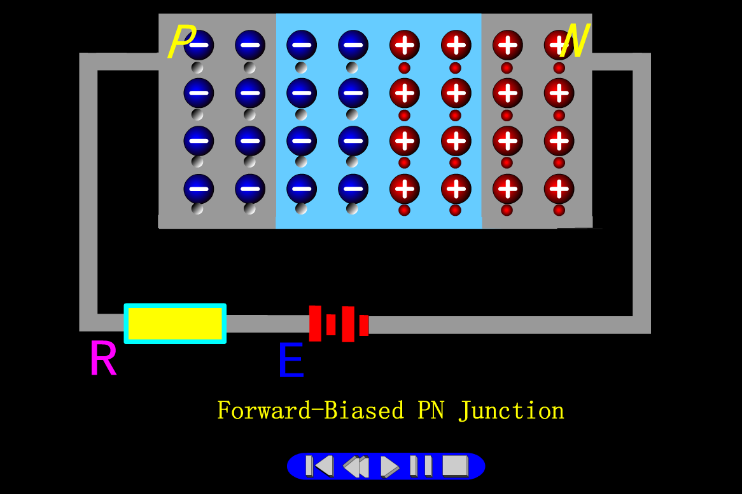
1.2.3 Forward-Biased PN Junction

Slide 15
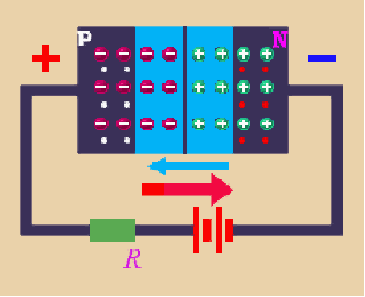
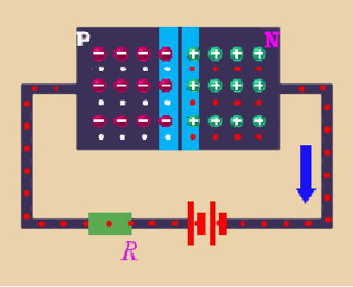
1.2.3 Forward-Biased PN Junction
Positive voltage is applied to P, forward-biased PN.
The two fields are opposite. The results are:
1. Depletion region is reduced, low resistance.
D-region electric field
2. Majority carriers flow across PN junction more easily.
I_{DF}>>I_{DR} , i_{D}=I_{DF}－I_{DR}
i_{D}
v_{D}
v_{D}
Applied electric field

Slide 16
Depletion region is reduced,
low resistance.
Depletion region is increased,
high resistance.
i_{D}
i_{D}
v_{D}
v_{D}
Reverse-Biased PN Junction
Forward-Biased PN Junction

Slide 17
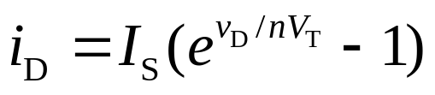
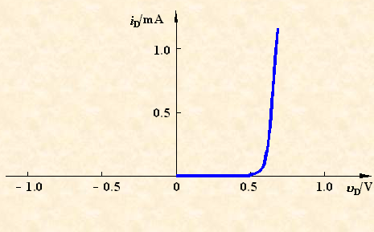
1.2.4 Ideal IV relationship
3. The current-voltage (v-i) characteristic
The current is an exponential function of voltage.
I_{S}__reverse-bias saturation current
V_{T} __thermal voltage at room temperature
V_{T} =0.026V
4. V_{γ} __turn-on, cut-in
voltage

Slide 18
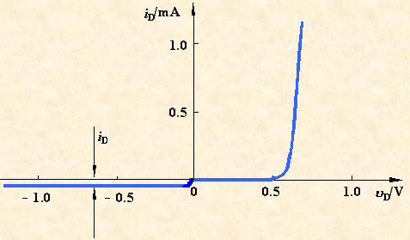
1.2.4 Ideal IV relationship
The reverse current flow will be due to the drift current I_{DR}, known as the reverse saturation (or leakage) current I_{S}.

Slide 19
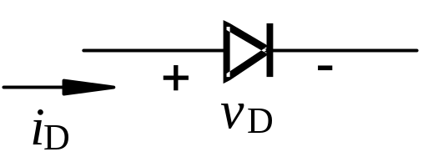
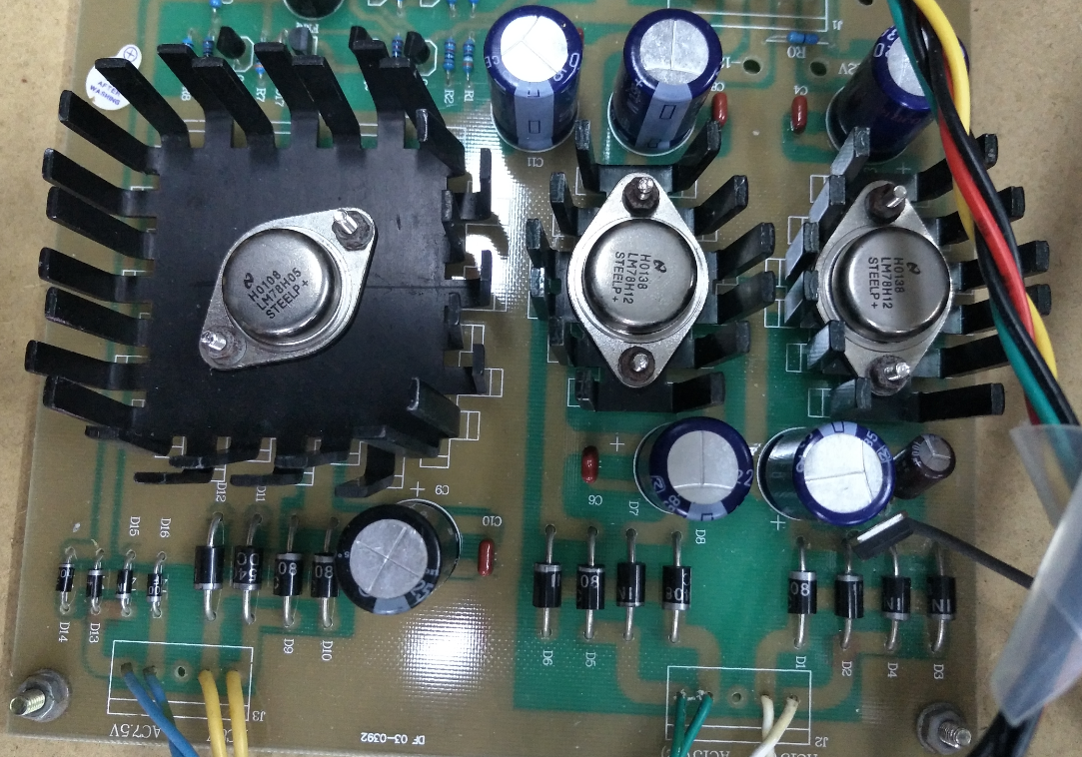
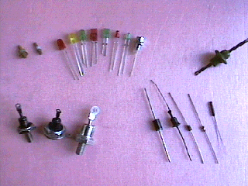
1.2.5 PN Junction Diode
1. Diode__ has one PN junction in it
circuit symbol
Photo of real diode

Slide 20
1.2.5 PN Junction Diode
Forward-bias
Region
Reverse-bias
Region

Slide 21
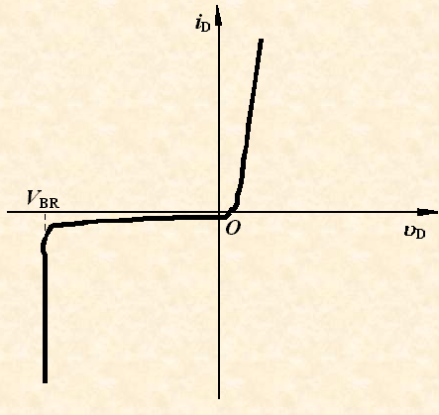

1.2.5 PN Junction Diode
3. Breakdown voltage
When the voltage is increased to some point, breakdown occurs and current increases rapidly. The voltage at this point is called the breakdown voltage.
Avalanche breakdown
Zener diode operate in
the breakdown region

Slide 22
Questions
and
Answers

