Slide 1

Huazhong University of Science and Technology
The Department of Electronics and Information Engineering
Electronic Circuit Analysis and Design
Dr. Tianping Deng
Email: dengtp@hust.edu.cn

Slide 2
Contents
PART 1 SEMICONDUCTOR DEVICES AND BASIC APPLICATIONS
Chapter 1 Semiconductor Materials and Diodes
Chapter 2 Diode Circuits
Chapter 3 The Field-Effect Transistor
Chapter 4 Basic FET Amplifiers
Chapter 5 The Bipolar Junction Transistor
Chapter 6 Basic BJT Amplifiers
Chapter 7 Frequency Response
Chapter 8 Output Stages and Power Amplifiers
PART 2 ANALOG ELECTRONICS
Chapter 9 Ideal Operational Amplifiers and Op-Amp Circuits
Chapter 10 Integrated Circuit Biasing and Active Loads
Chapter 11 Differential and Multistage Amplifiers
Chapter 12 Feedback and Stability
Chapter 13 Operational Amplifier Circuits
Chapter 14 Nonideal Effects in Operational Amplifier Circuits
Chapter 15 Applications and Design of Integrated Circuits
Chapter 1 Semiconductor Materials and Diodes

Slide 3
Ch1. Semiconductor Materials and Diodes
1.1 Semiconductor Materials and Properties
1.2 The PN Junction
1.3 Diode Circuits DC Analysis and Models
1.4 Diode Circuits AC Equivalent Circuit
1.5 Other Diode Types
1.6 Design Application: Diode Thermometer
1.7 Summary

Slide 4

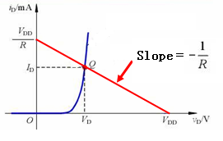
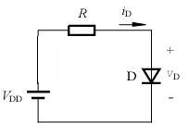


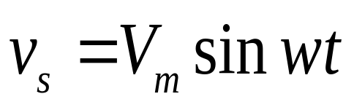
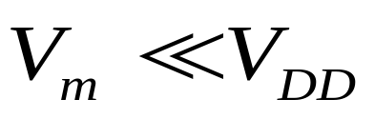
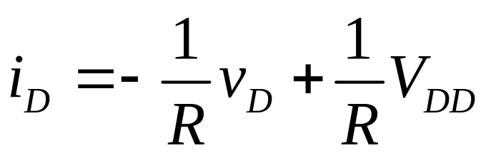
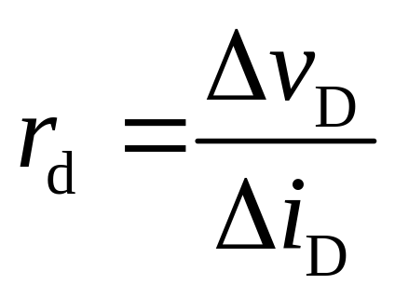

1.4 Diode Circuits:AC Equivalent circuit

Slide 5
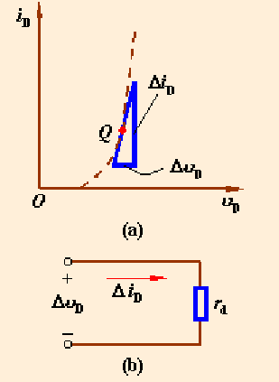
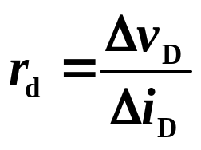
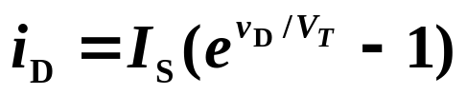
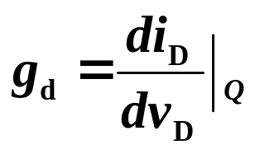
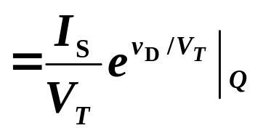
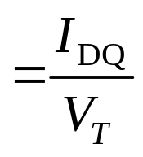
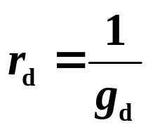
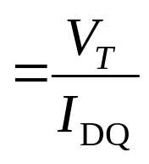
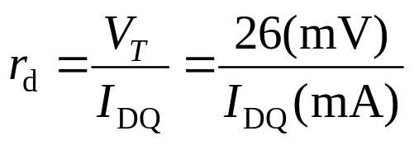
1.4 Diode Circuits:AC Equivalent circuit
Small signal model__AC model
When a diode is operating in the small range，it can be a small-signal incremental resistance.
That is:
∵
small-signal conductance
small-signal resistance
∴
Room T（T=300K）

Slide 6
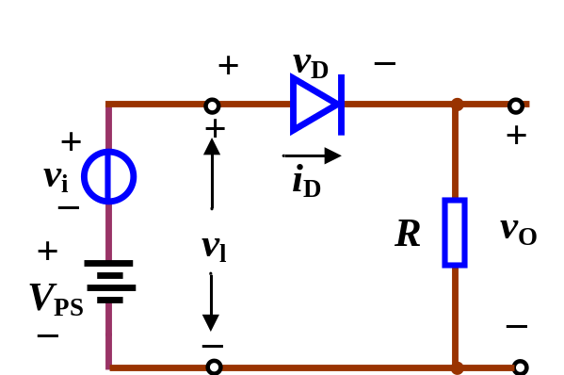

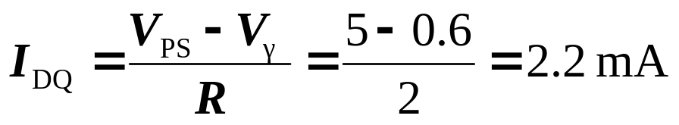
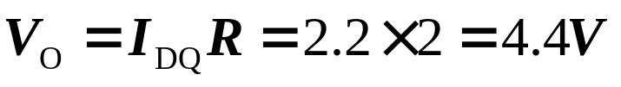
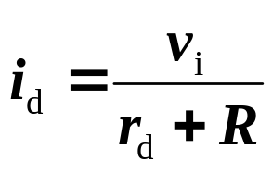
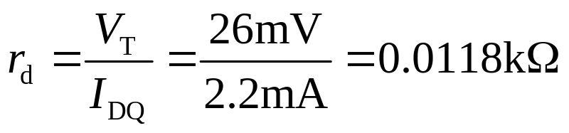

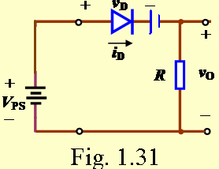
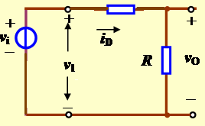
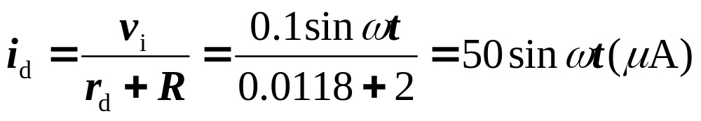

1.4.1 Sinusoidal Analysis
E.g.1.2. Determine the output voltage in Fig. 1.31. Assume circuit and parameter of V_{PS}=5V , R=2kΩ, V_{r}=0.6V ,and v_{i} =0.1sinwt(V).
Sol: because
(1) For the DC analysis, we set v_{i} =0, then
Fig. 1.31
(2) For the AC analysis, we set V_{PS} =0, then

Slide 7
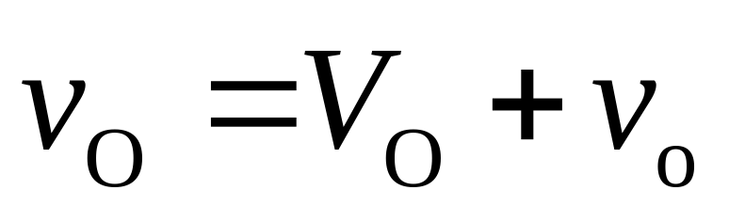
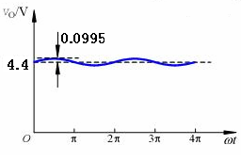

Slide 8
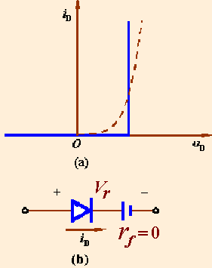
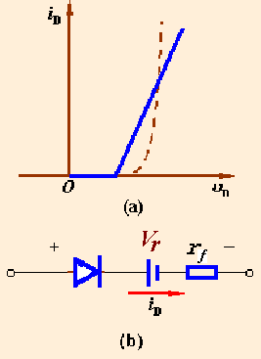
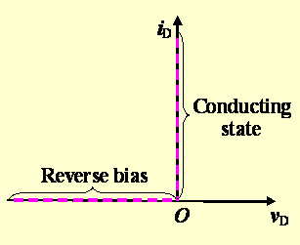
Review
Ideal model
Piecewise model
Small signal model
Case 1
Case 2

Slide 9

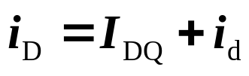
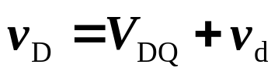
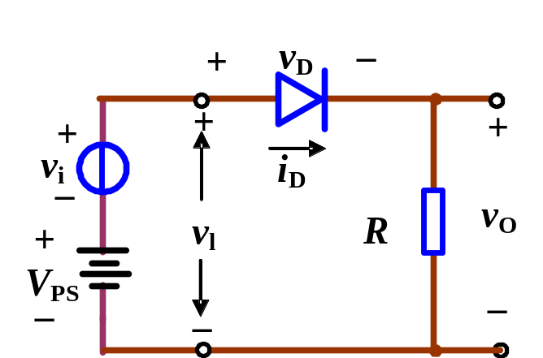

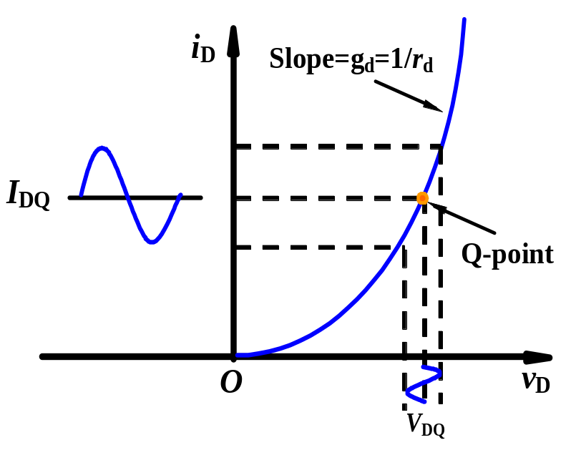
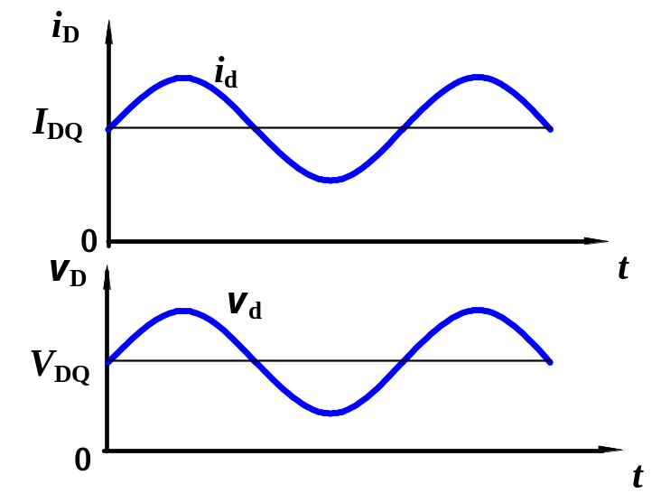
1.4 Diode Circuits_AC Equivalent Circuit
1.4.1 Sinusoidal Analysis

Slide 10

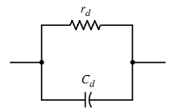
1.4 Diode Circuits_AC Equivalent Circuit
1.4.2 Small-Signal Equivalent Circuit

Slide 11
Ch1. Semiconductor Materials and Diodes
1.1 Semiconductor Materials and Properties
1.2 The PN Junction
1.3 Diode Circuits DC Analysis and Models
1.4 Diode Circuits AC Equivalent Circuit
1.5 Other Diode Types
1.6 Design Application: Diode Thermometer
1.7 Summary

Slide 12

1.5 Other Diode Types
1.5.1 Solar Cell
1.5.2 Photodiode
1.5.3 Light-Emitting Diode (LED)
1.5.4 Schottky Barrier Diode
1.5.5 Zener Diode

Slide 13

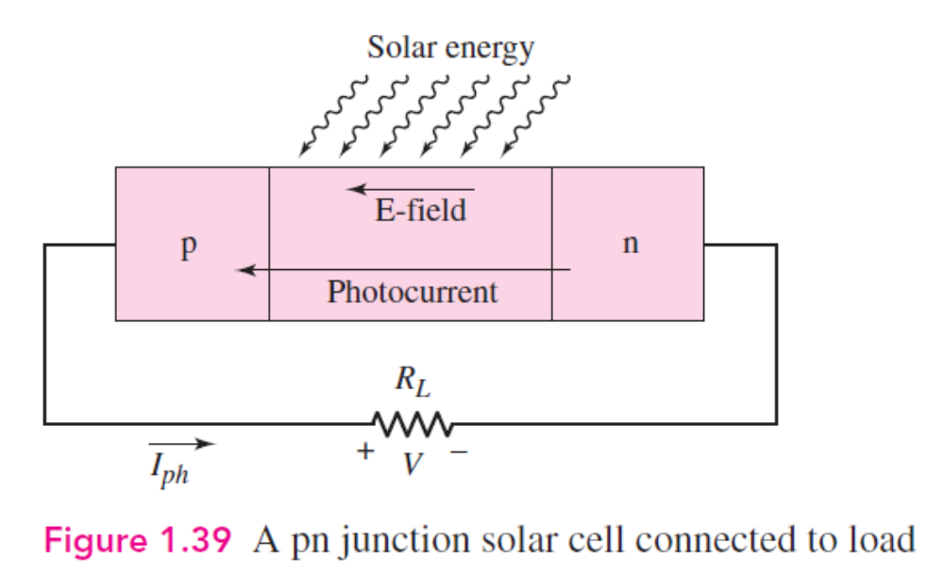

1.5.1 Solar Cell
satellite
space ship

Slide 14
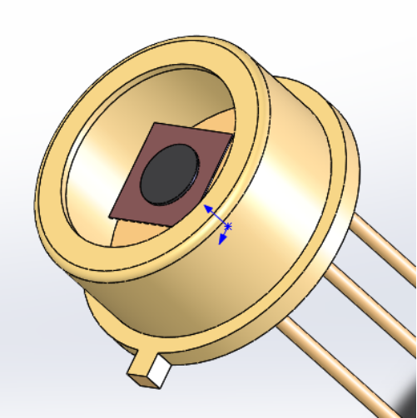
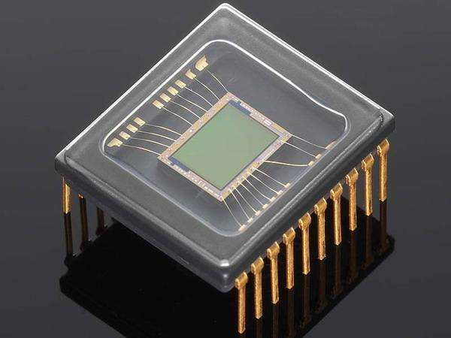
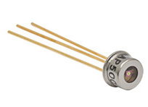
1.5.2 Photodiode
A photodiode is an electrical device used to detect and convert light into an energy signal through the use of a photodetector.
The photodiode can use a fiber optic element to deliver the light to the diode circuit to convert it to energy.
Charge Coupled Devices

Slide 15
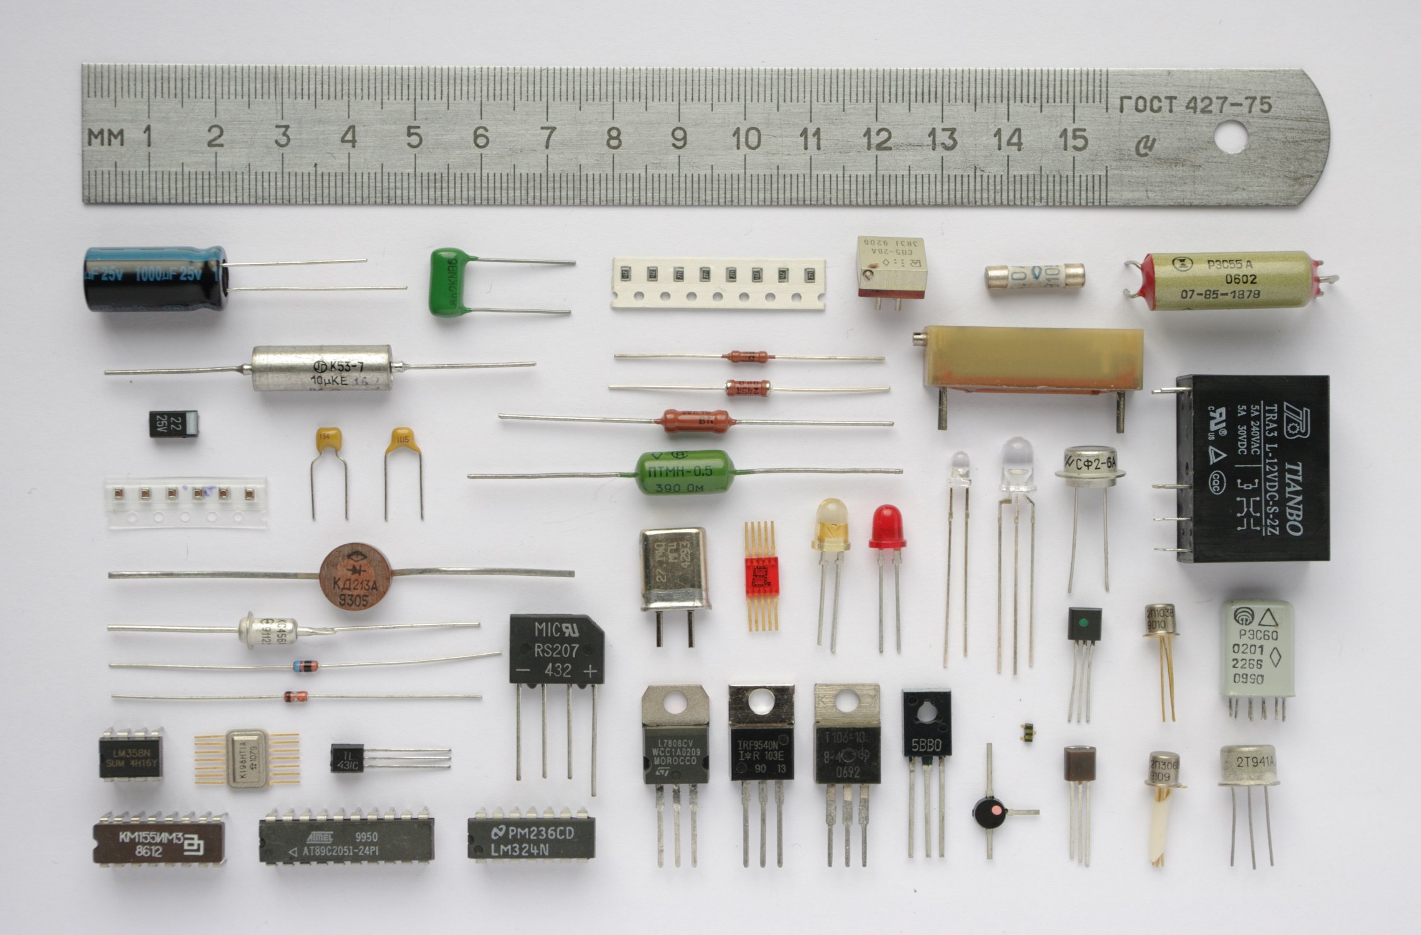
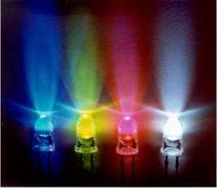

1.5.3 Light-Emitting Diode (LED)

Slide 16
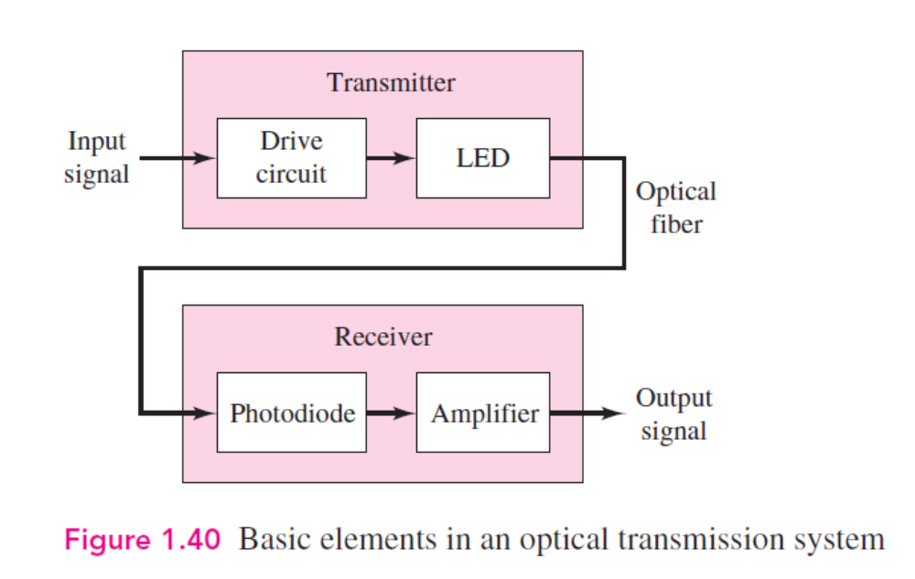
1.5.3 Light-Emitting Diode (LED)
light
current
light
voltage/current

Slide 17

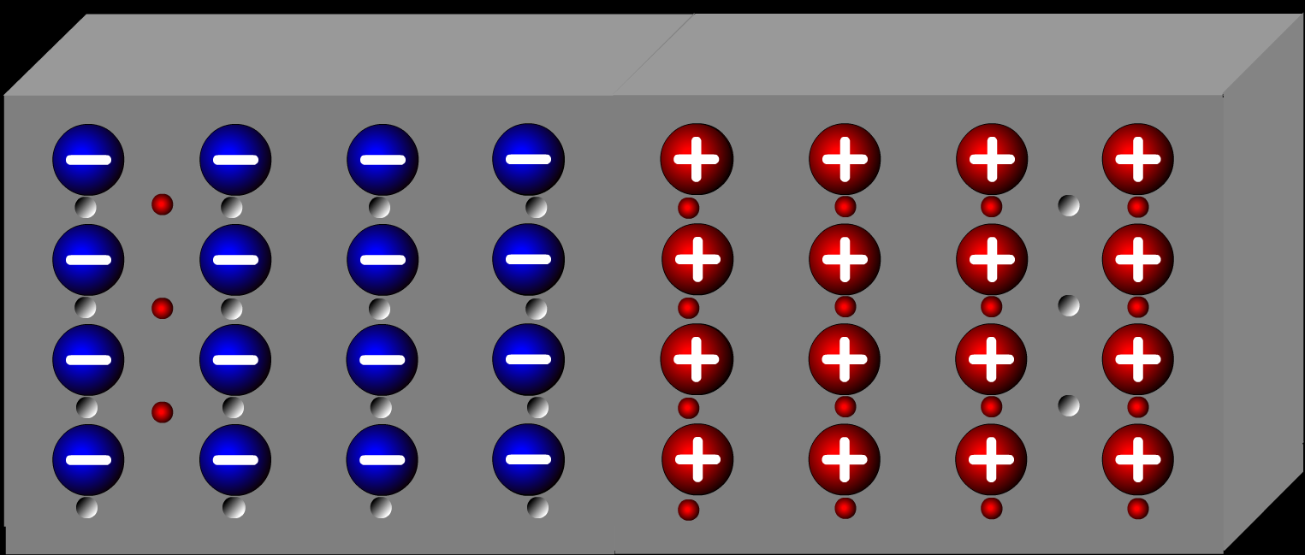

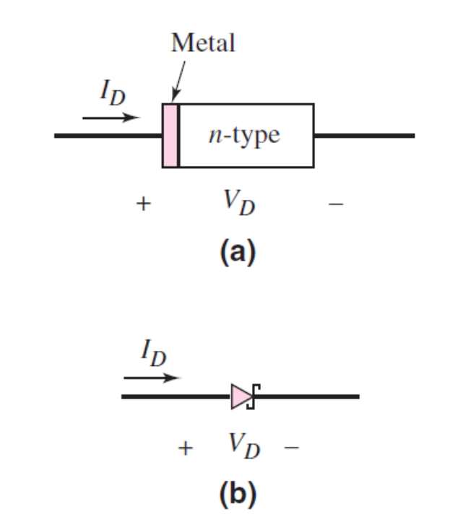
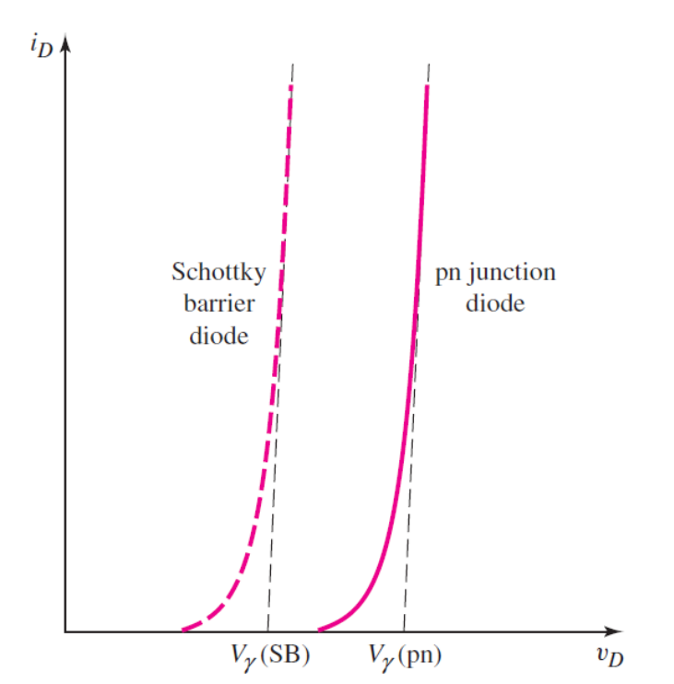
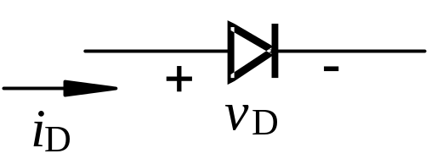

1.5.4 Schottky Barrier Diode
P
N
Aluminum
N

Slide 18
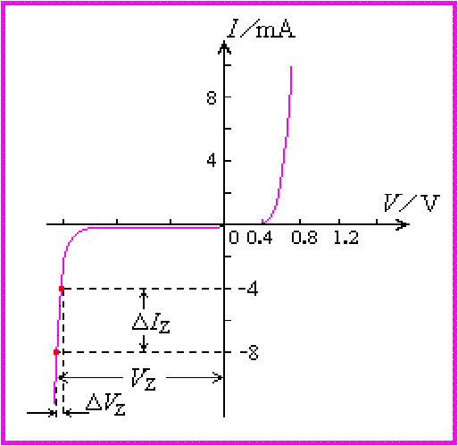
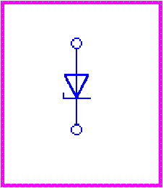
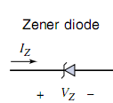
1.5.5 Zener Diode
1. Symbol and I-V characteristic
Zener diodes can be operated in the breakdown region by limiting the current to the capabilities of the diodes.
(a) symbol
(b) I-V characteristic

Slide 19
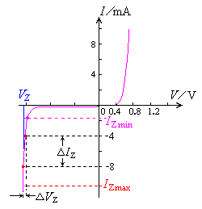
1.5.5 Zener Diode
2. Parameters
V_{Z} __ Zener breakdown voltage
r_{Z} __Incremental resistance
r_{Z} =ΔV_{Z} /ΔI_{Z}
I_{Z} __ Reverse-bias current when the diode is operating in the breakdown region.

Slide 20
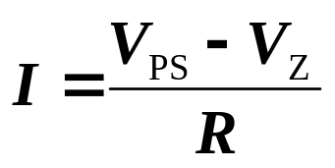


3. Zener Diode Circuits
E.g.1.3
Assume Zener diode V_{Z} =5.6V, r_{Z} =0 and I_{Z max}=3mA, find the value of resistance.
Sol:
Question:
Can we eliminate the R? Why?
If V_{PS} is replaced by sinusoidal input voltage v_{i} =15sinwt(V) , plot output voltage v_{O} versus v_{i} .

Slide 21




If V_{I} is the sinwave, and
V_{om}>V_{Z.}
V_{O}=?

Slide 22
1.7 Summary
Semiconductor
n_{i}＝p_{i}
Intrinsic
Extrinsic
N-type
P-type
PN junction
Diodes
Forward Biasing
Reverse Biasing
Rectifier
Zener

Slide 23





1.7 Summary

Slide 24
Questions
and
Answers

