Slide 1


Huazhong University of Science and Technology
The Department of Electronics and Information Engineering
Electronic Circuit Analysis and Design
Dr. Tianping Deng
Email: dengtp@hust.edu.cn

Slide 2
Contents
PART 1 SEMICONDUCTOR DEVICES AND BASIC APPLICATIONS
Chapter 1 Semiconductor Materials and Diodes
Chapter 2 Diode Circuits
Chapter 3 The Field-Effect Transistor
Chapter 4 Basic FET Amplifiers
Chapter 5 The Bipolar Junction Transistor
Chapter 6 Basic BJT Amplifiers
Chapter 7 Frequency Response
Chapter 8 Output Stages and Power Amplifiers
PART 2 ANALOG ELECTRONICS
Chapter 9 Ideal Operational Amplifiers and Op-Amp Circuits
Chapter 10 Integrated Circuit Biasing and Active Loads
Chapter 11 Differential and Multistage Amplifiers
Chapter 12 Feedback and Stability
Chapter 13 Operational Amplifier Circuits
Chapter 14 Nonideal Effects in Operational Amplifier Circuits
Chapter 15 Applications and Design of Integrated Circuits
Chapter 10 Integrated Circuit Biasing and Active Loads

Slide 3

10.1 Bipolar Transistor Current Source
10.2 FET Current Source
10.3 Circuit with Active Loads
10.4 Small-Signal Analysis: Active Load Circuits

Slide 4


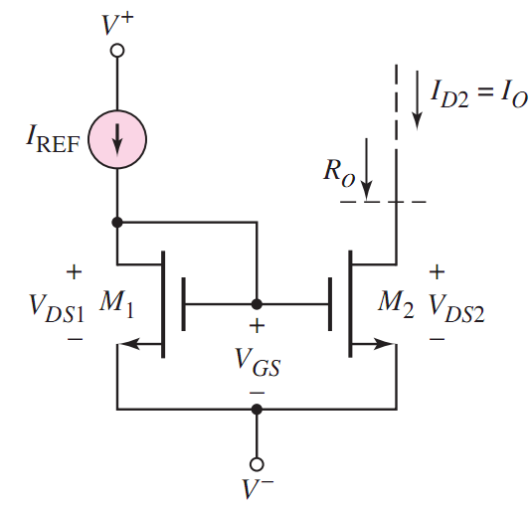


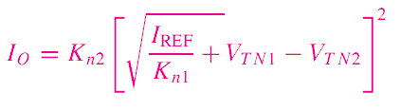


10.2 FET Current Sources
(P90)
10.2.1 Basic Current Source

Slide 5


10.2 FET Current Sources
(P90)
10.2.1 Basic Current Source

Slide 6
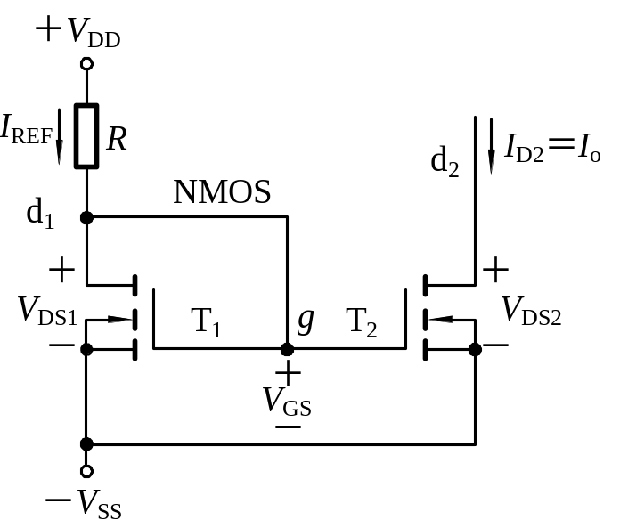
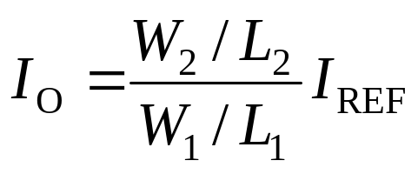
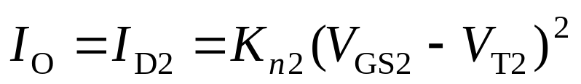
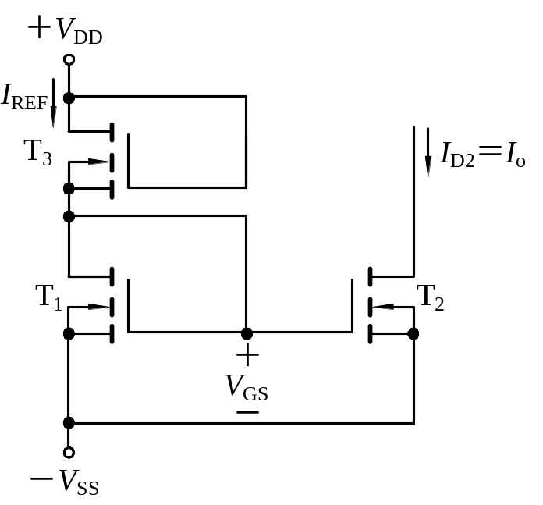
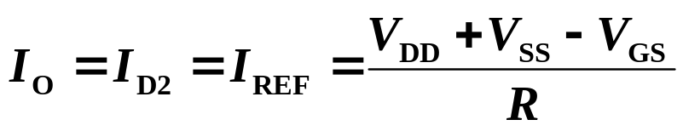
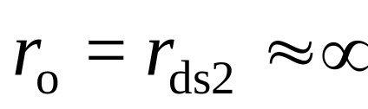
10.2 FET Current Sources
(P90)
10.2.1 Basic Current Source
Load current
Output Resistance
T₃ substitute R

Slide 7
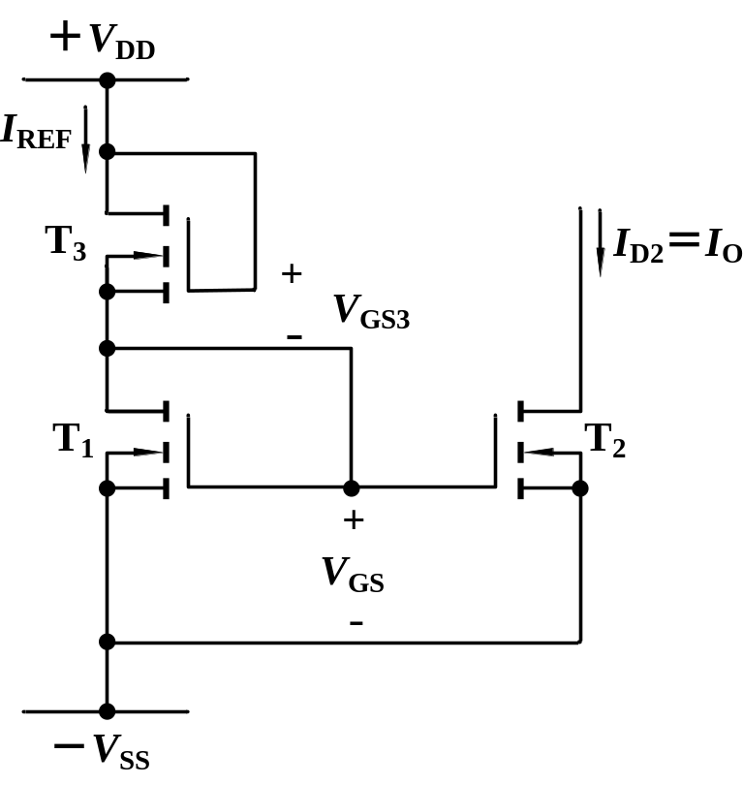
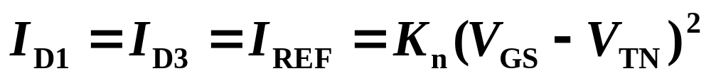
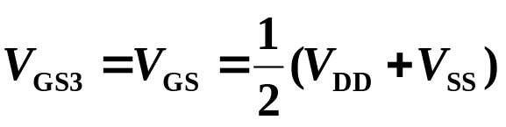
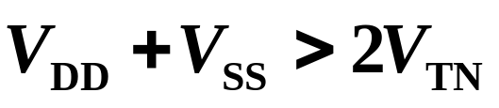
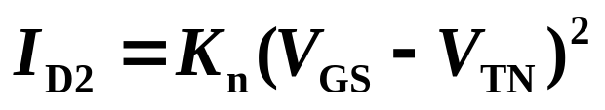
10.2 FET Current Sources

Slide 8
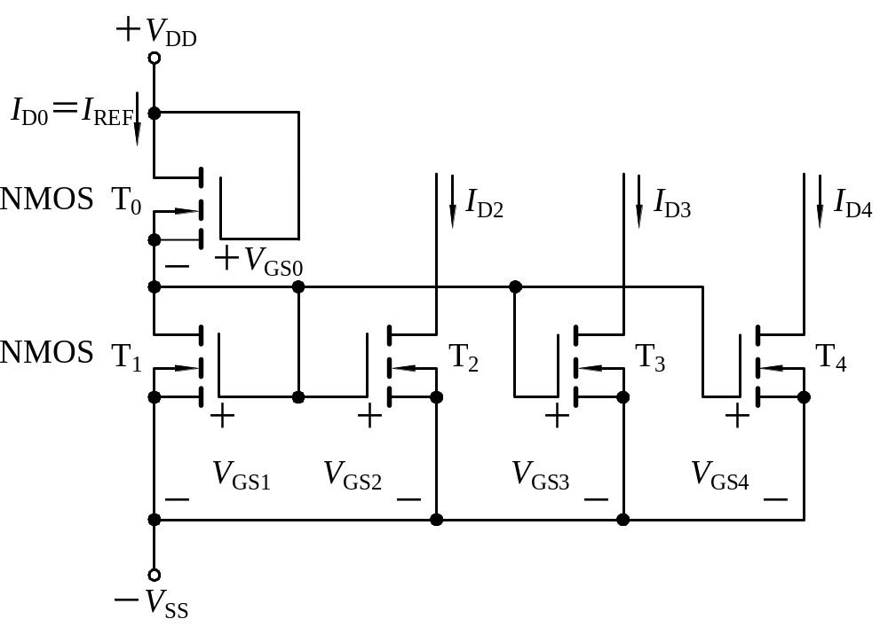
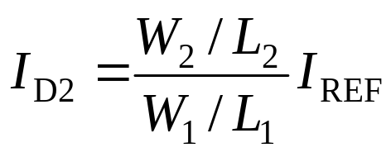
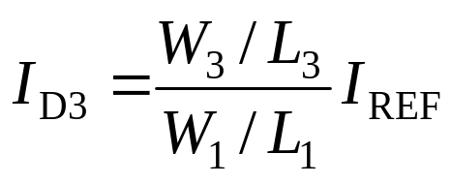
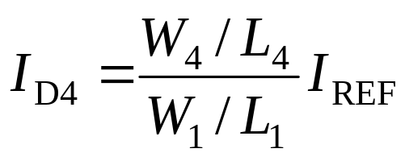
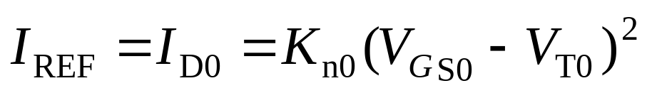
10.2 FET Current Sources
10.2.2 Multi-MOSFET Current Source(P94)
Currents

Slide 9

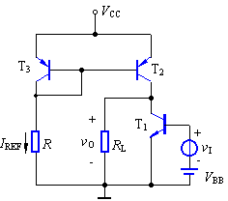
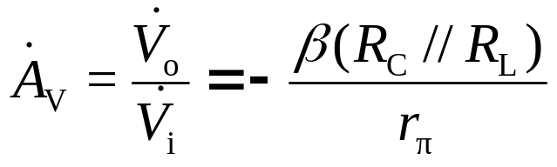
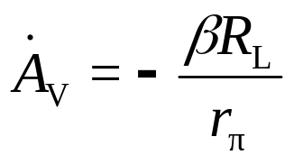
10.3 circuit with active loads (P102)
Current Source
T₂, T₃ , R form active load in amplifier T₁ circuit.
Voltage gain of CE：
Equivalent ac output resistance of current source is the load for T₁ , and very large.
Amplifier
common-emitter
Voltage gain with active load is greater than
that of no active load.

Slide 10
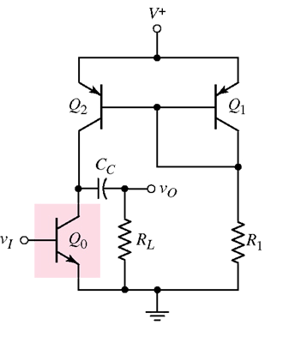
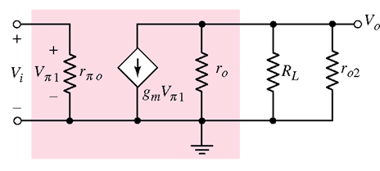

10.4 Small-Signal Analysis: Active Load Circuits (P109)
Active Load
small-signal equivalent circuit
r_{o2}=?
r_{o2}=r_{ce2}
Simple BJT amplifier with active load

Slide 11
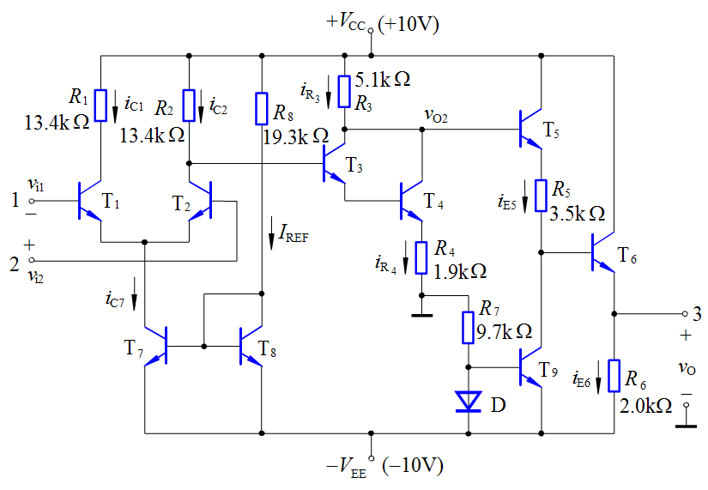
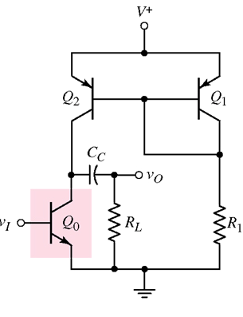
current source
Integrated Circuit Biasing
Active Loads

Slide 12
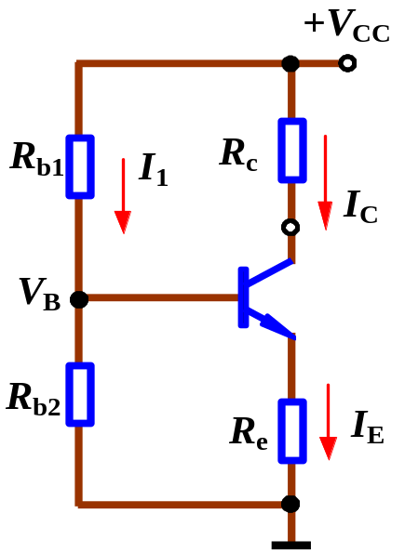
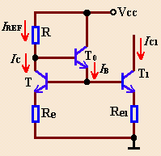
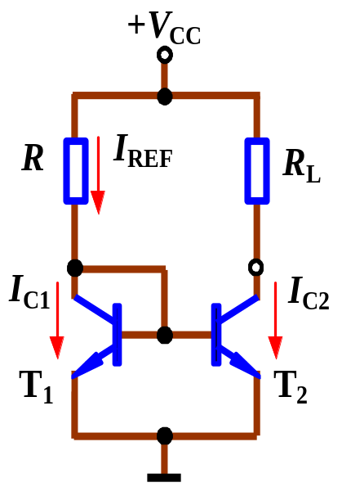
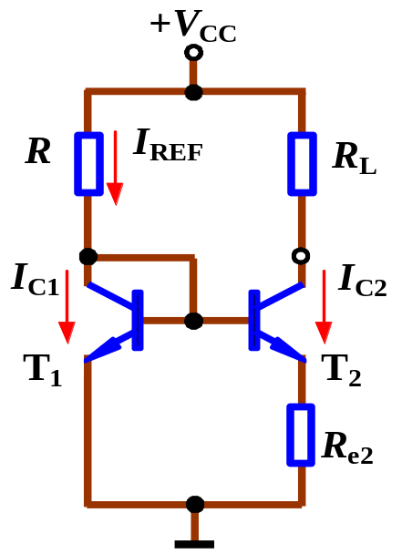
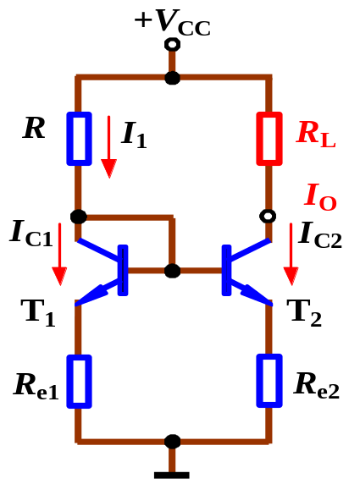
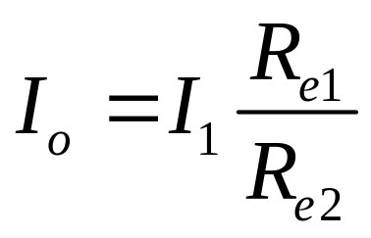
Summary

Slide 13
◆ Next, we will study ch11,
You must learn:
P135－P144
P147—P161
P174－P178

Slide 14

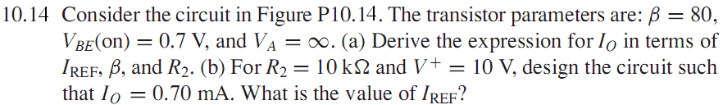
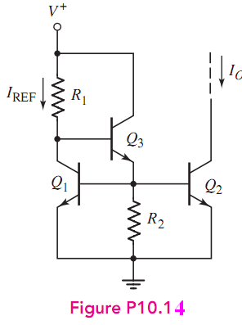
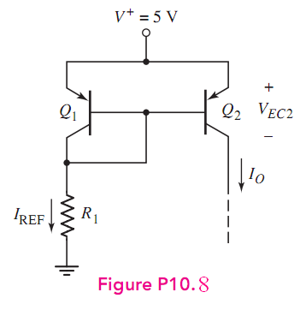
Homework:P120 10.8 P121 10.14

Slide 15
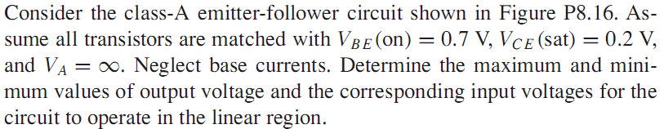
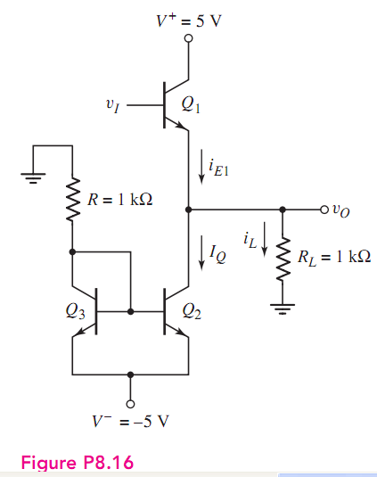



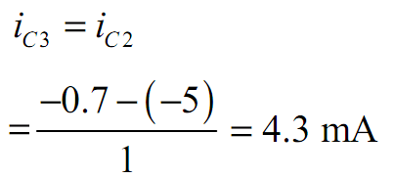
Which Region?
saturation

Slide 16




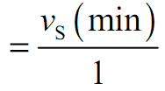

Q1 saturation
Which Region?
Cutoff Region

Slide 17
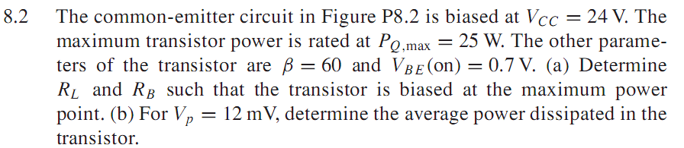
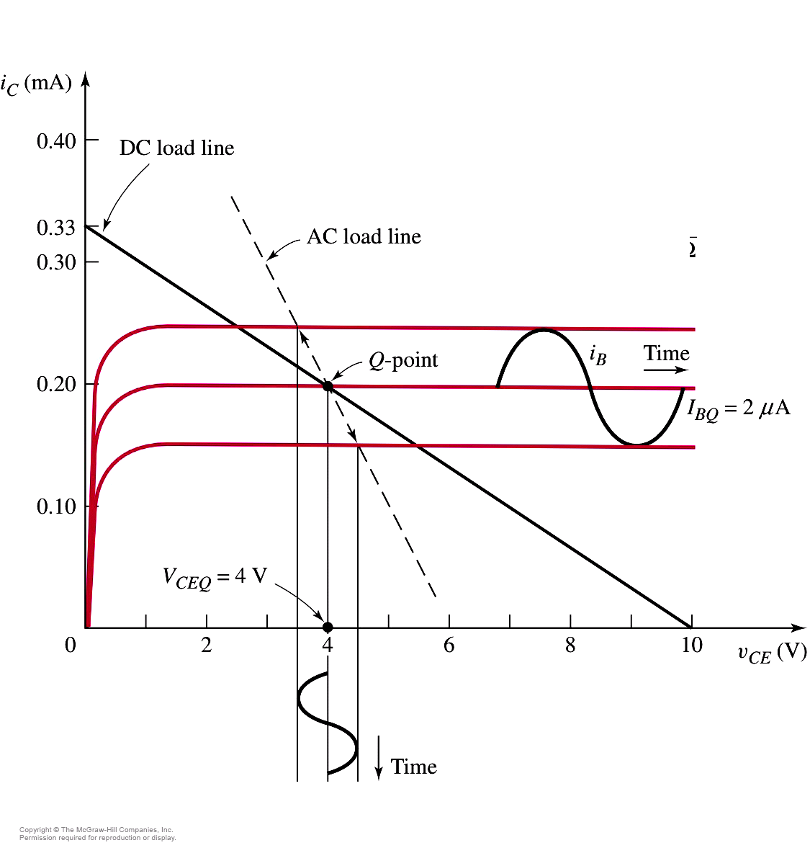
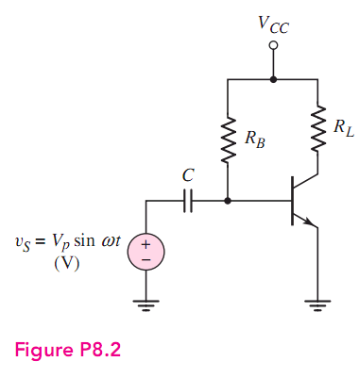

Slide 18
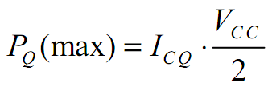
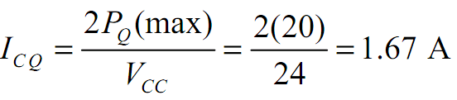
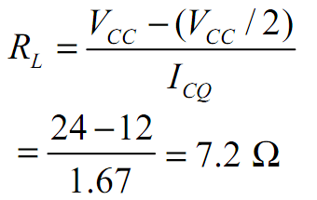
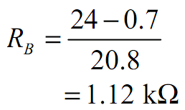
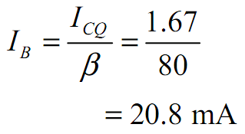

Slide 19
THE END
Questions
and
Answers

