Slide 1

Huazhong University of Science and Technology
The Department of Electronics and Information Engineering
Electronic Circuit Analysis and Design
Dr. Tianping Deng
Email: dengtp@hust.edu.cn

Slide 2
Contents
PART 1 SEMICONDUCTOR DEVICES AND BASIC APPLICATIONS
Chapter 1 Semiconductor Materials and Diodes
Chapter 2 Diode Circuits
Chapter 3 The Field-Effect Transistor
Chapter 4 Basic FET Amplifiers
Chapter 5 The Bipolar Junction Transistor
Chapter 6 Basic BJT Amplifiers
Chapter 7 Frequency Response
Chapter 8 Output Stages and Power Amplifiers
PART 2 ANALOG ELECTRONICS
Chapter 9 Ideal Operational Amplifiers and Op-Amp Circuits
Chapter 10 Integrated Circuit Biasing and Active Loads
Chapter 11 Differential and Multistage Amplifiers
Chapter 12 Feedback and Stability
Chapter 13 Operational Amplifier Circuits
Chapter 14 Nonideal Effects in Operational Amplifier Circuits
Chapter 15 Applications and Design of Integrated Circuits
Chapter 5 The Bipolar Junction Transistor

Slide 3
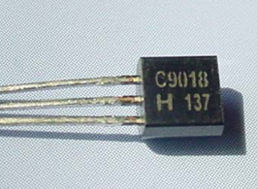
Ch5. The Bipolar Junction Transistor
5.1 Basic Bipolar Junction Transistor
5.2 DC Analysis of Transistor Circuits
5.3 Basic Transistor Application
5.4 Basic Transistor Biasing
5.5 Multistage Circuits

Slide 4
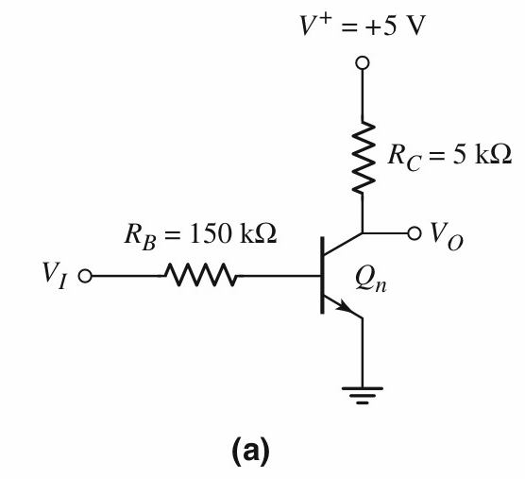
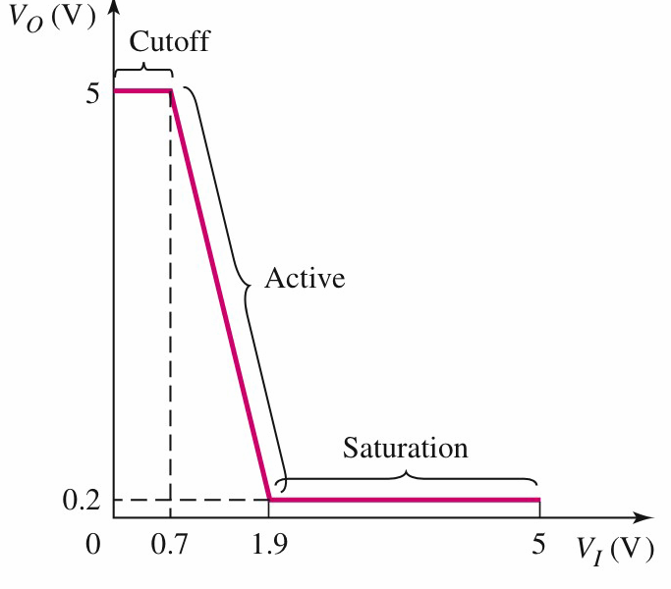
Review
Voltage Transfer Characteristic

Slide 5
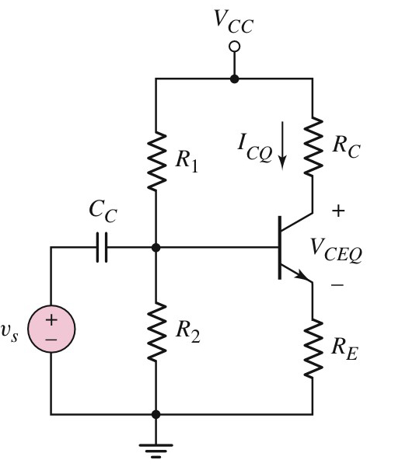
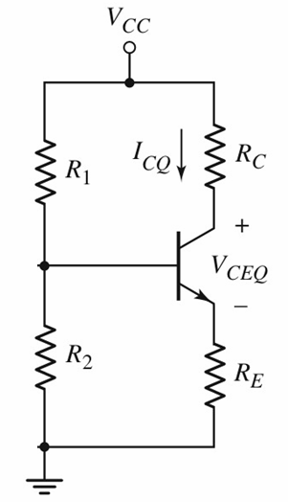
Review
DC Circuit

Slide 6
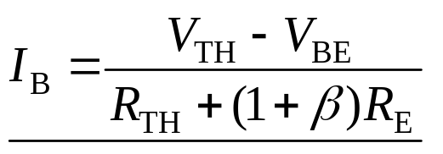

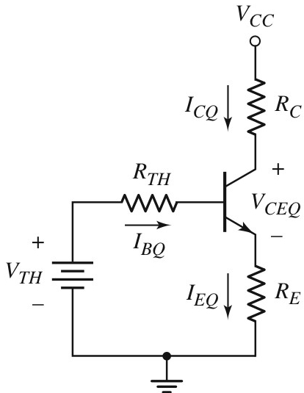

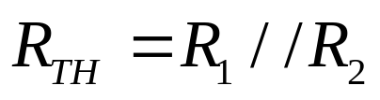
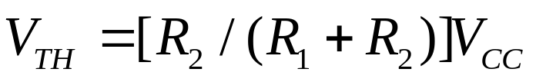
Review
Thevenin
equivalent

Slide 7
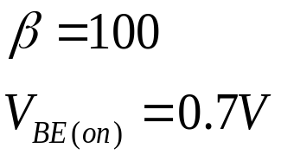
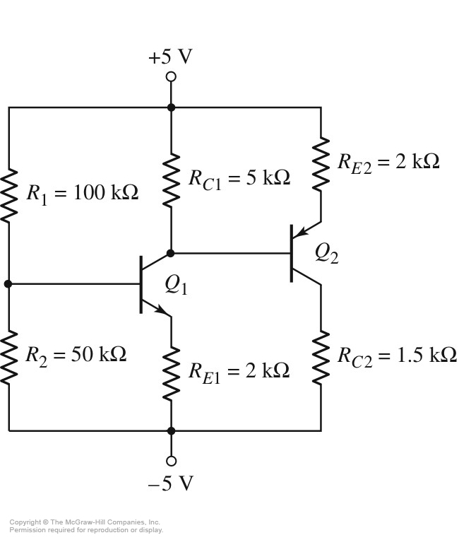
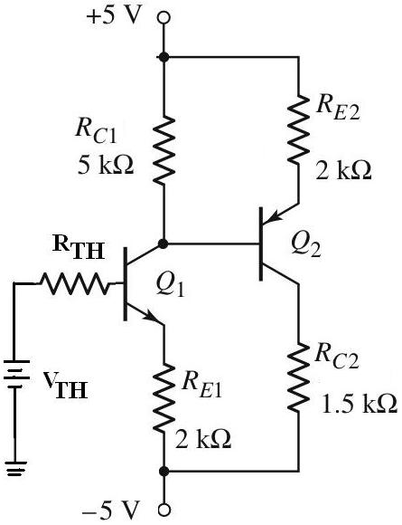


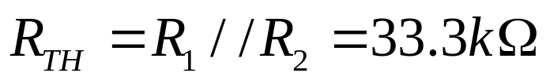
5.5 Multistage Circuits
Find Q-point for
each transistor
Cascade Transistor Circuit
级联

Slide 9
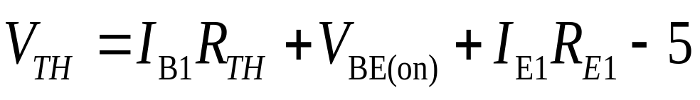
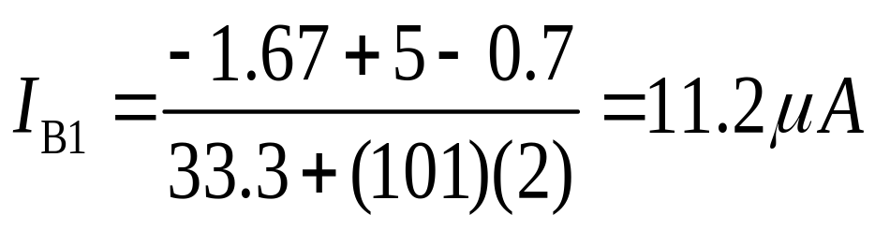
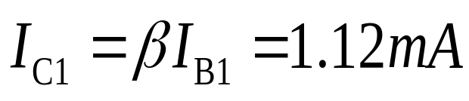

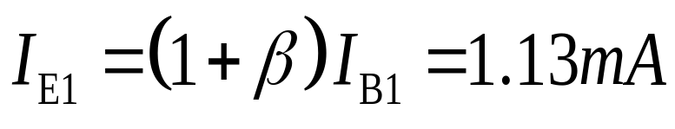
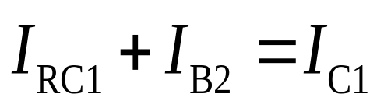
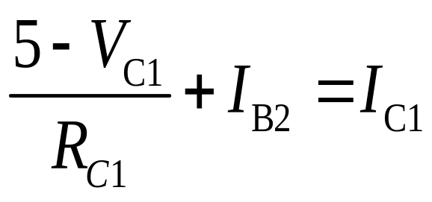

5.5 Multistage Circuits

Slide 10
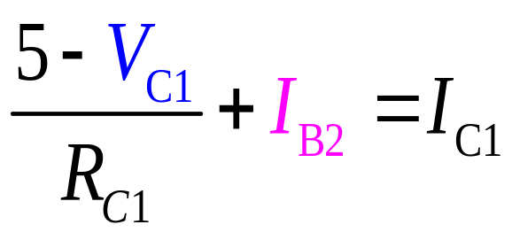

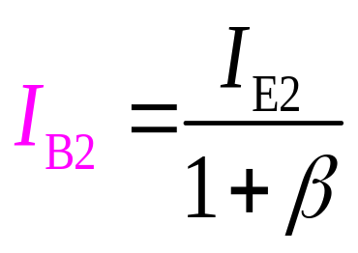
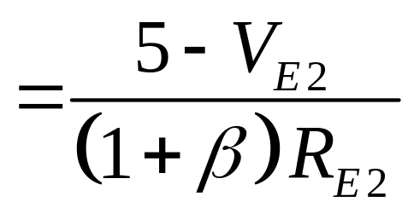
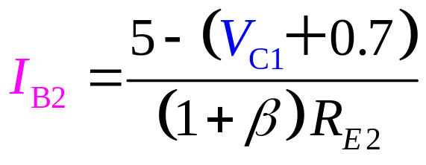

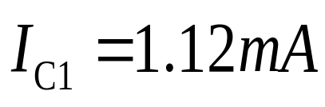
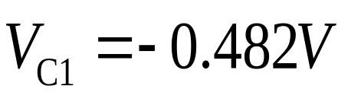
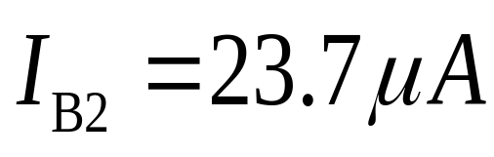
5.5 Multistage Circuits

Slide 11
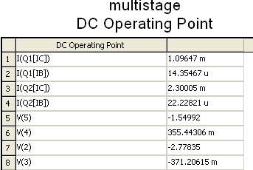
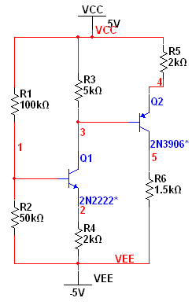

5.5 Multistage Circuits

Slide 12
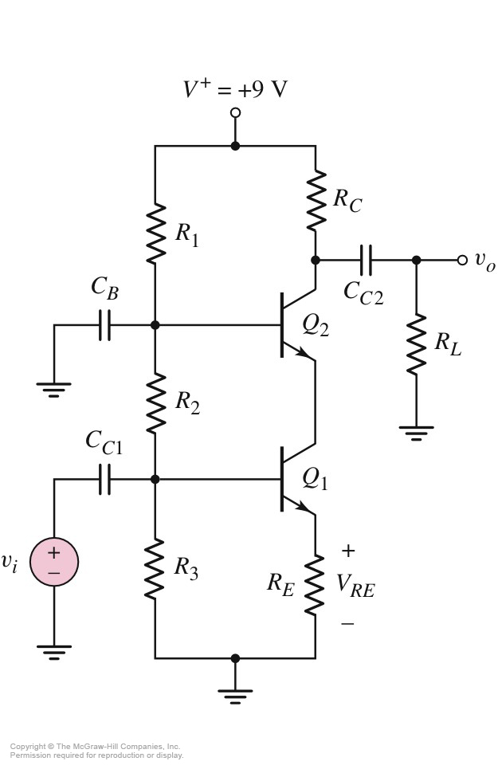
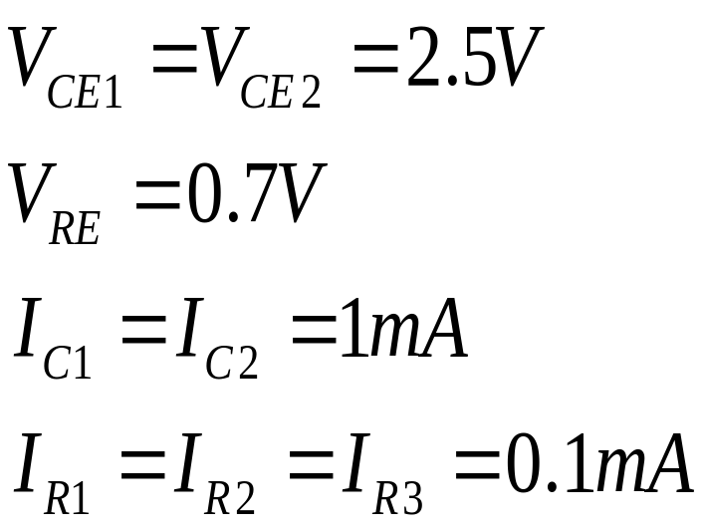
5.5 Multistage Circuits
Design the circuit
Cascode Transistor Circuit

Slide 13
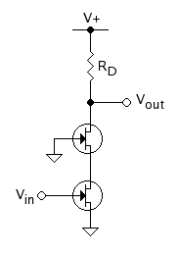
Cascode
CB
CG
CE
CS

Slide 14
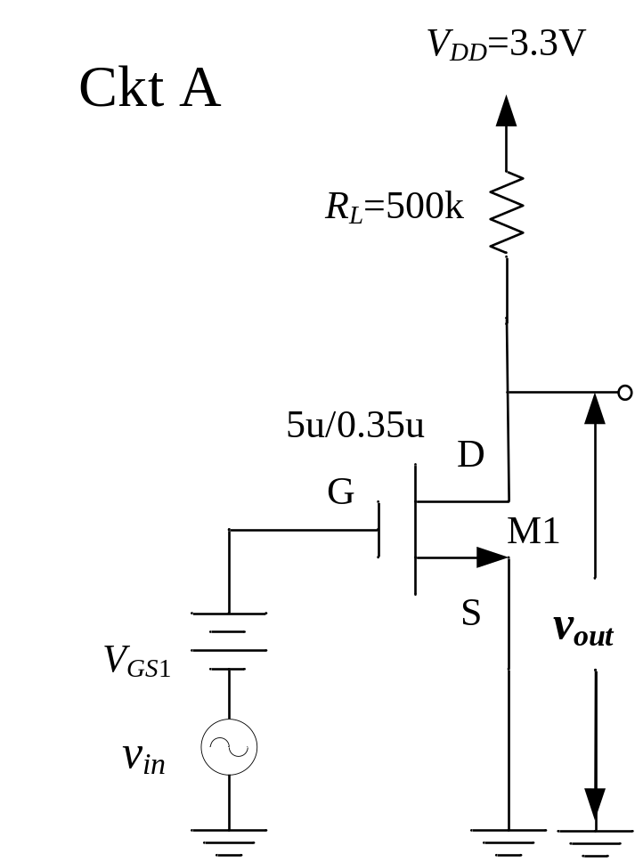
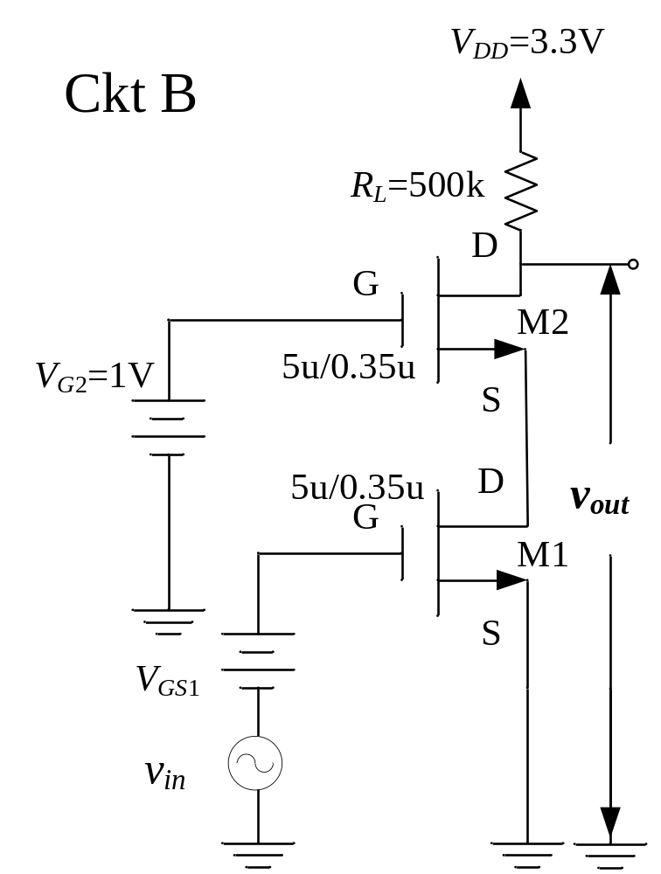
Simulation Homework
Comparing the I-V Curves of the Two Amplifiers.

Slide 15

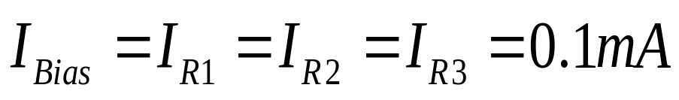
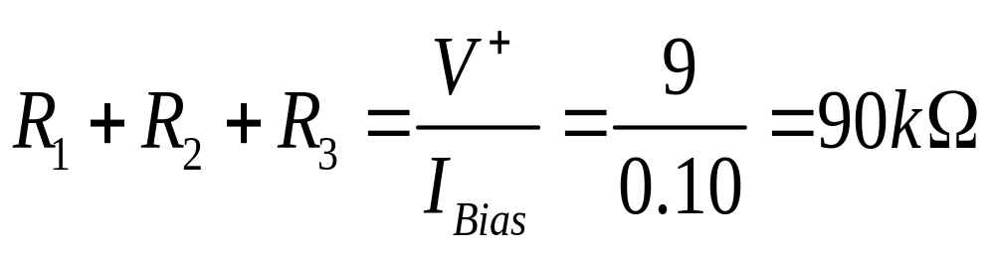
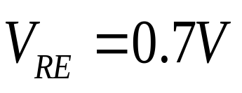
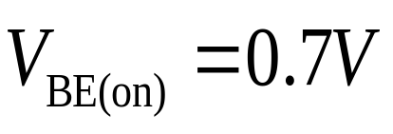
5.5 Multistage Circuits
Design the circuit
1.4V
Cascode Transistor Circuit

Slide 16
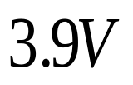
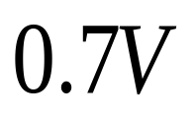
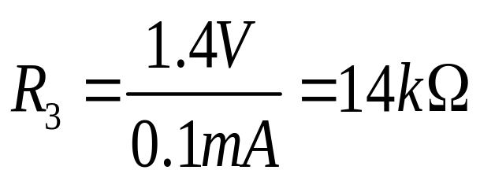
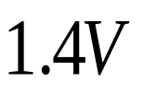
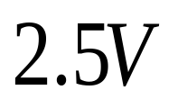
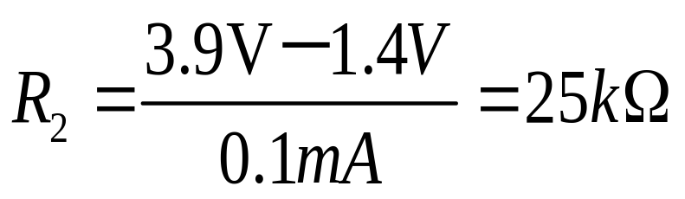
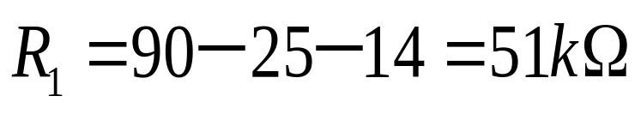
5.5 Multistage Circuits
Design the circuit
1.4V
Cascode Transistor Circuit

Slide 17
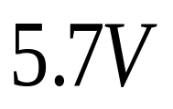
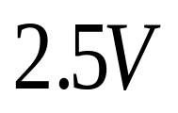
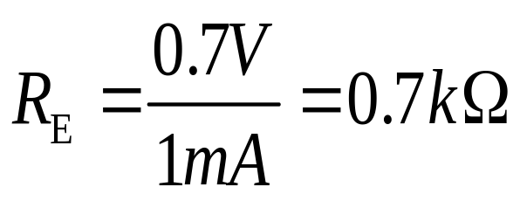

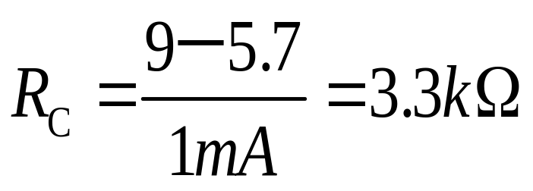
5.5 Multistage Circuits
Design the circuit
Cascode Transistor Circuit

Slide 18
5.5 Multistage Circuits
Design the circuit
Cascode Transistor Circuit

Slide 19
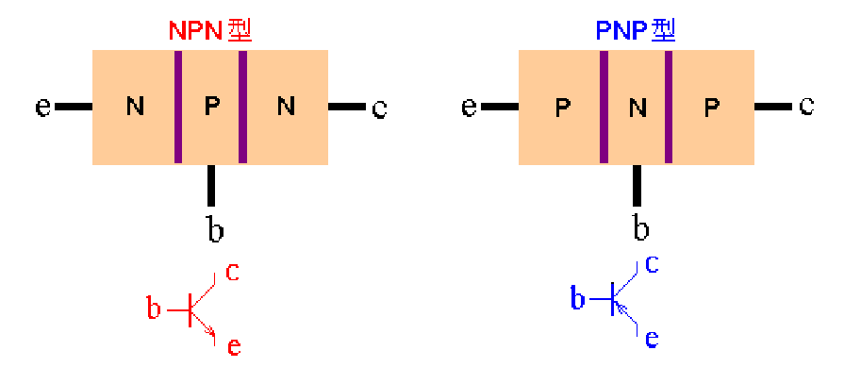
5.7 Summary
Three
terminals
Two pn junctions:
Three regions:

Slide 20
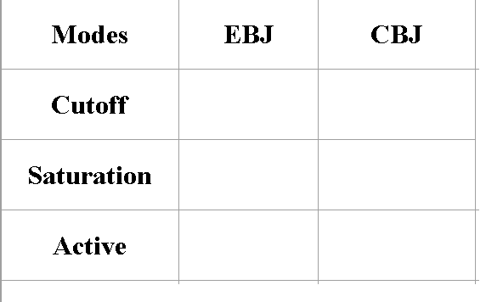


5.7 Summary
Modes of Operation

Slide 21


5.7 Summary
DC Equivalent Circuit
Common Emitter Circuit

Slide 22




5.7 Summary

Slide 23
Questions
and
Answers

