Slide 1

Huazhong University of Science and Technology
The Department of Electronics and Information Engineering
Electronic Circuit Analysis and Design
Dr. Tianping Deng
Email: dengtp@hust.edu.cn

Slide 2
Contents
PART 1 SEMICONDUCTOR DEVICES AND BASIC APPLICATIONS
Chapter 1 Semiconductor Materials and Diodes
Chapter 2 Diode Circuits
Chapter 3 The Field-Effect Transistor
Chapter 4 Basic FET Amplifiers
Chapter 5 The Bipolar Junction Transistor
Chapter 6 Basic BJT Amplifiers
Chapter 7 Frequency Response
Chapter 8 Output Stages and Power Amplifiers
PART 2 ANALOG ELECTRONICS
Chapter 9 Ideal Operational Amplifiers and Op-Amp Circuits
Chapter 10 Integrated Circuit Biasing and Active Loads
Chapter 11 Differential and Multistage Amplifiers
Chapter 12 Feedback and Stability
Chapter 13 Operational Amplifier Circuits
Chapter 14 Nonideal Effects in Operational Amplifier Circuits
Chapter 15 Applications and Design of Integrated Circuits
Chapter 6 Basic BJT Amplifiers

Slide 3
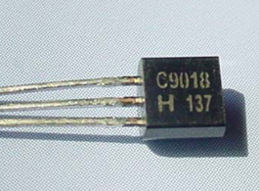
Ch6. Basic BJT Amplifiers
6.0 Preview
6.1 Analog Signals and Linear Amplifiers
6.2 The Bipolar Linear Amplifier
6.3 Basic Transistor Amplifier Configurations
6.4 Common-Emitter Amplifiers
6.5 AC Load Line Analysis
6.6 Common-Collector (Emitter-Follower) Amplifier
6.7 Common-Base Amplifier
6.8 The Three Basic Amplifiers: Summary and Comparison
6.9 Multistage Amplifiers
6.10 Power Considerations
6.11 Design Application
6.12 Summary

Slide 4
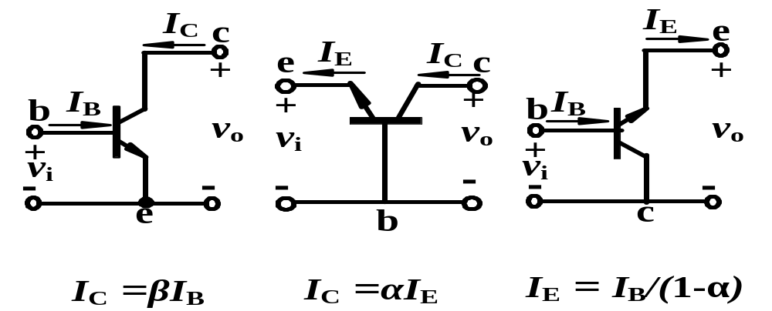
6.3 Basic Transistor Amplifier Configurations
Review
CE
CB
CC
BJT Circuit Configurations

Slide 5
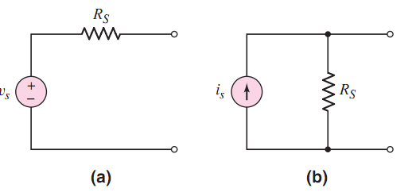


6.3 Basic Transistor Amplifier Configurations

Slide 6
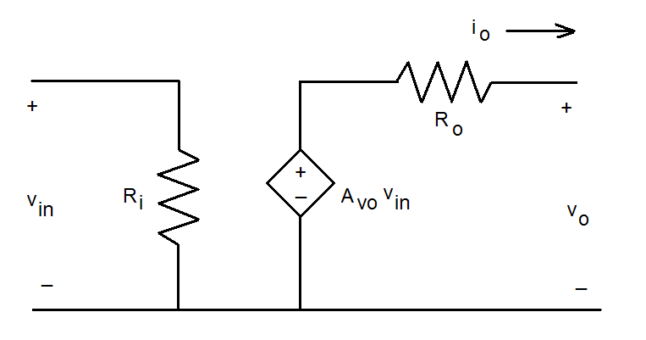

6.3 Basic Transistor Amplifier Configurations
Voltage Amplifier

Slide 7
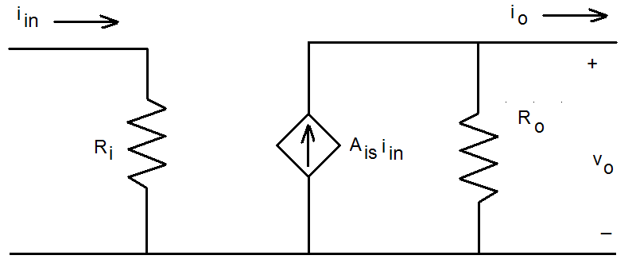

6.3 Basic Transistor Amplifier Configurations
Current Amplifier

Slide 8
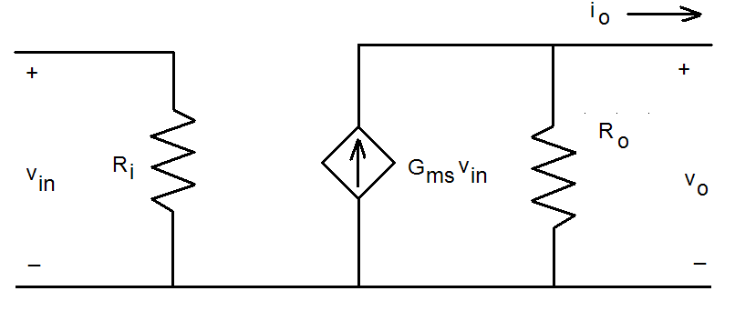

6.3 Basic Transistor Amplifier Configurations
Transconductance Amplifier

Slide 9
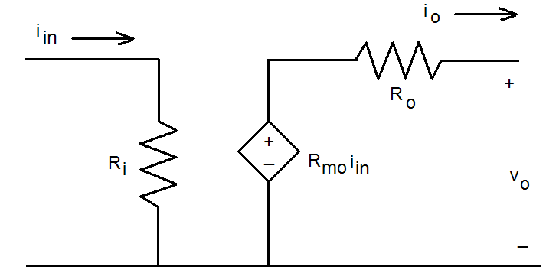

6.3 Basic Transistor Amplifier Configurations
Transresistance Amplifier

Slide 10
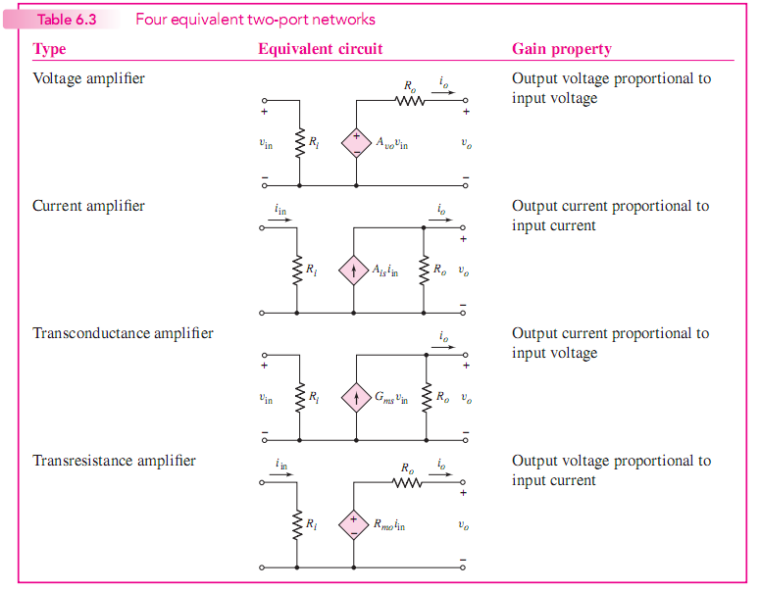
6.3 Basic Transistor Amplifier Configurations

Slide 11
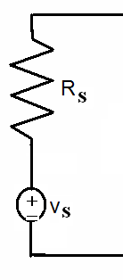
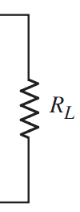
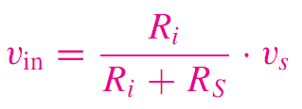
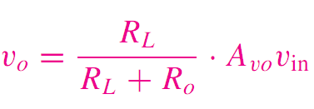
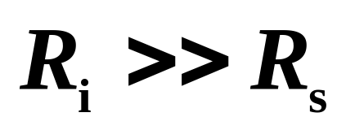

6.3 Basic Transistor Amplifier Configurations
Voltage Amplifier

Slide 12

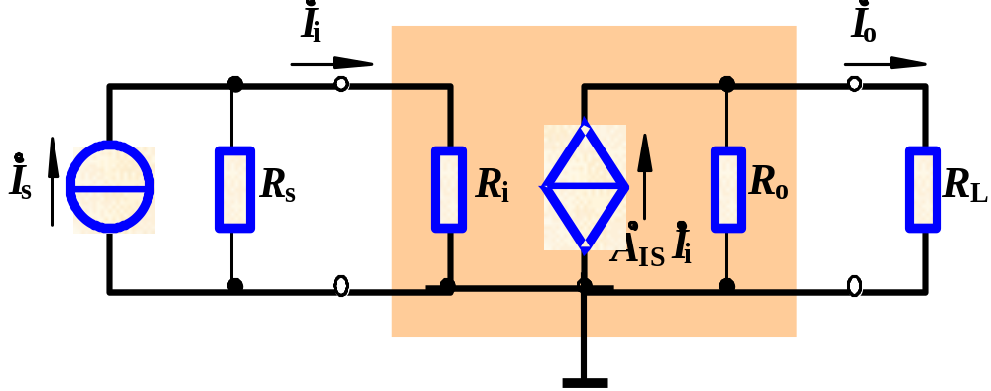
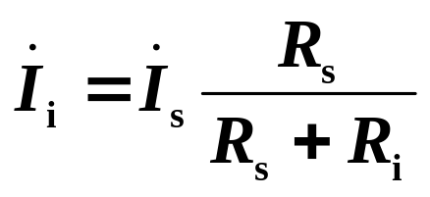

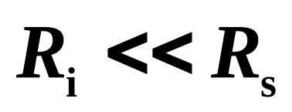
6.3 Basic Transistor Amplifier Configurations
Current amplifier

Slide 13
Questions
and
Answers

