Slide 1

Huazhong University of Science and Technology
The Department of Electronics and Information Engineering
Electronic Circuit Analysis and Design
Dr. Tianping Deng
Email: dengtp@hust.edu.cn

Slide 2
Contents
PART 1 SEMICONDUCTOR DEVICES AND BASIC APPLICATIONS
Chapter 1 Semiconductor Materials and Diodes
Chapter 2 Diode Circuits
Chapter 3 The Field-Effect Transistor
Chapter 4 Basic FET Amplifiers
Chapter 5 The Bipolar Junction Transistor
Chapter 6 Basic BJT Amplifiers
Chapter 7 Frequency Response
Chapter 8 Output Stages and Power Amplifiers
PART 2 ANALOG ELECTRONICS
Chapter 9 Ideal Operational Amplifiers and Op-Amp Circuits
Chapter 10 Integrated Circuit Biasing and Active Loads
Chapter 11 Differential and Multistage Amplifiers
Chapter 12 Feedback and Stability
Chapter 13 Operational Amplifier Circuits
Chapter 14 Nonideal Effects in Operational Amplifier Circuits
Chapter 15 Applications and Design of Integrated Circuits
Chapter 6 Basic BJT Amplifiers

Slide 3
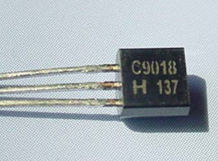
Ch6. Basic BJT Amplifiers
6.0 Preview
6.1 Analog Signals and Linear Amplifiers
6.2 The Bipolar Linear Amplifier
6.3 Basic Transistor Amplifier Configurations
6.4 Common-Emitter Amplifiers
6.5 AC Load Line Analysis
6.6 Common-Collector (Emitter-Follower) Amplifier
6.7 Common-Base Amplifier
6.8 The Three Basic Amplifiers: Summary and Comparison
6.9 Multistage Amplifiers
6.10 Power Considerations
6.11 Design Application
6.12 Summary

Slide 4
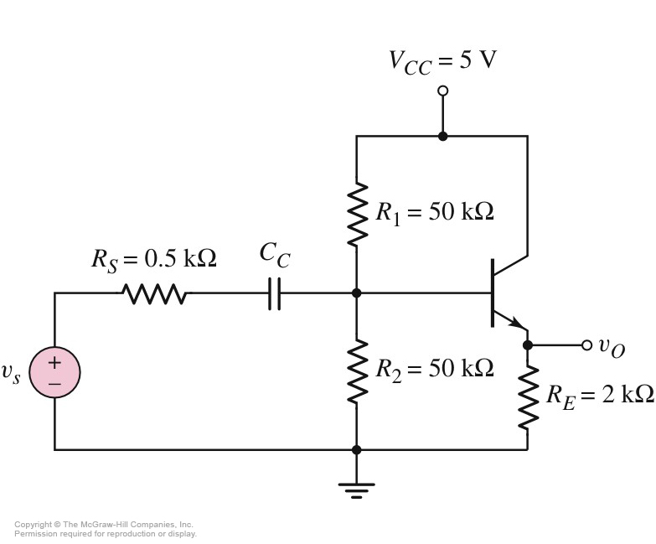
6.6 Common-Collector (Emitter-Follower) Amplifier
6.6.1 Small signal voltage gain
CC
Small-signal equivalent circuit
Emitter-Follower

Slide 5





6.6 Common-Collector (Emitter-Follower) Amplifier
6.6.1 Small signal voltage gain

Slide 6
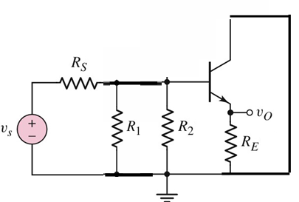


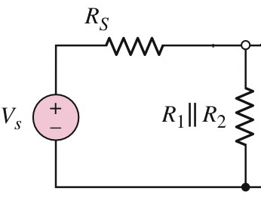
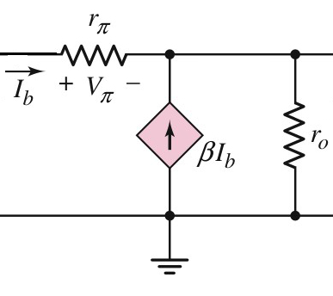
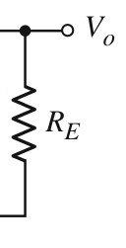
6.6 Common-Collector (Emitter-Follower) Amplifier
6.6.1 Small signal voltage gain

Slide 7
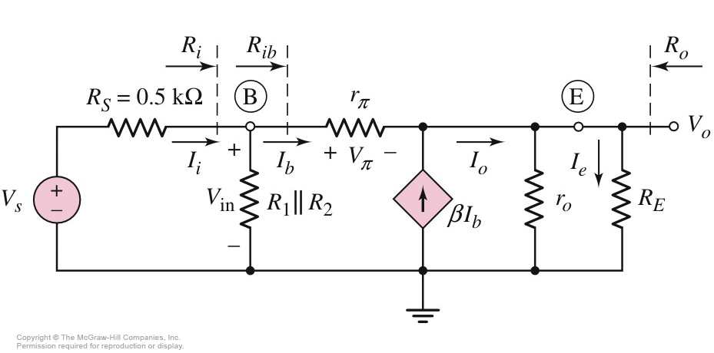







6.6 Common-Collector (Emitter-Follower) Amplifier
6.6.1 Small signal voltage gain

Slide 8

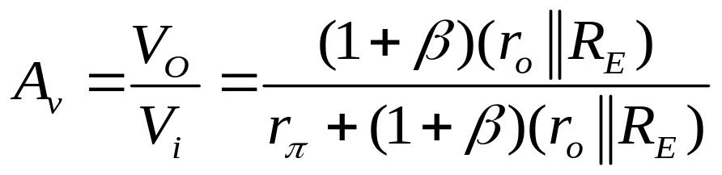
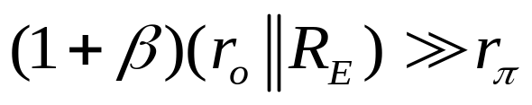
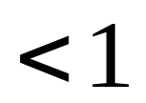
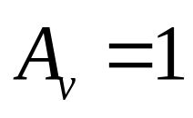
6.6 Common-Collector (Emitter-Follower) Amplifier
6.6.1 Small signal voltage gain
Follower

Slide 9
6.6 Common-Collector (Emitter-Follower) Amplifier
6.6.2 Input and output impedance

Slide 10

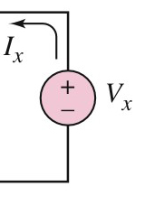


6.6 Common-Collector (Emitter-Follower) Amplifier
6.6.2 Input and output impedance

Slide 11
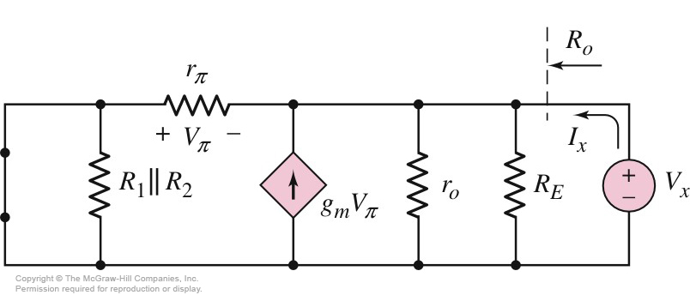




6.6 Common-Collector (Emitter-Follower) Amplifier
6.6.2 Input and output impedance

Slide 12



6.6 Common-Collector (Emitter-Follower) Amplifier
6.6.2 Input and output impedance

Slide 13

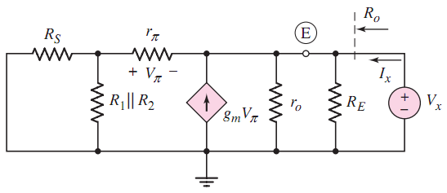


6.6 Common-Collector (Emitter-Follower) Amplifier
6.6.2 Input and output impedance

Slide 14








6.6 Common-Collector (Emitter-Follower) Amplifier
6.6.3 Small Signal Current Gain

Slide 15


6.6 Common-Collector (Emitter-Follower) Amplifier
Small signal voltage gain
Input impedance
Output impedance

Slide 16
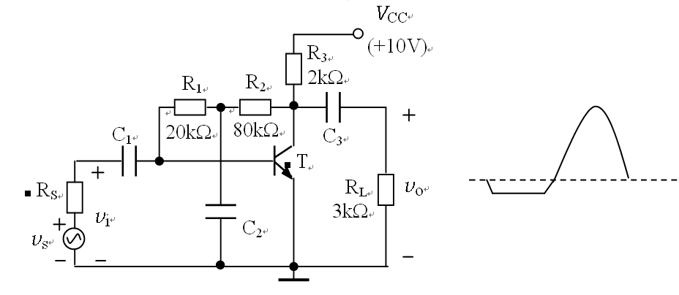

1、Calculate（I_{B}、I_{C}、V_{CE}）；
2、Sketch the small signal equivalent circuit；
3、Find R_{i} and R_{o} ；
4、Find A_{v} = V_{o} / V_{i} ；
5、 R_{S}=200Ω ， Find A_{vs} = V_{o} / V_{s} ；
6、The output voltage is shown as figure, which distortion?

Slide 17
Questions
and
Answers

