Slide 1

Huazhong University of Science and Technology
The Department of Electronics and Information Engineering
Electronic Circuit Analysis and Design
Dr. Tianping Deng
Email: dengtp@hust.edu.cn

Slide 2
Contents
PART 1 SEMICONDUCTOR DEVICES AND BASIC APPLICATIONS
Chapter 1 Semiconductor Materials and Diodes
Chapter 2 Diode Circuits
Chapter 3 The Field-Effect Transistor
Chapter 4 Basic FET Amplifiers
Chapter 5 The Bipolar Junction Transistor
Chapter 6 Basic BJT Amplifiers
Chapter 7 Frequency Response
Chapter 8 Output Stages and Power Amplifiers
PART 2 ANALOG ELECTRONICS
Chapter 9 Ideal Operational Amplifiers and Op-Amp Circuits
Chapter 10 Integrated Circuit Biasing and Active Loads
Chapter 11 Differential and Multistage Amplifiers
Chapter 12 Feedback and Stability
Chapter 13 Operational Amplifier Circuits
Chapter 14 Nonideal Effects in Operational Amplifier Circuits
Chapter 15 Applications and Design of Integrated Circuits
Chapter 6 Basic BJT Amplifiers

Slide 3
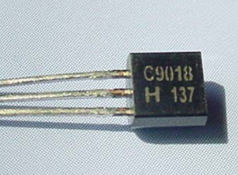
Ch6. Basic BJT Amplifiers
6.0 Preview
6.1 Analog Signals and Linear Amplifiers
6.2 The Bipolar Linear Amplifier
6.3 Basic Transistor Amplifier Configurations
6.4 Common-Emitter Amplifiers
6.5 AC Load Line Analysis
6.6 Common-Collector (Emitter-Follower) Amplifier
6.7 Common-Base Amplifier
6.8 The Three Basic Amplifiers: Summary and Comparison
6.9 Multistage Amplifiers
6.10 Power Considerations
6.11 Design Application
6.12 Summary

Slide 4
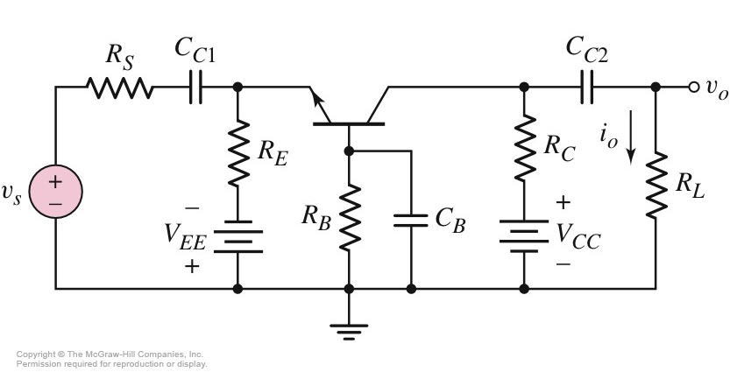
6.7 Common-Base Amplifier
6.7.1Small Signal Voltage and Current Gains
CB

Slide 5
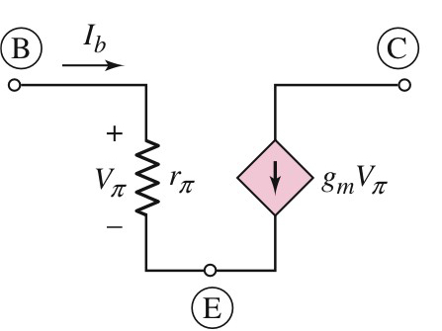
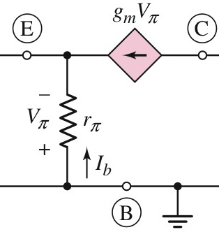
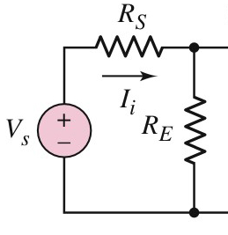
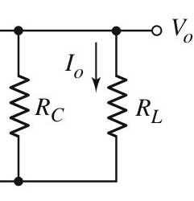
6.7 Common-Base Amplifier
6.7.1Small Signal Voltage and Current Gains
Small-signal equivalent circuit

Slide 6
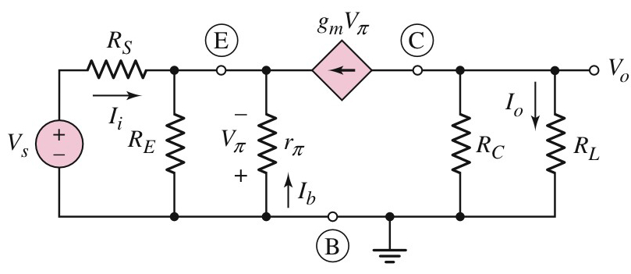
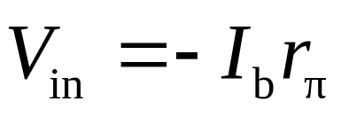


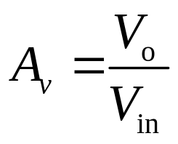
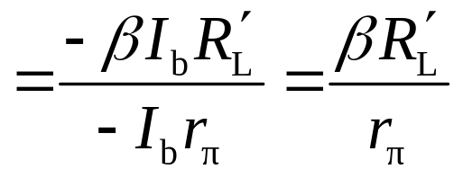
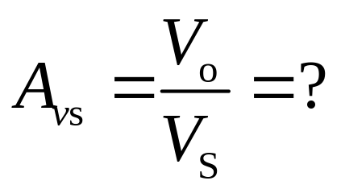
6.7 Common-Base Amplifier
6.7.1Small Signal Voltage and Current Gains
Input loop
Output loop
Voltage gain

Slide 7
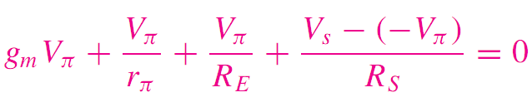
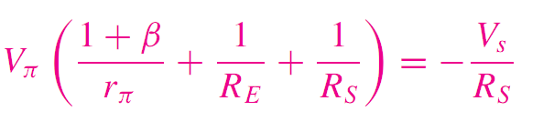
6.7 Common-Base Amplifier
6.7.1Small Signal Voltage and Current Gains

Slide 8
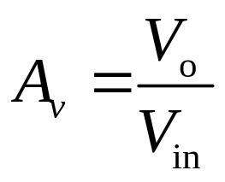
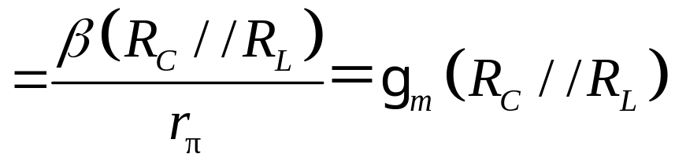
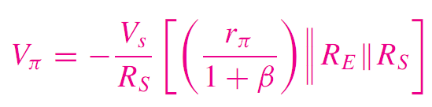
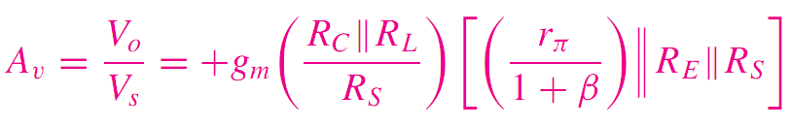
6.7.1Small Signal Voltage and Current Gains

Slide 9



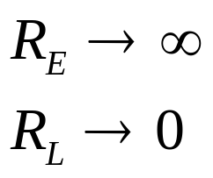



6.7 Common-Base Amplifier
6.7.1Small Signal Voltage and Current Gains

Slide 10




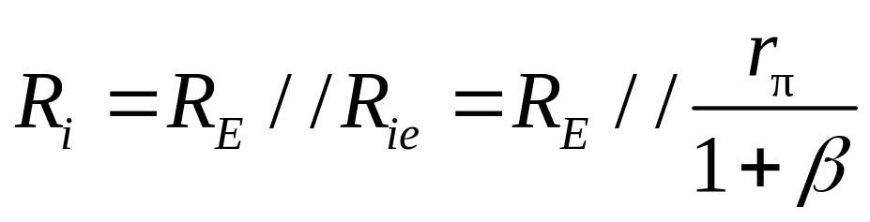
6.7 Common-Base Amplifier
6.7.2 Input and output impedance

Slide 11
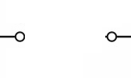
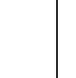


6.7 Common-Base Amplifier
6.7.2 Input and output impedance

Slide 12
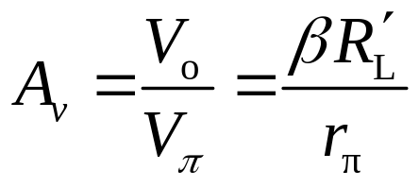
6.7 Common-Base Amplifier
Small Signal Voltage Gain
Input impedance
Output impedance

Slide 13
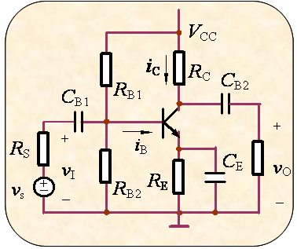
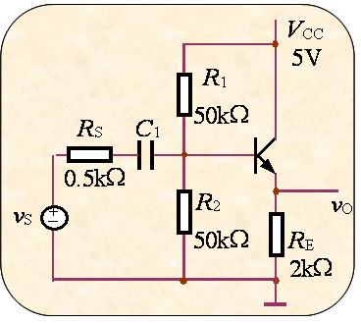
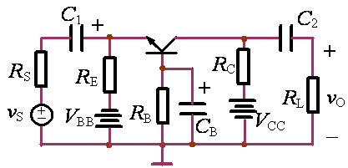
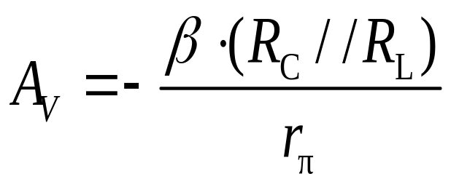
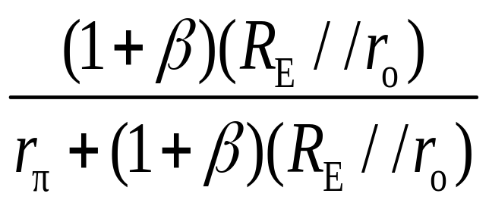
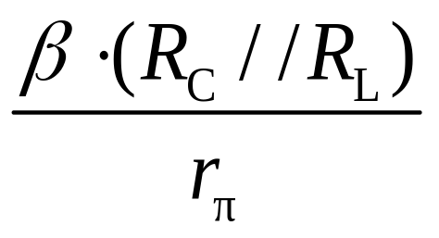
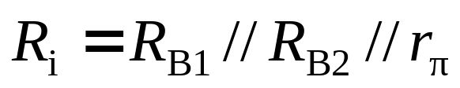
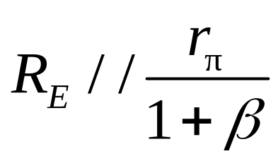

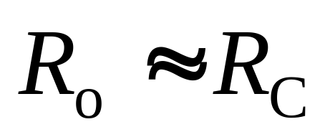
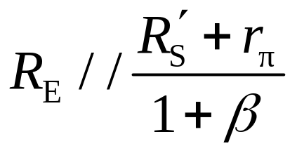
6.8 The Three Basic Amplifier: Summary and Comparison
Large
Small
Small

Slide 14
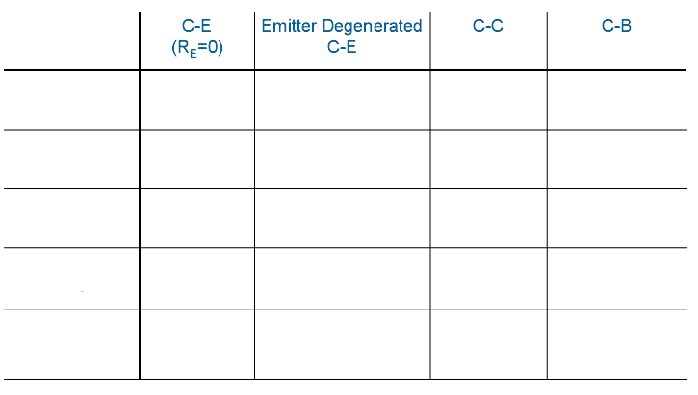








6.8 The Three Basic Amplifier: Summary and Comparison

Slide 15
1、The basic BJT amplifiers has:
(A) 、CE
(B )、CC
(C)、 CB
1） which has the lest input resistance ( )
2） which has the lest output resistance ( )
3）which can amplify the ac voltage ( )
4） which can amplify the ac current ( )
5）the input and the output has the same phase is ( )
6） the input and the output has the opposite phase is ( )
C
B
A
C
A
B
B、C
A

Slide 16
Questions
and
Answers

