Slide 1


Huazhong University of Science and Technology
The Department of Electronics and Information Engineering
Electronic Circuit Analysis and Design
Dr. Tianping Deng
Email: dengtp@hust.edu.cn

Slide 2
Contents
PART 1 SEMICONDUCTOR DEVICES AND BASIC APPLICATIONS
Chapter 1 Semiconductor Materials and Diodes
Chapter 2 Diode Circuits
Chapter 3 The Field-Effect Transistor
Chapter 4 Basic FET Amplifiers
Chapter 5 The Bipolar Junction Transistor
Chapter 6 Basic BJT Amplifiers
Chapter 7 Frequency Response
Chapter 8 Output Stages and Power Amplifiers
PART 2 ANALOG ELECTRONICS
Chapter 9 Ideal Operational Amplifiers and Op-Amp Circuits
Chapter 10 Integrated Circuit Biasing and Active Loads
Chapter 11 Differential and Multistage Amplifiers
Chapter 12 Feedback and Stability
Chapter 13 Operational Amplifier Circuits
Chapter 14 Nonideal Effects in Operational Amplifier Circuits
Chapter 15 Applications and Design of Integrated Circuits
Chapter 7 Frequency Response

Slide 3
Ch7 Frequency Response
7.1 Amplifier Frequency Response
7.2 System Transfer Functions
7.3 Frequency Response：Transistor Amplifier with Circuit Capacitors
7.4 Frequency Response：Bipolar Transistor
7.5 Frequency Response：FET
7.6 High-Frequency Response of Transistor Circuits

Slide 4
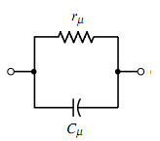
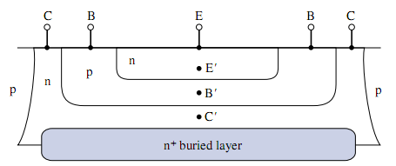
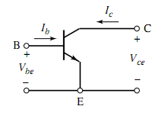
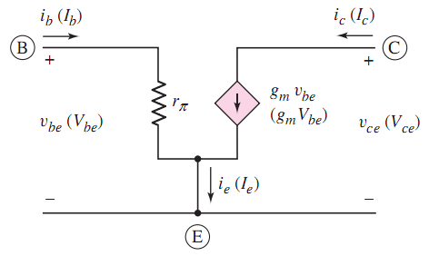
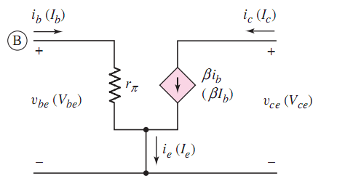
7.4 Frequency Response：Bipolar Transistor

Slide 5
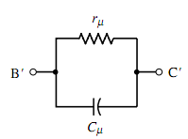
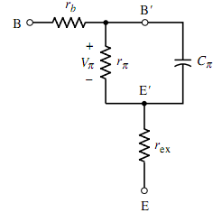
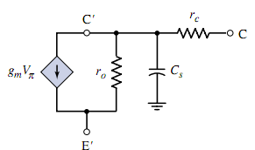
7.4 Frequency Response：Bipolar Transistor

Slide 6


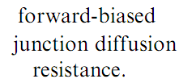
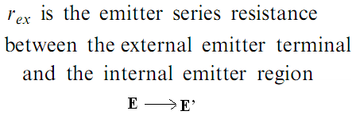

7.4 Frequency Response：Bipolar Transistor

Slide 7



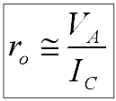
7.4 Frequency Response：Bipolar Transistor

Slide 8

7.4 Frequency Response：Bipolar Transistor

Slide 9
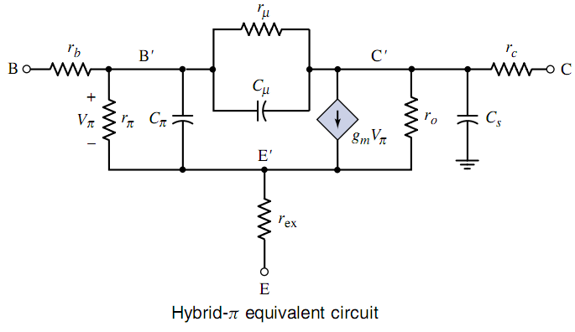



7.4 Frequency Response：Bipolar Transistor

Slide 10
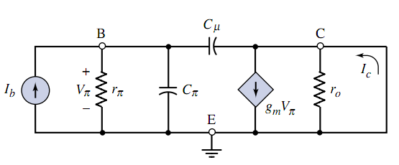
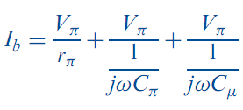
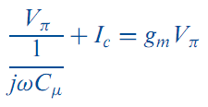


7.4 Frequency Response：Bipolar Transistor

Slide 11
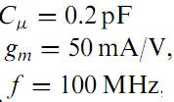

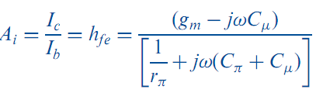


7.4 Frequency Response：Bipolar Transistor

Slide 12
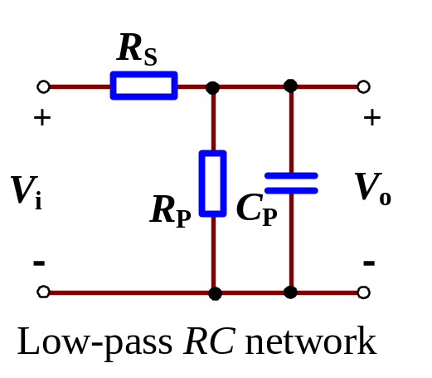
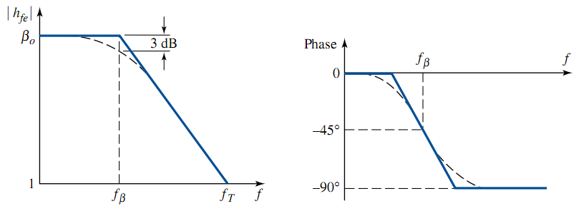

7.4 Frequency Response：Bipolar Transistor

Slide 13

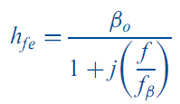
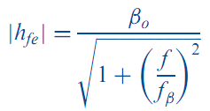
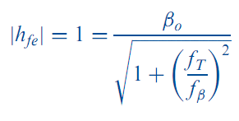

7.4 Frequency Response：Bipolar Transistor
>>1
9003 datasheet

Slide 14
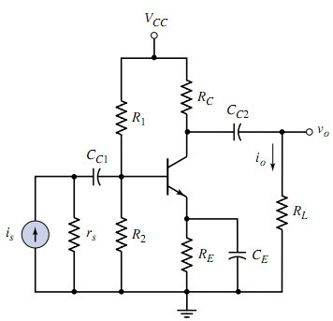
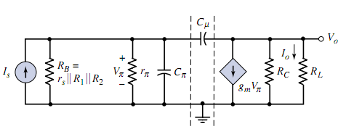
7.4 Frequency Response：Bipolar Transistor

Slide 15
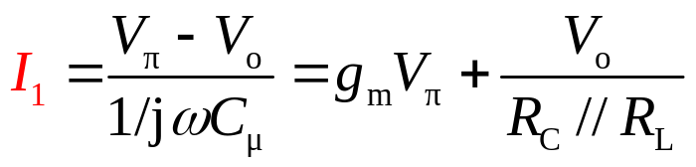
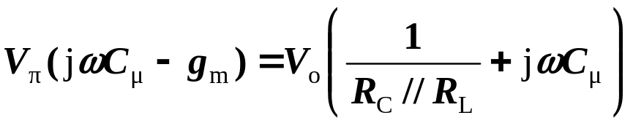
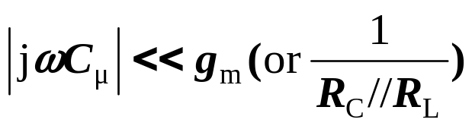
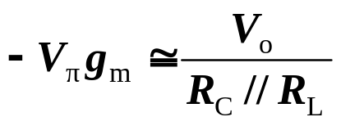
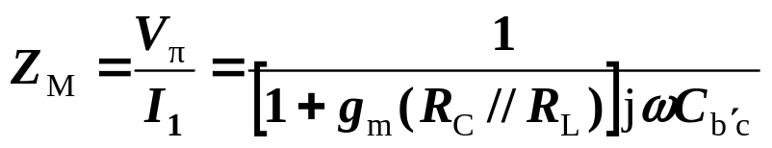

7.4 Frequency Response：Bipolar Transistor
Equivalent capacitance C_{M}
C_{M} is called the Miller capacitance.

Slide 16
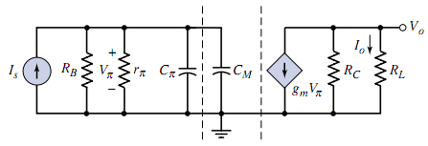
7.4 Frequency Response：Bipolar Transistor

Slide 17
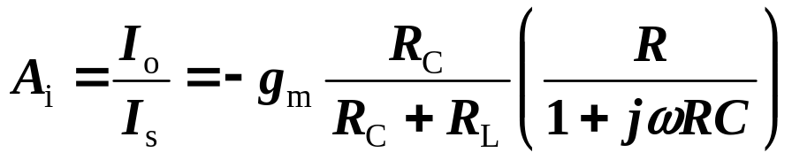


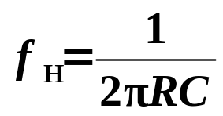
7.4 Frequency Response：Bipolar Transistor
Current gain
Upper corner freq.

Slide 18
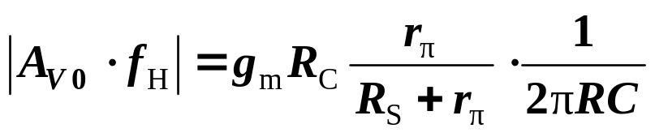
7.4 Frequency Response：Bipolar Transistor
Gain-bandwidth Product
This product is a constant.

Slide 19



Slide 20
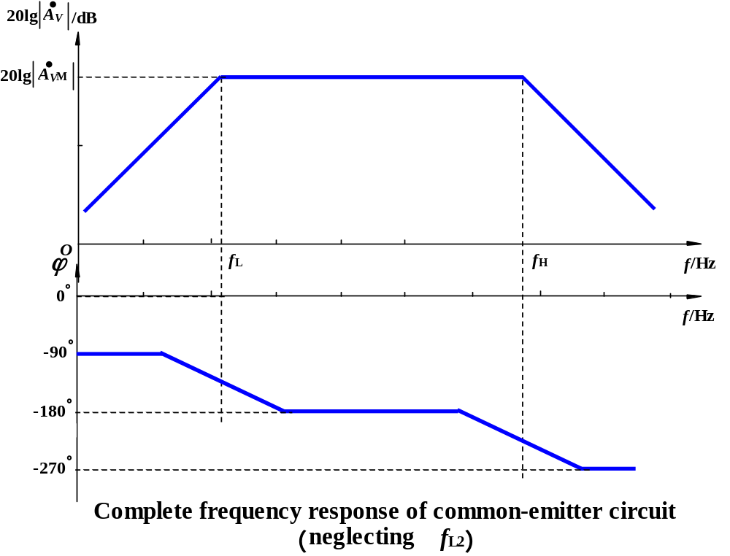
7.4 Frequency Response：Bipolar Transistor
Complete Frequency Response of Common-Emitter
-135°
-225°

Slide 21
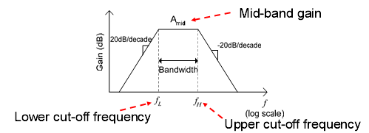

Conclusions:

Slide 22

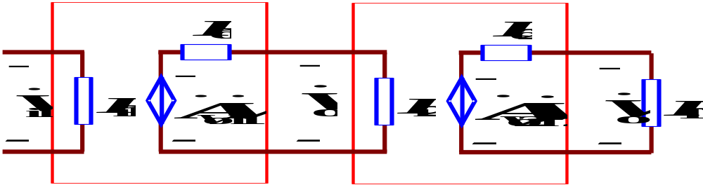
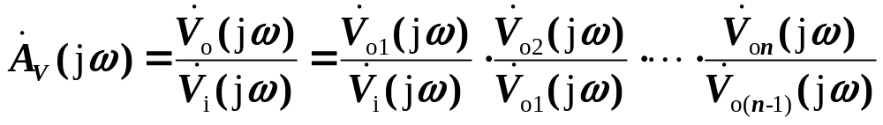


Frequency Response of Multistage Amplifiers
1. Overall Voltage Gain of Multistage Amplifiers
• Output voltage with open load is input signal source for next stage.
• The output impedance is the source resistance of its next stage.
• The input impedance is the load of its forestage.

Slide 23
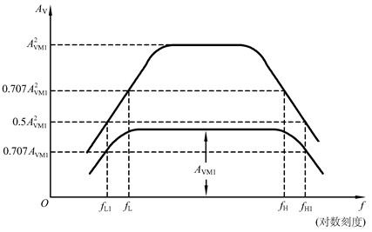
Frequency Response of Multistage Amplifiers

Slide 24
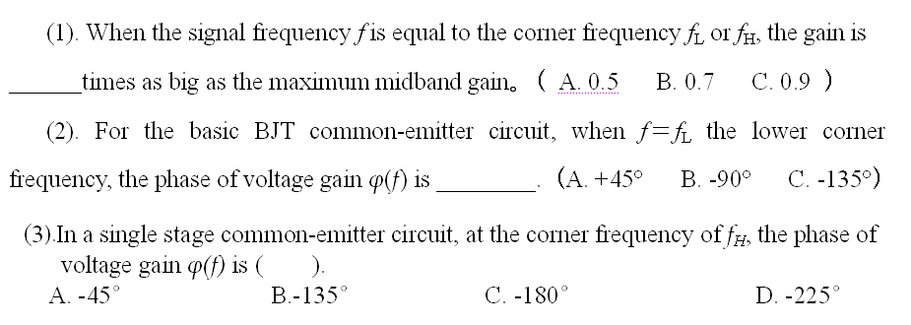
(B)
(C)
(D)

Slide 25
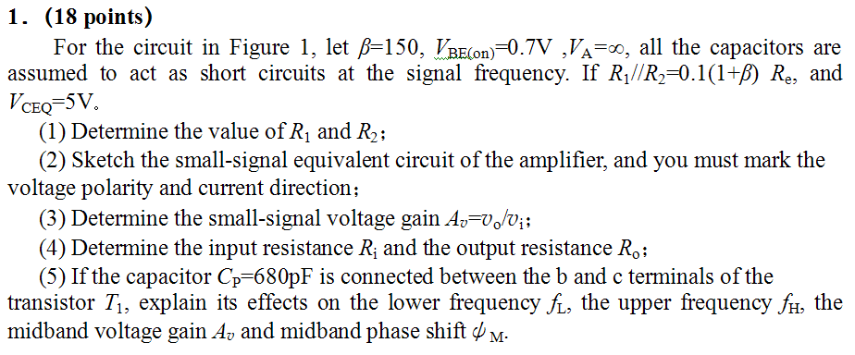
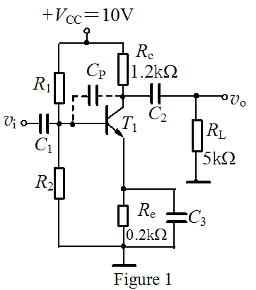

Slide 26
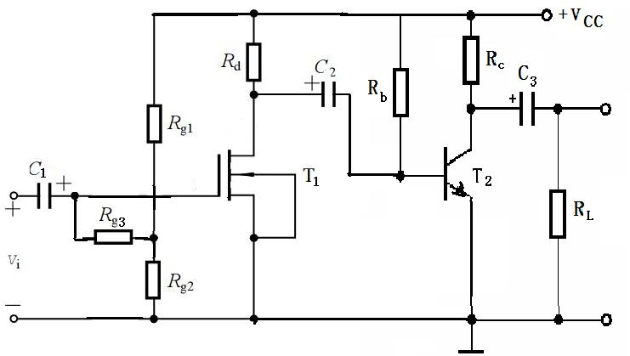

The circuit is as shown in the figure, and the Q-point of the amplification circuit is suitable.The capacitance in the passband can be regarded as a short circuit. The g_{m} of T₁ and the r_{π} and β of T₂ are known.and for T₁, λ=0.
(1) Sketch the small signal model equivalent circuit of the circuit;
(2) Determine the expression of the second stage input resistance R_{i2} of the circuit;
(3)Determine the voltage gain of the circuit A_{v}=v_{o}/v_{i};
（4）Determine the input resistance R_{i} of the circuit.
(5) Determine the output resistance R_{o} of the circuit.

Slide 27
The circuit is as shown in the figure, and the Q-point of the amplification circuit is suitable.The capacitance in the passband can be regarded as a short circuit. The g_{m} of T₁ and the r_{π} and β of T₂ are known.and for T₁, λ=0.
(1) Sketch the small signal model equivalent circuit of the circuit;
(2) Determine the expression of the second stage input resistance R_{i2} of the circuit;
(3)Determine the voltage gain of the circuit A_{v}=v_{o}/v_{i};
（4）Determine the input resistance R_{i} of the circuit.
(5) Determine the output resistance R_{o} of the circuit.

Slide 28
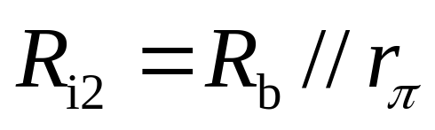
R_{i2}

Slide 29
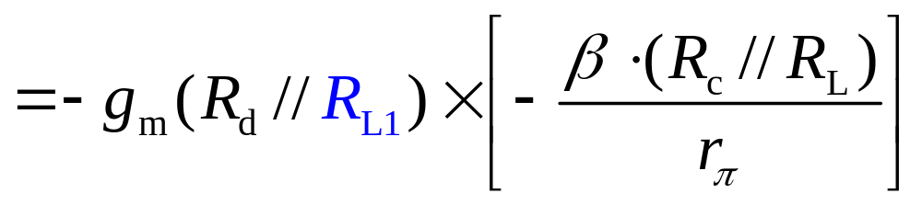
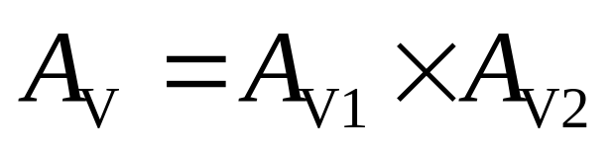
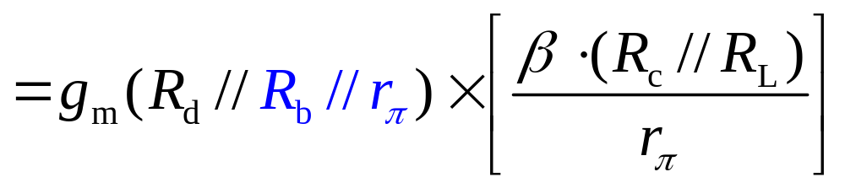

Slide 30
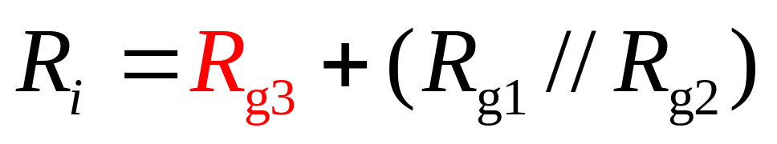
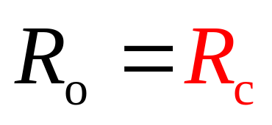

Slide 31
Questions
and
Answers

