Slide 1


Huazhong University of Science and Technology
The Department of Electronics and Information Engineering
Electronic Circuit Analysis and Design
Dr. Tianping Deng
Email: dengtp@hust.edu.cn

Slide 2
Contents
PART 1 SEMICONDUCTOR DEVICES AND BASIC APPLICATIONS
Chapter 1 Semiconductor Materials and Diodes
Chapter 2 Diode Circuits
Chapter 3 The Field-Effect Transistor
Chapter 4 Basic FET Amplifiers
Chapter 5 The Bipolar Junction Transistor
Chapter 6 Basic BJT Amplifiers
Chapter 7 Frequency Response
Chapter 8 Output Stages and Power Amplifiers
PART 2 ANALOG ELECTRONICS
Chapter 9 Ideal Operational Amplifiers and Op-Amp Circuits
Chapter 10 Integrated Circuit Biasing and Active Loads
Chapter 11 Differential and Multistage Amplifiers
Chapter 12 Feedback and Stability
Chapter 13 Operational Amplifier Circuits
Chapter 14 Nonideal Effects in Operational Amplifier Circuits
Chapter 15 Applications and Design of Integrated Circuits
Chapter 9 Ideal Operational Amplifiers and Op-Amp Circuits

Slide 3
Ch9 The Ideal Operational Amplifier
9.0 Preview
9.1 The Operational Amplifier
9.2 Inverting Amplifier
9.3 Summing Amplifier
9.4 Noninverting Amplifier
9.5 Op-Amp Application
P7-P39

Slide 4
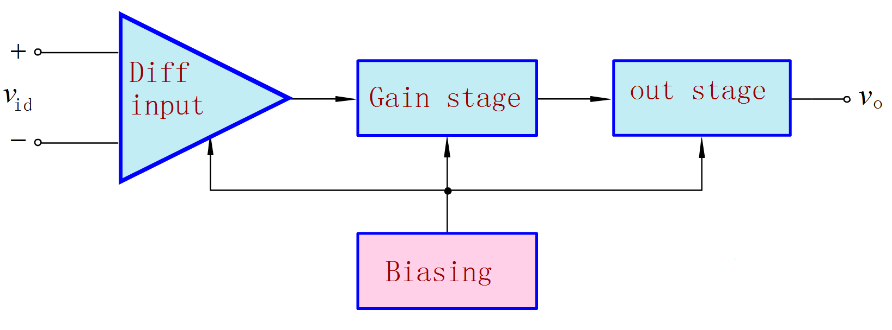
Ch9 The Ideal Operational Amplifier
9.0 Preview
Op-amp is high-gain, direct-coupled amplifier consisting of multiple stages: an input stage, a middle stage, and output stage.
It serves as a building block for many electronic circuits.

Slide 5
Ch9 The Ideal Operational Amplifier
9.0 Preview
Objectives
To learn about external characteristics of op-amps .
To analyze and design op-amp circuits
To learn about the usefulness of op-amps in signal
conditioning.

Slide 6
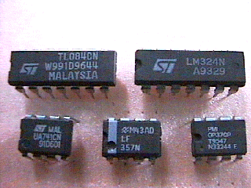
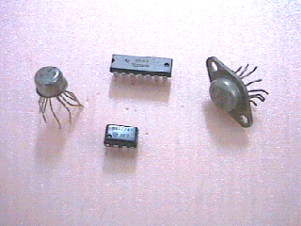
Pictures of Op Amps

Slide 7
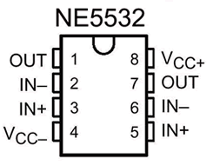
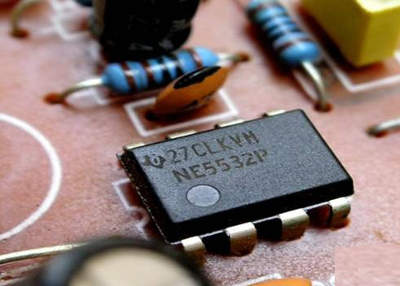
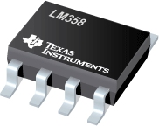
Pictures of Op Amps

Slide 8
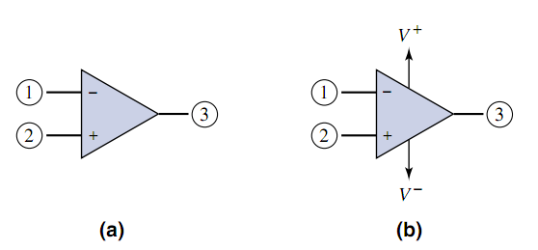
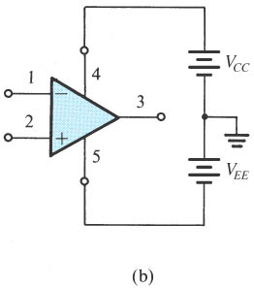
9.1 The Operational Amplifier
symbol for the op amp

Slide 9

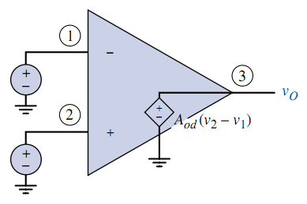


9.1.1 Ideal Parameters

Slide 10
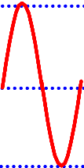
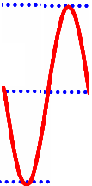

9.1 The Operational Amplifier

Slide 11
9.1.1 Ideal Parameters

Slide 12




9.1.1 Ideal Parameters
V_{CES}

Slide 13
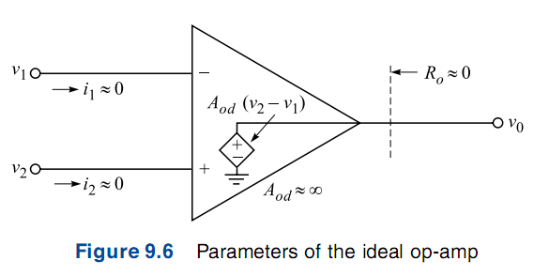



9.1.3 Analysis Method
The open-loop voltage gain is infinite: A_{od}=∞.
The input voltages must be nearly equal: v₂=v₁
Virtual short.

Slide 14
9.1.3 Analysis Method
The resistance r_{i}→∞
The input currents i₁ and i₂ are zero.
Virtual open.
The output resistance is negligible: R_{o}=0.

Slide 15

9.1.3 Analysis Method
A_{od}=∞.
Virtual short.
r_{i}→∞
R_{o}=0
Virtual open.

Slide 16
Questions
and
Answers

