Slide 1

Huazhong University of Science and Technology
The Department of Electronics and Information Engineering
Electronic Circuit Analysis and Design
Dr. Tianping Deng
Email: dengtp@hust.edu.cn

Slide 2
Contents
PART 1 SEMICONDUCTOR DEVICES AND BASIC APPLICATIONS
Chapter 1 Semiconductor Materials and Diodes
Chapter 2 Diode Circuits
Chapter 3 The Field-Effect Transistor
Chapter 4 Basic FET Amplifiers
Chapter 5 The Bipolar Junction Transistor
Chapter 6 Basic BJT Amplifiers
Chapter 7 Frequency Response
Chapter 8 Output Stages and Power Amplifiers
PART 2 ANALOG ELECTRONICS
Chapter 9 Ideal Operational Amplifiers and Op-Amp Circuits
Chapter 10 Integrated Circuit Biasing and Active Loads
Chapter 11 Differential and Multistage Amplifiers
Chapter 12 Feedback and Stability
Chapter 13 Operational Amplifier Circuits
Chapter 14 Nonideal Effects in Operational Amplifier Circuits
Chapter 15 Applications and Design of Integrated Circuits
Chapter 5 The Bipolar Junction Transistor

Slide 3
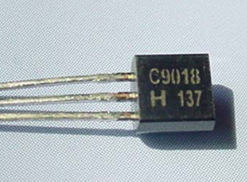
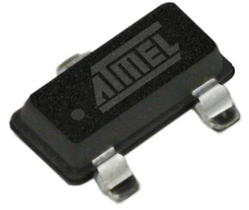
Ch5. The Bipolar Junction Transistor
5.1 Basic Bipolar Junction Transistor
5.2 DC Analysis of Transistor Circuits
5.3 Basic Transistor Application
5.4 Basic Transistor Biasing
5.5 Multistage Circuits
P287－P352

Slide 4
Ch5. The Bipolar Junction Transistor
5.1 Basic Bipolar Junction Transistor
5.1.1 Transistor Structure
5.1.2 NPN Transistor: Forward-Active Mode Operation
5.1.3 PNP Transistor: Forward-Active Mode Operation
5.1.4 Circuit Symbols and Conventions
5.1.5 Current-voltage Characteristics
5.1.6 Nonideal Transistor Leakage Current and Breakdown Voltage

Slide 5
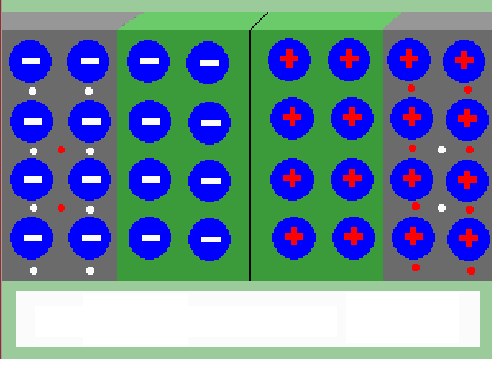
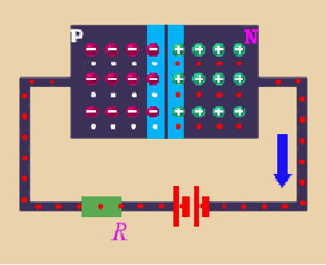
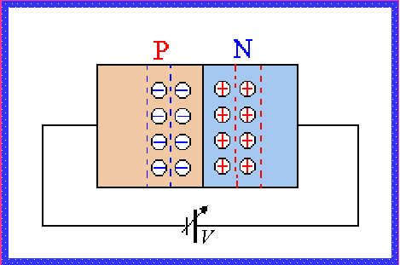
Review：
P
N
Forward Bias
Reverse Bias
i_{D}
v_{D}

Slide 6
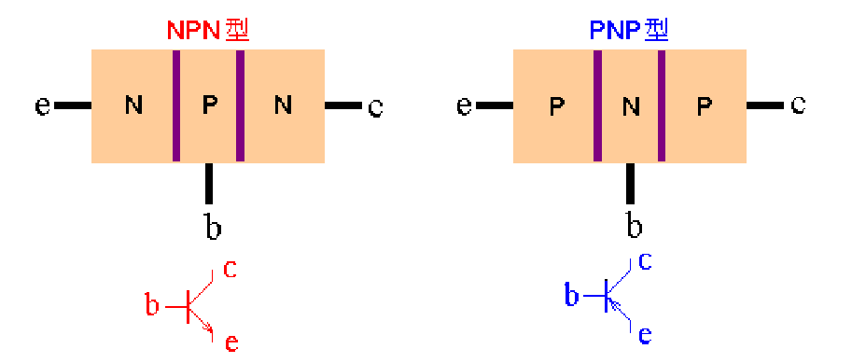
5.1 Basic Bipolar Junction Transistor (BJT)
5.1.1 Transistor Structure
There are two types of bipolar transistor: NPN and PNP.
Emitter terminal
Collector terminal
Emitter
Collector
Base
B-C junction
B-E junction
Base terminal
Symbol
Three regions:
Three
terminals
Two pn junctions:

Slide 7
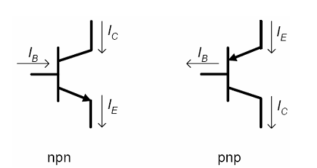
The emitter is distinguished by the arrowhead.

Slide 8
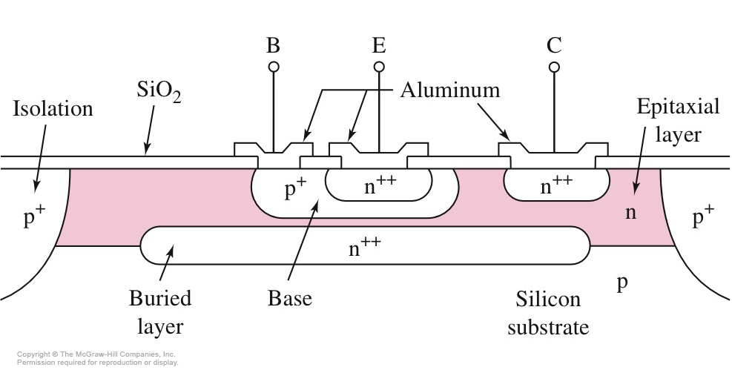
5.1.1 Transistor Structure
Cross Section of Integrated Circuit NPN Transistor
Not symmetrical

Slide 9
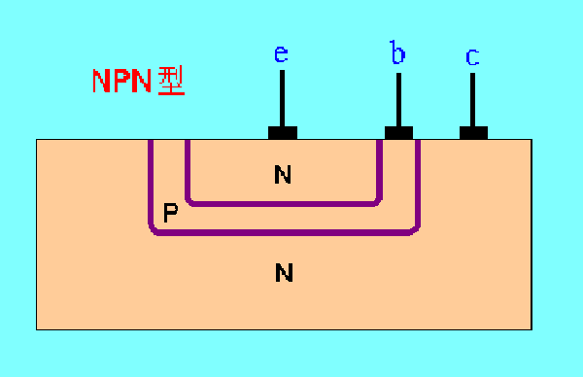


5.1.1 Transistor Structure
Feature of transistor structure
浓度
(1) Impurity doping concentration in emitter region is much larger than other two regions.
(2) Area of collector region is bigger than that of emitter.
(3) Base must be very narrow.
Cross section of NPN bipolar Transistor

Slide 10
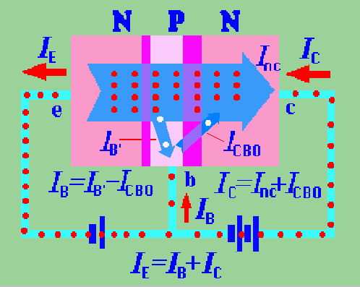
5.1.2 NPN Transistor: Forward-Active Mode Operation
Amplification condition
If transistor is used as an amplifying device.
B-E junction is forward biased.
B-C junction is reverse biased.
It is called the forward-active operating mode, or active region.
NPN bipolar transistor biased in the forward-active mode

Slide 11
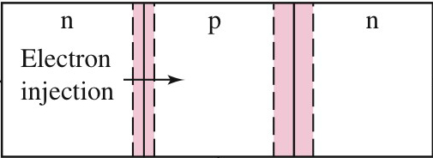



B-E junction is forward biased.
B-C junction is reverse biased.

Slide 12
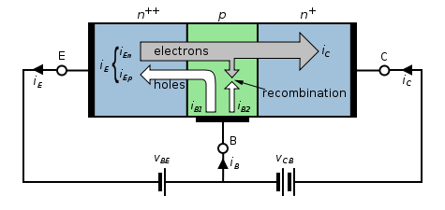
5.1.2 NPN Transistor: Forward-Active Mode Operation(P289)

Slide 13
5.1.2 NPN Transistor: Forward-Active Mode Operation
Amplification condition
1.Transfer process of carriers in npn
(1) Emitter region emit electrons into base.
(2) Collector region collect electrons injected base from emitter.
(3) B-E voltage controls collector current.
NPN bipolar transistor biased in the forward-active mode

Slide 14


Slide 15
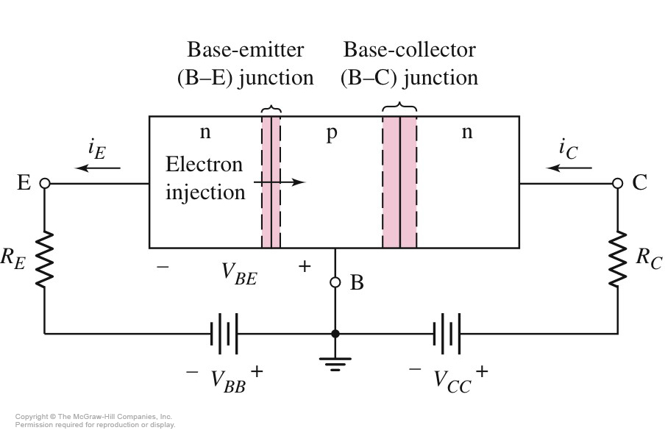
5.1.2 NPN Transistor: Forward-Active Mode Operation
There are two types of carriers, electrons and holes contributing to the current, so the transistor is called bipolar junction transistor (BJT).

Slide 16
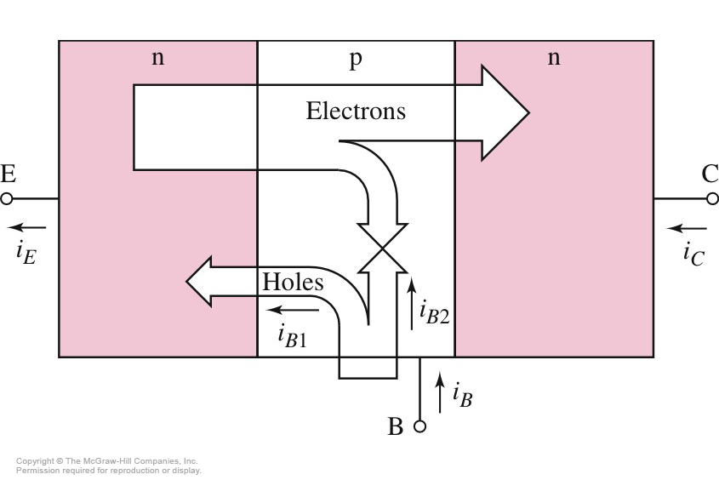
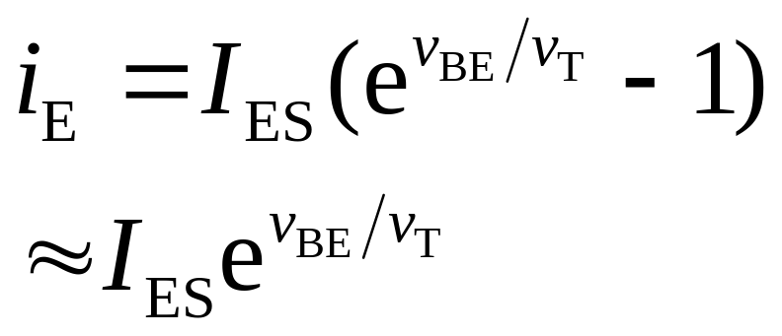
5.1.2 NPN Transistor: Forward-Active Mode Operation
Electrons and Holes in NPN BJT（P290)
Emitter Current
V_{T} __thermal voltage
I_{ES} __ emitter leakage current

Slide 17

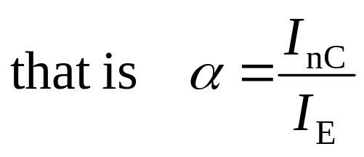
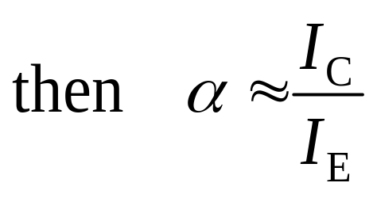

2. Current relationships
We know from transfer process of carriers
I_{E}=I_{B}+ I_{C}, I_{C}= I_{nC}+ I_{CBO} , I_{B}= I_{B’} - I_{CBO}
generally I_{C} >> I_{CBO}
α --common-base current gain, only depend on geometries and concentration, no relation with voltages. Generally α = 0.9∼0.99
Transfer process of carriers

Slide 18
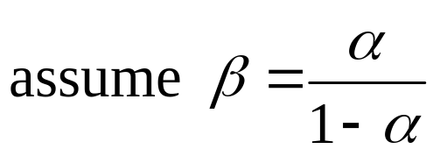
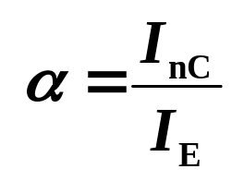
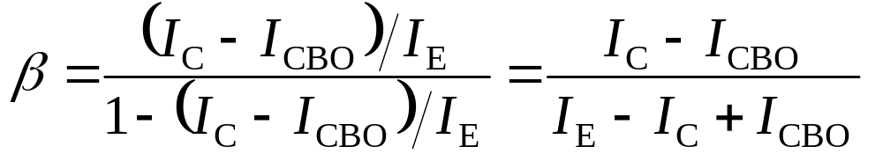

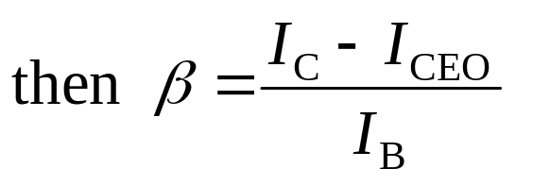
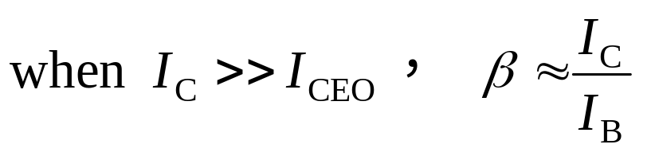
2. Current relationships
since I_{E}=I_{B}+I_{C} , I_{C}= I_{nC}+I_{CBO} ,
assume
I_{CEO}= (1+ β ) I_{CBO}
（leakage current）
β is common-emitter current gain, also, only depend on geometries and impurity concentration, independent of B-C and B-E voltages. Generally 50<β < 300.

Slide 19
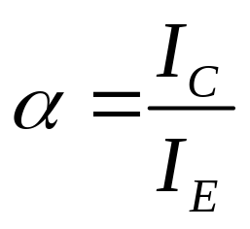
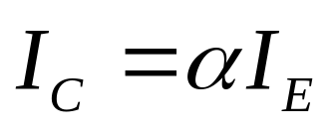
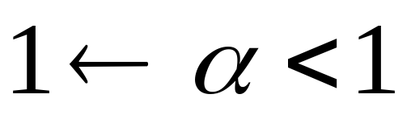
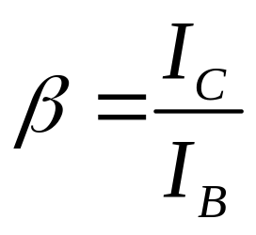
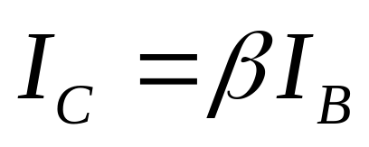
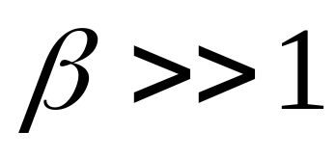
2. Current relationships
I_{E}=I_{B}+ I_{C}

Slide 20
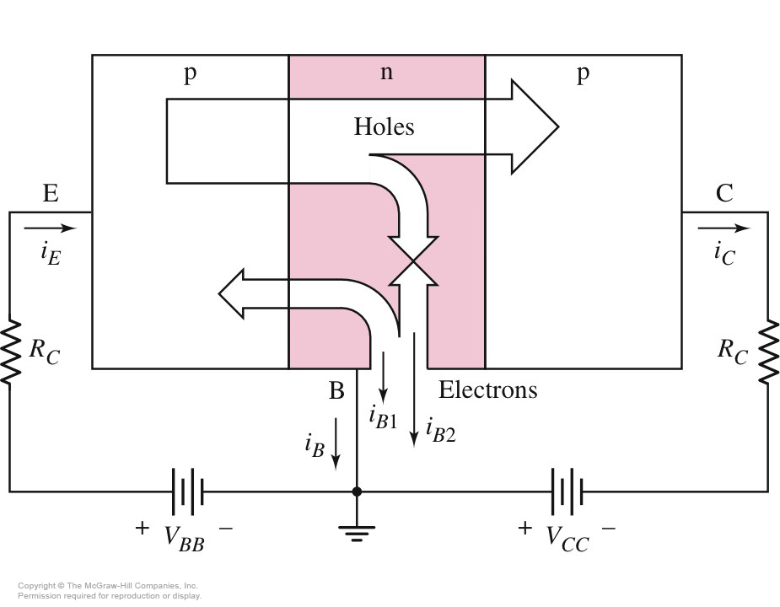
5.1.3 PNP Transistor: Forward-Active Mode Operation

Slide 21
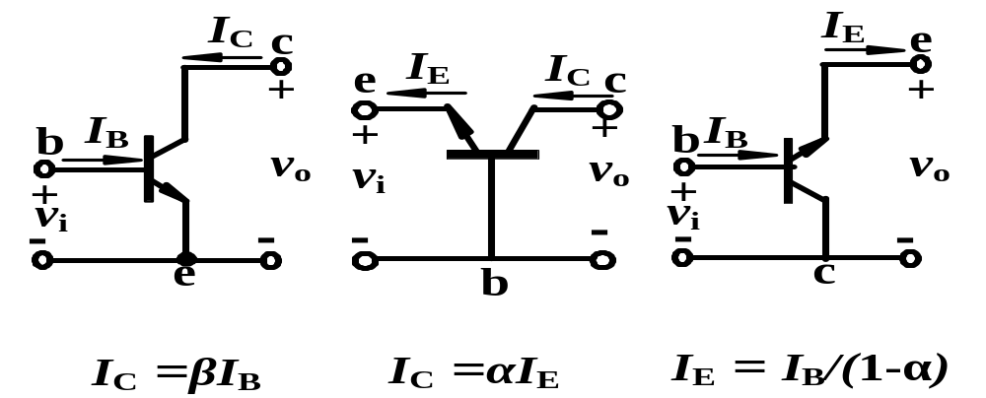

Three Types of Circuit Configurations
BJT Circuit Configurations
Common-emitter，emitter is a common terminal，briefly CE；
Common-base，base is a common terminal，briefly CB；
Common-collector，collector is a common terminal，briefly CC；
Which Configuration can amplify current?

Slide 22
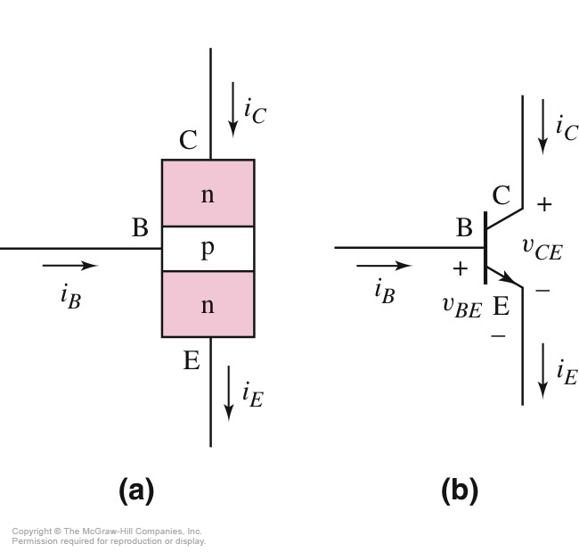
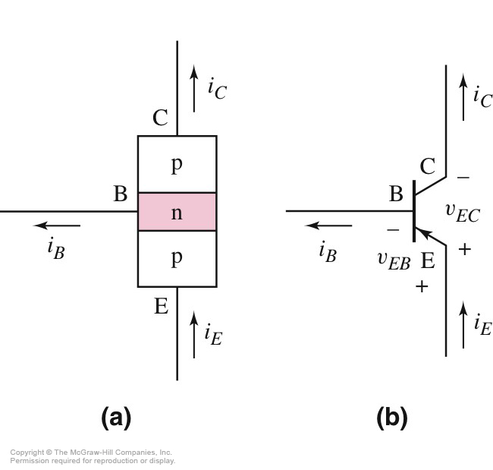
5.1.4 Circuit Symbols and Conventions
NPN
PNP

Slide 23
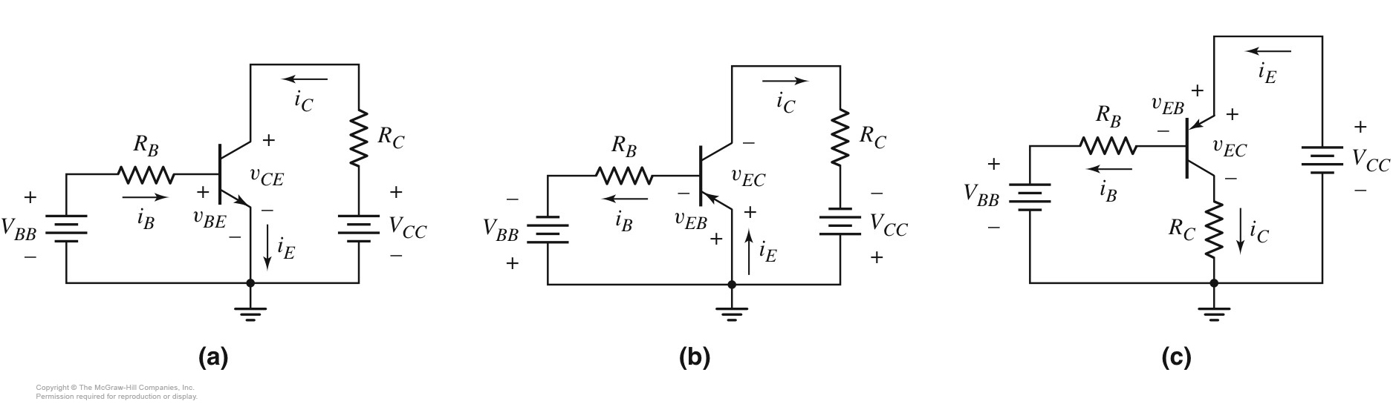
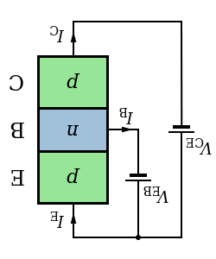
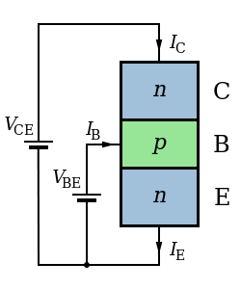
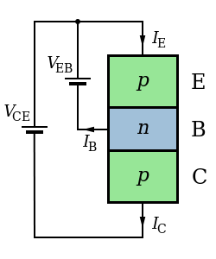
5.1.4 Circuit Symbols and Conventions
Common Emitter
PNP
NPN
PNP

Slide 24
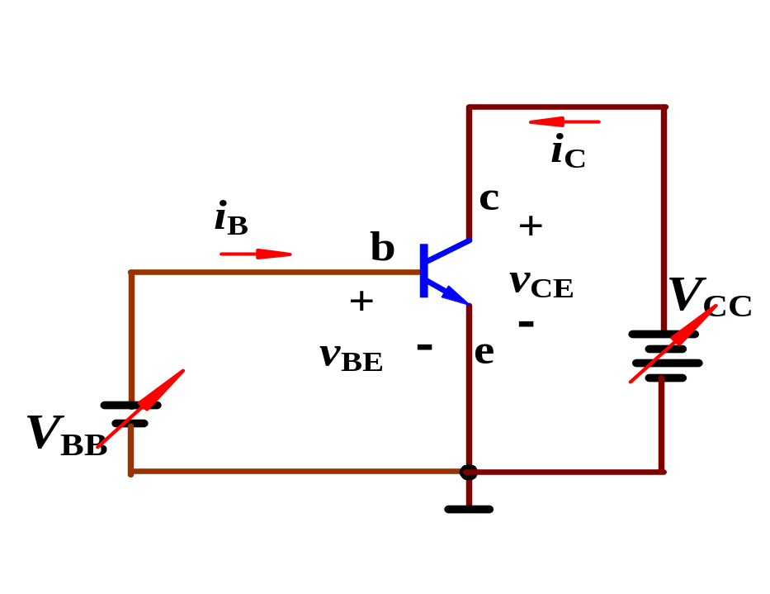
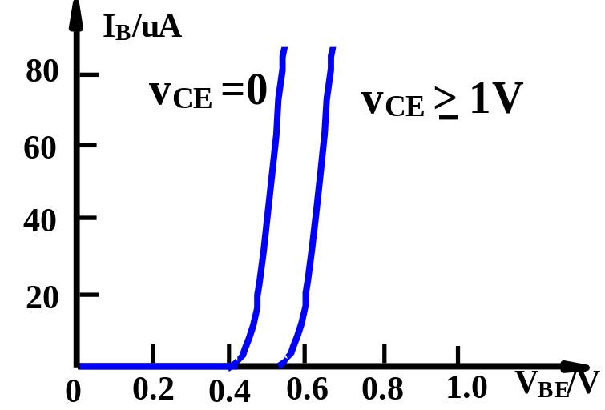
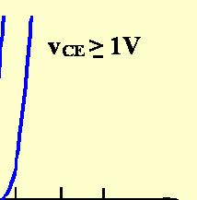

5.1.5 Current-Voltage Characteristics
1. Input characteristic of CE
（Taking CE circuit as e.g.)
i_{B}=f(v_{BE})⏐ _{vCE=const}
(1) when v_{CE}=0V, it is same as forward exponential relation of a diode 。
(2) When v_{CE}≥1V， v_{CB}= v_{CE}-v_{BE}>0，B-C is reverse biased，some electrons begin to sweep into collector, recombination decreases in base, so I_{B} reduces under same v_{BE}，
curve shifts to right。
Common-emitter circuit
Simulation

Slide 25
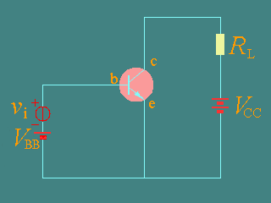
5.1.5 Current-Voltage Characteristics
2. The output Characteristic of CE
i_{C}=f(v_{CE})⏐ _{iB=const}
Simulation

Slide 26
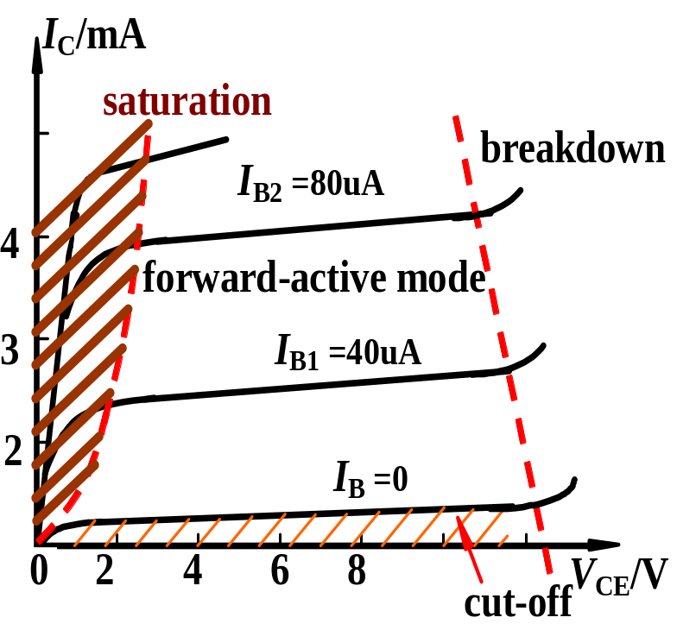
5.1.5 Current-Voltage Characteristics
2. Output characteristic of CE (Transistor characteristic)
i_{C}=f(v_{CE})⏐ _{iB=const}
Four regions for characteristic
Saturation：i_{C} is controlled by v_{CE}, i_{C} increases rapidly as v_{CE} increases, and v_{CE}＜0.7V (Silicon)。B-E is forward biased, B-C is forward biased, too, or voltage of reverse biased is very small.

Slide 27
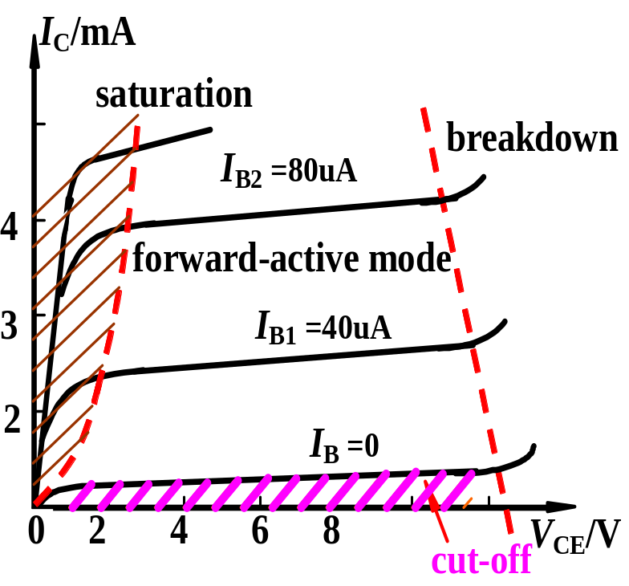
5.1.5 Current-Voltage Characteristics
2. Output characteristic of CE (Transistor characteristic)
i_{C}=f(v_{CE})⏐ _{iB=const}
Four regions for characteristic
Cut-off：i_{C} is nearly zero，Cut-off region is under i_{B}=0。V_{BE} < V_{th} (turn in voltage), B-C is reverse biased。

Slide 28
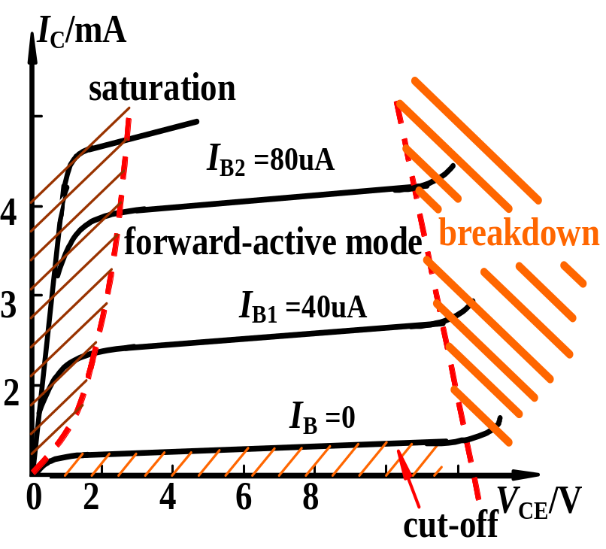
5.1.5 Current-Voltage Characteristics
2. Output characteristic of CE (Transistor characteristic)
i_{C}=f(v_{CE})⏐ _{iB=const}
Four regions for characteristic
Breakdown: Reverse-bias voltage of B-C increases too much, B-C junction begin to breakdown.

Slide 29
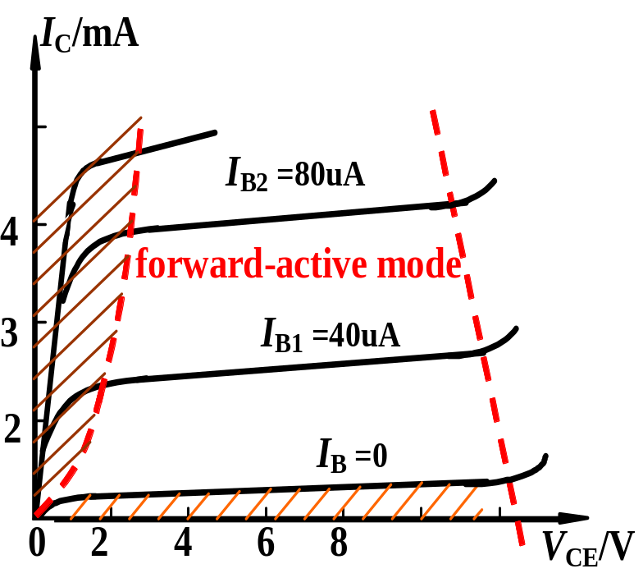

5.1.5 Current-Voltage Characteristics
2. Output characteristic of CE (Transistor characteristic)
i_{C}=f(v_{CE})⏐ _{iB=const}
Four regions for characteristic
Forward-active mode： i_{C} and i_{B} are related by i_{C} = i_{B}. Curves are parallel and equidistance. B-E is forward biased, B-C is reverse biased.

Slide 30
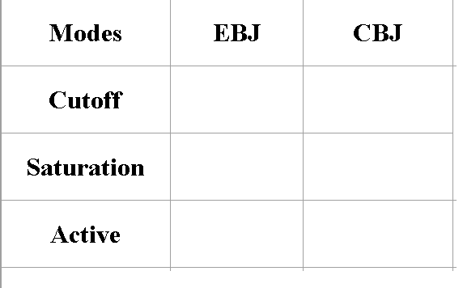


Modes of Operation

Slide 31
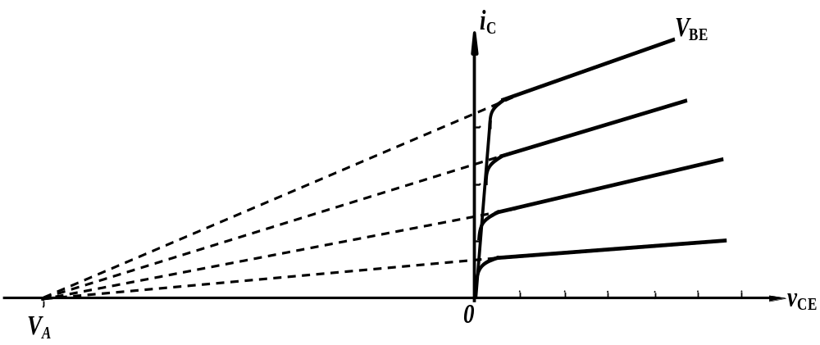
5.1.5 Current-Voltage Characteristics
2. The output Characteristic of CE
Current-voltage characteristics for the common-emitter circuit, showing the Early voltage

Slide 32
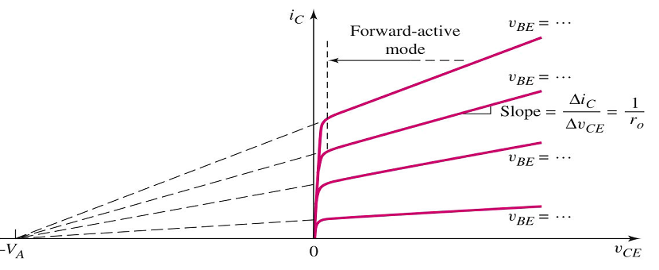
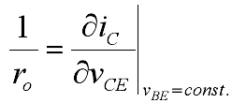
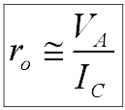


5.1.5 Current-Voltage Characteristics
2. The output Characteristic of CE

Slide 33
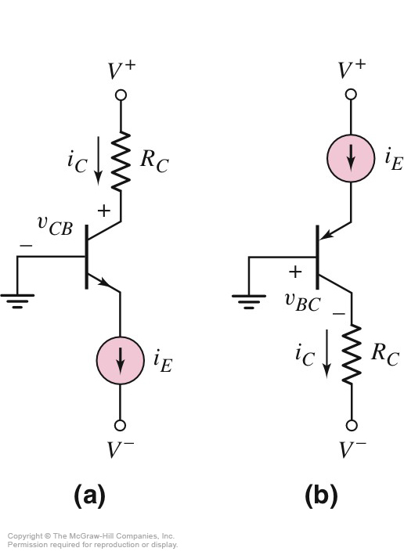

5.1.5 Current-voltage Characteristics
Common Base
Current-voltage Characteristics

Slide 34



5.1.6 Nonideal Transistor Leakage Current and Breakdown Voltage
1. Reverse-bias Leakage Currents
(1) Collector-base leakage current I_{CBO}
I_{CBO} is the collector leakage current in common-base configuration, when the emitter is an open circuit.
(2) Collector-emitter leakage current I_{CEO}
I_{CEO}=（1+ β_{F} ）I_{CBO}
In most instances in this text, leakage will be completely negligible.
I_{CEO}

Slide 35

Effects of Leakage Currents on I-V Characteristics

Slide 36
5.1.6 Nonideal Transistor Leakage Current and Breakdown Voltage
2. Breakdown Voltage
BV_{CBO}——Collector-base junction breakdown voltage in open-emitter configuration。
BV_{CEO}——Breakdown voltage between collector and emitter in open-base configuration.
BV _{EBO}——Base-emitter junction breakdown voltage in open-collector configuration。
V_{(BR)CBO}＞V_{(BR)CEO}＞V_{(BR) EBO}
These will be a limiting factors in the size of the dc bias voltages which can be used.

Slide 37


Review Questions
？
(1) Due to a BJT has two pn junction, can we conjoin two back-to-back diodes to be as a BJT? Why?
(2) Can we exchange the emitter and collector terminals of a BJT, when we use it as a amplifying device?
(3) Why we call a BJT as a current-controlled device?

Slide 38
Review Questions
？
4. The voltage values for three terminals are given, determine the region which BJT operates in.
(1) V_{C}=6V , V_{B}=0.7V , V_{E}=0V ,
(2) V_{C}=6V , V_{B}=6V , V_{E}=5.4V ,
(3) V_{C}=6V , V_{B}=4V , V_{E}=3.6V ,
(4) V_{C}=3.6V , V_{B}=4V , V_{E}=3.4V ,

Slide 39
(1)V_{C}=6V,V_{B}=0.7V, V_{E}=0V
V_{BE}=0.7V> V_{th}=0.5V
V_{CE}=6V
V_{C}>V_{B}>V_{E}
Forward active region

Slide 40
(2)V_{C}=6V,V_{B}=6V, V_{E}=5.4V
V_{BE}=0.6V> V_{th}=0.5V
V_{CE}=0.6V
V_{C}=V_{B}>V_{E}
Saturation Region

Slide 41
(3)V_{C}=6V,V_{B}=4V, V_{E}=3.6V
V_{BE}=0.4V<0.5V
Cut off region

Slide 42
4)V_{C}=3.6V,V_{B}=4V, V_{E}=3.4V
V_{BE}=0.6V
V_{CE}=0.2V
Saturation Region

Slide 43

Review Questions
？
5.Assume I₁= –1.2mA, I₂= –0.03mA, I₃= 1.23mA，
(1) Determine ① is ，② is ，③ is 。
C
B
E
(2) β =?
1.2/0.03=40

Slide 44
？
Review Questions
6. In an amplifier, the voltage of the three terminals is
0V，- 10V，-9.3V，
Determine the BJT is NPN or PNP, is made of Si or Ge？
Sol:
0V，-10V，-9.3V
C
U_{C} > U_{B} > U_{E}
NPN
V_{BE}=0.7V
Si

Slide 45
Questions
and
Answers

