Slide 1

Huazhong University of Science and Technology
The Department of Electronics and Information Engineering
Electronic Circuit Analysis and Design
Dr. Tianping Deng
Email: dengtp@hust.edu.cn

Slide 2
Contents
PART 1 SEMICONDUCTOR DEVICES AND BASIC APPLICATIONS
Chapter 1 Semiconductor Materials and Diodes
Chapter 2 Diode Circuits
Chapter 3 The Field-Effect Transistor
Chapter 4 Basic FET Amplifiers
Chapter 5 The Bipolar Junction Transistor
Chapter 6 Basic BJT Amplifiers
Chapter 7 Frequency Response
Chapter 8 Output Stages and Power Amplifiers
PART 2 ANALOG ELECTRONICS
Chapter 9 Ideal Operational Amplifiers and Op-Amp Circuits
Chapter 10 Integrated Circuit Biasing and Active Loads
Chapter 11 Differential and Multistage Amplifiers
Chapter 12 Feedback and Stability
Chapter 13 Operational Amplifier Circuits
Chapter 14 Nonideal Effects in Operational Amplifier Circuits
Chapter 15 Applications and Design of Integrated Circuits
Chapter 6 Basic BJT Amplifiers

Slide 3
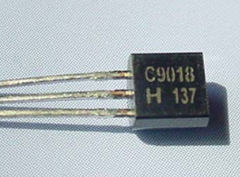
Ch6. Basic BJT Amplifiers
6.0 Preview
6.1 Analog Signals and Linear Amplifiers
6.2 The Bipolar Linear Amplifier
6.3 Basic Transistor Amplifier Configurations
6.4 Common-Emitter Amplifiers
6.5 AC Load Line Analysis
6.6 Common-Collector (Emitter-Follower) Amplifier
6.7 Common-Base Amplifier
6.8 The Three Basic Amplifiers: Summary and Comparison
6.9 Multistage Amplifiers
6.10 Power Considerations
6.11 Design Application
6.12 Summary

Slide 4
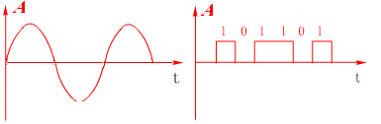
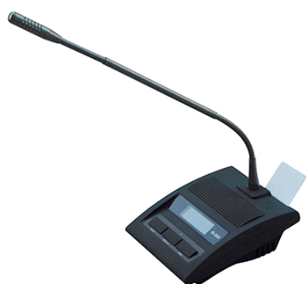

6.1 Analog Signals and Linear Amplifiers
Signals
A signal contains some type of information. There are two kinds of signals: analog and digital.
Analog signal
Digital signal

Slide 5

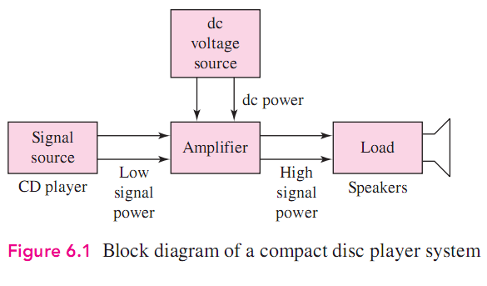
6.1 Analog Signals and Linear Amplifiers
Amplifiers

Slide 6
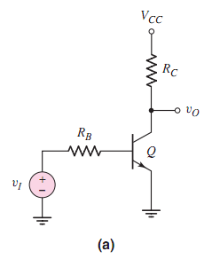
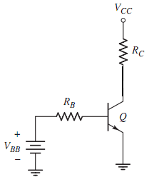
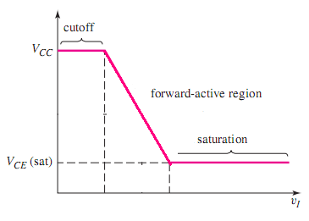

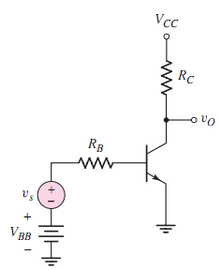

6.2 The Bipolar Linear Amplifier
which region ?
Forward active region

Slide 7

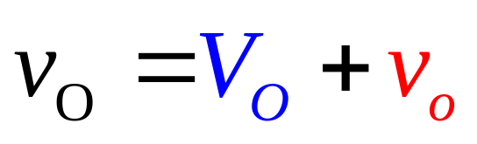
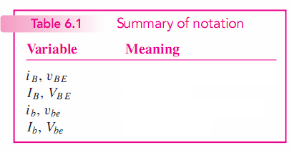
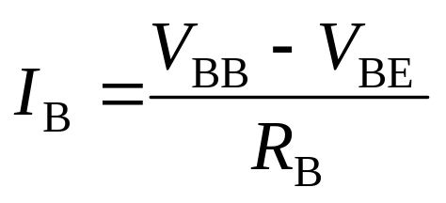
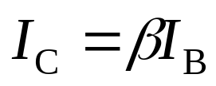

6.2 The Bipolar Linear Amplifier
DC
AC
DC analysis

Slide 8

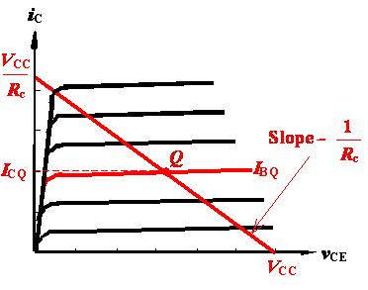
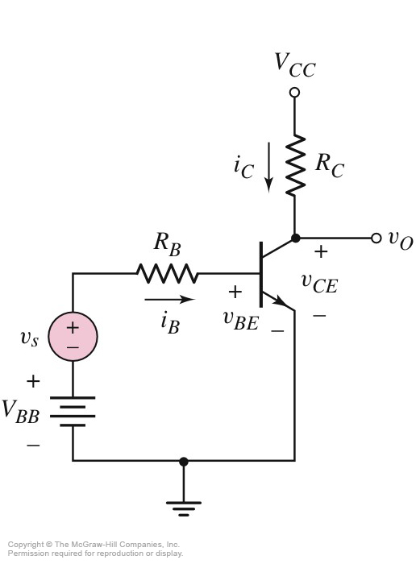
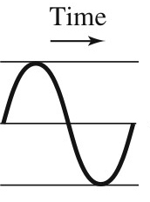
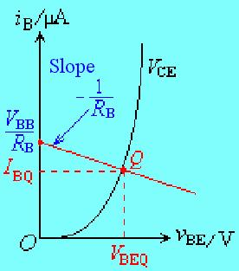
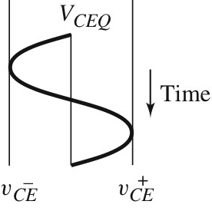
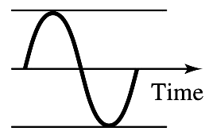
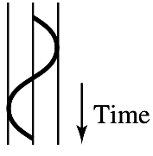
6.2.1Graphical Analysis and ac Equivalent Circuit
β
Common Emitter

Slide 9
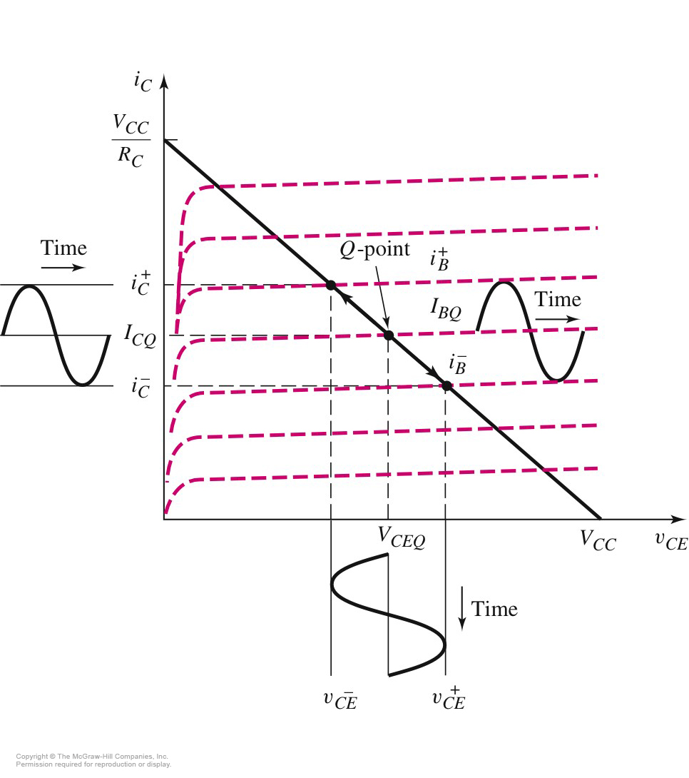
6.2.1Graphical Analysis and ac Equivalent Circuit
How to get the small signal model?

Slide 10
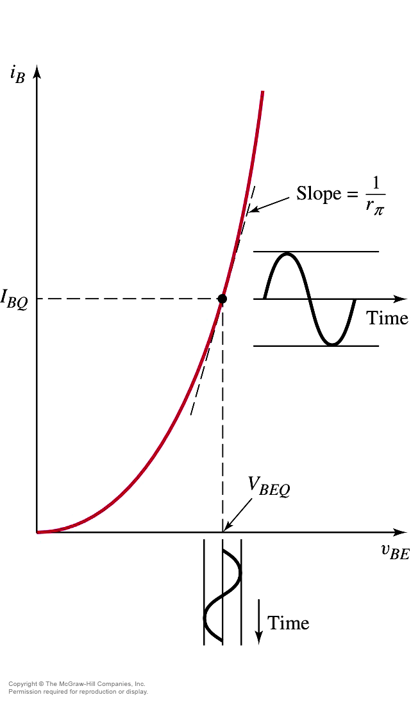
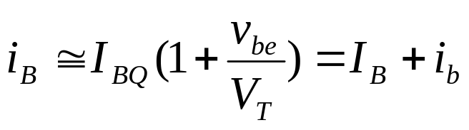
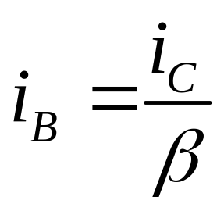
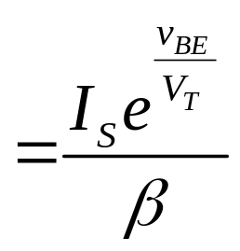
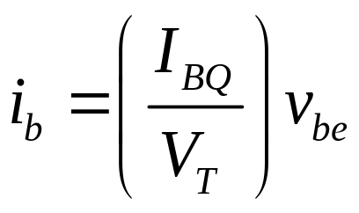
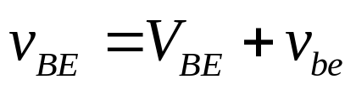
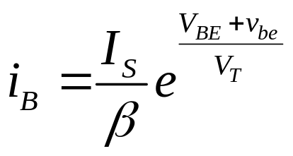
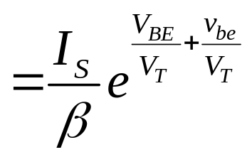
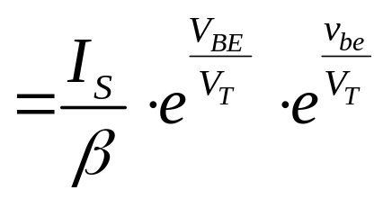
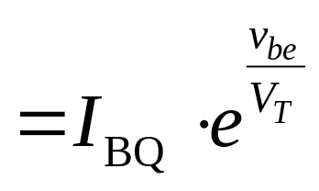
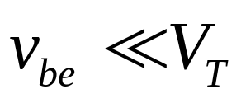
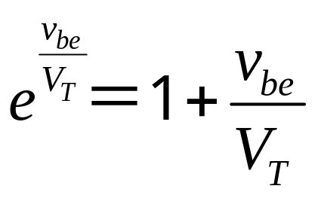
6.2.1Graphical Analysis and ac Equivalent Circuit
i_{B} Versus v_{BE} Characteristic
Small signal
Taylor series

Slide 11
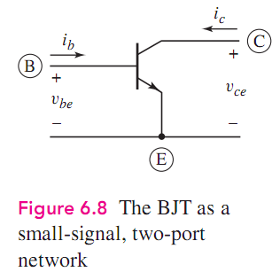
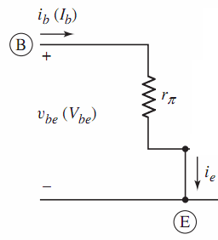
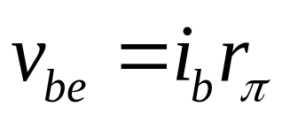
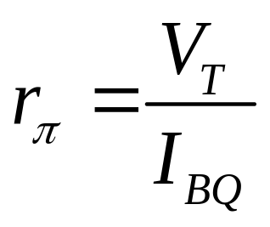
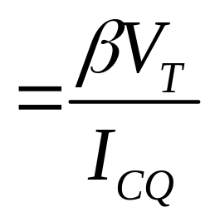
6.2.2 Small signal Hybrid-ΠEquivalent Circuit

Slide 12


Slide 13







6.2.2 Small signal Hybrid-ΠEquivalent Circuit
Transconductance

Slide 14
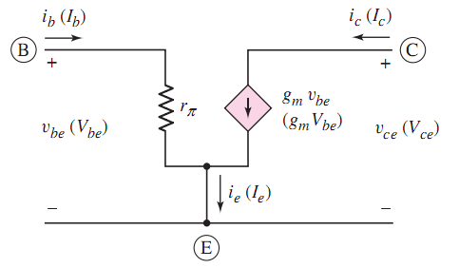
6.2.2 Small signal Hybrid-ΠEquivalent Circuit

Slide 15

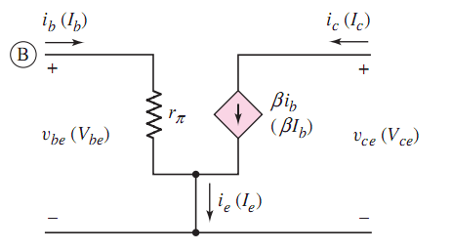



6.2.2 Small signal Hybrid-ΠEquivalent Circuit

Slide 16
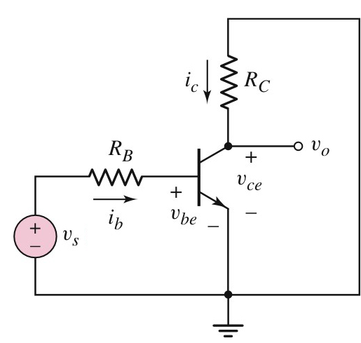


6.2.2 Small signal Hybrid-ΠEquivalent Circuit
Small signal voltage gain
AC circuit

Slide 17

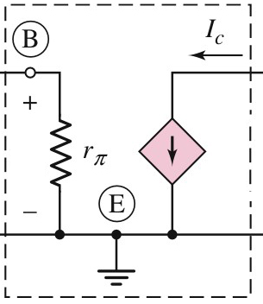
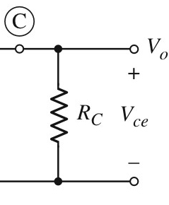
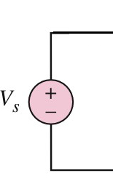
6.2.2 Small signal Hybrid-ΠEquivalent Circuit
Small signal voltage gain
Small-Signal Equivalent Circuit

Slide 18


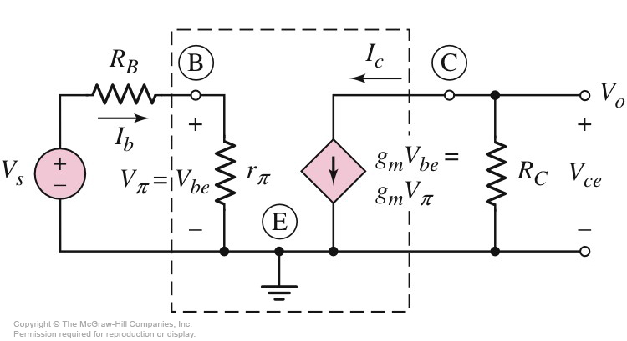
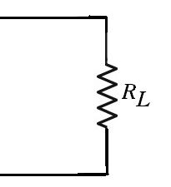






6.2.2 Small signal Hybrid-ΠEquivalent Circuit
Small signal voltage gain

Slide 19
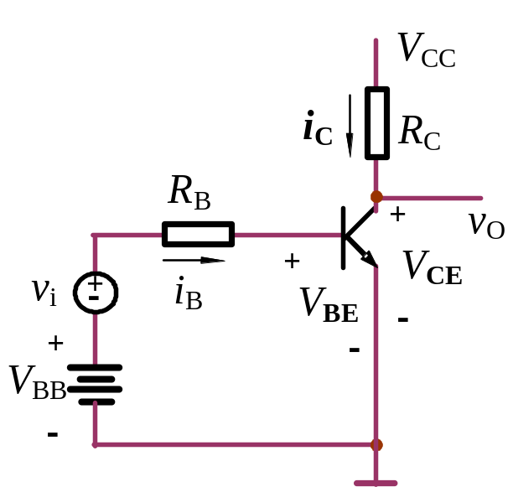
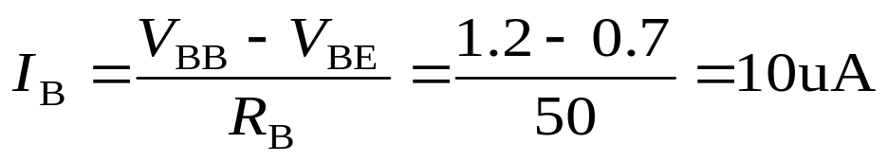

6.2.2 Small signal Hybrid-ΠEquivalent Circuit
Example 1
Calculate the small-signal voltage gain of the bipolar transistor circuit shown in Fig. Assume β=100, V_{CC}=12V, V_{BE}=0.7V, R_{C}=6kΩ, R_{B}=50kΩ, V_{BB}=1.2V. If v_{i}=0.25sinωt V, find v_{o} .
Sol: (1) Find the Q-point values
Which region?

Slide 20

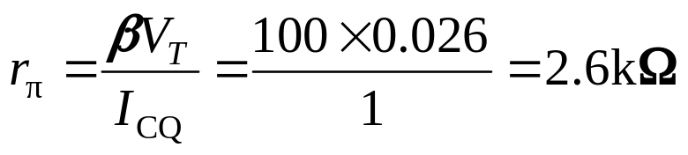
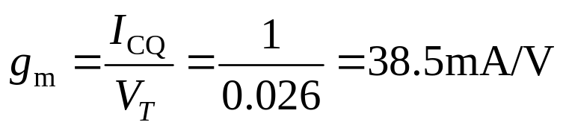

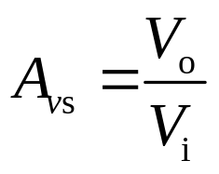





6.2.2 Small signal Hybrid-ΠEquivalent Circuit
Example 1
(2) Find the small-signal parameters
and
(3) Find AC parameters

Slide 21


6.2.2 Small signal Hybrid-ΠEquivalent Circuit
Example 1
(3) In small-signal circuit, ac base current is given by

Slide 22





6.2.2 Small signal Hybrid-ΠEquivalent Circuit
v_{s}=0.25sinωt V

Slide 23
6.2.2 Small signal Hybrid-ΠEquivalent Circuit
Problem-Solving Technique:
BJT AC Analysis
Analyze circuit with only dc sources to find Q point.
Replace each element in circuit with small-signal model, including the hybrid π model for the transistor.
Analyze the small-signal equivalent circuit after setting dc source components to zero.

Slide 24










6.2.2 Small signal Hybrid-ΠEquivalent Circuit

Slide 25





6.2.3 Hybrid-ΠEquivalent Circuit , Including the Early Effect

Slide 26


6.2.3 Hybrid-ΠEquivalent Circuit , Including the Early Effect
Hybrid π Model for npn with Early Effect

Slide 27









6.2.3 Hybrid-ΠEquivalent Circuit , Including the Early Effect
Calculate the small-signal voltage gain of the bipolar transistor circuit shown in Fig. Assume β=100, V_{CC}=12V, V_{BE}=0.7V, R_{C}=6kΩ, R_{B}=50kΩ, V_{BB}=1.2V.

Slide 28







6.2.3 Hybrid-ΠEquivalent Circuit , Including the Early Effect
P389-396
Teach yourself!

Slide 29


Example
The circuit shown in Fig.
Draw its small-signal equivalent circuit.

Slide 30
Questions
and
Answers

