Slide 1

Huazhong University of Science and Technology
The Department of Electronics and Information Engineering
Electronic Circuit Analysis and Design
Dr. Tianping Deng
Email: dengtp@hust.edu.cn

Slide 2
Contents
PART 1 SEMICONDUCTOR DEVICES AND BASIC APPLICATIONS
Chapter 1 Semiconductor Materials and Diodes
Chapter 2 Diode Circuits
Chapter 3 The Field-Effect Transistor
Chapter 4 Basic FET Amplifiers
Chapter 5 The Bipolar Junction Transistor
Chapter 6 Basic BJT Amplifiers
Chapter 7 Frequency Response
Chapter 8 Output Stages and Power Amplifiers
PART 2 ANALOG ELECTRONICS
Chapter 9 Ideal Operational Amplifiers and Op-Amp Circuits
Chapter 10 Integrated Circuit Biasing and Active Loads
Chapter 11 Differential and Multistage Amplifiers
Chapter 12 Feedback and Stability
Chapter 13 Operational Amplifier Circuits
Chapter 14 Nonideal Effects in Operational Amplifier Circuits
Chapter 15 Applications and Design of Integrated Circuits
Chapter 5 The Bipolar Junction Transistor

Slide 3
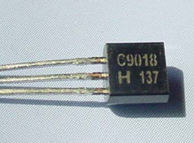
Ch5. The Bipolar Junction Transistor
5.1 Basic Bipolar Junction Transistor
5.2 DC Analysis of Transistor Circuits
5.3 Basic Transistor Application
5.4 Basic Transistor Biasing
5.5 Multistage Circuits

Slide 4

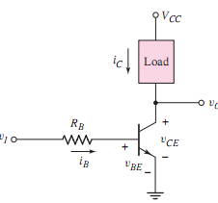
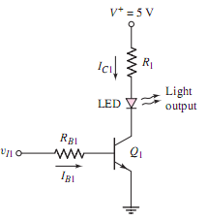





Slide 5
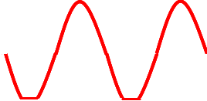
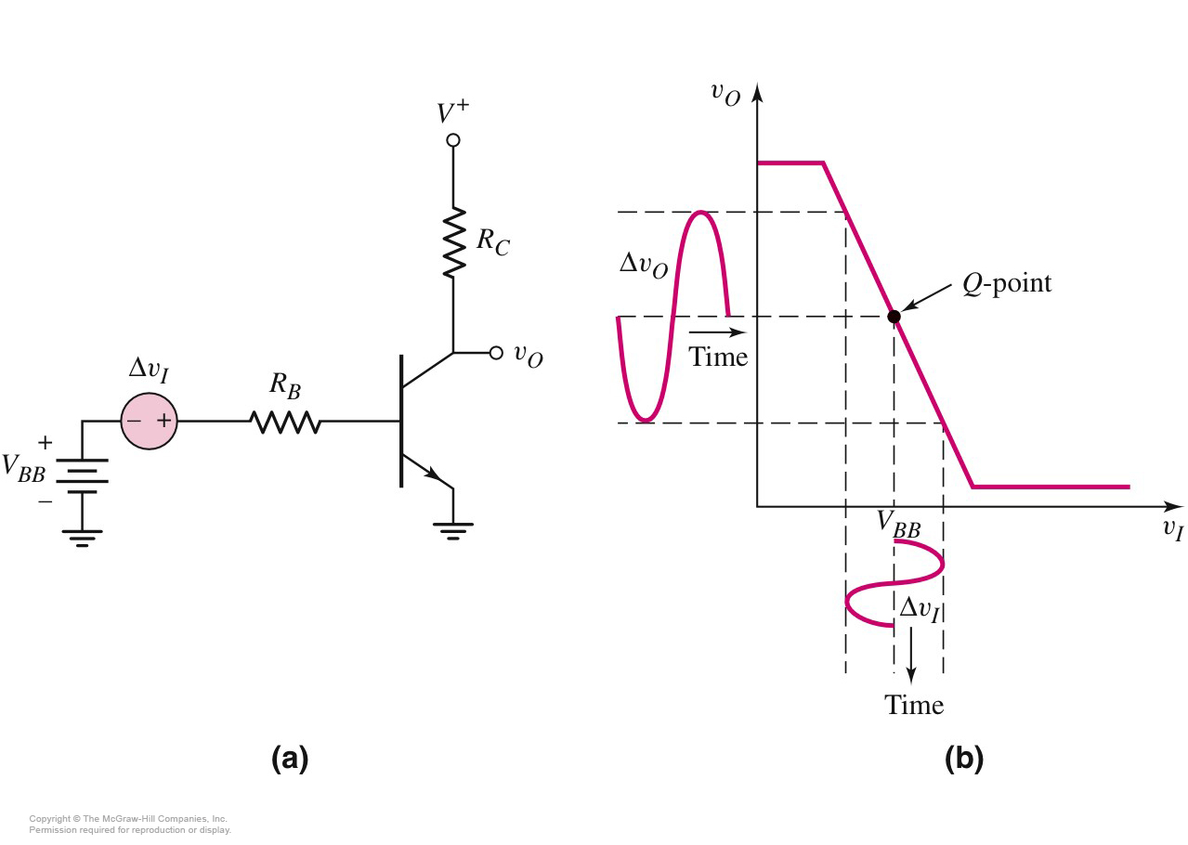
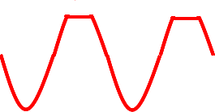
5.3.3 Amplifier
V_{O}=?

Slide 6
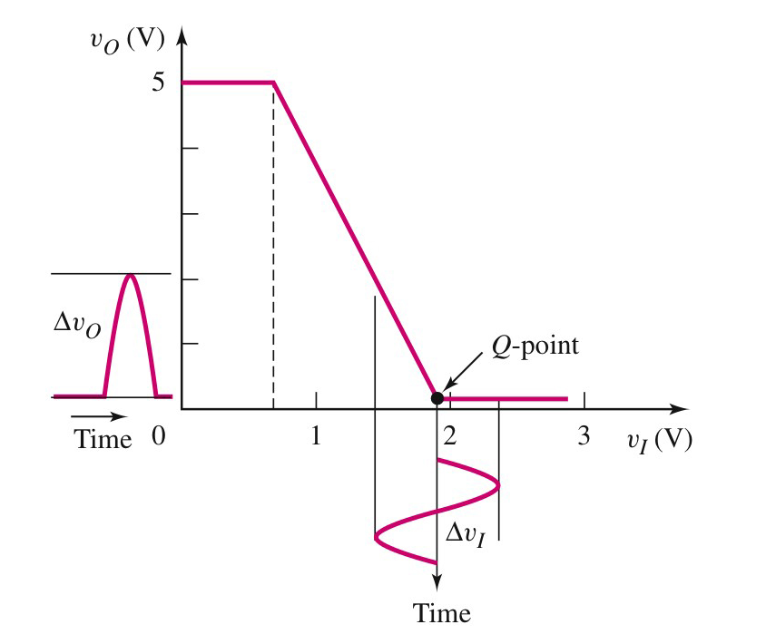
Effect of Improper Biasing on Amplified Signal Waveform

Slide 7

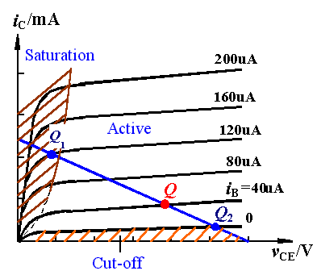
Effect of Improper Biasing on Amplified Signal Waveform
The i-v characteristic of npn

Slide 8
Effect of Improper Biasing on Amplified Signal Waveform
saturation distortion
For NPN BJT and the CE circuit
0

Slide 9
The Q-point is too high, output waveform is distorted.
i_{C}
i_{b}
Input
v_{CE}
Output
v_{o}

Slide 10
Cut-off distortion
For NPN BJT and the CE circuit
0
Note: For the PNP, as a negative power supply,
the distortion is against to NPN.

Slide 11
The Q-point is too low, output waveform is distorted.
i_{C}
Input
i_{b}
u_{CE}
u_{o}
Output

Slide 12
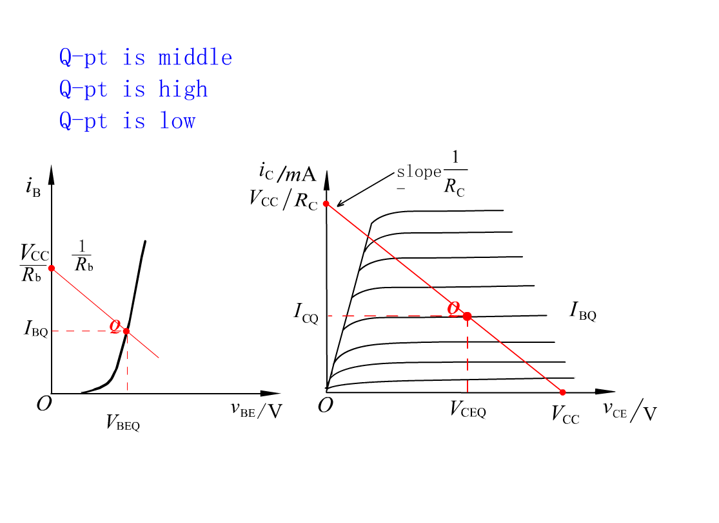

Slide 13

0
0
0
saturation distortion
Cut-off distortion
Clipping distortion

Slide 14
5.4 Basic Transistor Biasing
DC Biasing
Establish Q-point
Forward active region

Slide 15
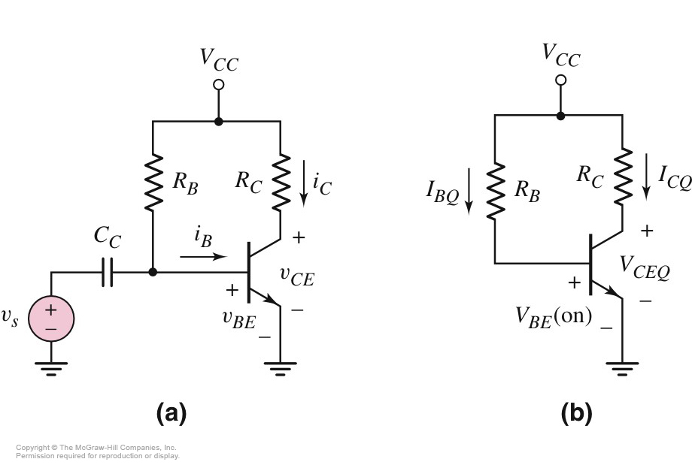
5.4.1 Single Base Resistor Biasing
DC
circuit
Coupling
capacitor

Slide 16
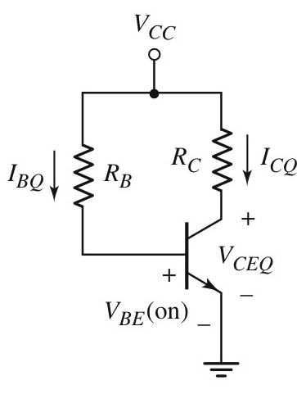
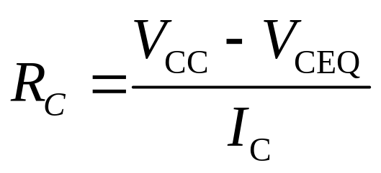
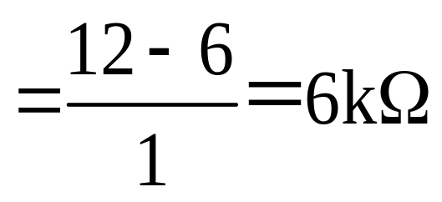
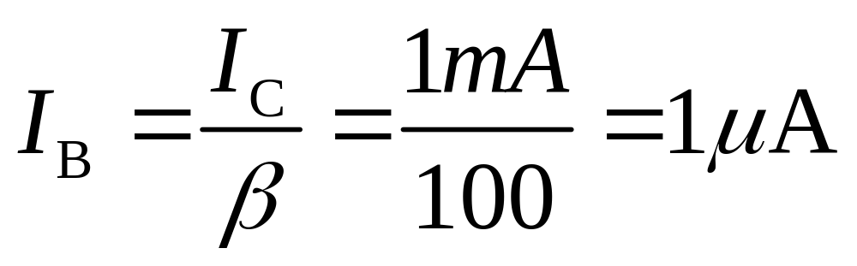
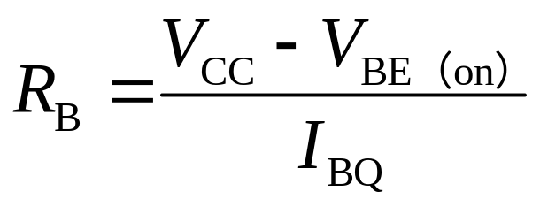
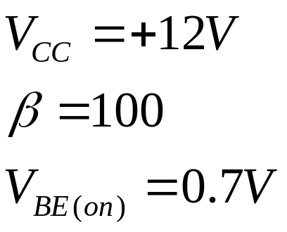
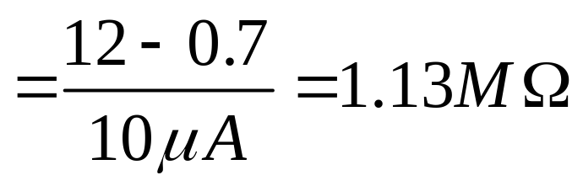
5.4.1 Single Base Resistor Biasing
Find R_{C}，R_{B}，
for I_{CQ}=1mA, V_{CEQ}=6V
IF Cut-off distortion？

Slide 17
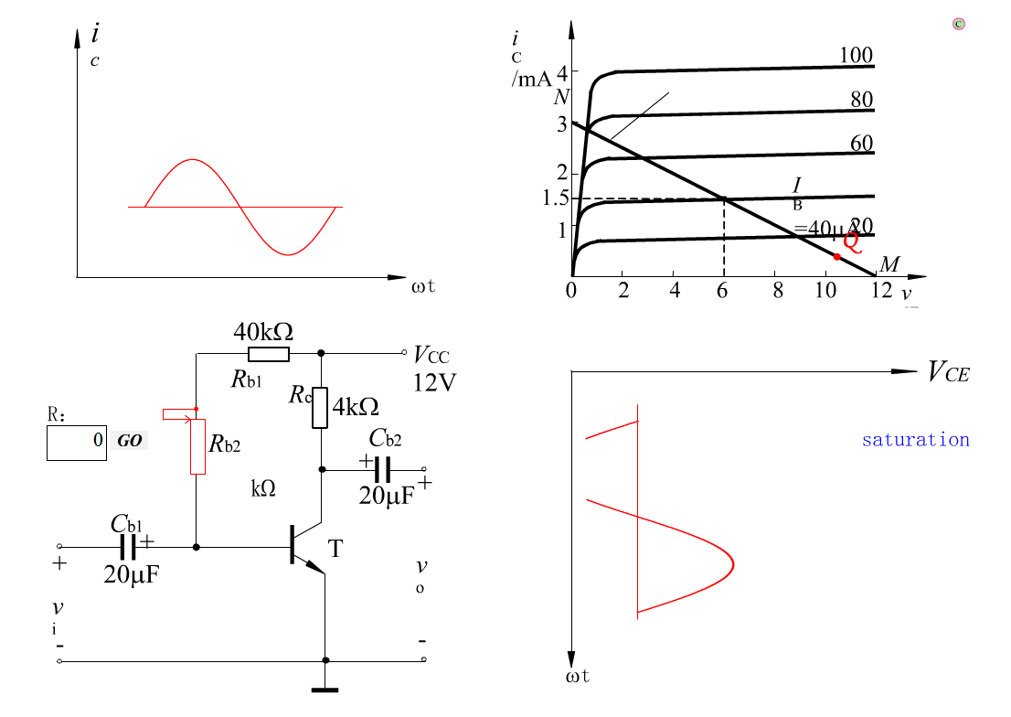

Slide 18
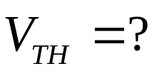
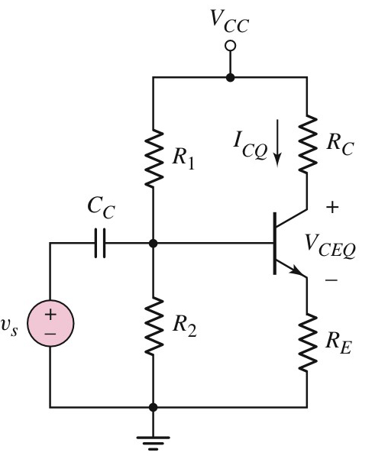
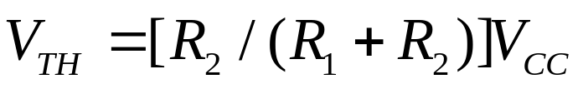
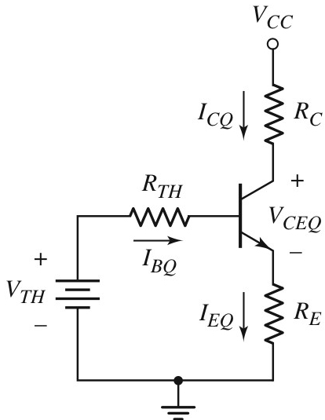

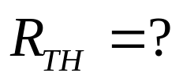
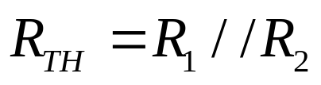
5.4.2 Voltage Divider Biasing and Bias Stability
DC circuit
Thevenin
equivalent

Slide 19
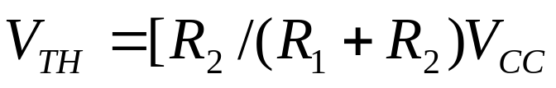
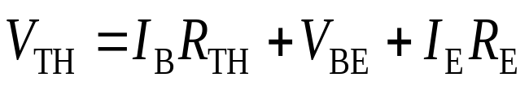
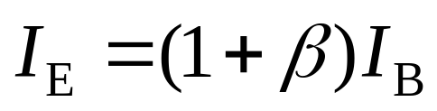
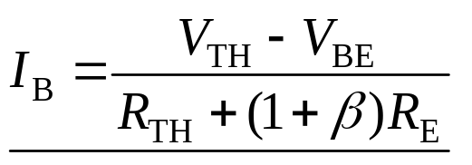


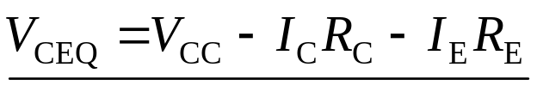
5.4.2 Voltage Divider Biasing and Bias Stability
Input loop
Q-point

Slide 20

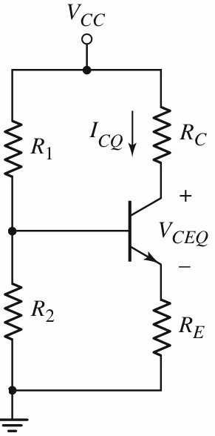

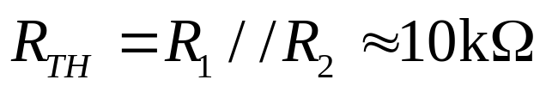

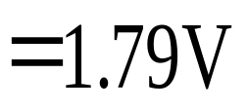
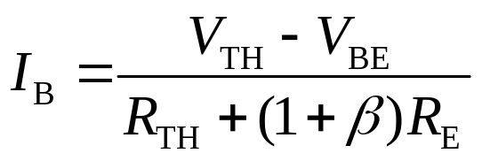
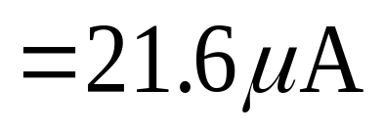

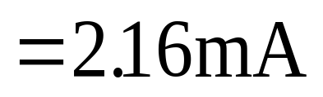




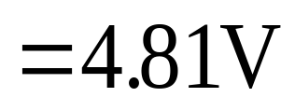
5.4.2 Voltage Divider Biasing and Bias Stability
Find Q-point.

Slide 21



5.4.2 Voltage Divider Biasing and Bias Stability
Forward active region
General rule of bias stable:
and

Slide 22
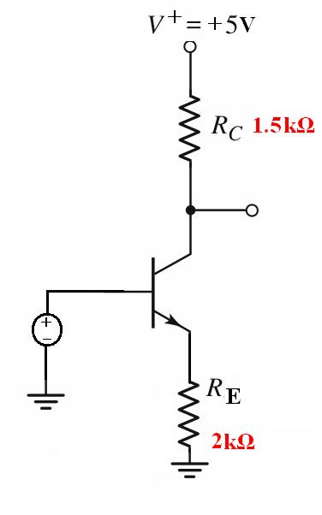
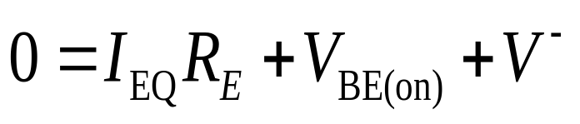
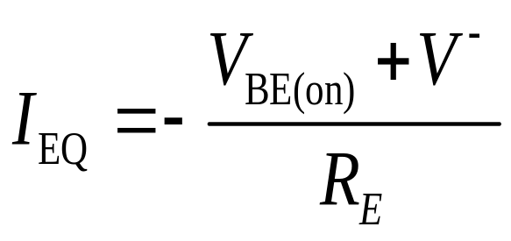
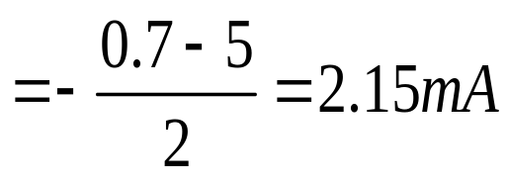

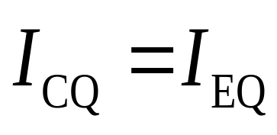
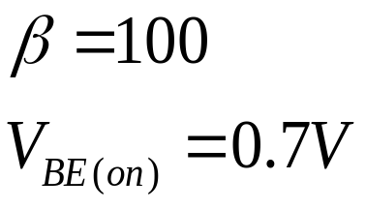
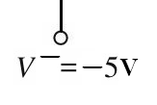


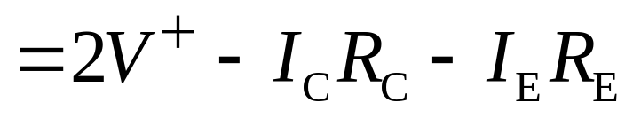
5.4.3 Positive and Negative Voltage Biasing
Forward active region？
×
DC circuit
Find the Q-point？

Slide 23
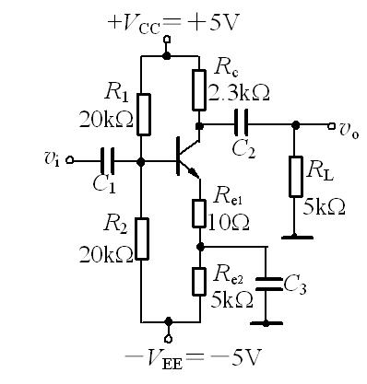



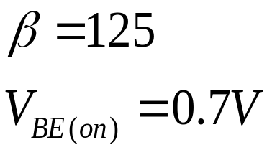
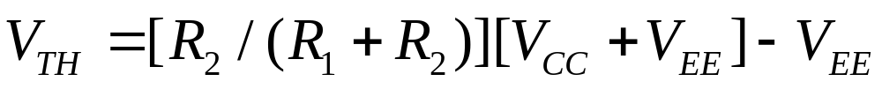
5.4.3 Positive and Negative Voltage Biasing
Find the Q-point？
DC circuit

Slide 24
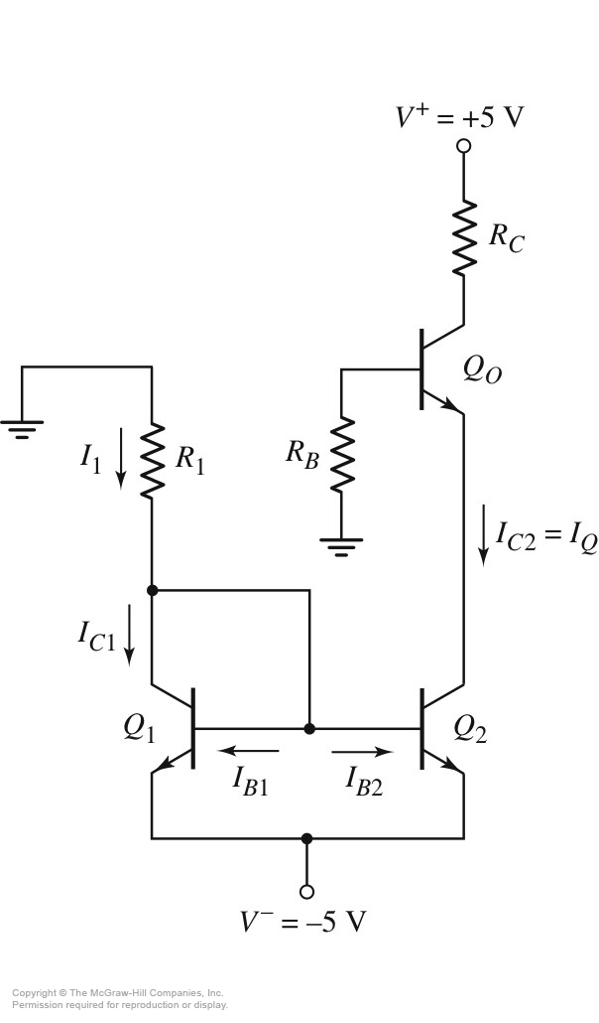
5.4.4 Integrated Circuit Biasing
Current source
Chapter 10

Slide 25
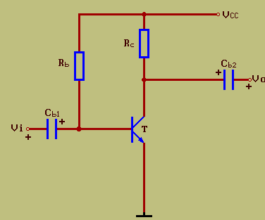
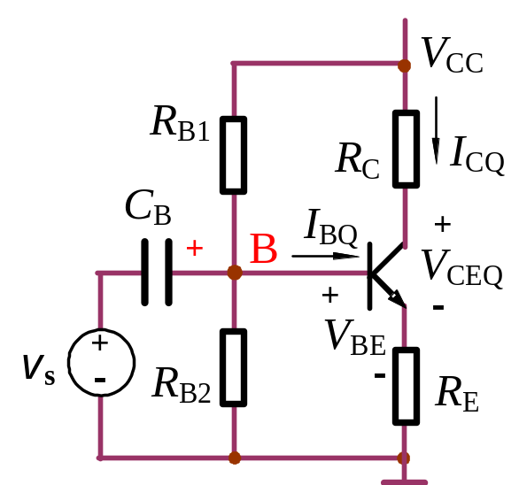








Slide 26




Example 1
Assume β＝50，find out V_{CQ}= ？ V_{CC}＝12V，U_{CES}＝0.5V。
(1) Normal;(2)R_{b1} is short;(3)R_{b1} is open;(4)R_{b2} open;
(5)R_{C} short。
Sol: assume U_{BE}＝0.7V。then
(1)
(2)
U_{BE}=0V →T cut off → U_{C}=12V。
(3)
I_{B}＞I_{BS}，T saturation，U_{C}＝U_{CES}＝0.5V。
(4)
(5)
T cutoff，U_{C}＝12V。
U_{C}＝V_{CC}＝12V

Slide 27

？
Review Questions
2. When V_{CE} of BJT is nearly equal V_{CC} , Which region is it operating in? What may the reasons?
Answer：
Cut-off region
Reasons may:
• R_{b} may open circuit, I_{B}=0, I_{C}=0, V_{CE}= V_{CC} - I_{C} R_{c}= V_{CC} .
• C₁ may short circuit
V_{BE}=0， I_{B}=0， I_{C}=0， V_{CE}= V_{CC} - I_{C} R_{c}= V_{CC} .

Slide 28
Questions
and
Answers

