Slide 1

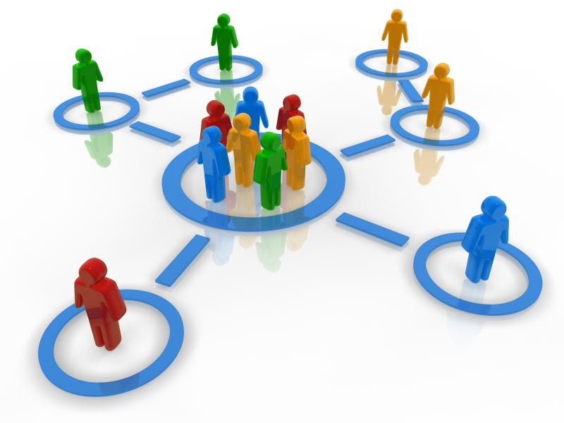
Tailored News Recommendations
Based on User Community Structure
How personalized do you want your news recommendations to be?
Goal:
Recommendations based on users with similar interests, but still with diversity!

Slide 2
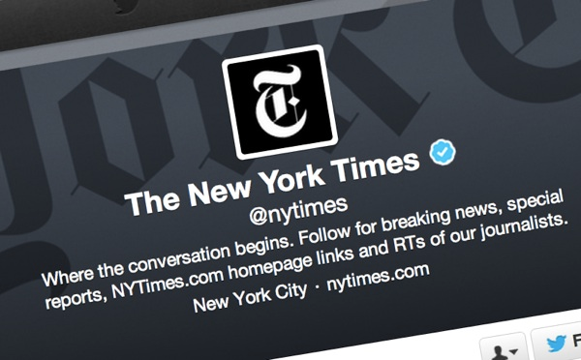
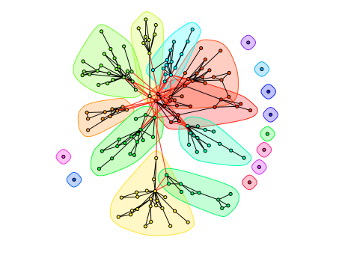
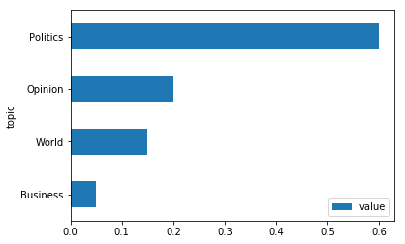
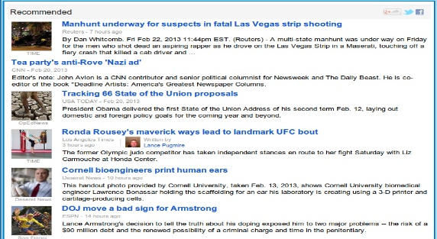
Social Media Comes To Rescue!
Shared Topics in The Community
News Recommendations
Community structures in New York Times users on Twitter based on their retweeting behavior on NYT news posted on Twitter

Slide 3

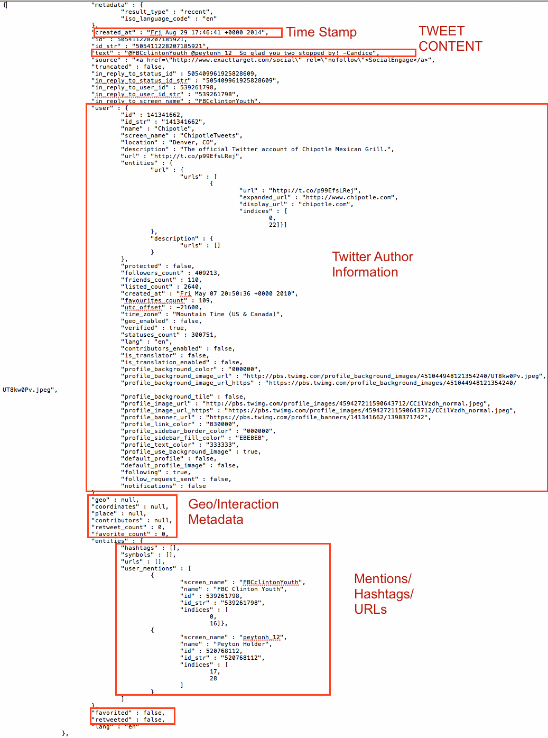
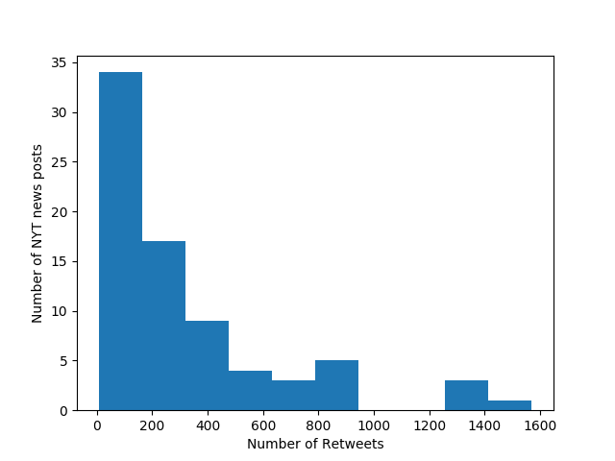
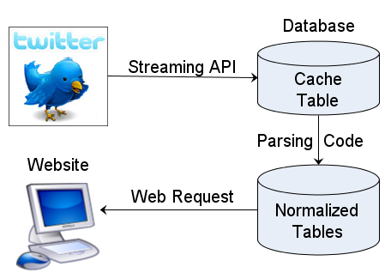
Data
Preliminary Analysis
Data Processing Pipeline
API Request
Distribution of retweet numbers among the most recent 100 NYT news on Twitter

Slide 4
Approaches
Community Detection in Network Data
Topic Summarization
Graph Clustering Algorithms
Hierarchical Clustering
Greedy algorithm
Can not scale
Monte Carlo Clustering based on statistical models
Nondeterministic
Problematic for sparse graph
New York Times API
Sections, subsections of articles
Natural language Processing on news titles
Wordnet model

