Slide 1

HOLA
A Human–AI Collaborative Framework for Aortic Segmentation with Quality Assessment
Hsu Hlaing Hnin
MSc Data Science · Queen Mary University of London
Supervisor: Dr Xu Chen
Notes:
Open here. Name, programme, supervisor, institute. Mention early that this ran on QMUL Apocrita HPC through DERI, and that the work has been written up and submitted to MICAD. Point at the 3D aorta on the right and use it to start the next slide.

Slide 2
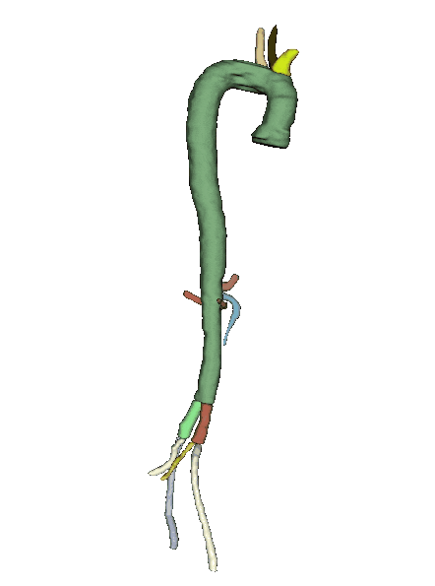
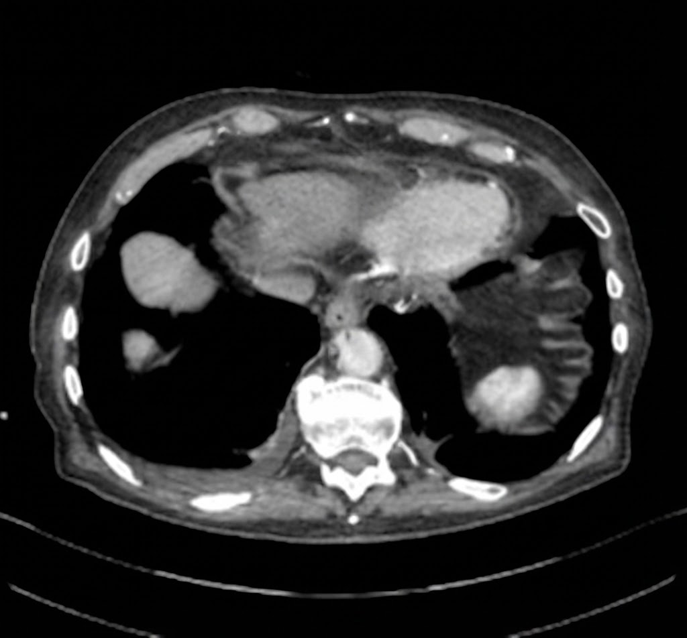
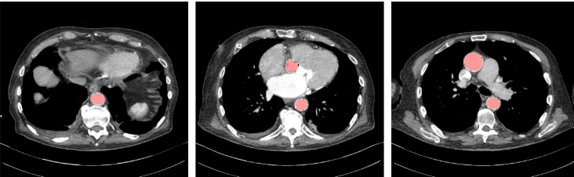
Why Segment the Aorta?
01
Main artery from the heart
Carries blood from the heart to the rest of the body
02
Clinical importance
Supports measurement, assessment, and treatment planning
03
Complex 3D structure
Trace consistently across multiple slices
04
Subtle Tissue Boundaries
Distinguish the aortic boundary under low contrast, calcification, and abnormal anatomy
Aorta
Axial CT scan
Notes:
Open here. Name, programme, supervisor, institute. Mention early that this ran on QMUL Apocrita HPC through DERI, and that the work has been written up and submitted to MICAD. Point at the 3D aorta on the right and use it to start the next slide.

Slide 3
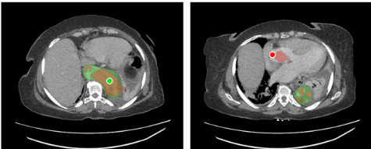
What Existing Methods Leave Unsolved?
01
Manual segmentation
Positive click
Time-consuming and labour-intensive
02
Automatic segmentation
Produce one fixed prediction: fails on rare anatomy
Negative click
03
Interactive segmentation
Provide corrective interaction: lack quality assessment
Notes:
Point at the left tile. Even in 3D, with contrast, the aorta sits in a crowd of similar-brightness tissue. Doing this by hand takes up to an hour a patient and two people do not agree. That disagreement is the same size as the change you are trying to detect between scans.

Slide 4
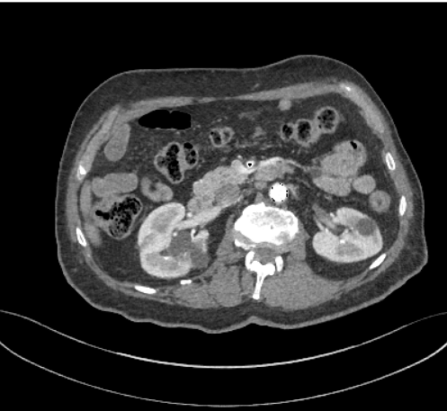
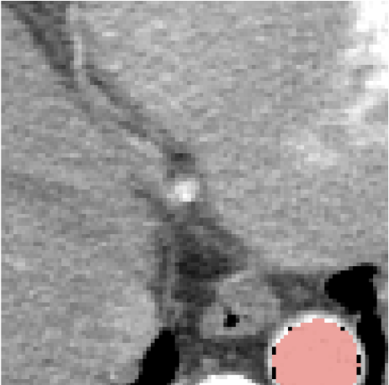
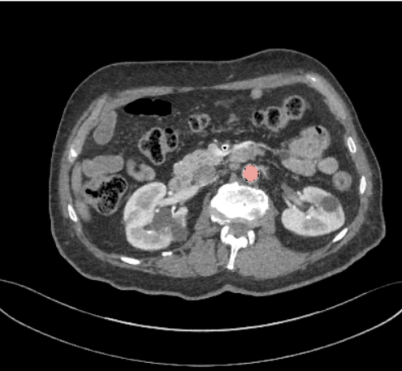
What I Developed?
3D DynUNet
+ DeepEdit
Quality Prediction Network
→
→
→
→
CTA volume
Predicted mask + cropped CT scan
Refined mask
clicks feedback: quality below threshold τ
01
Interactive 3D Framework
02
Quality Prediction Network
03
Clinical prototype
Volumetric correction
Allow positive/negative clicks until the threshold is met
Predicts Dice with no ground truth during deployment
  Provide clinicians with real-time visual quality feedback
Notes:
Point at the left tile. Even in 3D, with contrast, the aorta sits in a crowd of similar-brightness tissue. Doing this by hand takes up to an hour a patient and two people do not agree. That disagreement is the same size as the change you are trying to detect between scans.

Slide 5
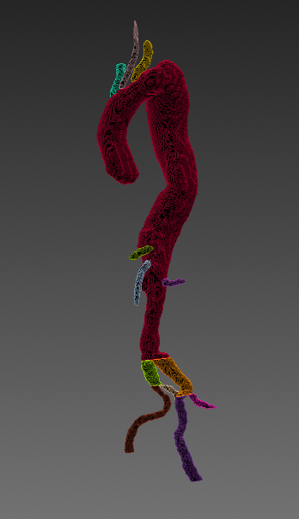
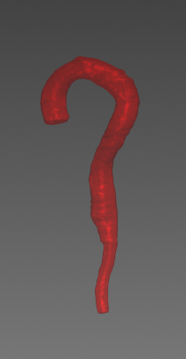


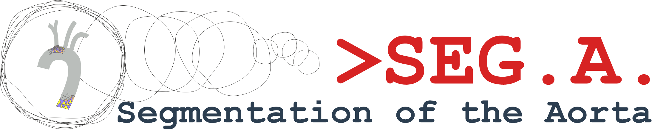




How I Built the Training Pipeline?
01
Combine diverse CTA cohorts
02
Standardise every volume before training
03
Train on QMUL Apocrita HPC
357
214 / 71 / 72
CTA cases
train / val / test
Before and after preprocessing
158
Base (43)
Dissection (40)
SEGA (55)
CIS-Unet (59)
Aortasega_60 (60)
TBAD (100)

Slide 6
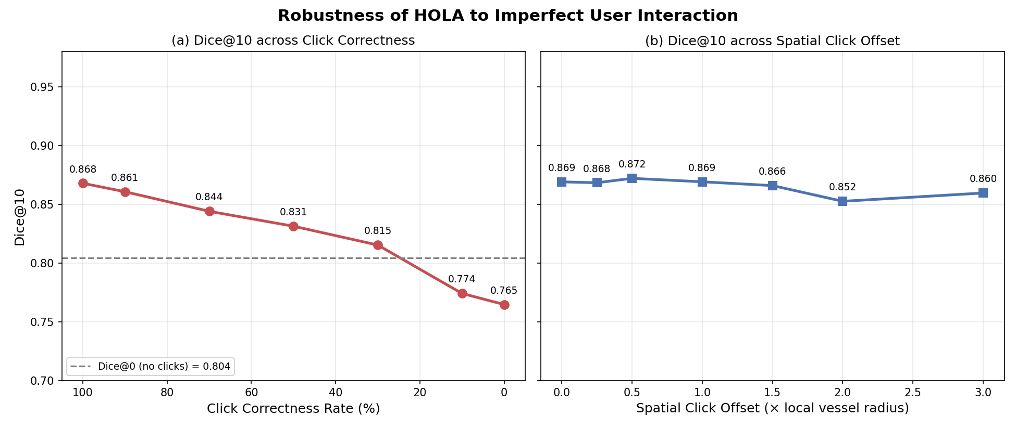
What are the Main Outcomes?
0.804 → 0.868
r = 0.953
MAE = 0.039
1.03
Dice, 0 to 10 Corrective Clicks
Quality Prediction vs True Dice
Quality Error Prediction
Mean Clicks Under the Stopping Policy

Slide 7
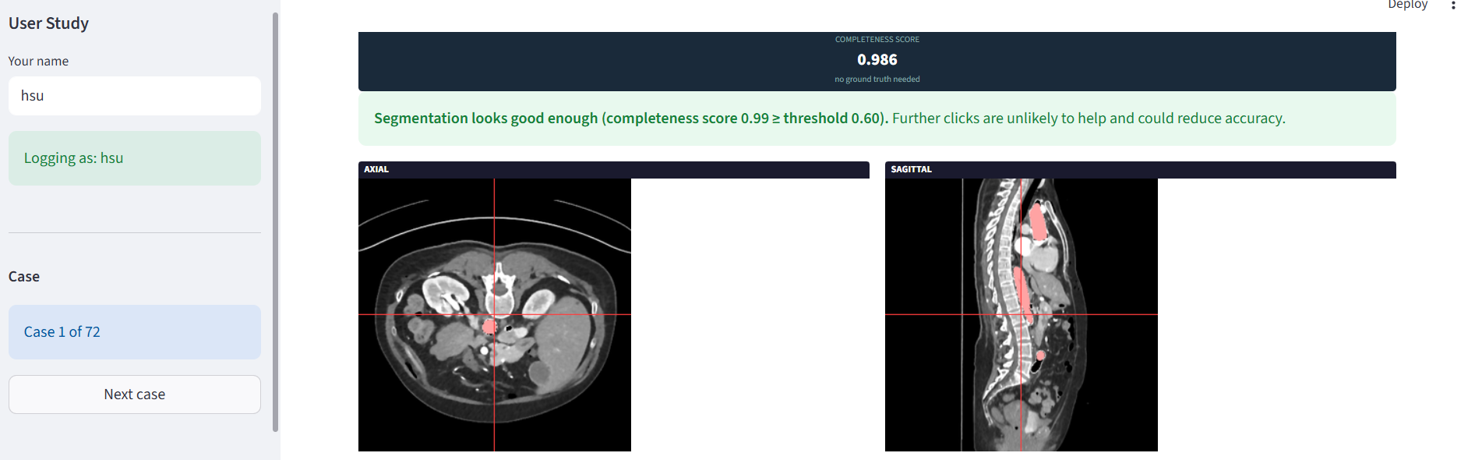
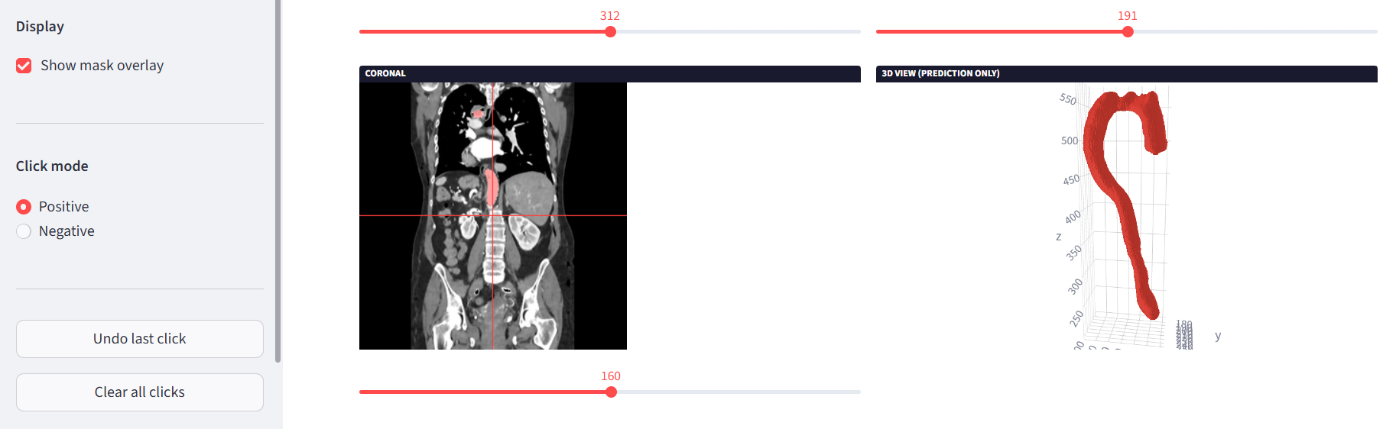
Research Journey
01
Investigated unexpected failures
02
Traced problems to their root causes
03
Redesigned the quality predictor
04
Strengthened the system through experiments
05
Developed an interactive Streamlit interface

Slide 8
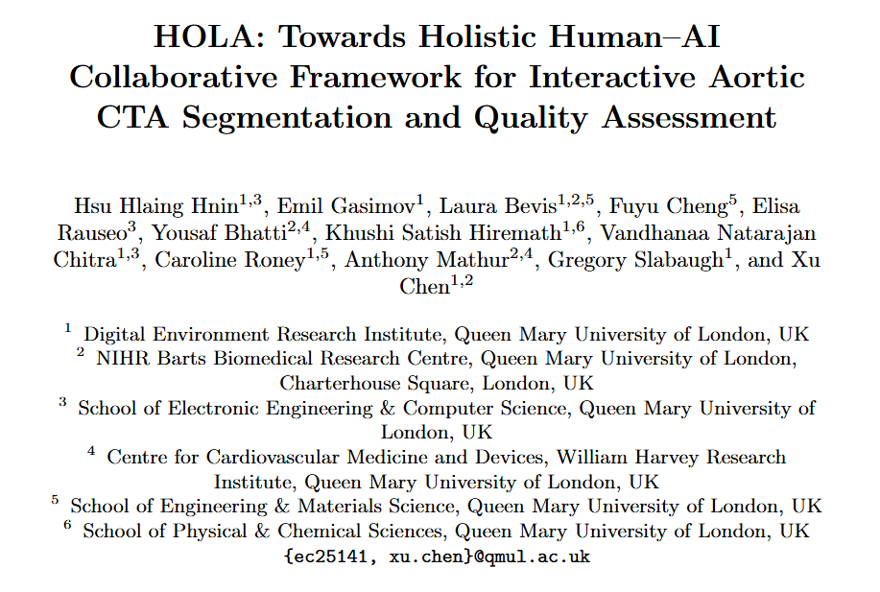




What Became Beyond The Dissertation?
MICAD paper submitted
Full Aortic-Branch segmentation
Clinical Interface Development
Reproducible GitHub Repository

Slide 9
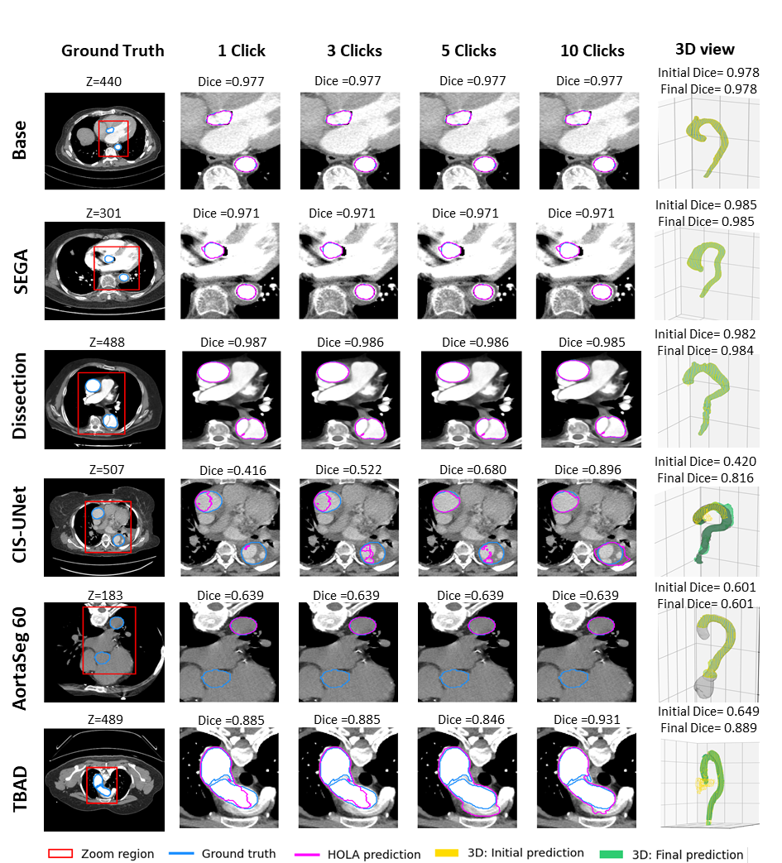
Conclusion
01
Research Contribution
Strong Interactive aortic segmentation
Quality-aware interaction
Strong accuracy with reduced interaction
02
Personal and Academic Growth
Research problem-solving and critical thinking
Technical and methodological skill development
Academic communication and research confidence

Slide 10
THANK YOU
VERY MUCH

