Slide 1
Developing Microservices Full Stack 2015
@pelger
@mcollina
@mcdonnelldean
@wpreul

Slide 2
Microservices are…
Not a new concept; see unix
Small, focused, decoupled components
Independently deployable
Particularly suited to node.js

Slide 3
Some Benefits
Accelerated development
Small components – easily grokked
Independently deployable
Easily replaceable
Inherently scale-able
Distributed by nature
Optimised for delete
Greg Young - https://vimeo.com/108441214

Slide 4
But Enough Theory!
This is a workshop…

Slide 5
Prerequisites
Connect to this access point:
Keynoteworkshop
Password: keynoteworkshop
Open http://192.168.100.85/
Download and install docker-machine for your platform
Follow the instructions to load the base images

Slide 6
Prerequisites
Keynoteworkshop
http://192.168.100.85/

Slide 7
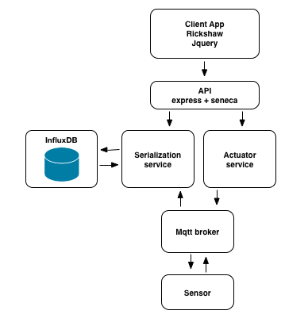
Let’s build a system…

Slide 8
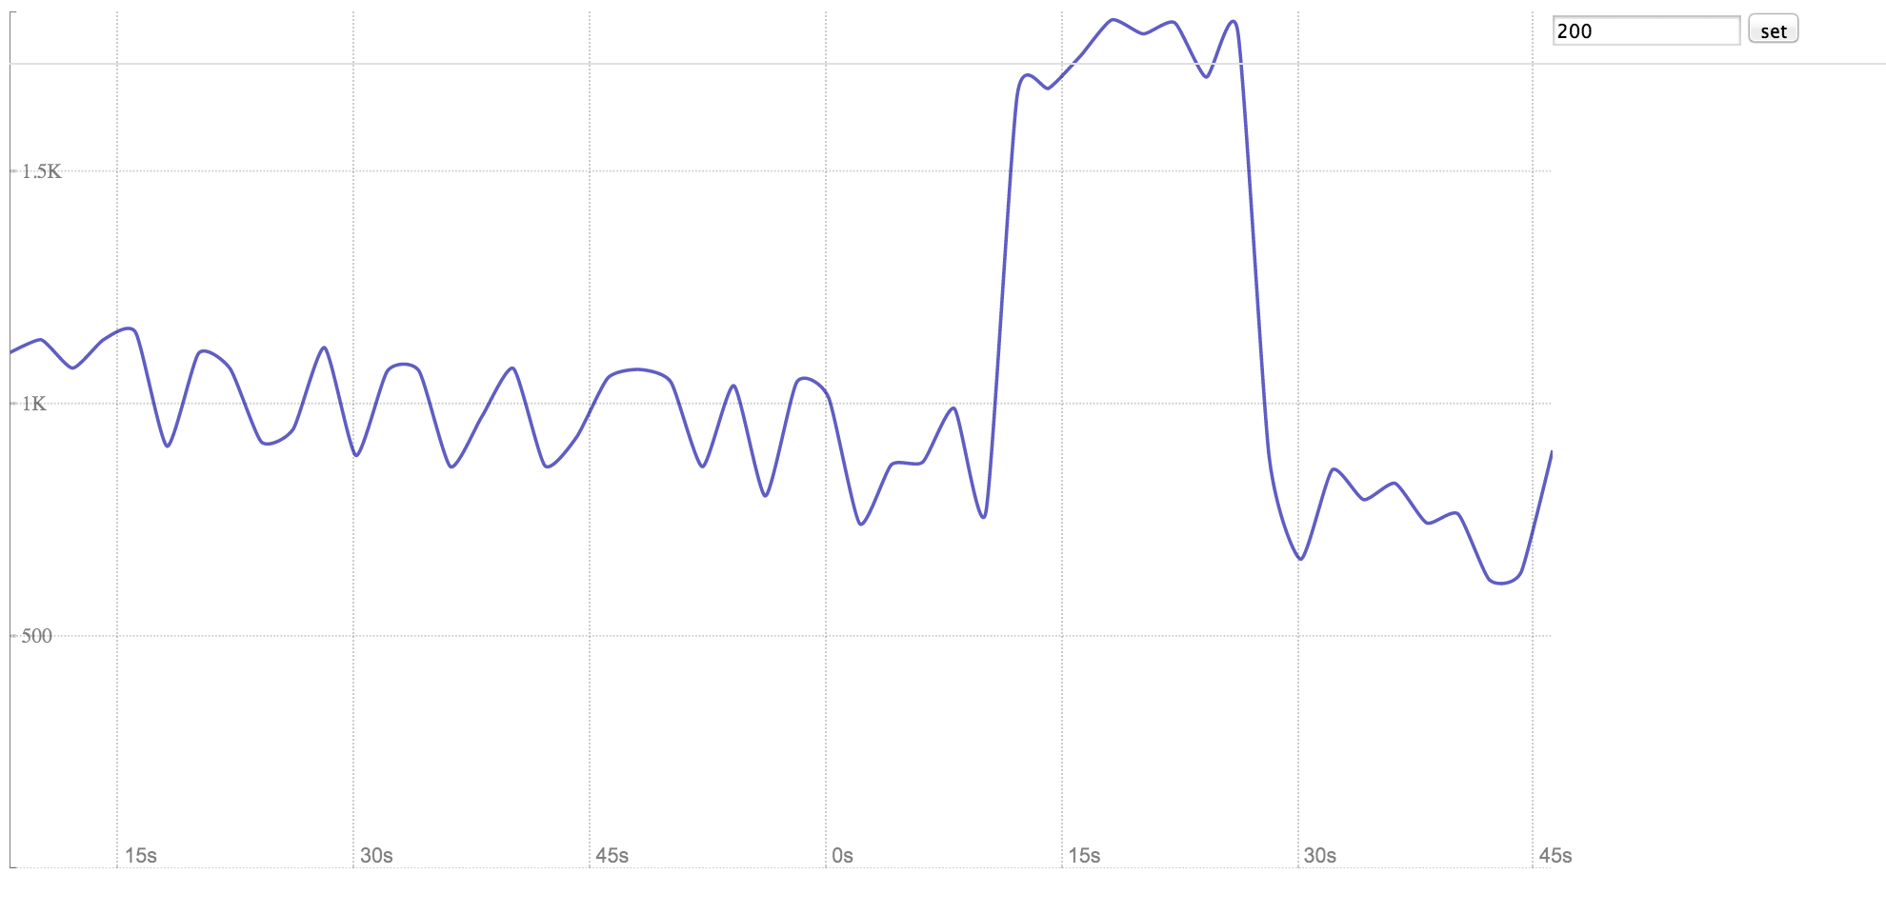
It looks like this..

Slide 9
We will be using…
Rickshaw charts + socket.io
Node.js + express
Seneca (Microservices framework)
Mosca (MQTT broker)
InfluxDB (Time series database)
Docker

Slide 10
You should now have
Run ‘docker ps’
Should execute and show no processes
Run ‘docker images’
Should show two images loaded
Node
tutum/influxdb

Slide 11
Get the workshop
Clone the following repo
https://github.com/nearform/developing-microservices
Or grab the tarball

Slide 12
Step 0 – Build the frontend
Step0/README.md
Build and run the front end as a container
Hint
Docker build –t frontend .

Slide 13
Step 1 – Add websockets
Step1/README.md
Move the data generation function to the back end

Slide 14
Step2 – The data writer
Step2/README.md
The `step2` folder has a skeleton for the serializer service, your challenge is to write a Seneca (http://senecajs.org) handler to write points to influxdb.

Slide 15
Step 3 – Docker compose
Step3/README.md
Running multiple containers individually is error prone, your challenge is to use docker-compose. In this step you will create a docker compose .yml file to launch all our containers with a single command.

Slide 16
Step 4 – Wire up the MQTT Broker
Step4/README.md
You are provided with a dummy sensor and a MQTT broker service, your challenge is to wire these into the docker compose .yml.

Slide 17
Step 5 – The read handler
Step5/README.md
Your challenge is to add a read action handler to select data from influx the handler should take a start and end time and also a sensor id as input parameters and return time series data.

Slide 18
Step 6 – Connect the read handler
Step6/README.md
Your challenge is to wire the data reader up to the front end. To do this you will need to replace the random value generator in the frontend/api/index.js with a call to read data from the serializer service.

Slide 19
Step 7 – Wire up the actuator
Step7/README.md
Your challenge is to wire up the actuator micro-service. The actuator service is provided for you in services/actuator. The actuator service will send a new offset message to the sensor via the MQTT broker.

Slide 20
Step 8 – To the bar
Close your laptop
Make your way to the bar
Order a beer or a coke
Repeat…
Thank you!

