Slide 1
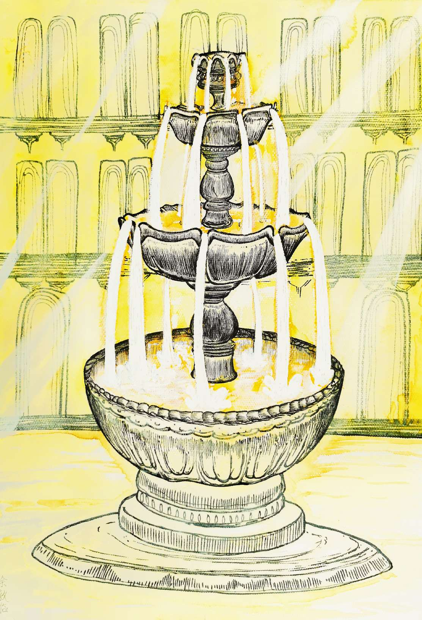
1

Slide 2
1

