Slide 1
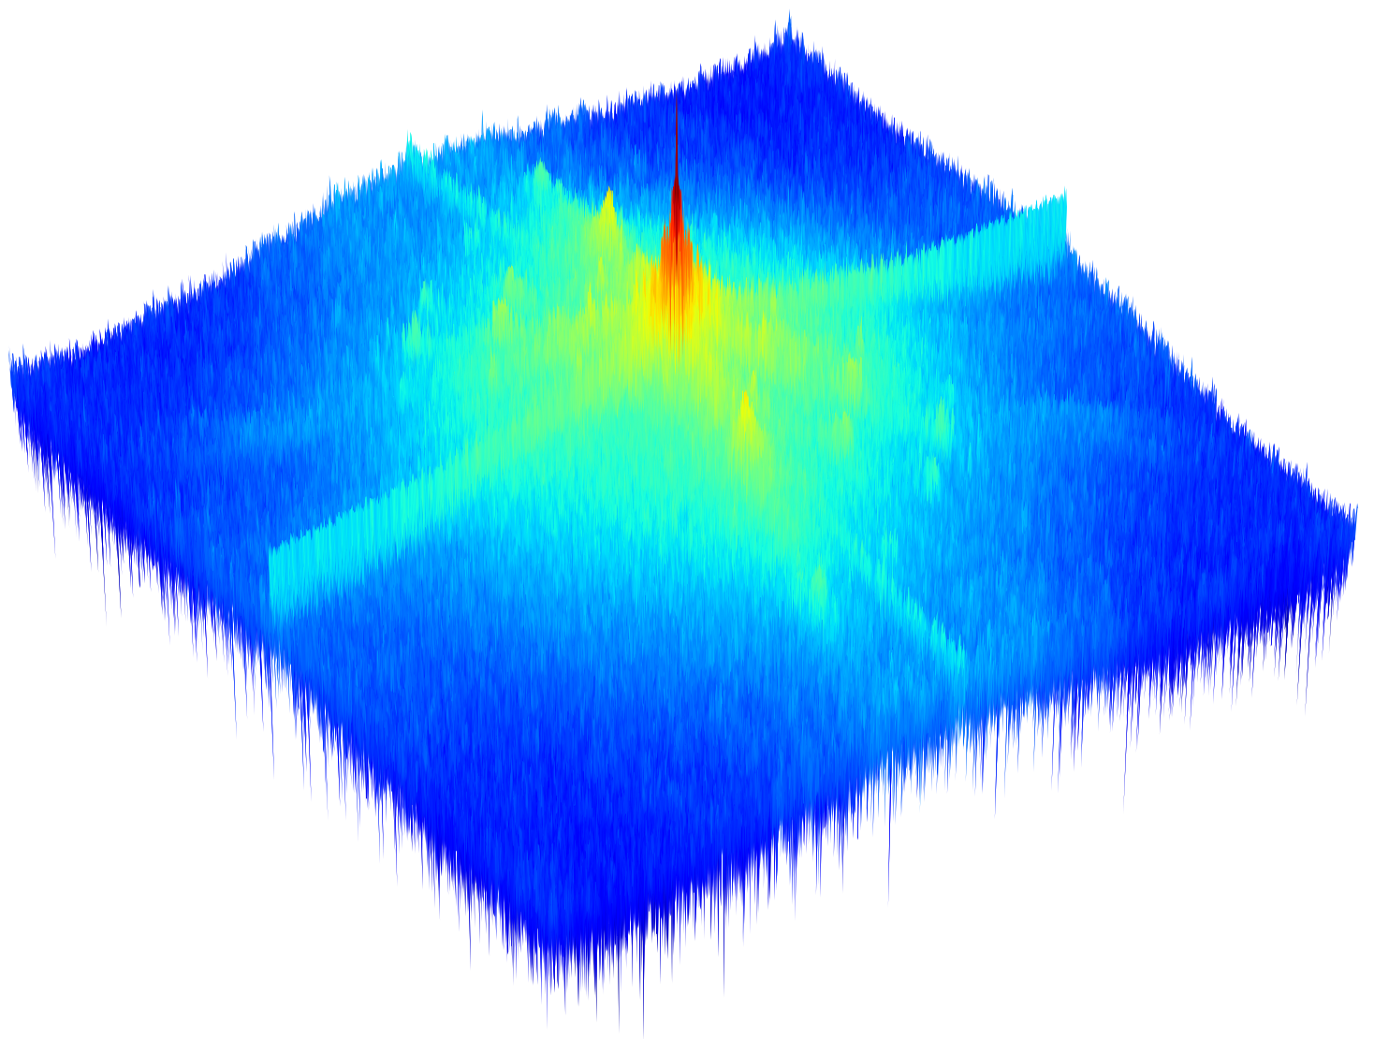
CBR
G
C
G
FBlock
CBR
CBR
FFT
IFFT
G
IBBF
G
Improved Butterworth-Basis Filter
Multi-Receptive Field Depthwise Separable Channel Gating
CBR
G
depth-wise separable convolution
FBlock
Conv+BatchNorm2d+ReLU
channel selector

