Slide 1
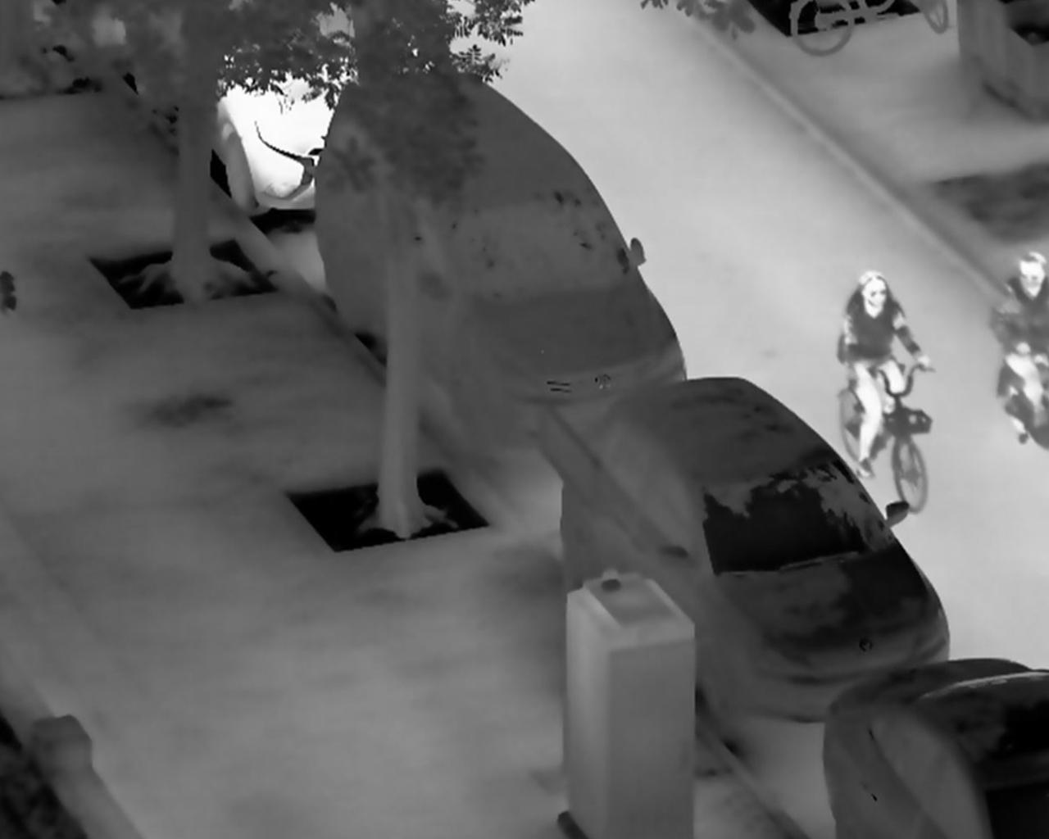
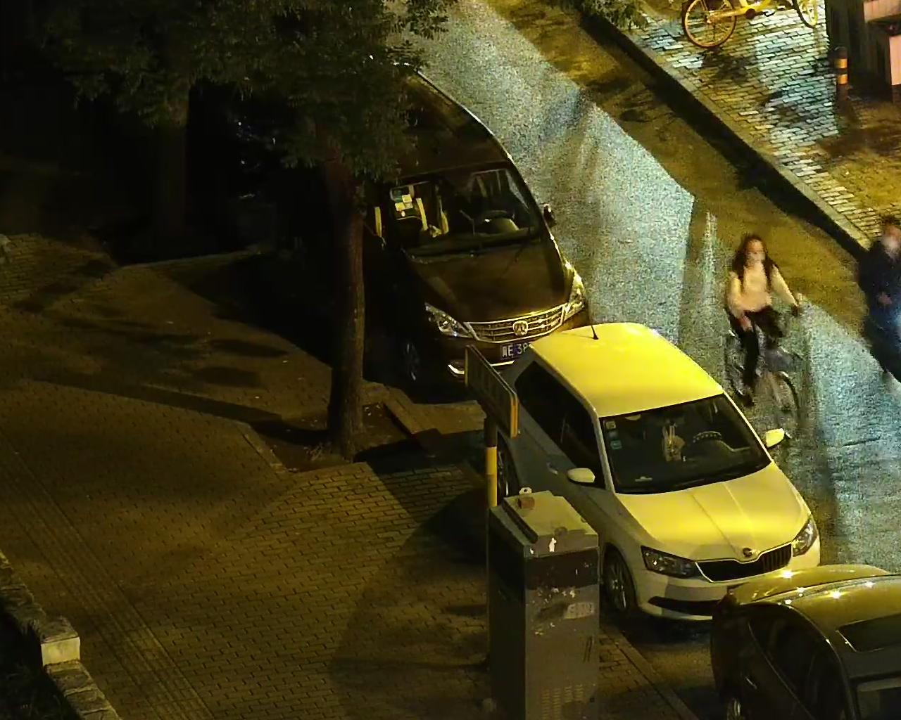
ir
CBS
FSE
CBS
FSE
C3K2
CBS
C3K2
Sv2B
Sv2B
Sv2B
Sv2B
SPPF
C2PSA
C
CBS
FSE
CBS
FSE
C3K2
CBS
C3K2
Sv2B
Sv2B
RGB
DSDA
DSDA
DSDA
shallow feature stream
middle-level feature stream
deep feature stream
head
LDC
C3K2
CONCAT
Add
CBS
UPSAMPLE
C
Concat
DSDA
Detail-Semantic Dual Attention
LDC
C3K2
CONCAT
C3K2
CONCAT
LDC
Long-range Detail Compensation
CBS
UPSAMPLE
FSE
Frequency-Spatial Encoder
LDC
C3K2
CONCAT
Sv2B
ShuffleNetV2Block

