Slide 1


中国邮政速递物流数据平台迁移项目
三、平台运维
星环科技
www.transwarp.io

Slide 2
日志查询
1.报表日志查询
2.增量合并日志查询
3.批量更新日志查询

Slide 3
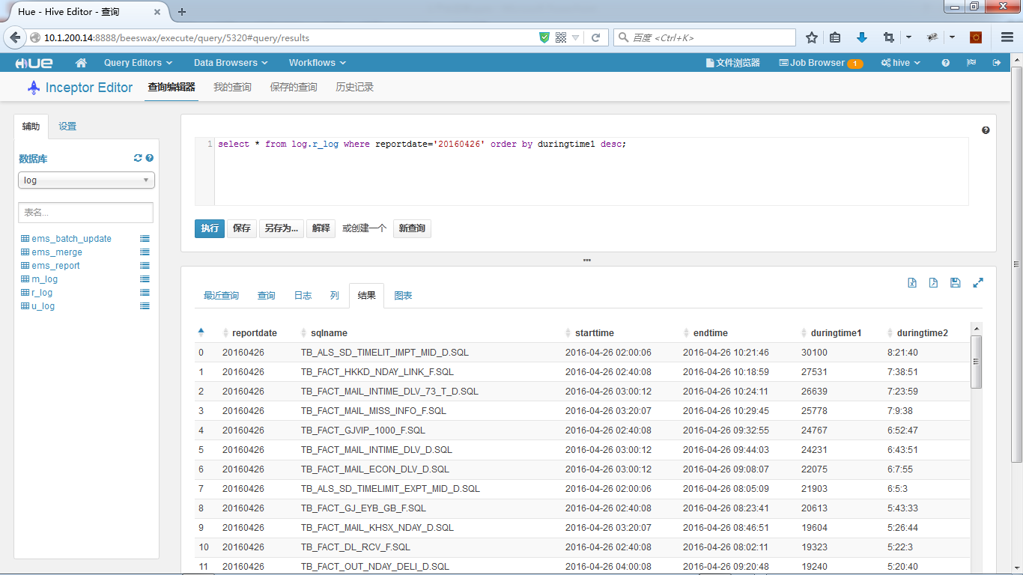
报表日志查询
select * from r_log where reportdate='20160426' order by duringtime1 desc;

Slide 4
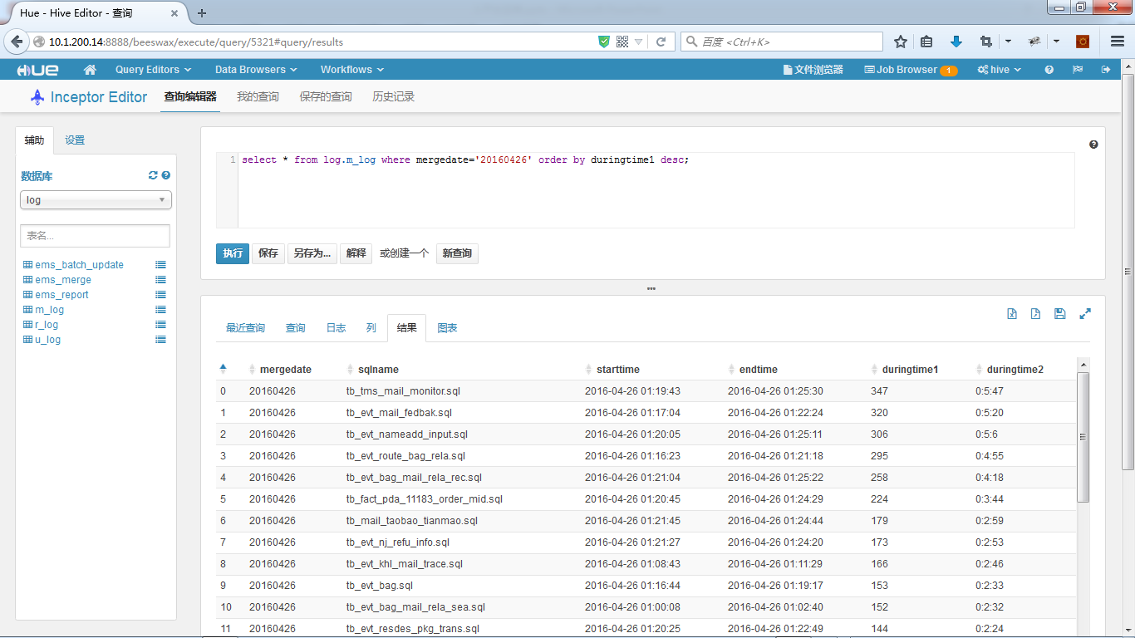
增量合并日志查询
select * from log.m_log where mergedate='20160426' order by duringtime1 desc;

Slide 5
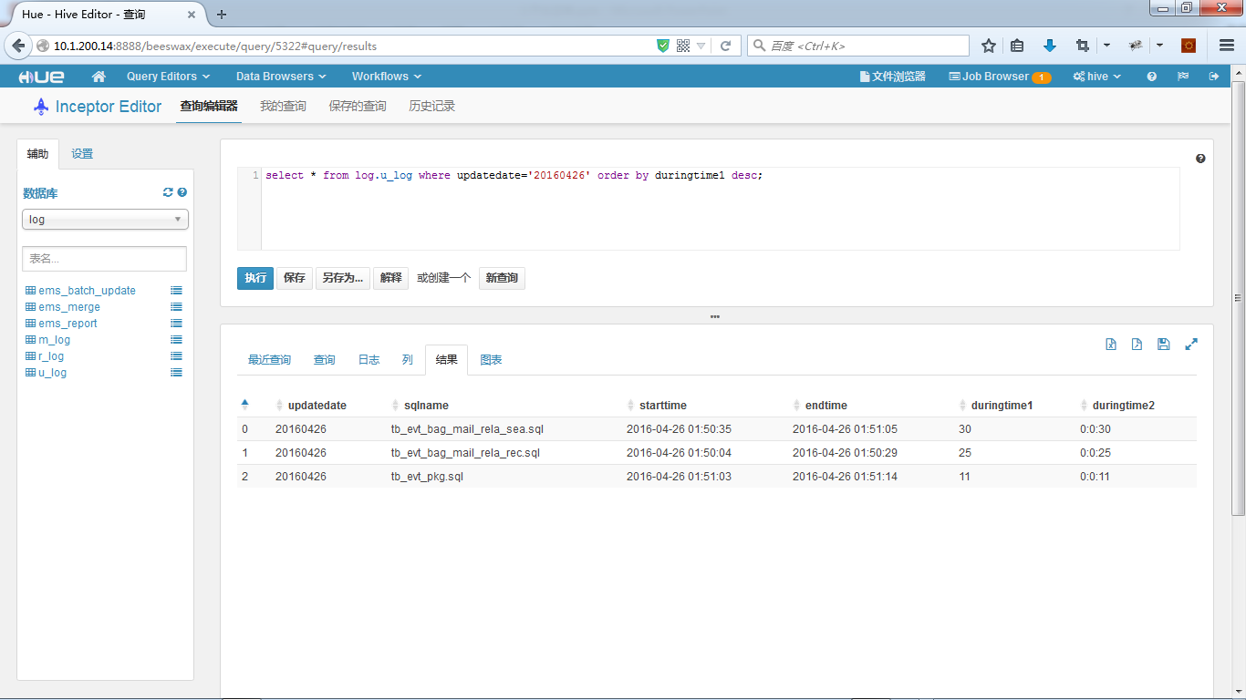
批量更新日志查询
select * from log.u_log where updatedate='20160426' order by duringtime1 desc;

Slide 6
批量更新日志查询
select * from log.u_log where updatedate='20160426' order by duringtime1 desc;

Slide 7
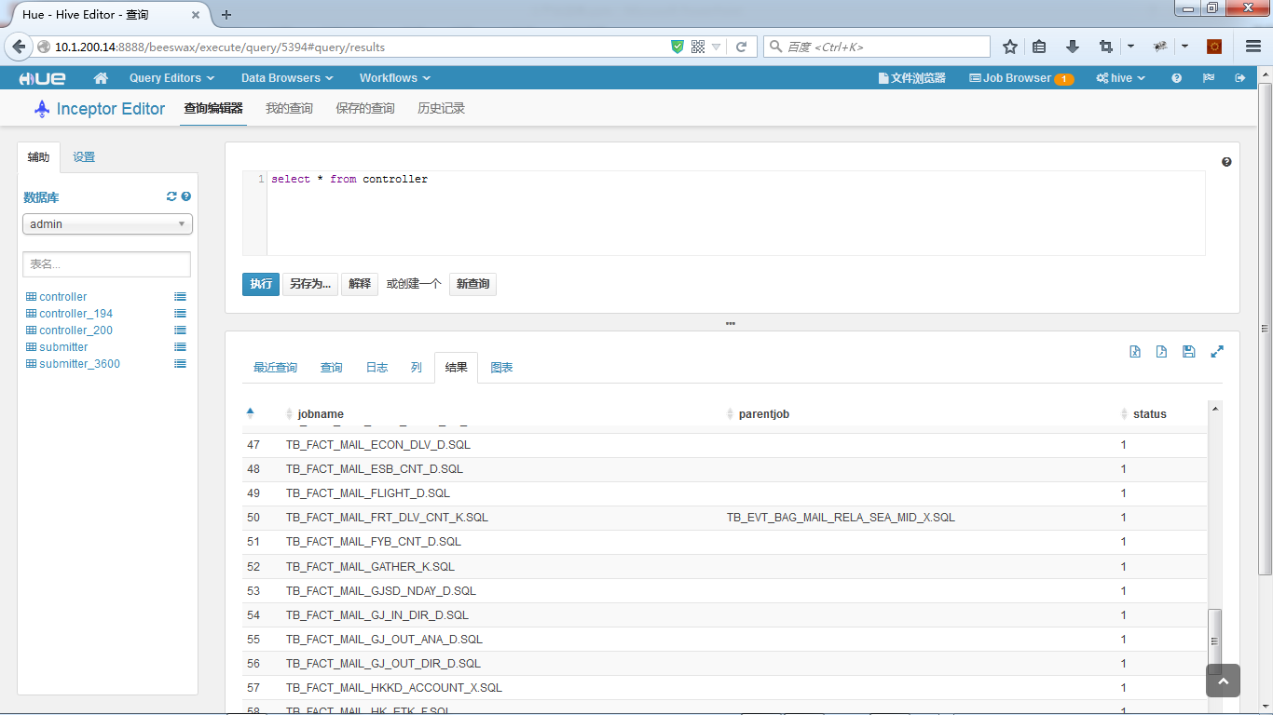
增删报表
新增6张报表：
insert into admin.controller values('TB_ALS_SD_TIMELIT_IMPT_MID_D.SQL','','');
insert into admin.controller values('TB_FACT_GJ_EYB_TIME_LIMIT_T_D.SQL','','');
insert into admin.controller values('TB_FACT_MAIL_INTIME_DLV_73_T_D.SQL','','');
insert into admin.controller values('TB_FACT_MAIL_MISS_INFO_F.SQL','','');
insert into admin.controller values('TB_FACT_MAIL_OUT_DIR_F.SQL','','');
insert into admin.controller values('TB_FACT_ONLINE_ORG_IN_INFO2_K.SQL','','');
删除6张报表：
delete from admin.controller where jobname='TB_FACT_GJ_EYB_TIME_LIMIT_T_D.SQL';
delete from admin.controller where jobname='TB_FACT_MAIL_OUT_DIR_F.SQL';
delete from admin.controller where jobname='TB_FACT_MAIL_MISS_INFO_F.SQL';
delete from admin.controller where jobname='TB_ALS_SD_TIMELIT_IMPT_MID_D.SQL';
delete from admin.controller where jobname='TB_FACT_ONLINE_ORG_IN_INFO2_K.SQL';
delete from admin.controller where jobname='TB_FACT_MAIL_INTIME_DLV_73_T_D.SQL';

Slide 8
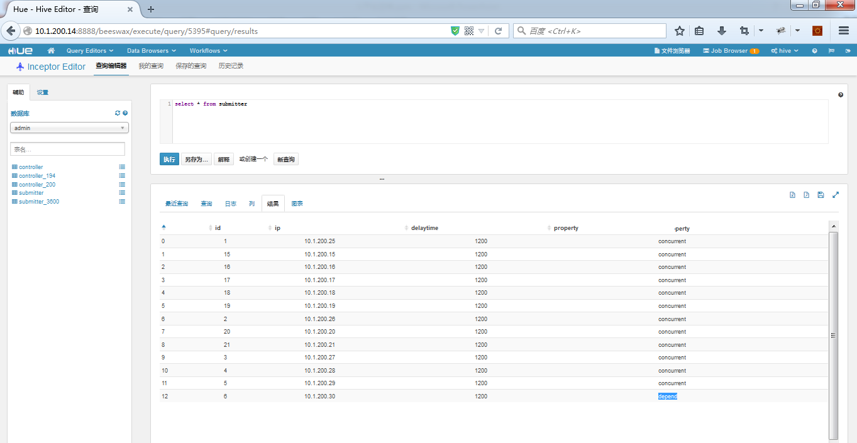
增删提交机（并发多台，依赖一台）
insert into submitter values('1','10.1.200.25','3600','concurrent'); insert into submitter values('2','10.1.200.26','3600','concurrent'); insert into submitter values('3','10.1.200.27','3600','concurrent'); insert into submitter values('4','10.1.200.28','3600','concurrent'); insert into submitter values('5','10.1.200.29','3600','concurrent'); insert into submitter values('6','10.1.200.30','3600','depend');

Slide 9
Merge Into
[root@TD-APP-31 merge_into]# pwd
/home/softwares/report/merge_into
merge into (select * from ems_pdata_range.tb_mail_taobao_tianmao where date_code >= 'qqyymm') a using (select * from ems_pdata.tb_mail_taobao_tianmao where date_code='qqyyrr') b on (a.key = b.key) when matched then update set a.load_date=b.load_date,a.load_time=b.load_time,a.load_timestamp=b.load_timestamp when not matched then insert (a.key,a.date_code,a.mail_num,a.load_date,a.load_time,a.load_timestamp) values (b.key,b.date_code,b.mail_num,b.load_date,b.load_time,b.load_timestamp);
alter table ems_pdata_range.tb_mail_taobao_tianmao compact 'major';
步骤：
1.将merge脚本放入：/home/softwares/report/merge_into/sql_templates
2.将脚本名称添加进：/home/softwares/report/merge_into/daily_list

Slide 10
添加报表
步骤：
1.将报表模板脚本放入：/home/softwares/report/sql_templates
2.将脚本名称添加进： admin.controller
3.全量分发同步
Notes:
依赖是通过循环检测status来启动的，所以负载较轻

Slide 11
手动单跑报表
beeline -u 'jdbc:hive2://10.1.200.24:10000/default' -f /home/softwares/report/daily_reports_sql/20160427/TB_FACT_PACK_DIR_TOTAL_D.SQL
可参看：/home/softwares/report/custermize/run.sh
Notes:
依赖是通过循环检测status来启动的，所以负载较轻

Slide 12
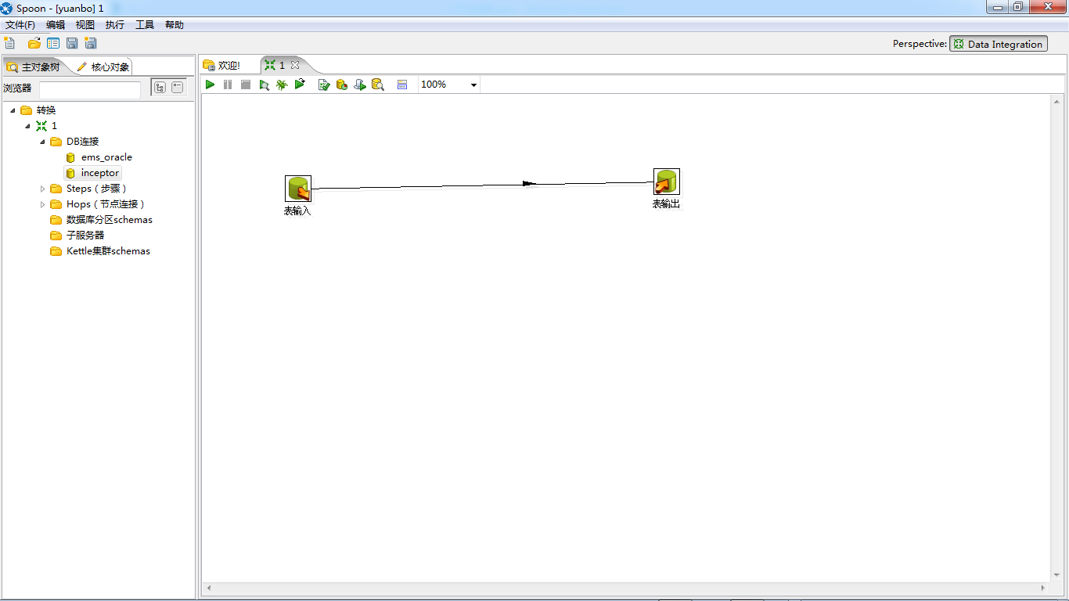
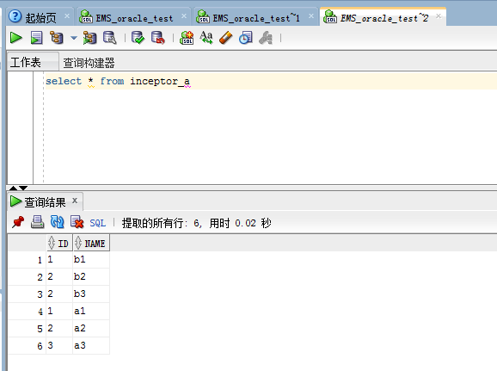
ETL工具 Kettle 5.0 (inceptor->oracle)
192.168.50.2:1521:orcl
emspdadev/emspdadev
org.apache.hive.jdbc.HiveDriver
jdbc:hive2://10.1.200.24:10000/default
Notes:
http://diethardsteiner.blogspot.tw/2011/05/kettle-sourcing-data-from-hadoop-hive.html

Slide 13
Balance工具集合
[root@TD-APP-31 balance]# pwd
/home/softwares/report/balance
ID | name | desc
1 | ./distribute.sh | 全量分发同步（只能在非提交机上操作）
2 | ./distribute_sql_templates.sh | 仅分发同步报表模板
3 | ./getFileDistribute.sh | 获取提交机上分布的报表名称
4 | ./getRunningStatus.sh | 获取提交机上正在运行报表状态
5 | ./getJPS.sh | 获取提交机jps
6 | ./restartInceptorServer.sh | 重启inceptorServer
7 | ./killAllRuningReport.sh | 停止所有报表

Slide 14
系统工具集合
[root@TD-APP-31 tools]# pwd
/home/softwares/report/tools
ID | name | desc
1 | ./getcpu.sh | 获取集群cpu状态
2 | ./getfree.sh | 获取集群mem状态
3 | ./getdisk.sh | 获取集群disk状态
4 | ./getjps.sh | 获取集群jps状态
5 | ./getJPS.sh | 获取集群jps状态
6 | ./getjstack.sh | 获取集群jstack状态
7 | ./getmd5.sh | 获取集群md5状态

Slide 15
Q & A
谢谢

