Slide 1

Content Based Music Recommendation System

Slide 2
Internship Presentation (DSBDA inhouse internship)
Internship Guide - Dr. Arati Deshpande
Mentor – Dr. Arati Deshpande
Presented By – Ashutosh Thite (31462)
Date – 23-04-2022

Slide 3
Contents
Problem Statement
Introduction
Methodological details
Implementation
Future scope
Outcome of the internship

Slide 4
Problem Statement
Design and Develop a recommendation system with collaborative/content/hybrid algorithm with context. Test on the accuracy and build a website/mobile application for the same.

Slide 5
Introduction
This inhouse internship at Big Data and Text Analytics Group, PICT started on 12-02-2022 and will end on 25-04-2022. This was a research-based internship, where the problem statement was to develop a content based music recommendation system.
The internship was under the guidance of Dr. Arati Deshpande ma’am.
The whole internship progress was subdivided into smaller tasks in order to complete the internship on time.

Slide 6
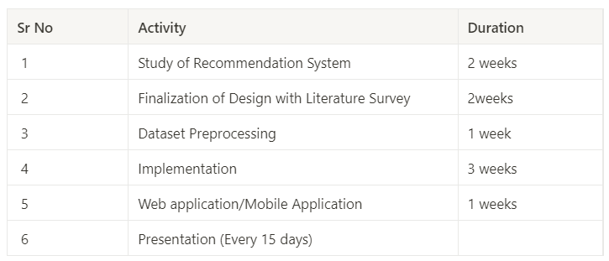

Slide 7



Methodological Details
Tools and Technologies Used -

Slide 8
Implementation Details

Slide 9
Reading about Recommendation Systems and Literature Survey
Initially, our task was to gain as much information as possible about recommendation systems.
So, we read several research papers and articles explaining different types of recommendation systems.
We also read about different types of recommendation systems to finalise any one of them for the project.
I chose content based recommendation system.
We also analyzed features of available dataset and I decided to implement music recommendation system.

Slide 10
Data Preprocessing
The task was to import the dataset, merge various relevant datasets into one, more useful dataset.
Also the necessary libraries used for feature extraction, cosine similarity and vectorisation had to be imported.
Most of the songs had more than one genre, so the string of genre had to be split and converted into bunch of regular words.
The spaces between Track Names, Genre and Playlist names had to be removed.
The three columns of Artists, Genre and Playlist are merged into one single column in order to check similarities for content based recommendation.

Slide 11
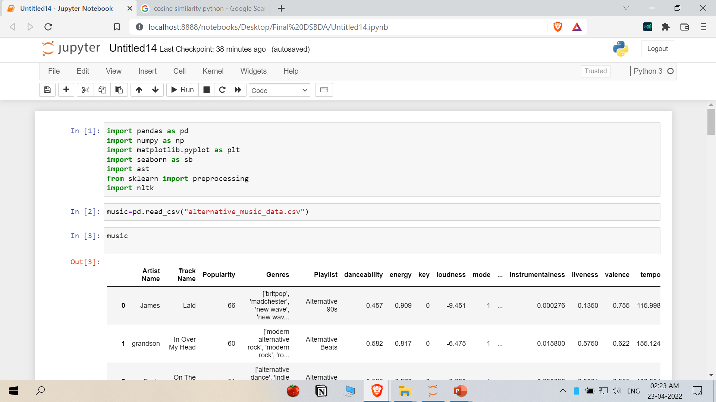
Implementation Details

Slide 12
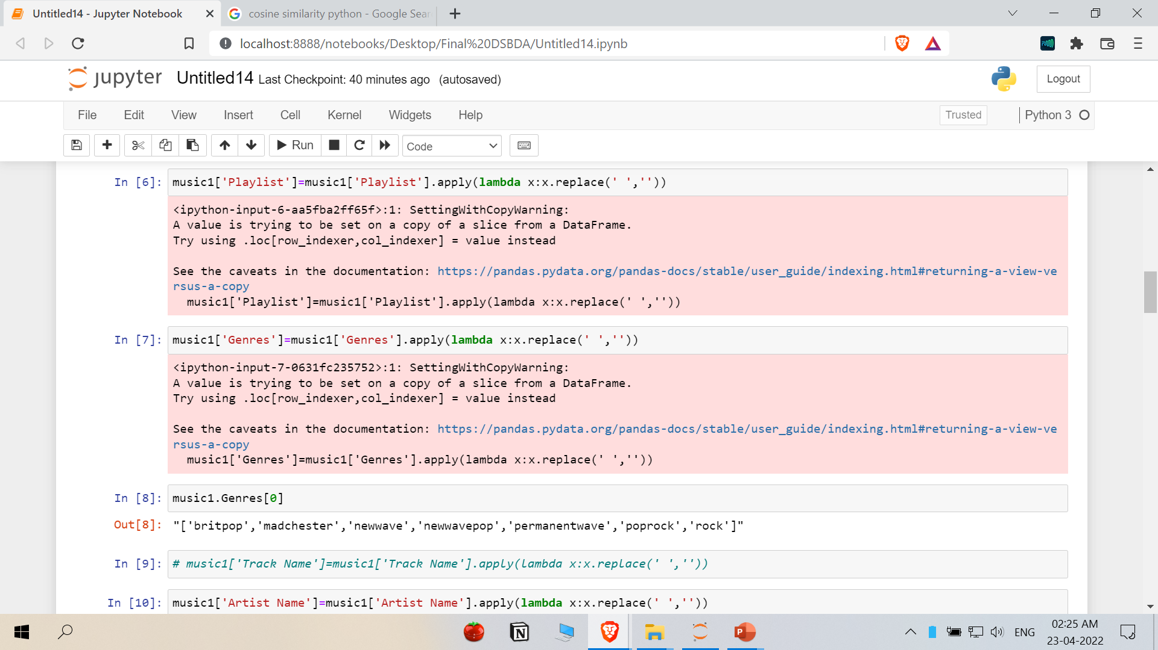

Slide 13
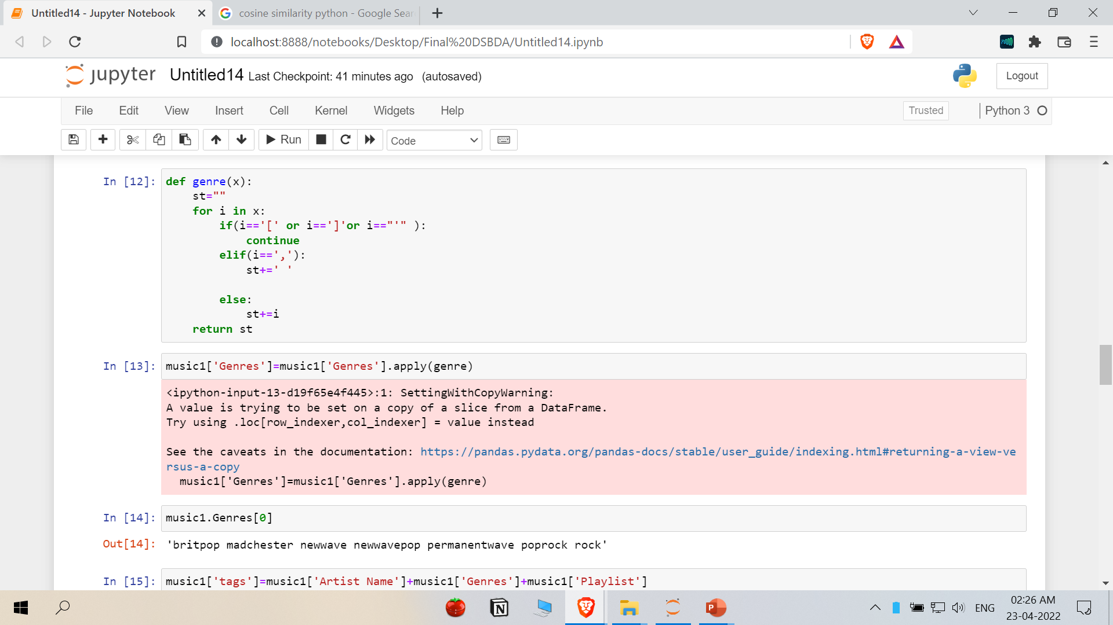

Slide 14
Feature extraction using CountVectorizer
Here, the CountVectorizer is used to vectorize and check for similarity in the input song title and the artist, genres and playlist name.
Cosine similarity is checked and the songs matching the most are showed in decreasing order of their cosine similarity.
We can specify the number of songs we want to be recommended/ displayed based on this similarity.

Slide 15
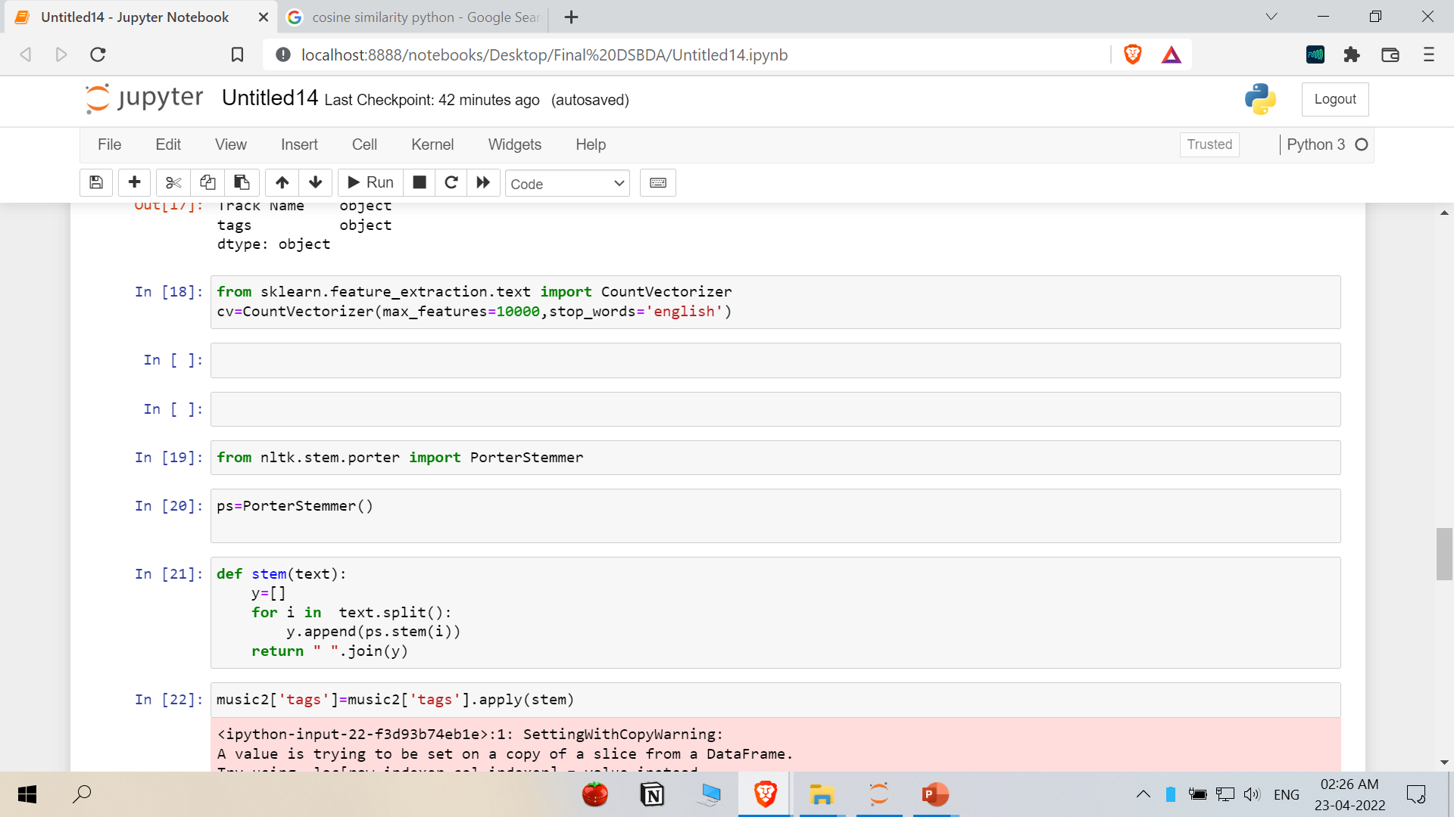

Slide 16
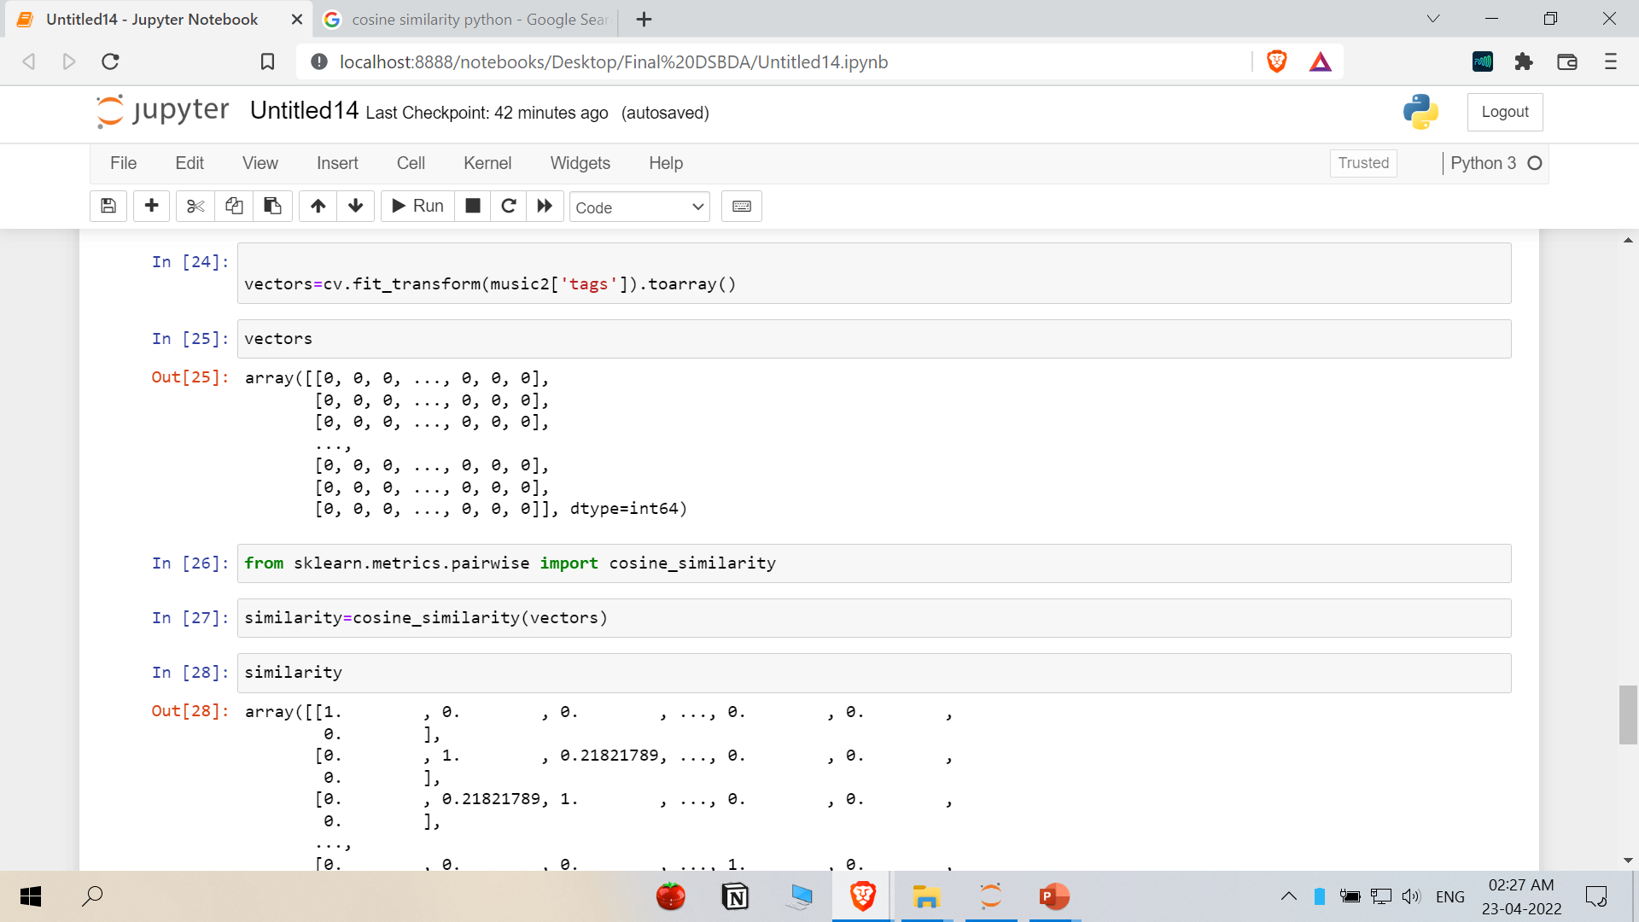

Slide 17
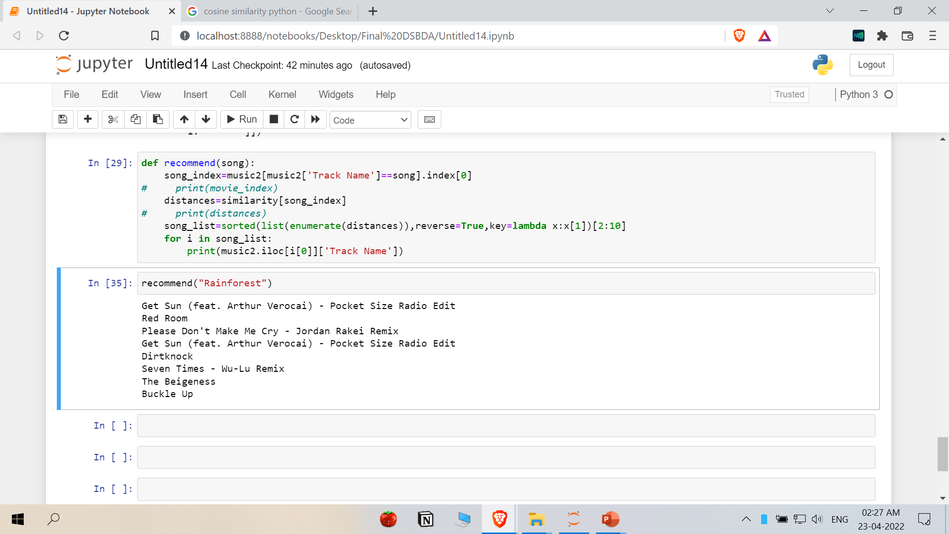

Slide 18
Future Scope
In the growing e-commerce era, finding the right product is essential. Recommendation systems are essential for that.
Finding the right product as well as right content (e.g. Movie, book, song) is also very necessary in current world of enormous information.
Some more advanced methods like collaborative filtering, knowledge based recommendation systems can also be integrated into the current project to make it more useful and accurate.

Slide 19
Outcome of the Internship
Throughout the internship, I gained experience working in the field of data science, collaborating with others, and brainstorming with others to solve a problem.
During this time, I was introduced to various new algorithms and concepts in the field of recommendation systems and basic python data science libraries.
I also learnt the importance of planning and consistent work for completing a project.

Slide 20
Thank You !!

