Slide 1


Interactive Online Learning for Obstacle Classification on a Mobile Robot
Viktor Losing^{1,2}, Barbara Hammer² and Heiko Wersing¹
¹University of Bielefeld
Bielefeld, Germany
²Honda Research Institute Europe GmbH
Offenbach, Germany

Slide 2

Online Learning
Motivation:
Adaptation to user habits & environment
Current methods rather simple¹
Benefits:
Incremental learning
Incorporation of new classes
Control of model complexity
Handling of drift
Challenges:
Stability - Plasticity
¹ R. Yang et al. “Learning from a learning thermostat: Lessons for intelligent systems for the home“, UbiComp 2013

Slide 3
Contributions
Realization of a new interactive Learning Scenario on a Mobile Robot
Outdoor object recognition in a garden environment
Interaction via iPad
Recording of a challenging outdoor benchmark image dataset for learning
Application of prototype based learning to online scenarios
Extensive evalualtion of different prototype placement strategies

Slide 4
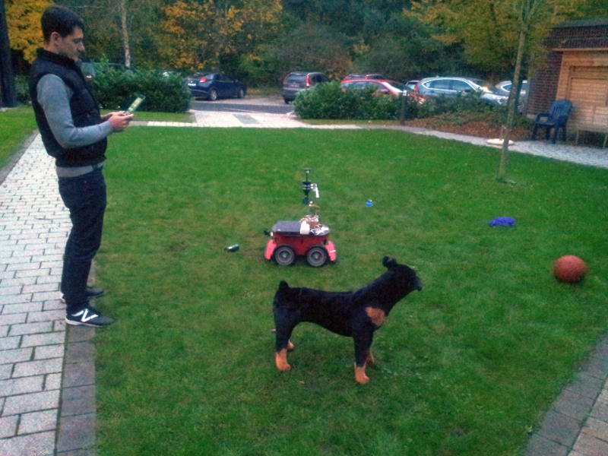
Interactive Scenario
Random exploration
Grass-segmentation for detection
Labeling via iPad
Object specific actions
Comment
Drive around/over
Confidence estimation
Unknown objects

Slide 5
Video

Slide 6
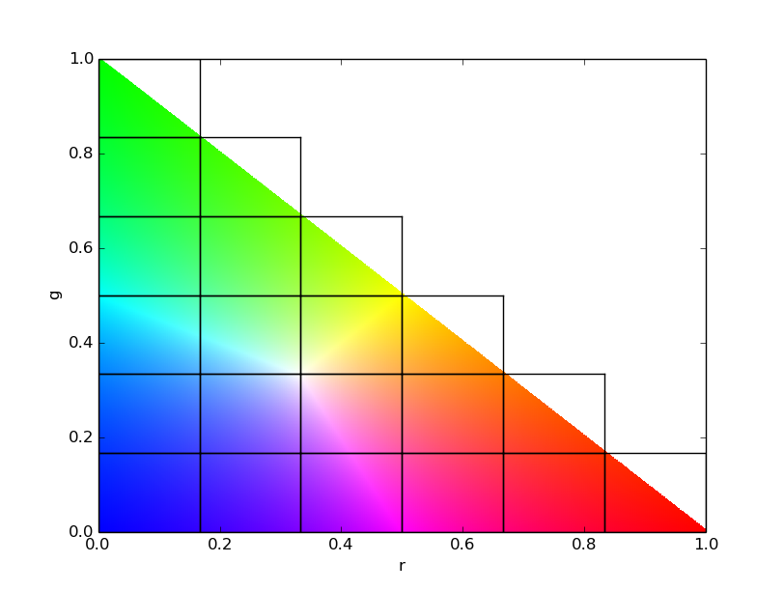
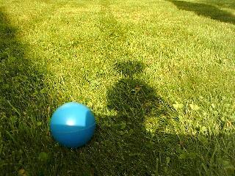
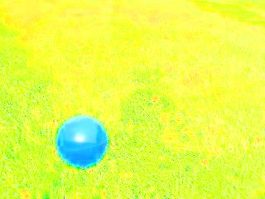
Feature Representation
Color based: simple & robust
rg-Chromaticity histogram
Intensity invariant
21 dimensions
Hist.-normalization for size invariance

Slide 7


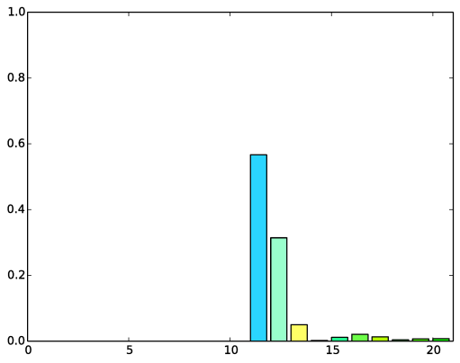
Processing Pipeline
Input
Segmentation
rg-Chromaticity
Histogram

Slide 8
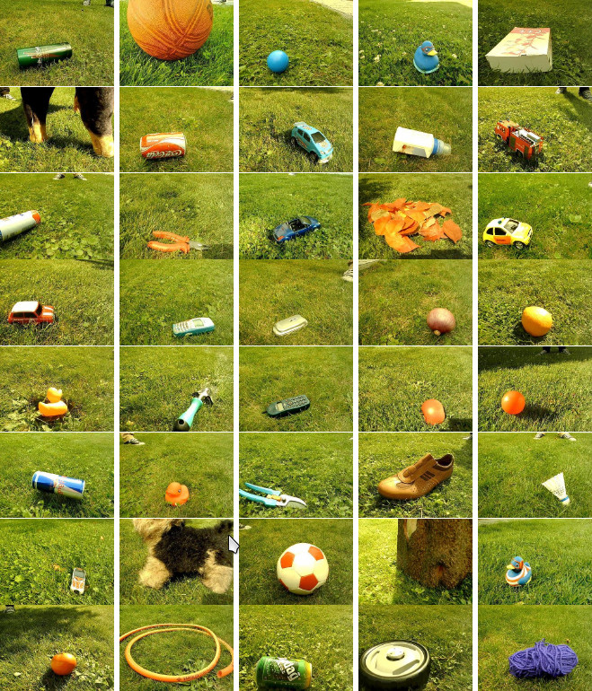
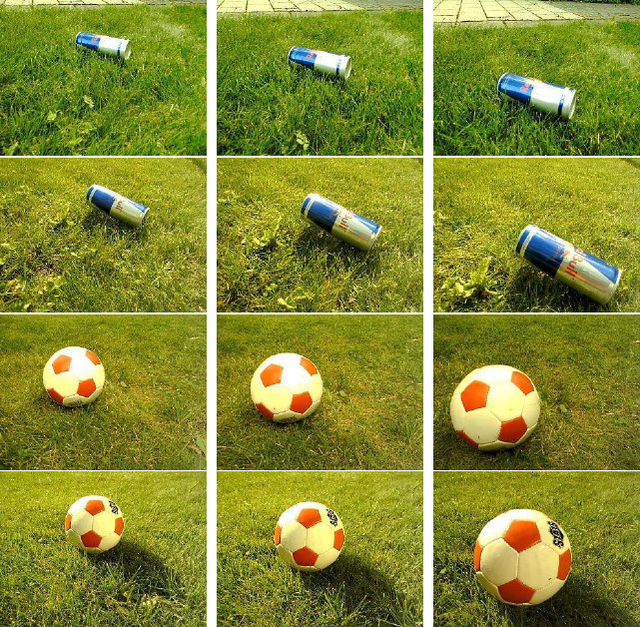
Outdoor Benchmark Image Dataset
40 objects
5 sequences in cloudy/sunny conditions
10 images per sequence
Sequences
All objects

Slide 9
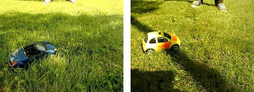

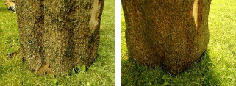

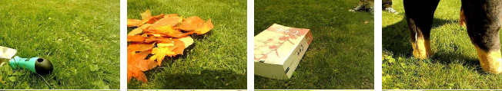
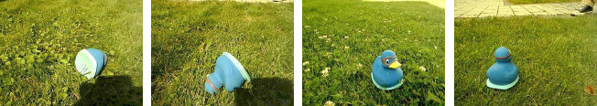
Challenges

Slide 10
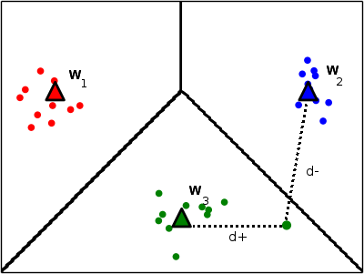
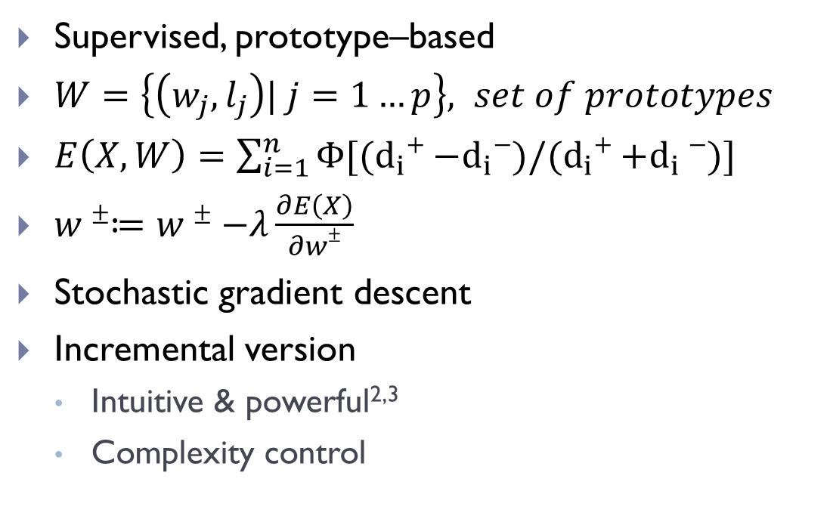
GLVQ¹
Supervised, prototype–based
$W=\left\{\left(w_{j}, l_{j}\right)| j=1…p\right\}, set of prototypes$
$E\left(X,W\right)=\sum_{i=1}^{n}{Φ[{(d}_{i}+−d_{i}−)/{(d}_{i}+{+d}_{i}−)]}$
$w±≔w±−λ\frac{∂E\left(X\right)}{∂w±}$
Stochastic gradient descent
Incremental version
Intuitive & powerful^{2,3}
Complexity control
¹ A.Sato et al. “Generalized Learning Vector Quantization“, NIPS 1995
² S.Kirstein et al. “Rapid Online Learning of objects in a biologically motivated architecture“, 2005
³ T. Kietzmann et al. “Incremental GRLVQ: Learning relevant features for 3D object recognition“, Neurocomputing 2008

Slide 11
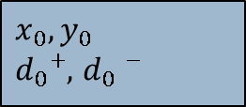

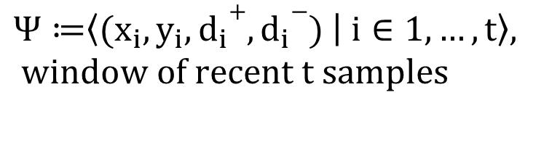

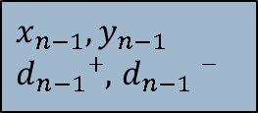
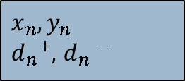
Short-term Memory
$$Ψ≔\left\langle {(x}_{i},y_{i},d_{i}+,d_{i}−) | i∈1,…,t\right\rangle , window of recent t samples$$
$$Ψ$$
...
...
$$x_{0}, y_{0}$$
$d_{0}+,$ $d_{0}−$
$$x_{n−t+1}, y_{n−t+1}$$
$$d_{n−t+1}+,d_{n−t+1}−$$
$$x_{n−1}, y_{n−1}$$
$d_{n−1}+,$ $d_{n−1}−$
$$x_{n}, y_{n}$$
$d_{n}+,$ $d_{n}−$
sample idx.
0
n-t+1
n-1
n

Slide 12
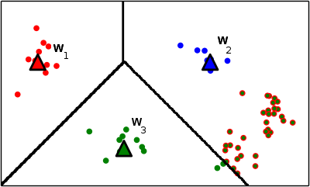
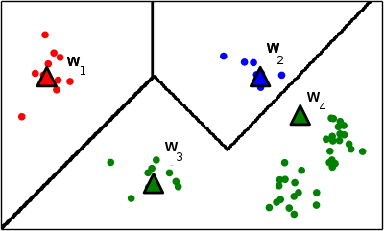
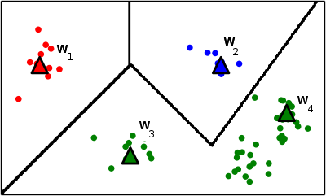
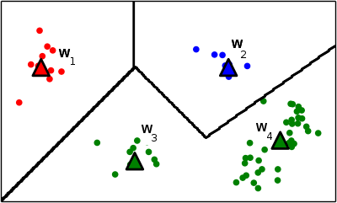
State of the Art Placement Strategies
Based on class-local heuristics
Use misclassifications only
Closest¹
Cluster²
Voronoi³
¹ S.Kirstein et al. “Rapid Online Learning of objects in a biologically motivated architecture“, 2005
² M.Grbovic et al. “Learning Vector Quantization with adaptive prototype addition and removal“, 2009
³ S. Bermejo et al. “A new dynamic lvq-based classifier and its application to handwritten digits“, 1998

Slide 13
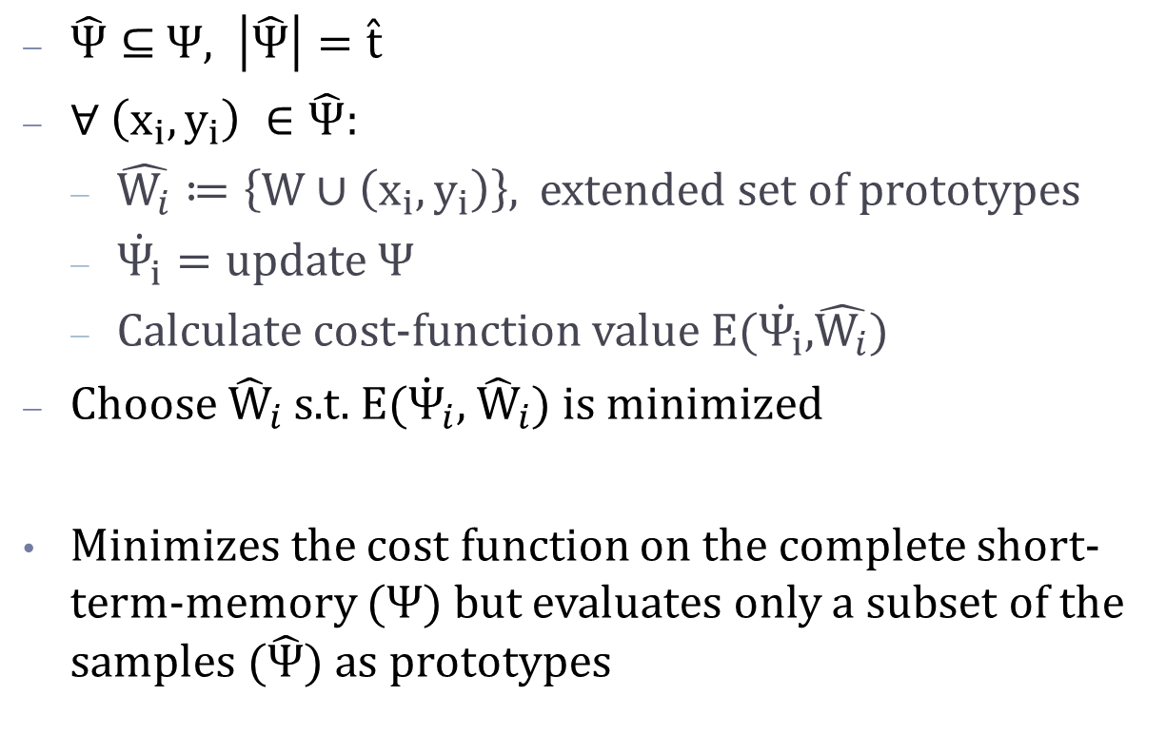
Our Strategy - SamplingCost
$\hat{Ψ}⊆$ $Ψ, \left|\hat{Ψ}\right|=\hat{t}$
$∀ \left(x_{i},y_{i}\right) ∈\hat{Ψ}$:
$\hat{W_{i}}≔\left\{W∪\left(x_{i},y_{i}\right)\right\}$, extended set of prototypes
$\dot{Ψ_{i}}=update Ψ$
Calculate cost-function value E($\dot{Ψ_{i}}$,$\hat{W_{i}}$)
Choose ${\hat{W}}_{i}$s.t. E(${\dot{Ψ}}_{i}$, ${\hat{W}}_{i}$) is minimized
Minimizes the cost function on the complete short-term-memory ($Ψ$) but evaluates only a subset of the samples ($\hat{Ψ}$) as prototypes

Slide 14
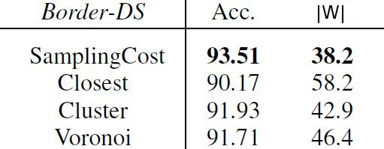
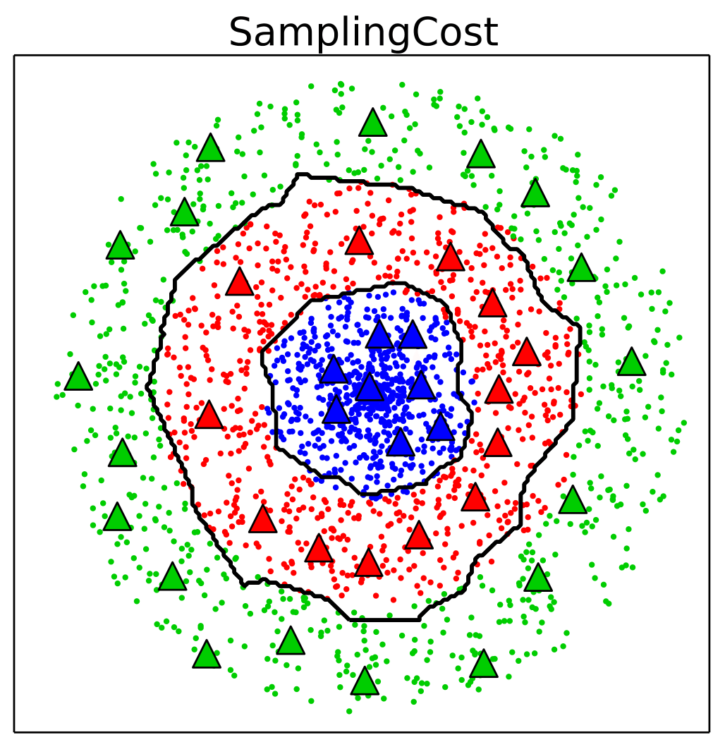
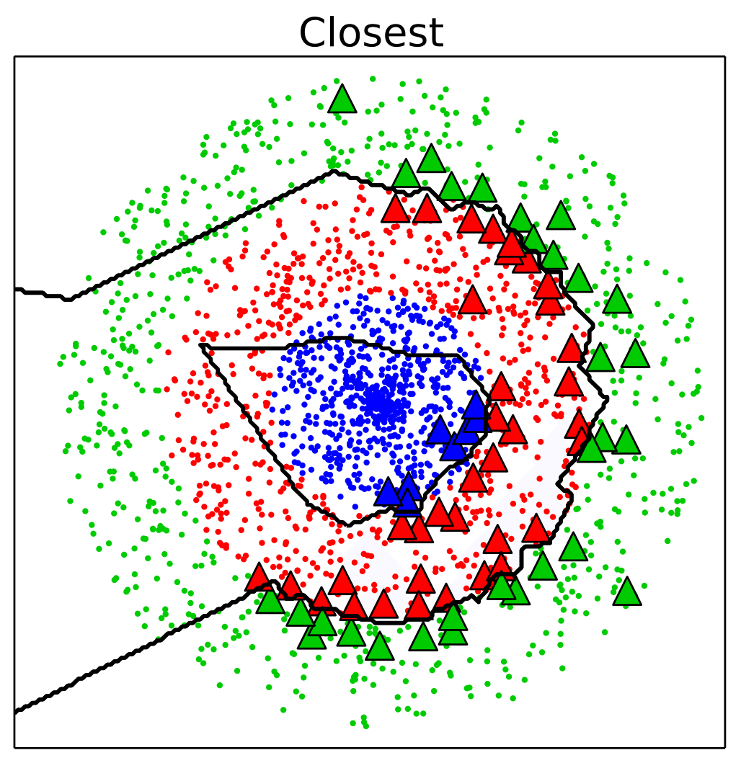
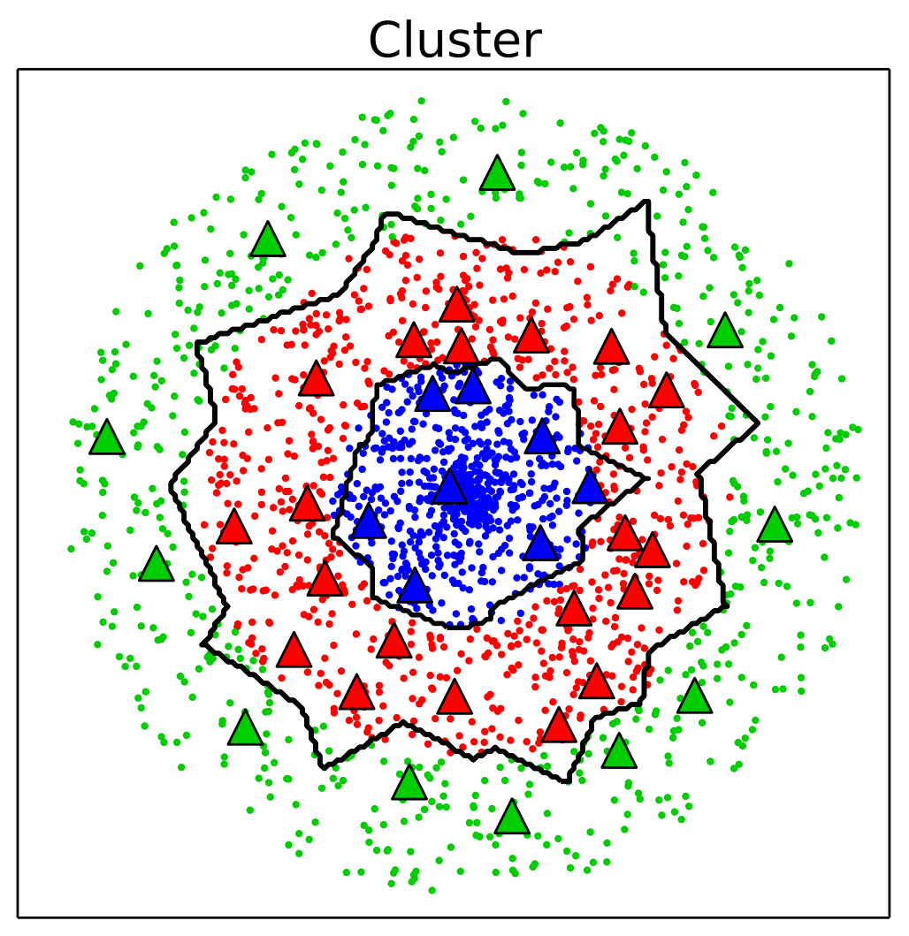
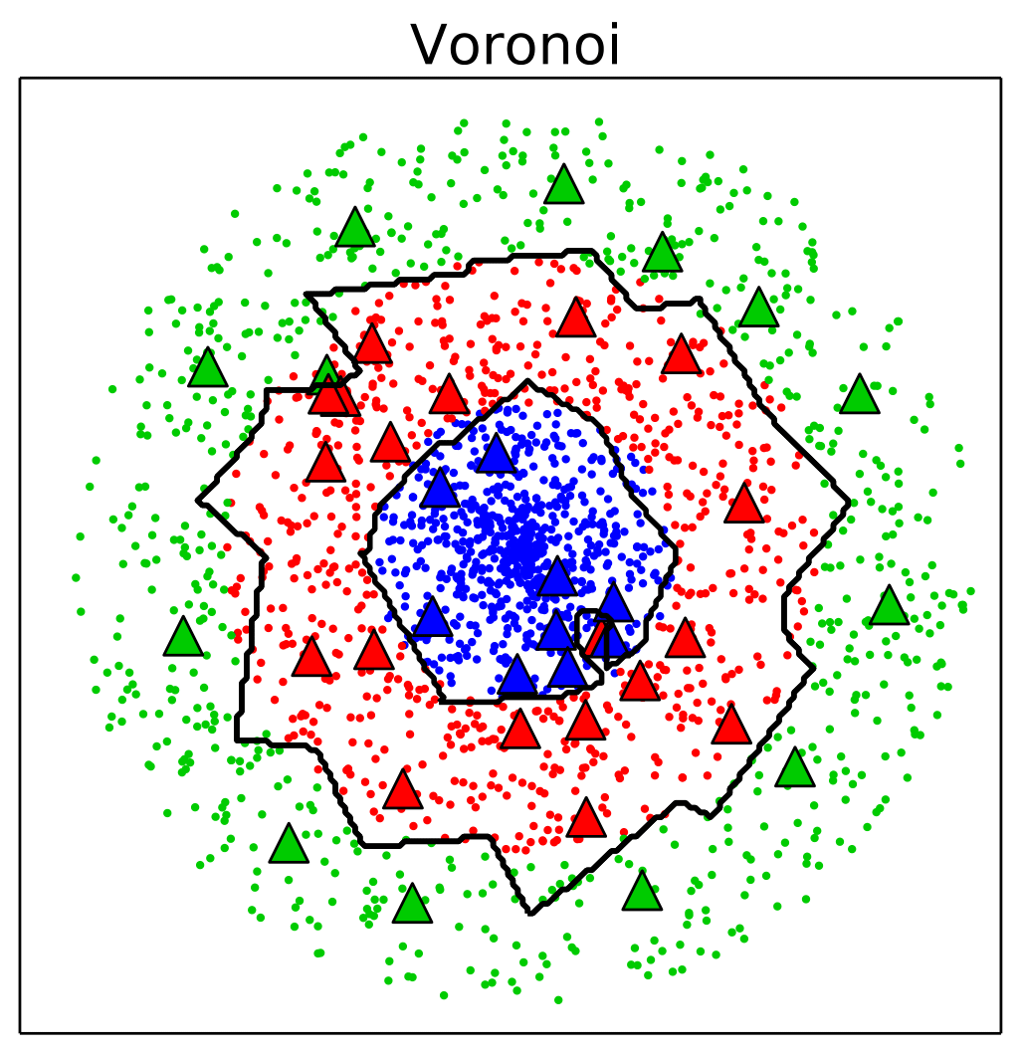

Artificial Dataset Border
$$\left|W\right|=Number of prototypes$$

Slide 15
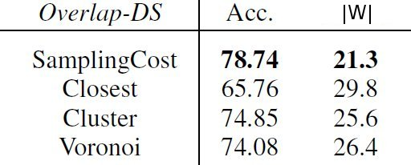
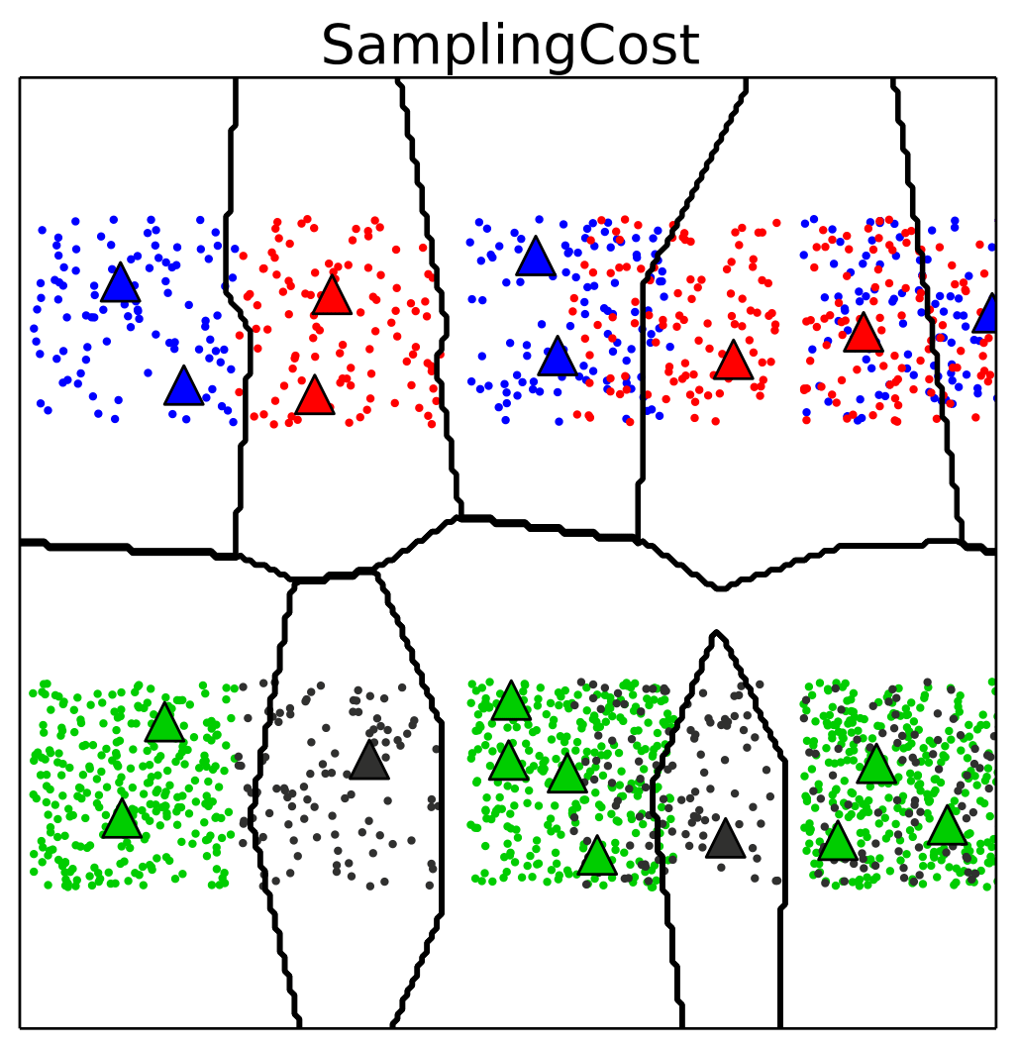
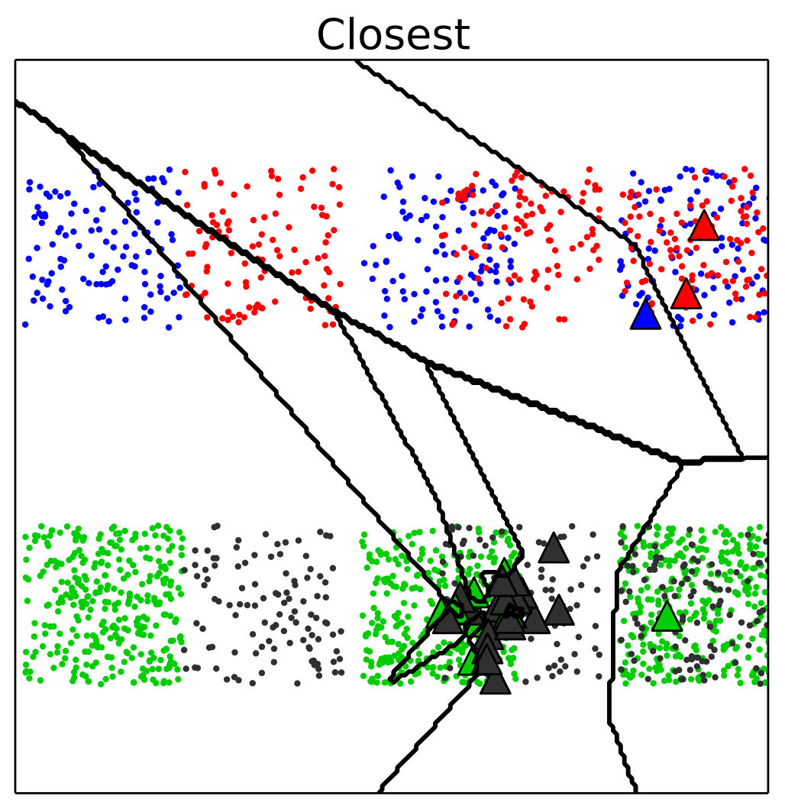
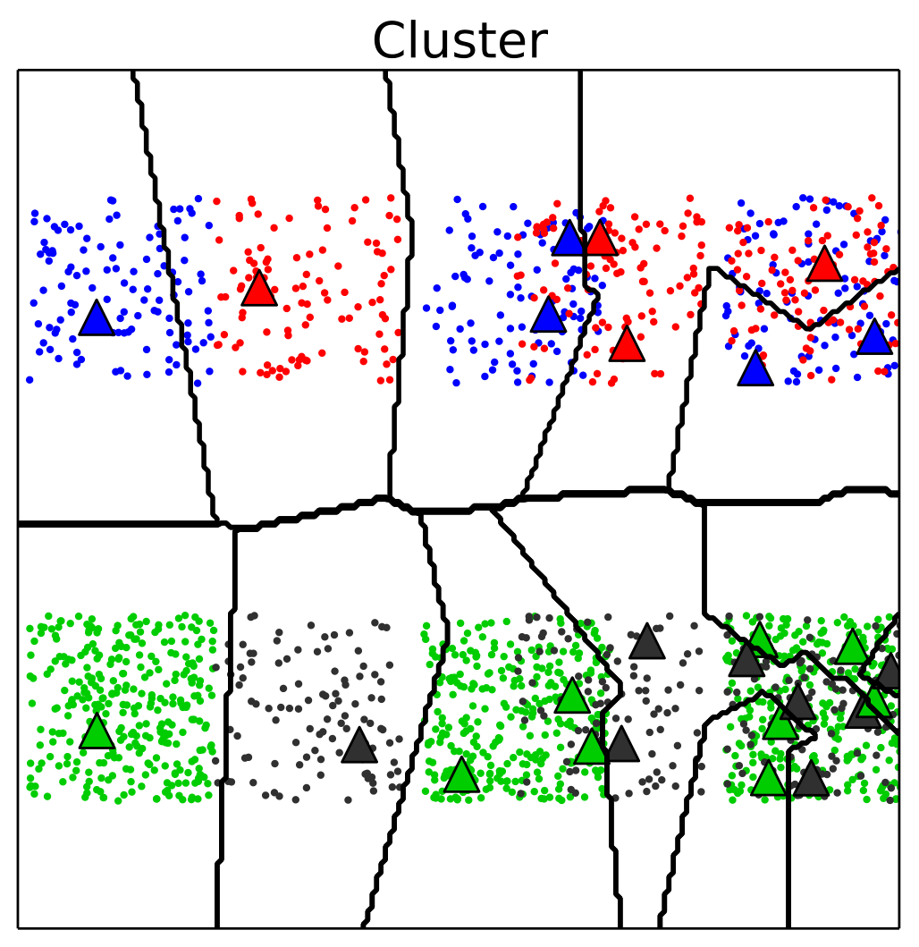
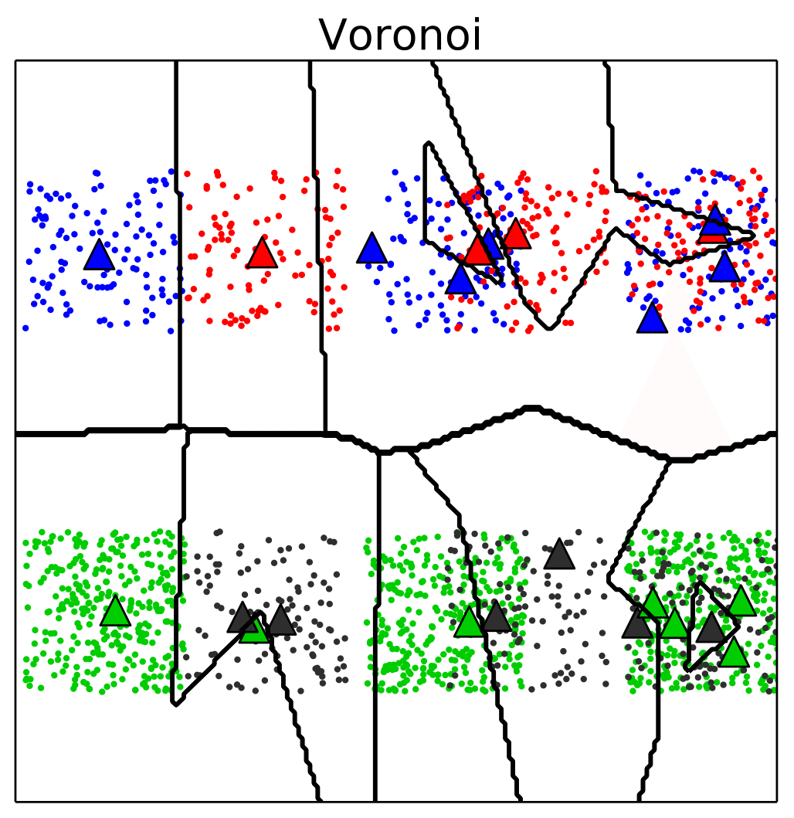
Artificial Dataset Overlap
$$\left|W\right|=Number of prototypes$$

Slide 16
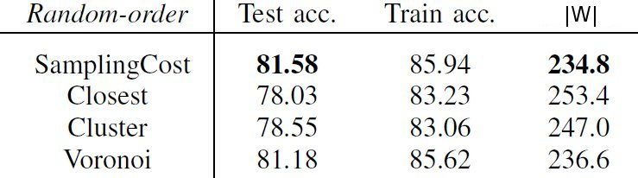
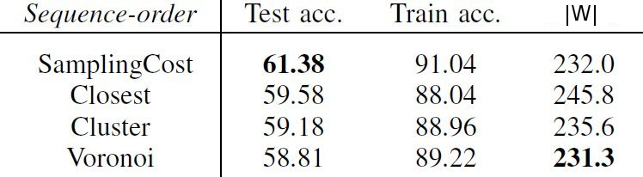
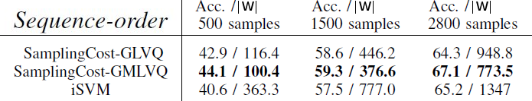

Outdoor Dataset
Random-order
Sequence-order
Seq₁
Seq₂
Seq₁
Seq₂
Train-set
Test-set
Train-set
Test-set
$$\left|W\right|=Number of prototypes$$
¹ C.P. Diehl, G. Cauwenberghs “SVM incremental learning, adaptation and optimization“, IJCNN 2003

Slide 17

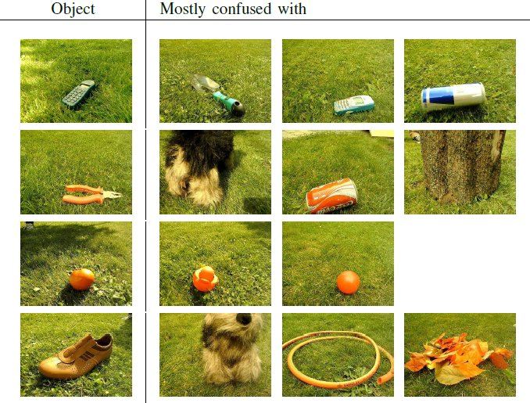
Easy/Difficult Objects
Easy
Difficult

Slide 18
Summary
New interactive real-time learning scenario
Outdoor benchmark image dataset for learning
Proposal of cost-function based placement strategy
SamplingCost performs superior, especially for Overlaps
Representation not robust enough, could be extended by shape based features¹
¹ S. Kirstein et al. “A life-long learning vector quantization approach for interactive learning of multiple categories“, Neural Networks 2012

Slide 19
Thank you for your attention!

