Slide 1


Interactive Online Learning for Obstacle Classification on a Mobile Robot
Viktor Losing^{1,2}, Barbara Hammer², and Heiko Wersing¹
¹University of Bielefeld
Bielefeld, Germany
²Honda Research Institute Europe GmbH
Offenbach, Germany

Slide 2
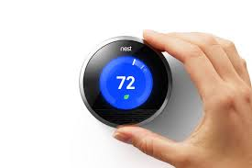
Online Learning
Motivation:
Adaptation to user habits & environment
Current methods rather simple
Benefits:
Incremental learning
Incorporation of new classes
Control of model complexity
Handling of drift
Challenges:
Stability - Plasticity

Slide 3
Goals
Realization of a new interactive Learning Scenario on a Mobile Robot
Outdoor object recognition in a garden environment
Interaction via iPad
Recording of a challenging outdoor benchmark dataset for learning
Improvement of incremental learning for LVQ
Analysis of prototype placement strategies
Comparison on artificial/real datasets

Slide 4
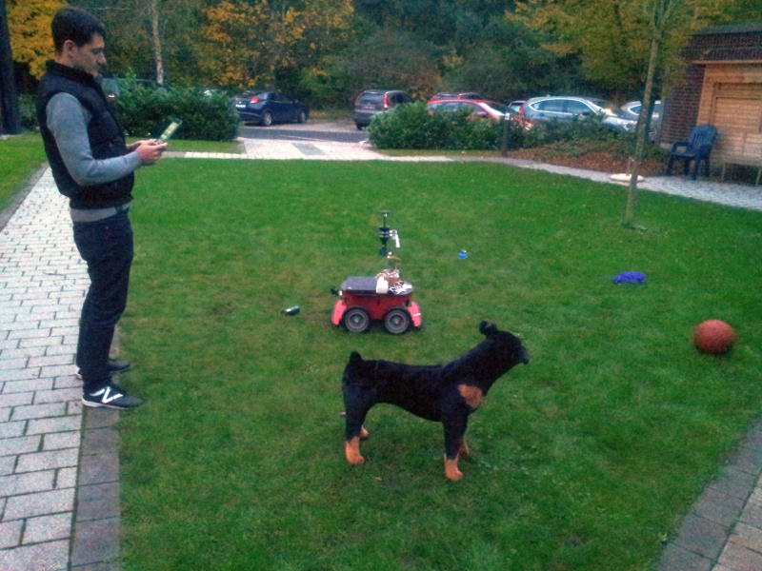
Interactive Scenario
Random exploration
Grass-segmentation for obstacle detection
Labeling via iPad
Object specific actions
Comment
Drive around/over
Confidence estimation
Unknown objects
Drive around in case of low confidence

Slide 5
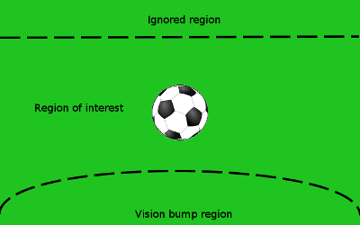
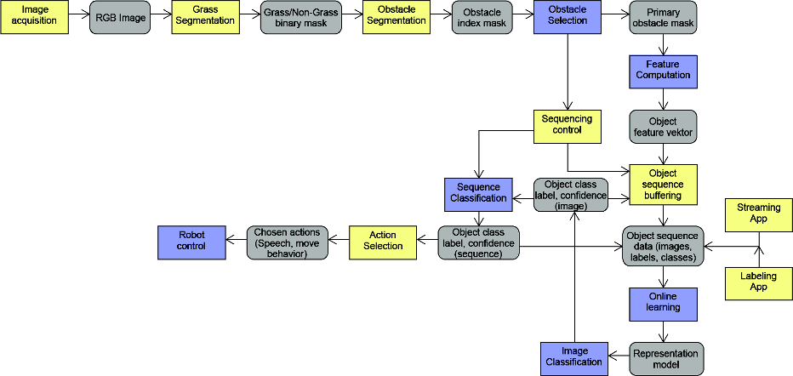
Perception and Control

Slide 6
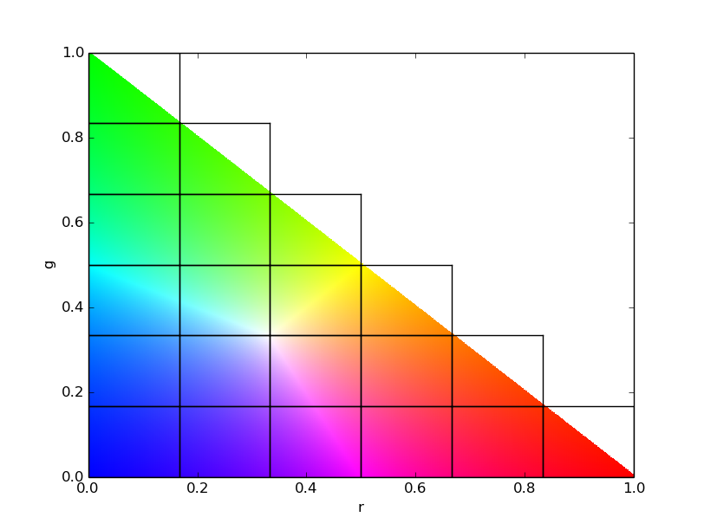
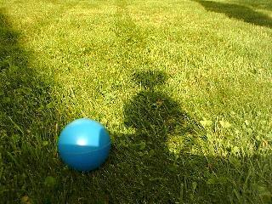
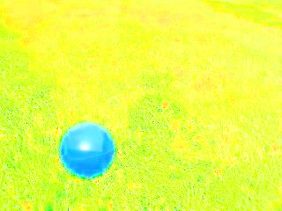
Feature Representation
Color based: simple & robust
rg-Chromaticity histogram
Intensity invariant
e.g. r = R / R+G+B
21 dimensions
Hist.-normalization for size invariance

Slide 7
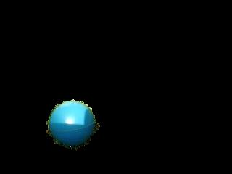

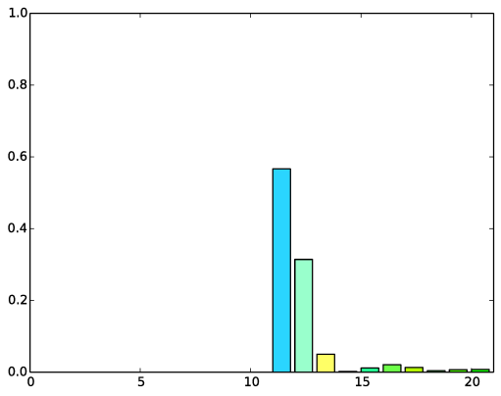
Pipeline
Input
Segmentation
rg-Chromaticity
Histogram

Slide 8
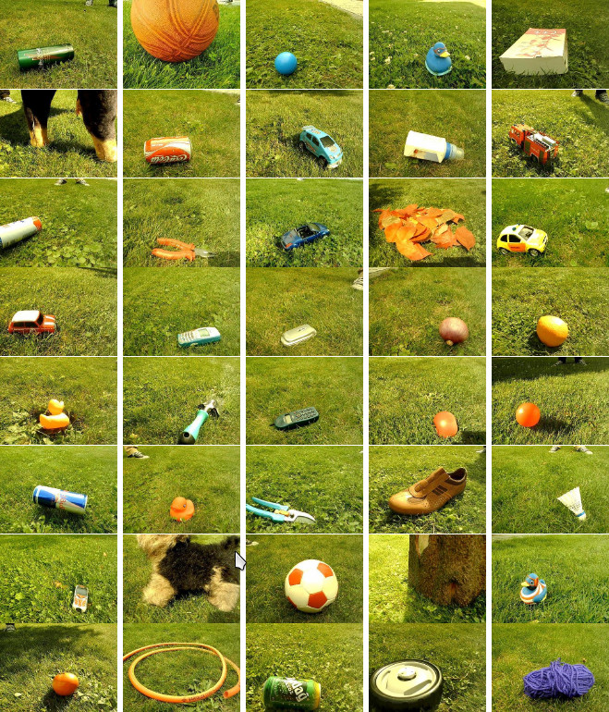
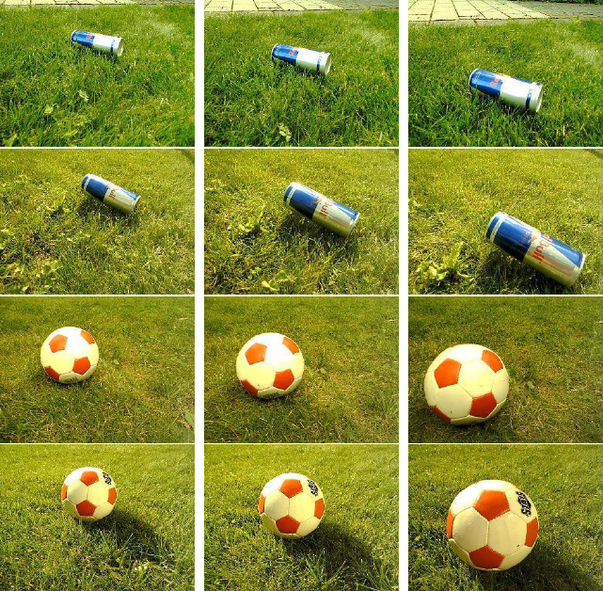
Outdoor benchmark dataset
40 objects
5 sequences in cloudy/sunny conditions
10 images per sequence
Sequences
All objects

Slide 9
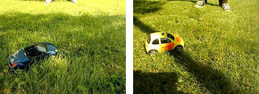
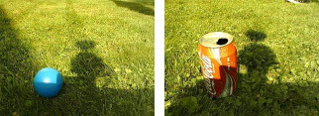
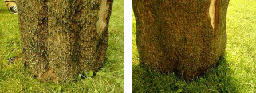
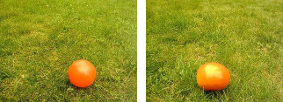
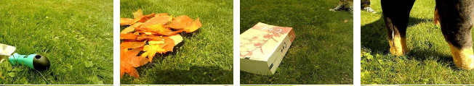
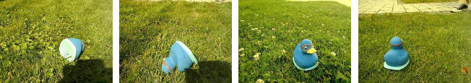
Challenges

Slide 10
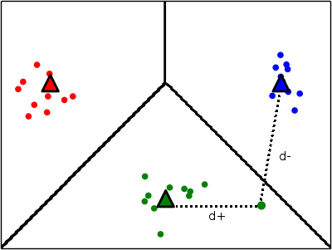
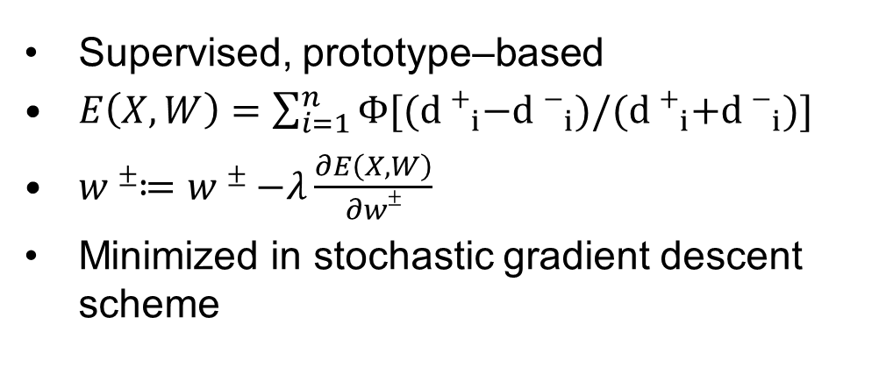
GLVQ¹
Supervised, prototype–based
$E\left(X,W\right)=\sum_{i=1}^{n}{Φ[{(d+}_{i}−{d−}_{i})/{(d+}_{i}{+d−}_{i})]}$
$w±≔w±−λ\frac{∂E\left(X,W\right)}{∂w±}$
Minimized in stochastic gradient descent scheme
¹ A.Sato, K.Yamada “Generalized Learning Vector Quantization“, 1995

Slide 11
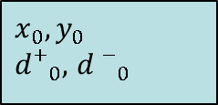


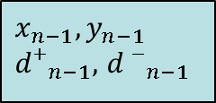
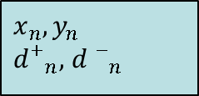
Short term memory
$$Ψ≔\left\langle {(x}_{i},y_{i},{d+}_{i},{d−}_{i}) | i∈1,…,t\right\rangle , window of recent t samples$$
$$Ψ$$
...
...
$$x_{0}, y_{0}$$
$d+_{0},$ $d−_{0}$
$$x_{n−t+1}, y_{n−t+1}$$
$d+_{n−t+1},$ $d−_{n−t+1}$
$$x_{n−1}, y_{n−1}$$
$d+_{n−1},$ $d−_{n−1}$
$$x_{n}, y_{n}$$
$d+_{n},$ $d−_{n}$
0
n-t+1
n-1
n
sample idx.

Slide 12
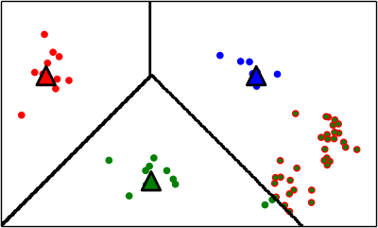
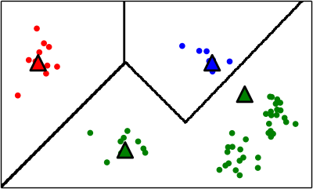
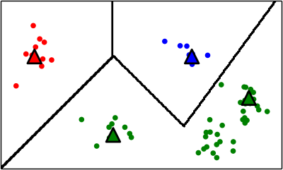
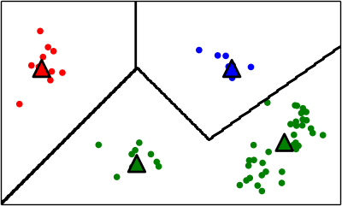
Current Placement Strategies
Based on class-local heuristics
Use misclassifications only
Closest¹
Cluster²
Voronoi³
¹ S.Kirstein, H.Wersing “Rapid Online Learning of objects in a biologically motivated architecture“, 2005
² M.Grbovic, S. Vucetic “Learning Vector Quantization with adaptive prototype addition and removal“, 2009
³ S. Bermejo, J. Cabestany “A new dynamic lvq-based classifier and its application to handwritten digits“, 1998

Slide 13
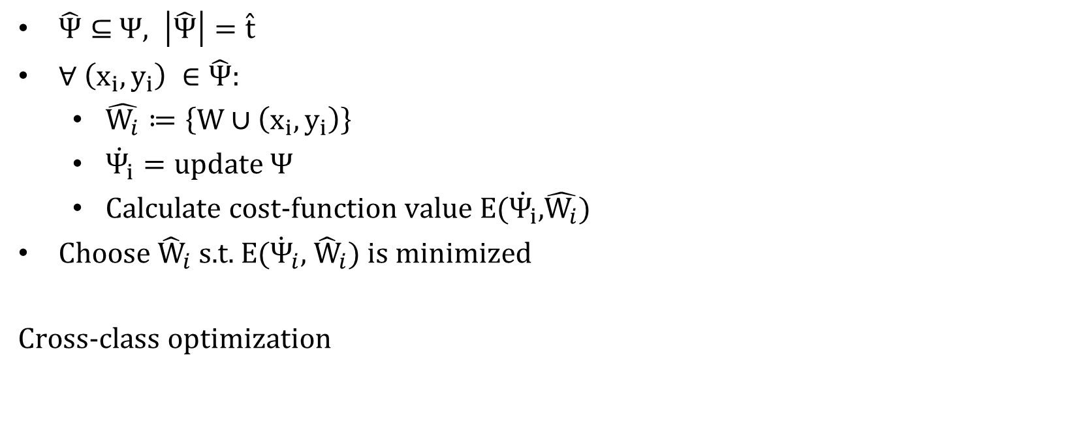
Proposed Strategy - SamplingCost
$\hat{Ψ}⊆$ $Ψ, \left|\hat{Ψ}\right|=\hat{t}$
$∀ \left(x_{i},y_{i}\right) ∈\hat{Ψ}$:
$\hat{W_{i}}≔\left\{W∪\left(x_{i},y_{i}\right)\right\}$
$\dot{Ψ_{i}}=update Ψ$
Calculate cost-function value E($\dot{Ψ_{i}}$,$\hat{W_{i}}$)
Choose ${\hat{W}}_{i}$s.t. E(${\dot{Ψ}}_{i}$, ${\hat{W}}_{i}$) is minimized
Cross-class optimization

Slide 14
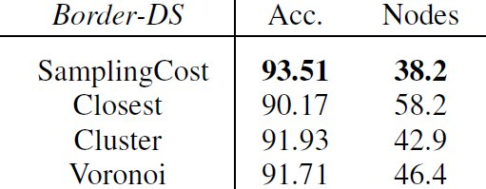
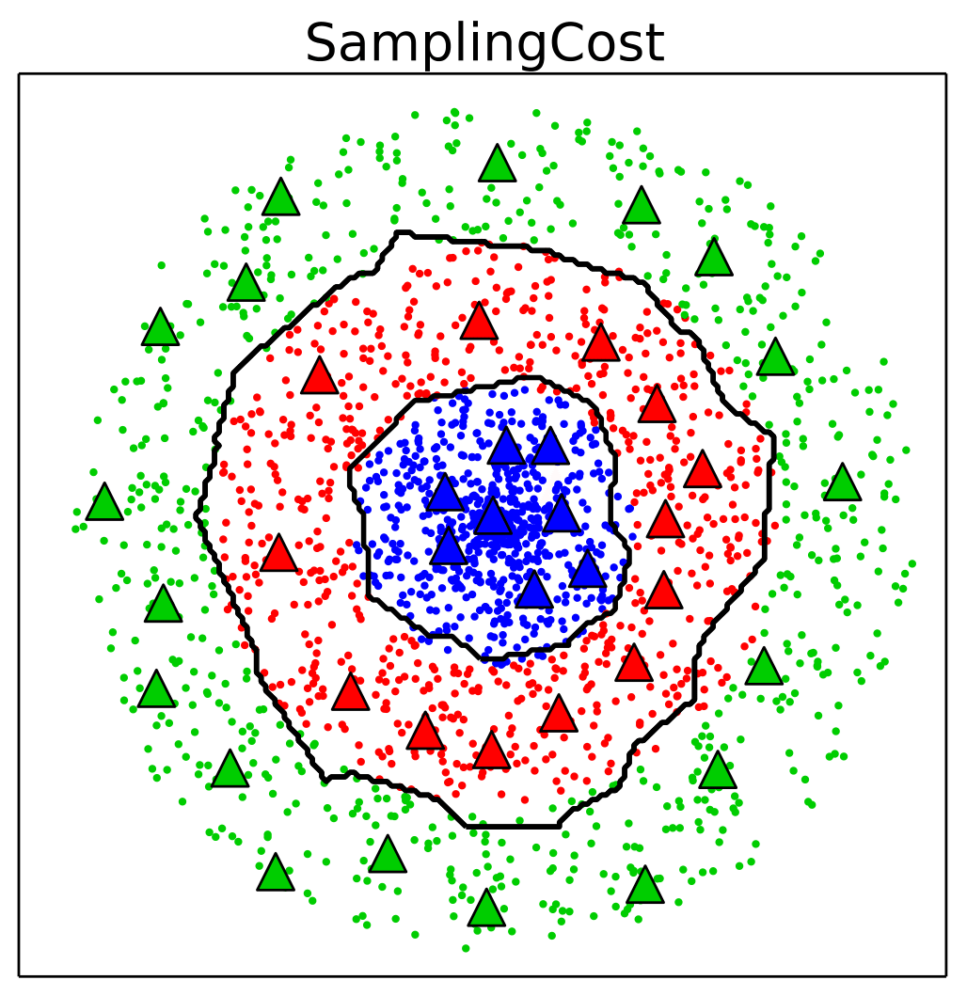
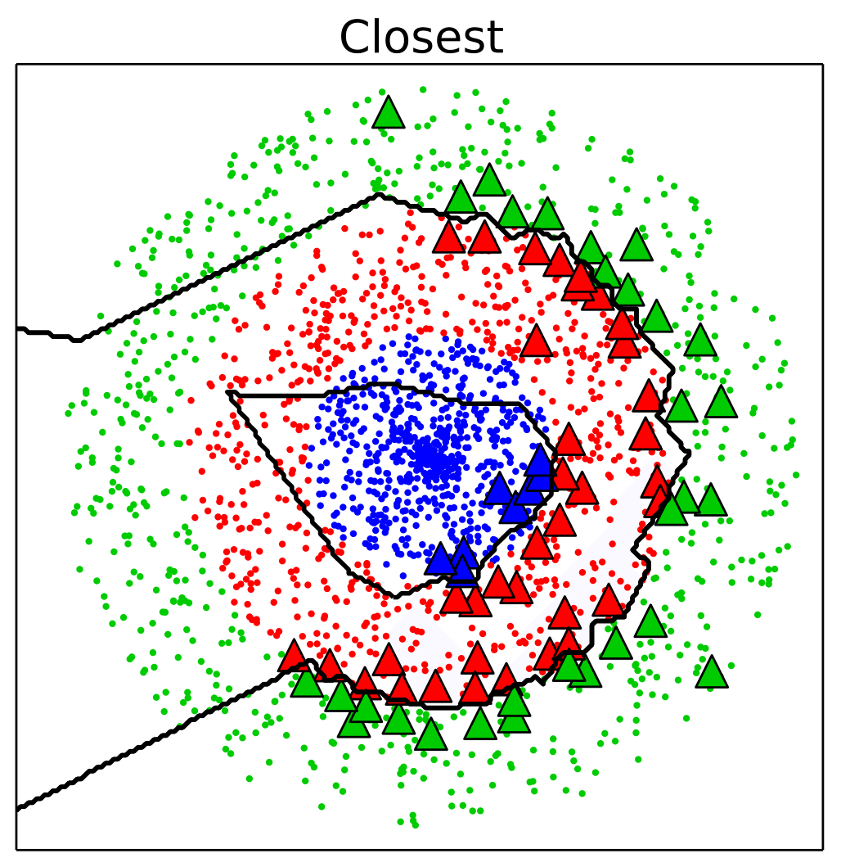
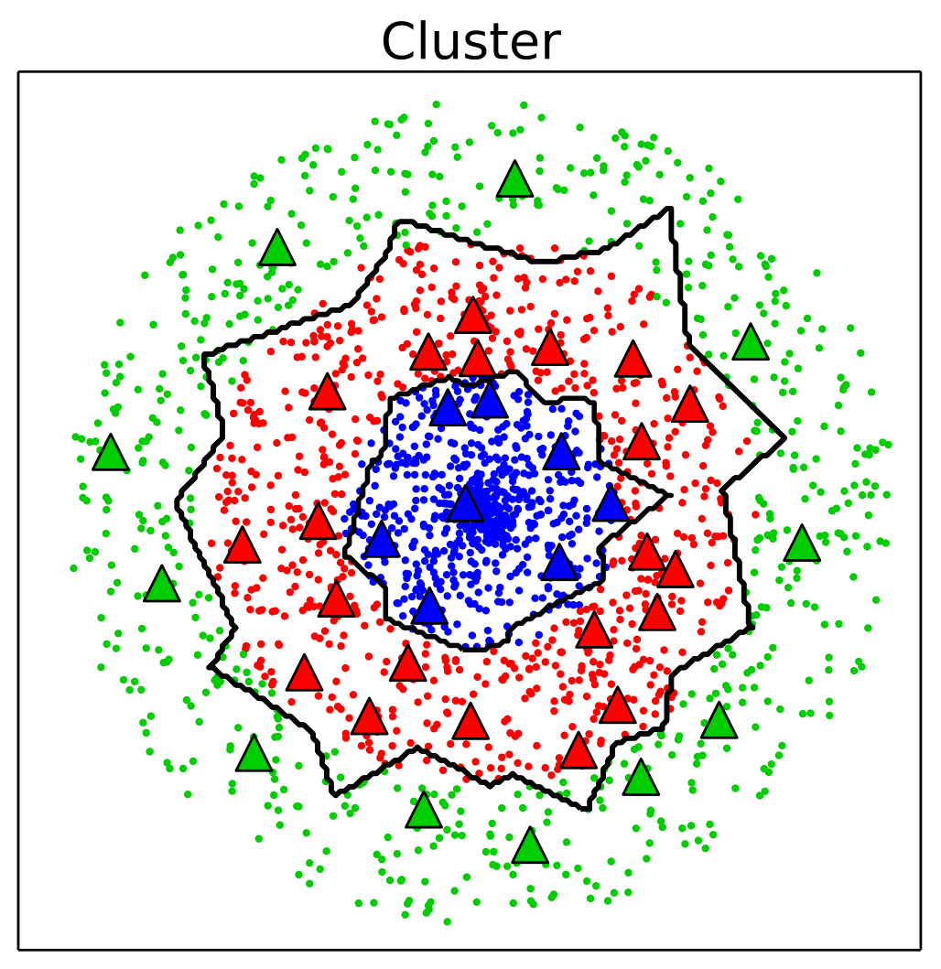
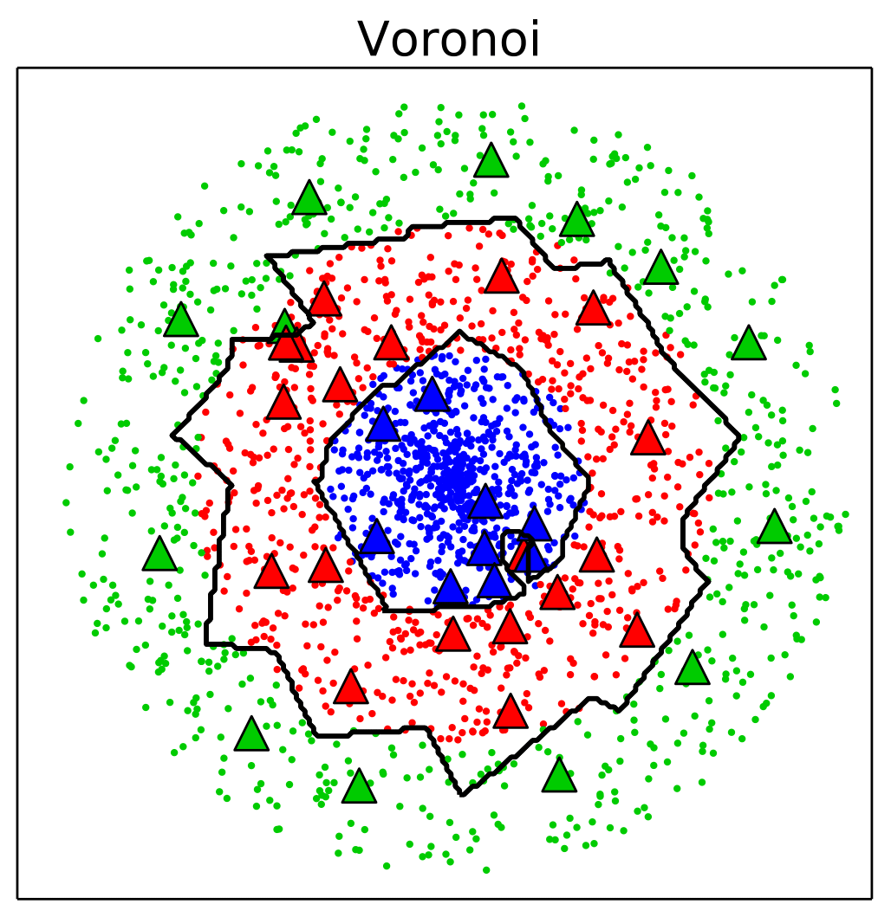
Artificial dataset Border

Slide 15
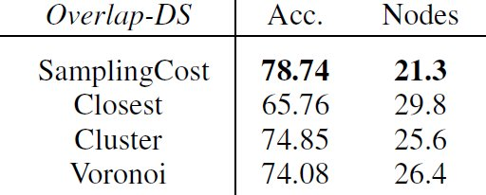
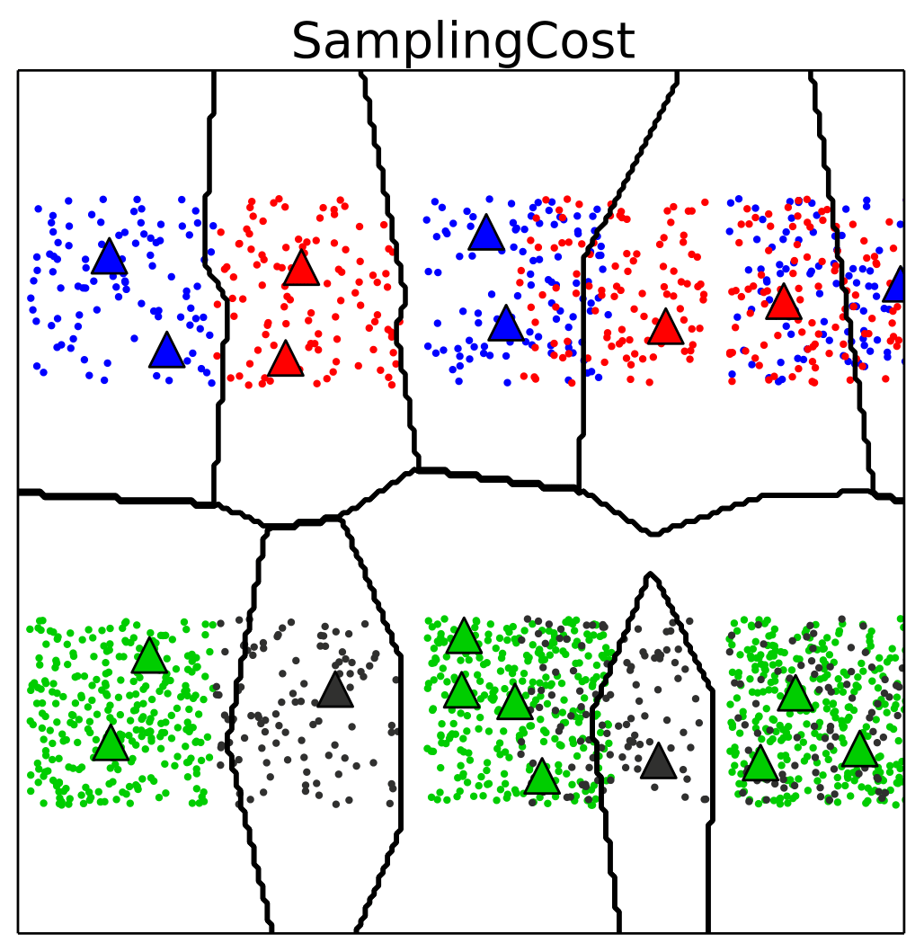
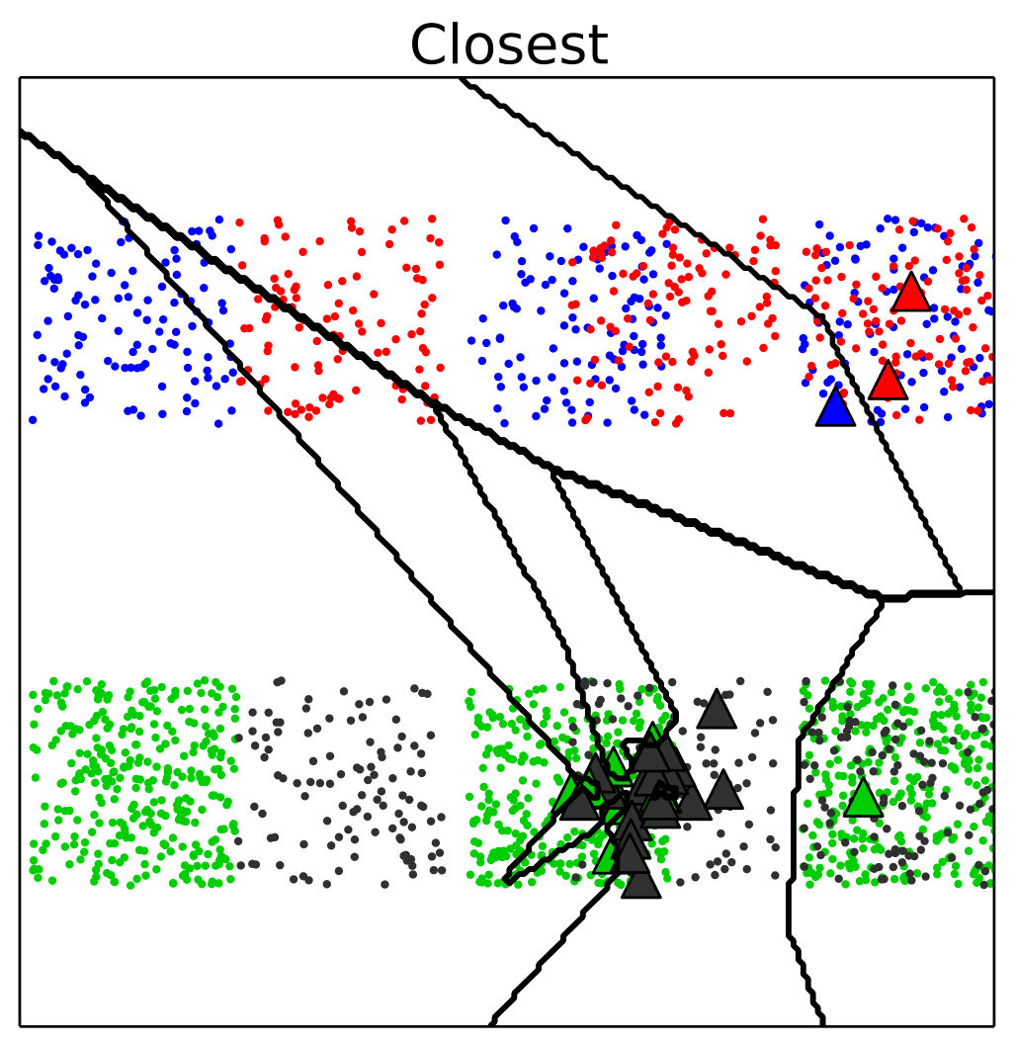
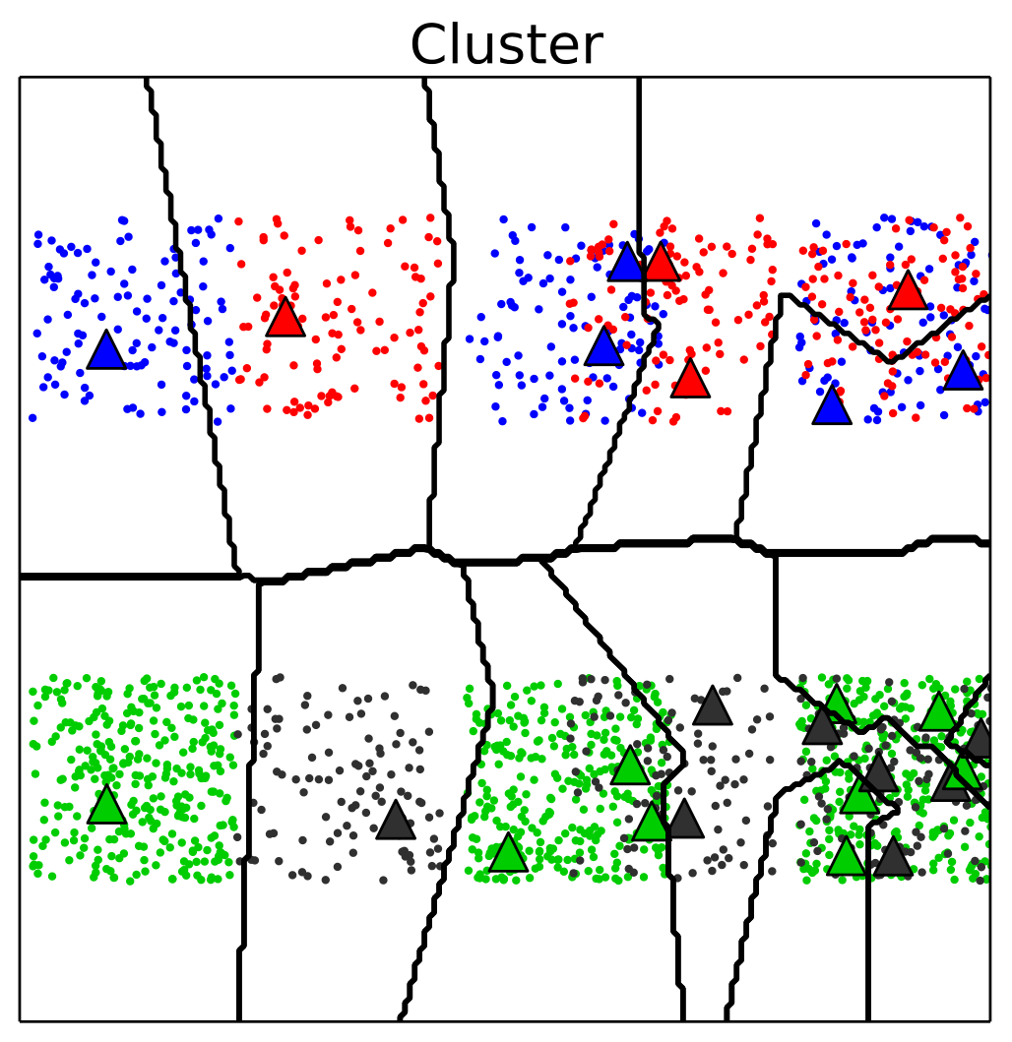
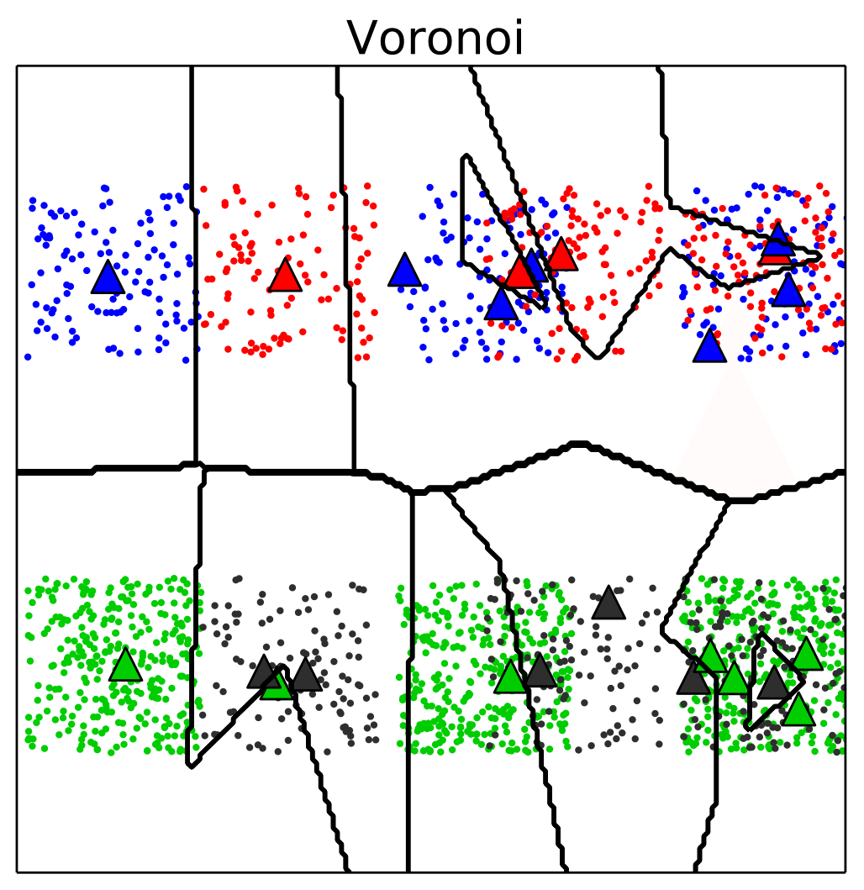
Artificial Dataset Overlap

Slide 16
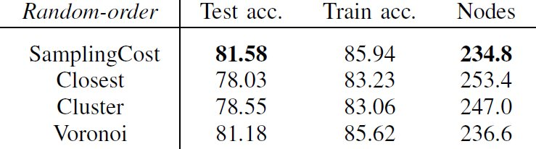
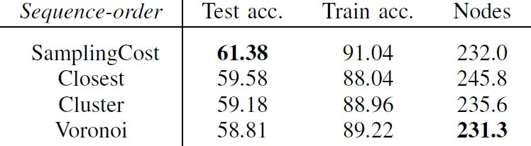
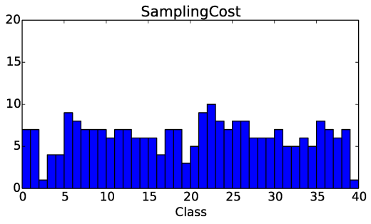
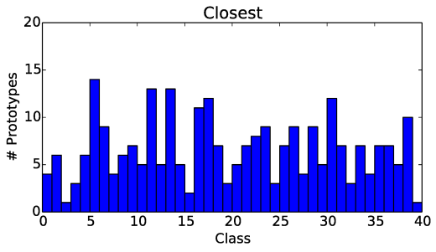
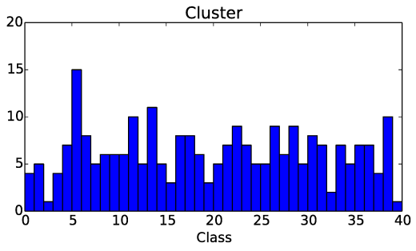
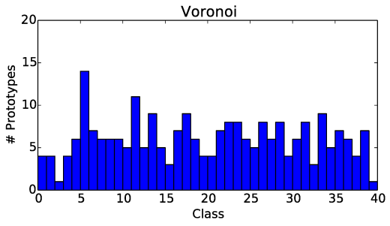
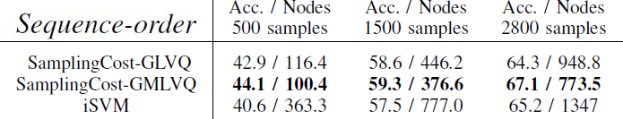
Outdoor Dataset

Slide 17

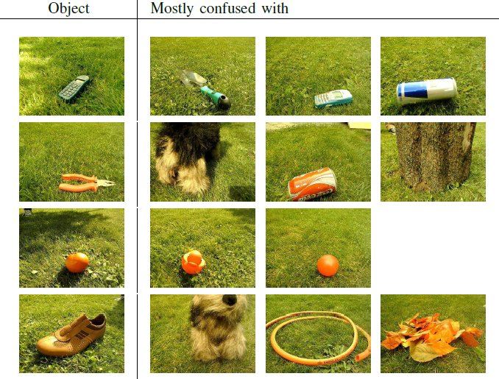
Easy/Difficult Objects
Easy
Difficult

Slide 18
Video

Slide 19
Summary
New interactive real-time learning scenario
Outdoor benchmark dataset for learning
Proposal of cost-function based placement strategy
Comparison to current strategies on artificial and real datasets
SamplingCost performs superior, especially for Overlaps
Representation not robust enough, could be extended by shape based features

Slide 20
Thank you for your attention!

