Slide 1
Online Learning on a Mobile Robot
Master thesis
By Viktor Losing
Supervisor: Heiko Wersing & Barbara Hammer

Slide 2

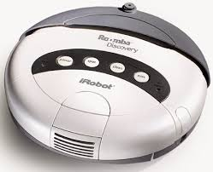
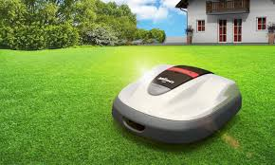
Online Learning
Benefits:
Incremental learning
Control of model complexity
Limited Ressources & Efficiency
Handling of drift
Incorporation of new classes
Adaptation to user habits & environment
Challenges:
Stability - Plasticity

Slide 3
Goals
Realization of an interactive Learning Scenario on a Mobile Robot
Outdoor object recognition in a garden environment
Interaction via iPad
Recording of a challenging object dataset (40 Objects)
Live-Demonstration
Proposal of a non-heuristic prototype placement strategy for LVQ
Implementation of available strategies
Comparison & evaluation on artificial/real datasets

Slide 4
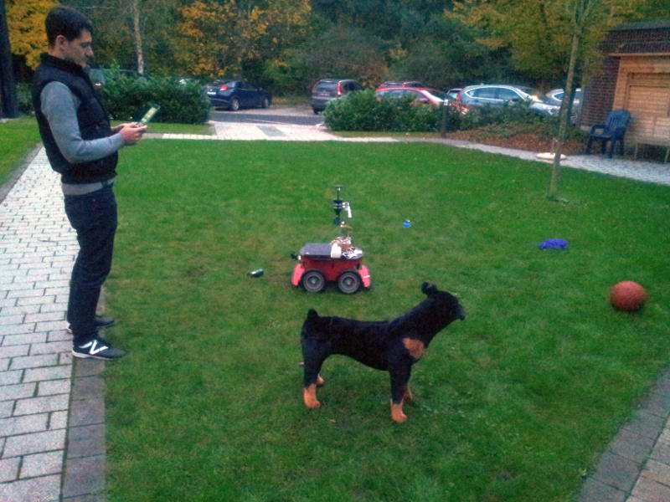
Interactive Scenario
Random exploration
Grass-segmentation for obstacle detection
Labeling via iPad
Object specific actions
Comment
Drive around/over
Confidence estimation
Unknown objects
Drive around in case of low confidence
Bumpers for collision detection

Slide 5
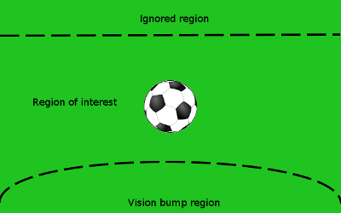
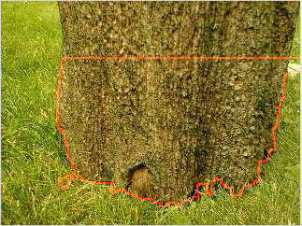
Control
Object image position is used for situation recognition
Far distanced objects are ignored
Vision bump triggers end of a sequence
Only approached objects are considered
Last 10 images of a sequence are used for learning / classification

Slide 6
Apps
Streaming – App:
Stream of visual input
Enables live-Labeling
Display of classification confidence
Labeling– App:
Label management
Configuration of object specific actions
Post labeling

Slide 7
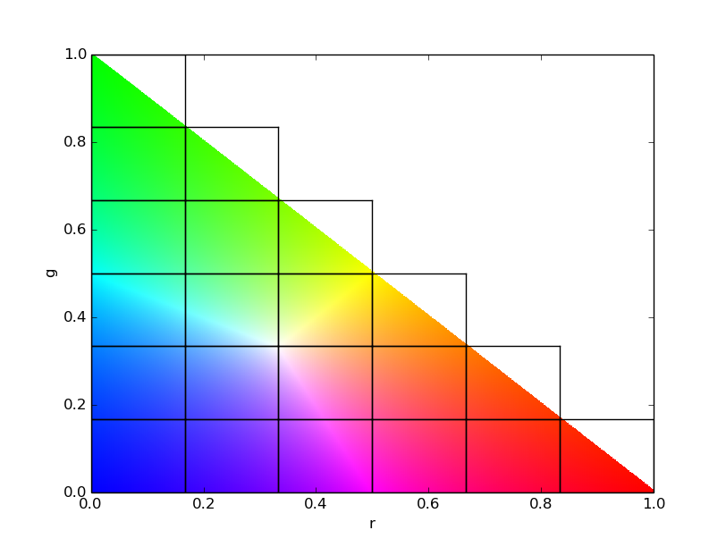
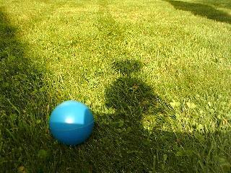
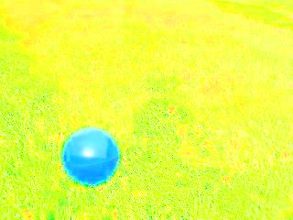
Feature Representation
rg-Chromaticity histogram
Intensity invariant
e.g. r = R / R+G+B
21 dimensions
Hist.-normalization for size invariance

Slide 8
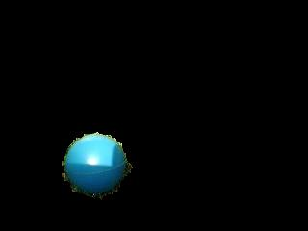

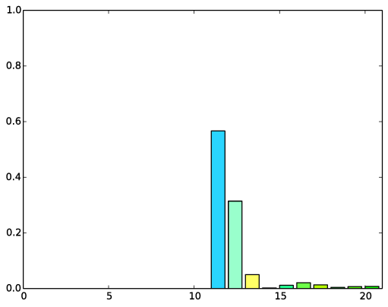
Pipeline
Input
Segmentation
rg-Chromaticity
Histogram

Slide 9
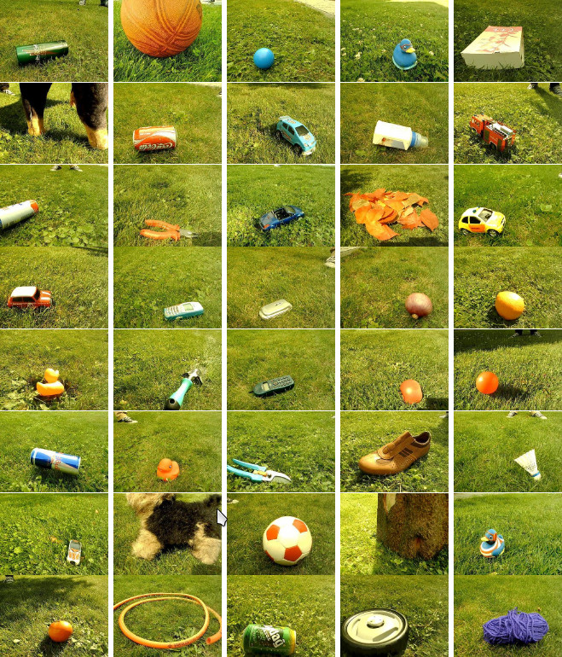
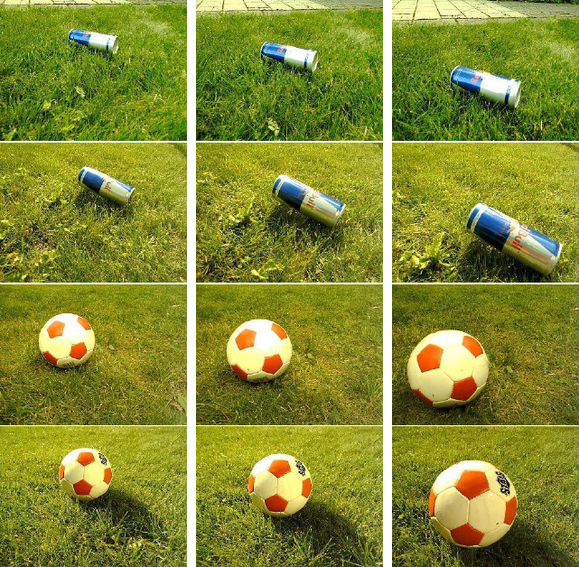
Outdoor dataset
40 objects
5 sequences in cloudy/sunny conditions
10 images per sequence

Slide 10
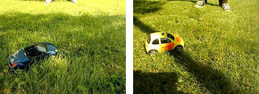

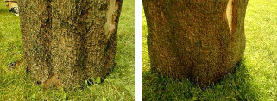

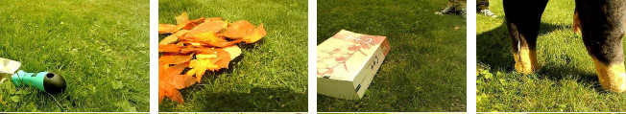
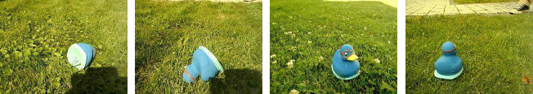
Challenges

Slide 11
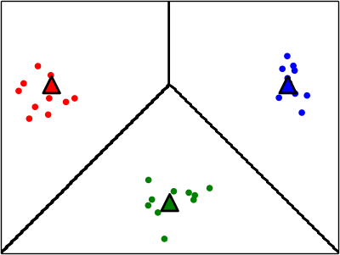
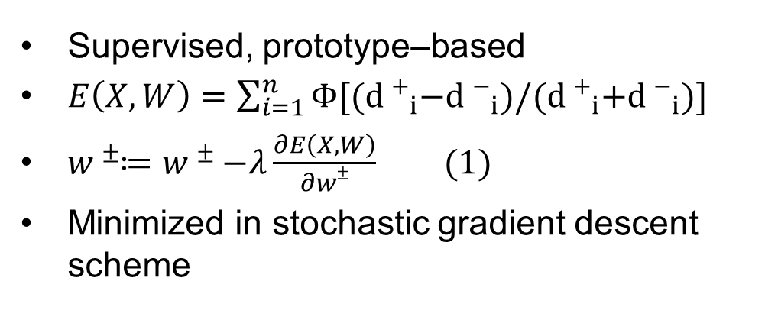
GLVQ¹
Supervised, prototype–based
$E\left(X,W\right)=\sum_{i=1}^{n}{Φ[{(d+}_{i}−{d−}_{i})/{(d+}_{i}{+d−}_{i})]}$
$w±≔w±−λ\frac{∂E\left(X,W\right)}{∂w±} (1)$
Minimized in stochastic gradient descent scheme
¹ A.Sato, K.Yamada “Generalized Learning Vector Quantization“, 1995

Slide 12
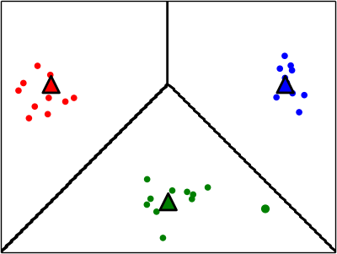
GLVQ¹
Supervised, prototype–based
$E\left(X,W\right)=\sum_{i=1}^{n}{Φ[{(d+}_{i}−{d−}_{i})/{(d+}_{i}{+d−}_{i})]}$
$w±≔w±−λ\frac{∂E\left(X,W\right)}{∂w±} (1)$
Minimized in stochastic gradient descent scheme
¹ A.Sato, K.Yamada “Generalized Learning Vector Quantization“, 1995

Slide 13
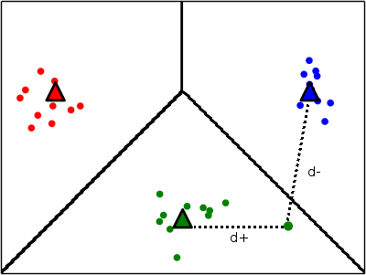
GLVQ¹
Supervised, prototype–based
$E\left(X,W\right)=\sum_{i=1}^{n}{Φ[{(d+}_{i}−{d−}_{i})/{(d+}_{i}{+d−}_{i})]}$
$w±≔w±−λ\frac{∂E\left(X,W\right)}{∂w±} (1)$
Minimized in stochastic gradient descent scheme
¹ A.Sato, K.Yamada “Generalized Learning Vector Quantization“, 1995

Slide 14
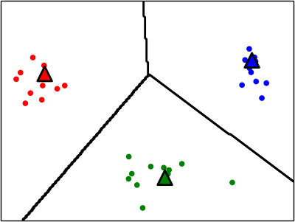
GLVQ¹
Supervised, prototype–based
$E\left(X,W\right)=\sum_{i=1}^{n}{Φ[{(d+}_{i}−{d−}_{i})/{(d+}_{i}{+d−}_{i})]}$
$w±≔w±−λ\frac{∂E\left(X,W\right)}{∂w±} (1)$
Minimized in stochastic gradient descent scheme
¹ A.Sato, K.Yamada “Generalized Learning Vector Quantization“, 1995

Slide 15
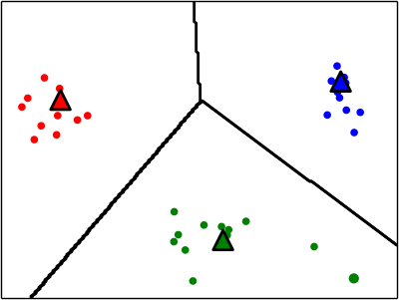
GLVQ¹
Supervised, prototype–based
$E\left(X,W\right)=\sum_{i=1}^{n}{Φ[{(d+}_{i}−{d−}_{i})/{(d+}_{i}{+d−}_{i})]}$
$w±≔w±−λ\frac{∂E\left(X,W\right)}{∂w±} (1)$
Minimized in stochastic gradient descent scheme
¹ A.Sato, K.Yamada “Generalized Learning Vector Quantization“, 1995

Slide 16
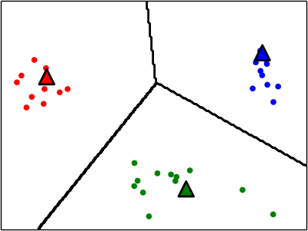
GLVQ¹
Supervised, prototype–based
$E\left(X,W\right)=\sum_{i=1}^{n}{Φ[{(d+}_{i}−{d−}_{i})/{(d+}_{i}{+d−}_{i})]}$
$w±≔w±−λ\frac{∂E\left(X,W\right)}{∂w±} (1)$
Minimized in stochastic gradient descent scheme
¹ A.Sato, K.Yamada “Generalized Learning Vector Quantization“, 1995

Slide 17
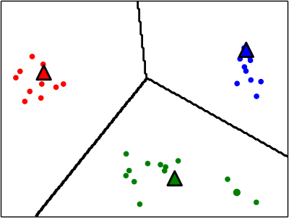
GLVQ¹
Supervised, prototype–based
$E\left(X,W\right)=\sum_{i=1}^{n}{Φ[{(d+}_{i}−{d−}_{i})/{(d+}_{i}{+d−}_{i})]}$
$w±≔w±−λ\frac{∂E\left(X,W\right)}{∂w±} (1)$
Minimized in stochastic gradient descent scheme
¹ A.Sato, K.Yamada “Generalized Learning Vector Quantization“, 1995

Slide 18
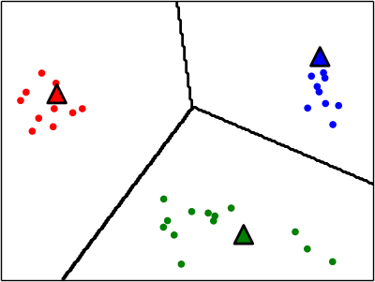
GLVQ¹
Supervised, prototype–based
$E\left(X,W\right)=\sum_{i=1}^{n}{Φ[{(d+}_{i}−{d−}_{i})/{(d+}_{i}{+d−}_{i})]}$
$w±≔w±−λ\frac{∂E\left(X,W\right)}{∂w±} (1)$
Minimized in stochastic gradient descent scheme
¹ A.Sato, K.Yamada “Generalized Learning Vector Quantization“, 1995

Slide 19

Learning architecture
Insertion of new prototypes based on error counting¹
$Ψ≔\left\langle {(x}_{i},y_{i},{d+}_{i},{d−}_{i}) | i∈1,…,t\right\rangle , window of recent t samples$
Update of $Ψ$ for a new prototype (w,l):
$∀{(x}_{i},y_{i},{d+}_{i},{d−}_{i})∈$ $Ψ$:
${d+}_{i}≔d\left(w,x_{i}\right), if y_{i}=l ∧{ d+}_{i} >$ $d\left(w,x_{i}\right)$ (2)
${d−}_{i}≔d\left(w,x_{i}\right), if y_{i}≠l{ ∧d+}_{i}>$ $d\left(w,x_{i}\right)$
Efficient, linear complexity $Ο(t)$
¹ S.Kirstein, H.Wersing “Rapid Online Learning of objects in a biologically motivated architecture“, 2005

Slide 20

Learning architecture
$∀ new sample \left(x_{i},y_{i}\right)$:
$Ψ≔\left\langle Ψ {∪(x}_{i},y_{i},{d+}_{i},{d−}_{i})\right\rangle , \left|Ψ\right|=t$
GLVQ-update as in (1)
$errorCount+=1, if{ d+}_{i}>{d−}_{i}$
if errorCount > maxErrors:
$(w,l) ≔$ GetNewPrototypeByStrategy($Ψ$)
$W≔\left\{W∪(w,l)\right\}$
$Ψ$ update as in (2)
$errorCount ≔0$

Slide 21
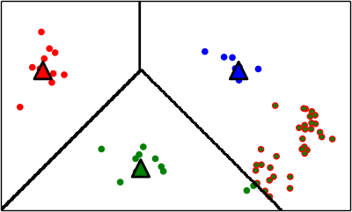
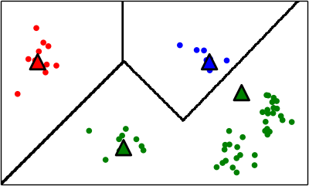
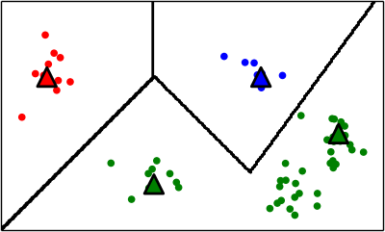
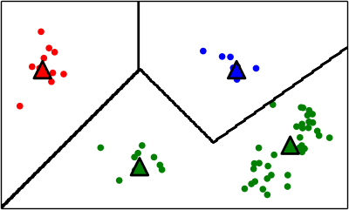
Current Placement Strategies
Based on class-local heuristics
Use missclassifications only
Closest¹
Cluster²
Voronoi³
¹ S.Kirstein, H.Wersing “Rapid Online Learning of objects in a biologically motivated architecture“, 2005
² M.Grbovic, S. Vucetic “Learning Vector Quantization with adaptive prototype addition and removal“, 2009
³ S. Bermejo, J. Cabestany “A new dynamic lvq-based classifier and its application to handwritten digits“, 1998

Slide 22
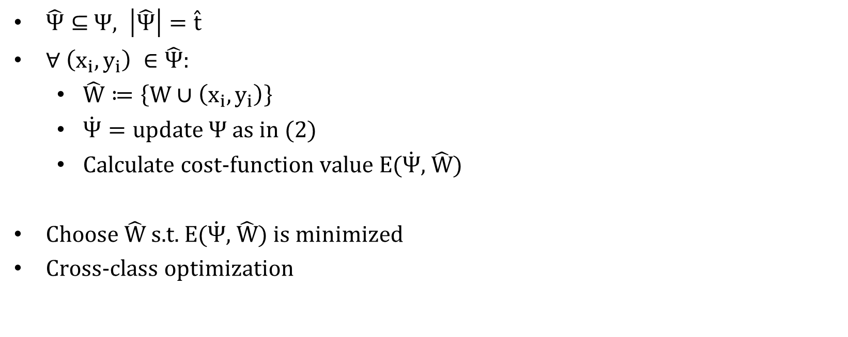
Proposed Strategy - SamplingCost
$\hat{Ψ}⊆$ $Ψ, \left|\hat{Ψ}\right|=\hat{t}$
$∀ \left(x_{i},y_{i}\right) ∈\hat{Ψ}$:
$\hat{W}≔\left\{W∪\left(x_{i},y_{i}\right)\right\}$
$\dot{Ψ}=update Ψ as in (2)$
Calculate cost-function value E($\dot{Ψ}$, $\hat{W}$)
Choose $\hat{W}$s.t. E($\dot{Ψ}$, $\hat{W}$) is minimized
Cross-class optimization

Slide 23
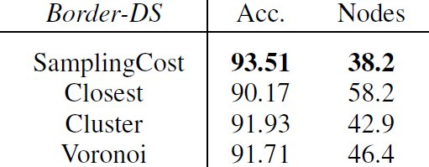
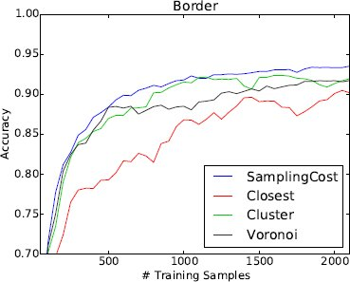
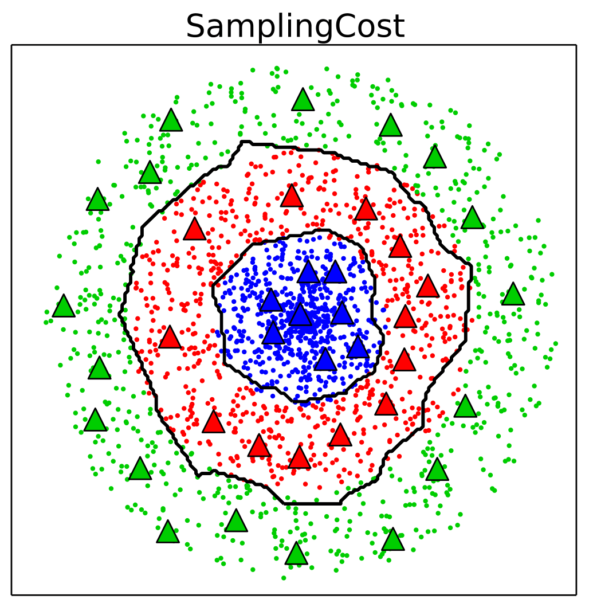
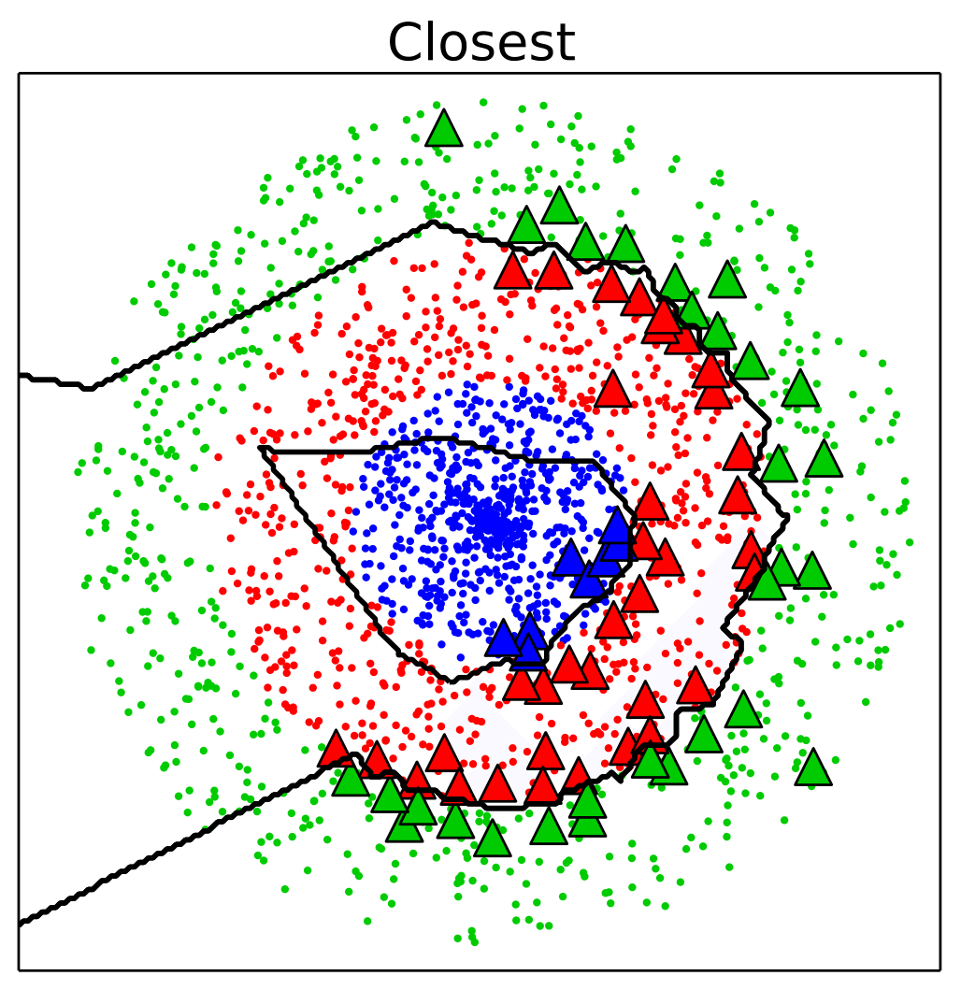
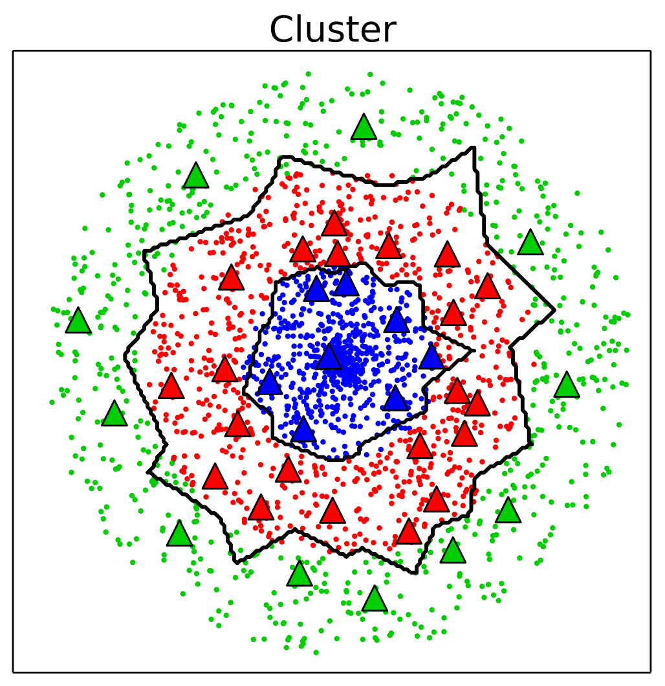
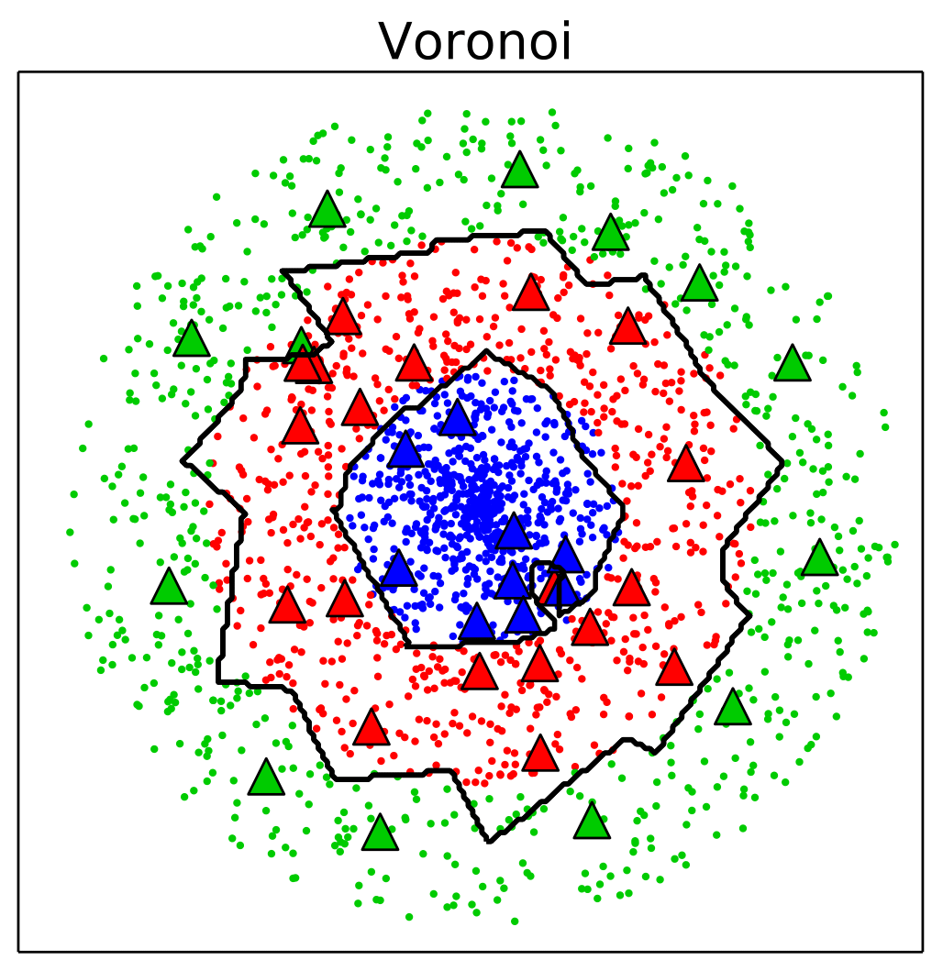
Artificial dataset Border

Slide 24
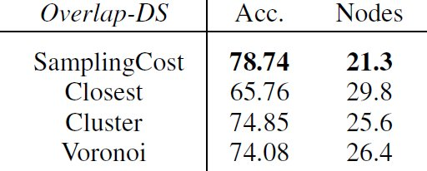
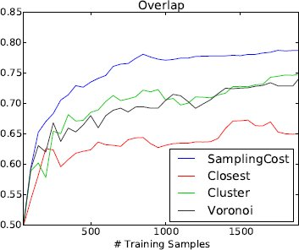
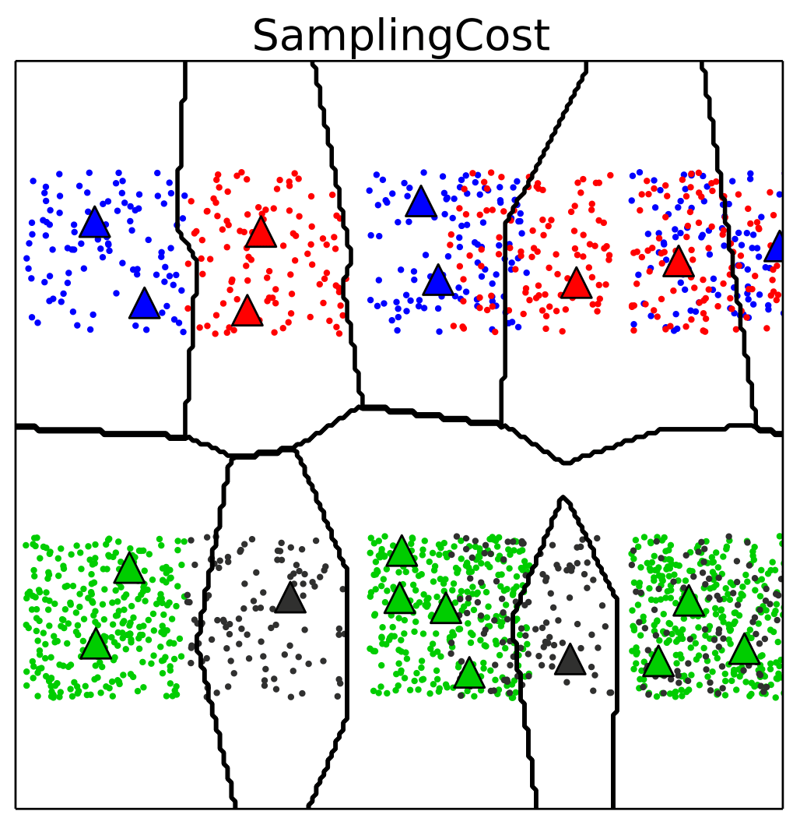
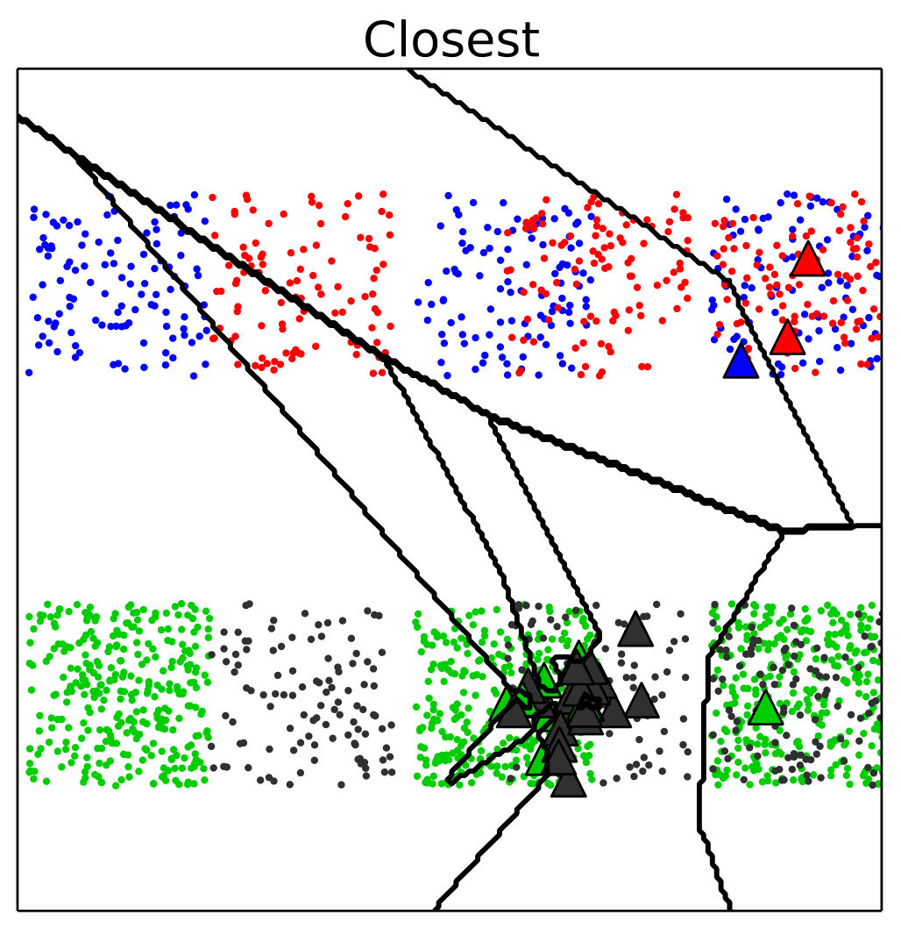
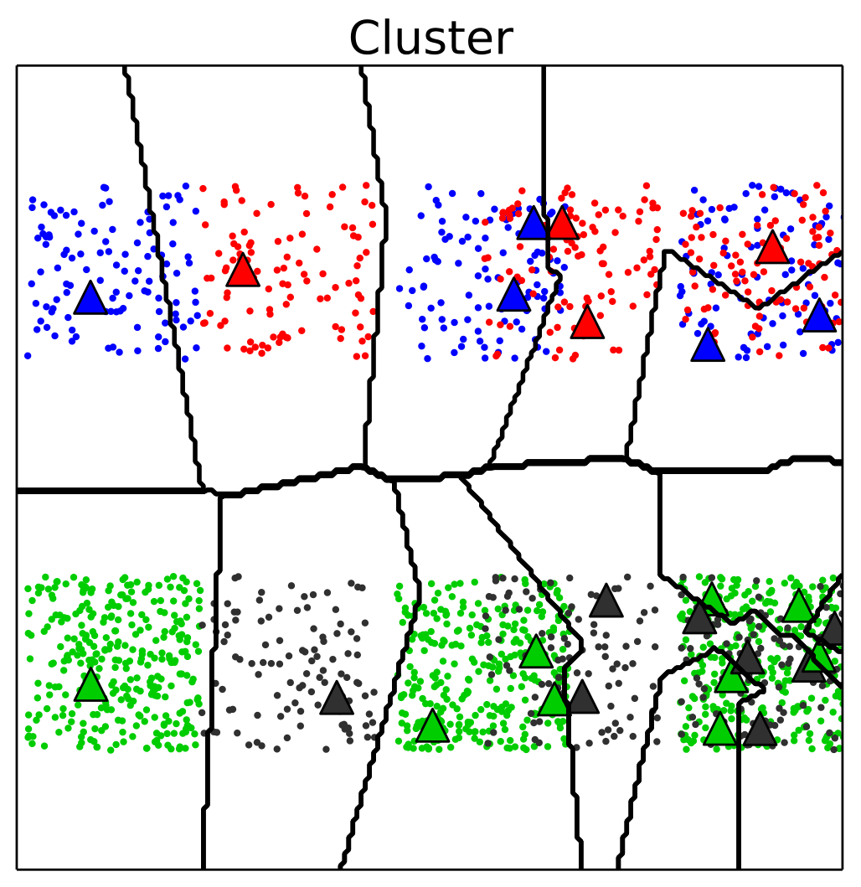
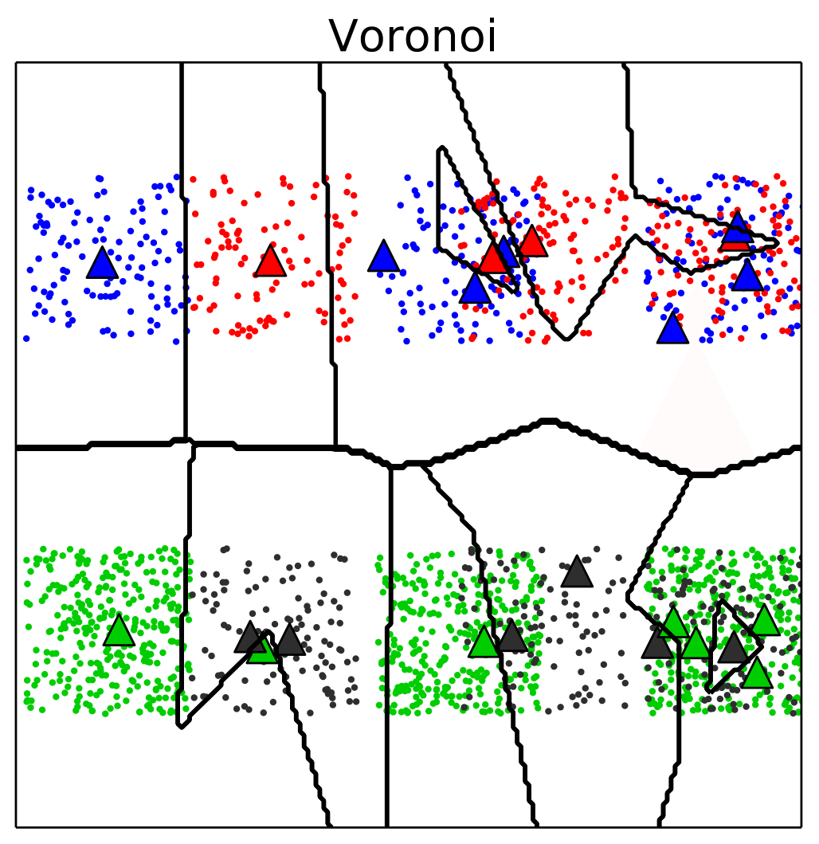
Artificial Dataset Overlap

Slide 25
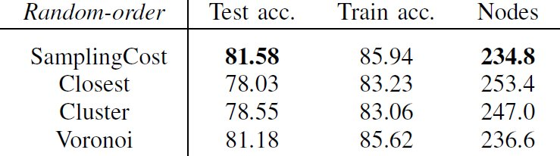
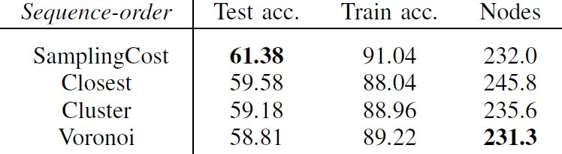
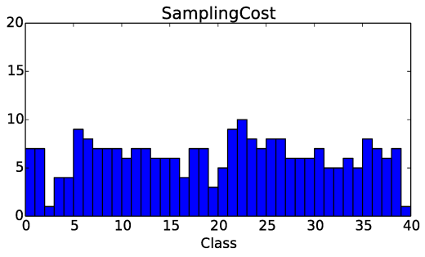
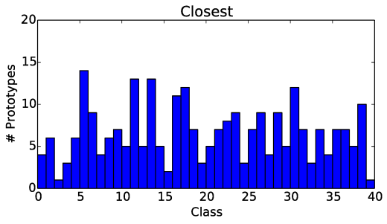
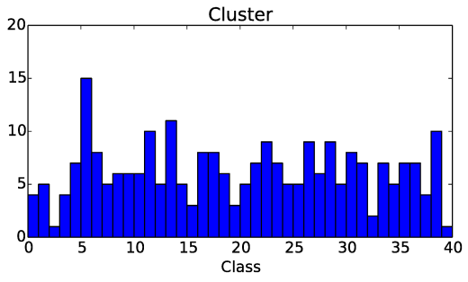
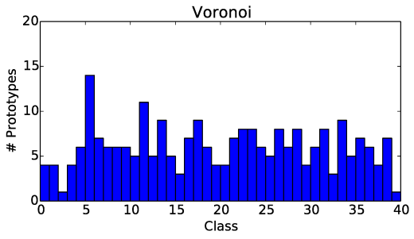
Outdoor Dataset

Slide 26


Easy/Difficult Objects
Easy
Difficult

Slide 27
Summary
Interactive real-time learning scenario
Challenging outdoor object dataset
Online learning architecture
Proposal of cost-function based placement strategy
Comparison to current strategies on artificial and real datasets
SamplingCost performs superior, especially for Overlaps
Outdoor recognition is very challenging, feature representation not robust enough

Slide 28

Questions

