Slide 1
Proof of life
Your API documentation is your API
Notes:
Unlike a user interface client that people can click around and learn, your API documentation is the only proof users have that your API exists, so it’s worth your time to take steps to make your API documentation as effective as possible. We’ll discuss some of the steps to do just that.

Slide 2
Is it really that important?
“Ten Reasons Developers Hate Your API”
source: John Musser
Reason 1: Your documentation sucks!
“12 Reasons Your API Sucks”
source: D. Keith Casey
Reason 1: Documentation
Reason 2: Incomplete/Wrong Docs
“Your API Sucks: Why Developers Hang Up and How To Stop That”
source: Marsh Gardiner
Notes:
By 2015, all of the Forbes 500 companies will have an API. If that’s not reason enough, take it from these people who are far less biased than me because their job doesn’t depend on it.
10 Reasons: The #1 reason cited is “Your documentation sucks.”
Your API Sucks: “Your engineers may be great at writing the code behind your API, but are they good at writing API docs?
It’s a different skill set.

Slide 3

Pattern recognition
Every page in your API reference and supplemental content should follow the same content model.
Same visual display/CSS.
Be consistent with references:
Operation vs. Method
URL vs. URI
Parameters vs. Arguments
Notes:
Our pal Algernon here knows a thing or two about pattern recognition, but your users are the same way. They’ll learn your API more quickly when you give them a pattern to follow.
So what is a content model? It’s kind of like a style guide but covers more governing principles about how you develop your content. This can include things like how you title your topics, how you’ll use images, what language you use for a POST vs a GET, etc.
Structural
Visual
Linguistic

Slide 4

Pattern recognition
Add a user to a group
Configuring group members
How to add users to a group
Group member definition
POST /groups/users
Notes:
Here we have 4 different titles for what is potentially the same procedure, they’re all just different names for the same thing. If you weren’t familiar with this API and it used all 4 of these ways of introducing information, you’d be lost. It’s just like learning code, you can learn quicker when there is structure and patterns to follow instead of spaghetti code.

Slide 5

Language agnostic
If you try to document specific to each platform, you’ll quickly become overwhelmed.
Every time an API entity changes, you’ll have to change the documentation for each platform.
Think about translation and i18n.
Notes:
You might think it’s to your benefit to document specifically to Python, Ruby, PHP, etc., but you have to think about what your staff can handle and how it will scale. What approach are you going to take to keep the documentation up to date and what will it cost me to translate all this content, because you don’t have a Tardis to translate it for you? Most developers, given JSON or XML, can figure out the rest.

Slide 6
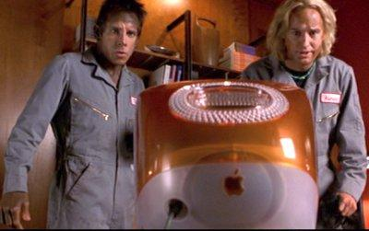
Usable code samples
Whenever possible, make formatting copy over.
Line numbers should not copy over.
Syntax highlighting (Google code prettify).
Keep samples up to date - changing the doc samples should be part of changing the code.
Single-click copying.
Think about maintaining an external code sample library.
Notes:
Writers creating code samples is never ideal, but code samples are a crucial part of any developer documentation so it’s important to make these a first class citizen in your documentation. You want to make your code samples as easy for your developers to use and read as possible, and this includes things like - If you can have your developers do what they are good at, creating code (and code samples) and simply reference those samples in your documentation it makes everyone’s jobs easier.

Slide 7
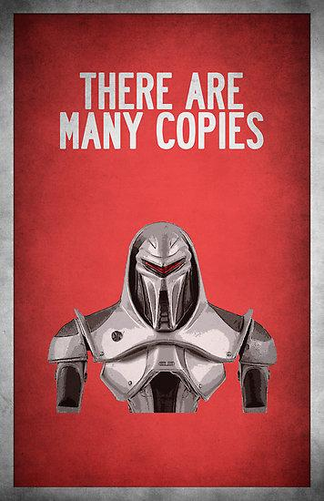
Token replacements
Find a way to reuse content for entities that appear in several requests or responses.
Database, authoring tool, script, etc.
Keep translation and i18n in mind.
Notes:
How many of you enjoy copying and pasting the same sections of code over and over? Of course you wouldn’t do that, you’d create a class for that or find some other programmatic way to do it. Writers don’t enjoy copying and pasting either, so find some mechanism for tokenizing common content, particularly if you have the something like a user token required in every single request or audit information returned in every single response.

Slide 8
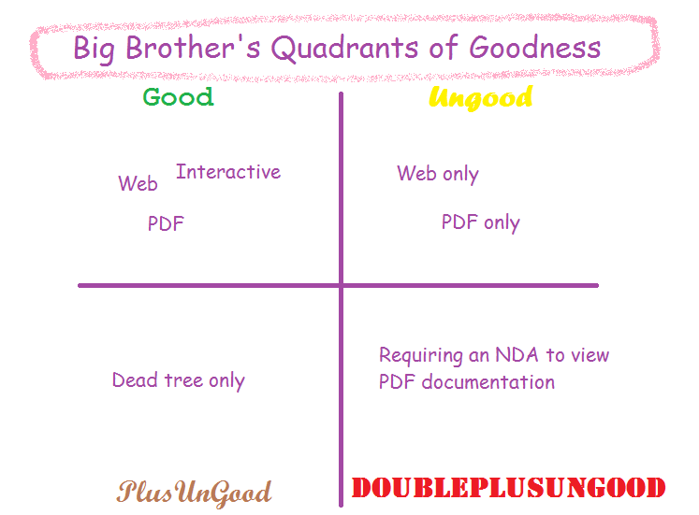
Flexible outputs
Ungood

Slide 9

Get started
If people can’t adopt your API in the first place, they’ll never use your API reference.
Hello World tutorials are a great way to onboard new users.
If you need a “How to use this documentation,” your documentation is too complicated.
Notes:
You may spend a ton of time invested in creating your API reference content, but don’t neglect your onboarding content because they may never ever see it if they get stuck trying to use the API for the first time. If you’ve ever read the Game of Thrones books you know that before you even read the story there is a description of who all’s in the different houses and a map of Westeros, but that’s not the model you want to follow for your developer documentation. If it’s me, I take one look at “How to use this documentation” and say “NOPE!”

Slide 10
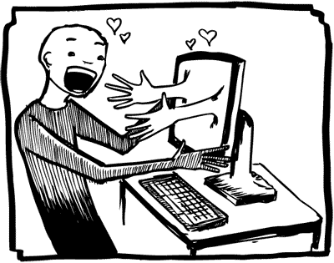
Interactivity != Content
Interactive done well with Swagger
Interactive done badly with Apiary
Having a snappy, interactive API doc site is not a substitute for good content.
Few codebases are in a state to use these tools out of the gate.
If you need a “How to use this documentation,” your documentation is too complicated.
Notes:
Tools like this are great for enhancing the developer experience, but it doesn’t change the fact that you still need someone who knows how your API is going to be used to describe the entities in your API in a way that makes sense to your developer base. You also have to think about how people will access the docs offline. So if you look at these examples, you’ll see a stark contrast between good content done interactively and bad content done interactively.

Slide 11

200: OK
@KellyHitchcock

