Slide 1
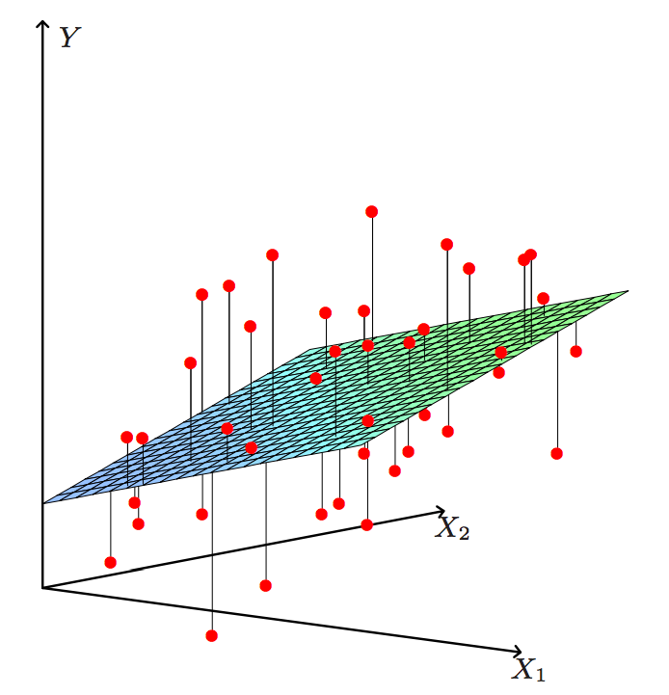
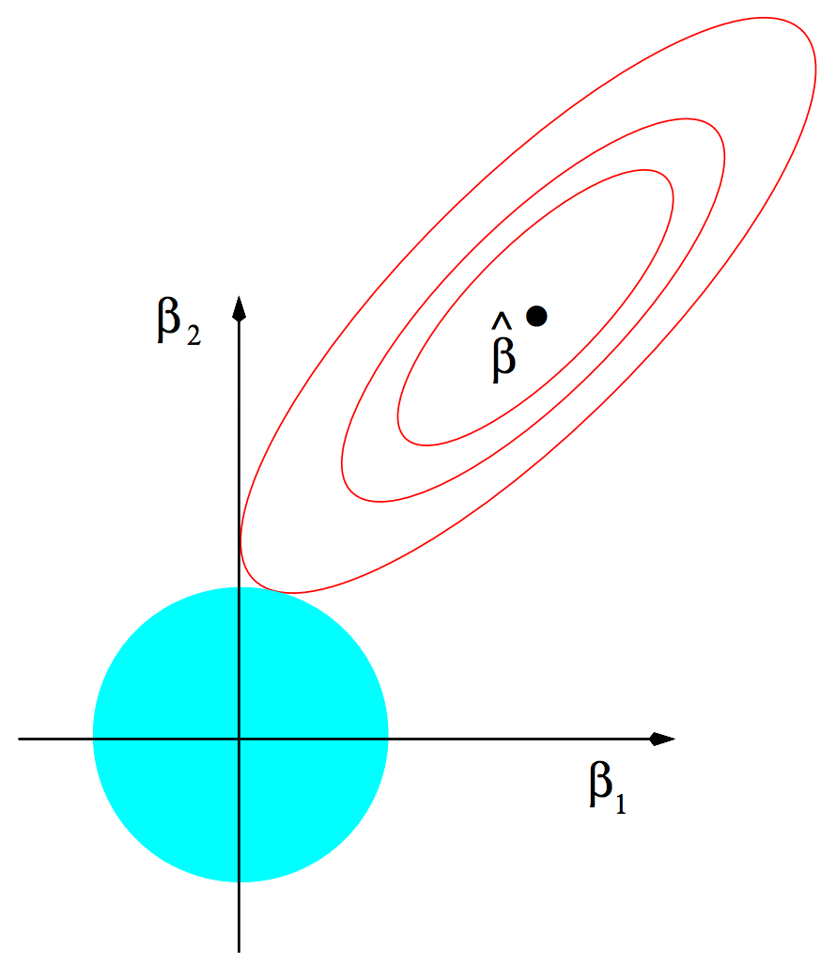
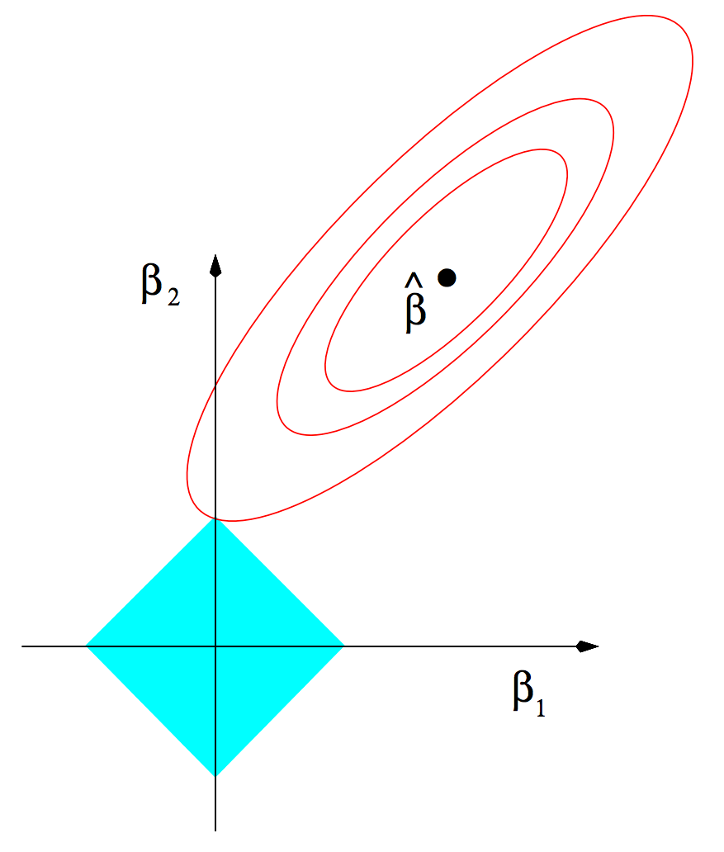
Generalized Linear Modelling in H2O4GPU
Framework utilizes Proximal Graph Solver (POGS) from Stephen Boyd & Chris Fougner (Parameter Selection and Pre-Conditioning for a Graph Form Solver -- C. Fougner and S. Boyd)
A solver for convex optimization problems in graph form using Alternating Direction Method of Multipliers (ADMM)
Solvers include Lasso, Ridge Regression, Logistic Regression, and Elastic Net Regularization
Improvements to original implementation of POGS:
Full alpha search
Cross Validation
Early Stopping (RMSE for regression problems and Logloss for classification)
Various bug fixes from original implementation
Added Scikit learn “like” API
Supports multiple GPUs
Hastie, Tibshirani, Friedman. Elements of Statistical Learning
Hastie, Tibshirani, Wainwright. Statistical Learning with Sparsity
Hastie, Tibshirani, Friedman. Elements of Statistical Learning
Hastie, Tibshirani, Wainwright. Statistical Learning with Sparsity

Slide 2

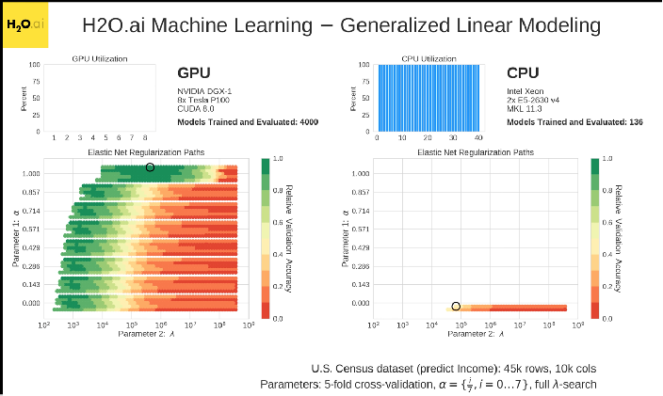
https://www.youtube.com/watch?v=LrC3mBNG7WU
2

Slide 3
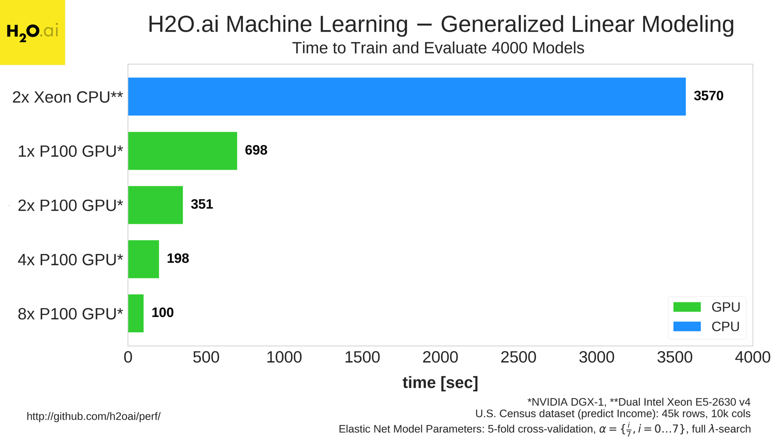
https://www.youtube.com/watch?v=4RKSXNfreLE
3

Slide 4
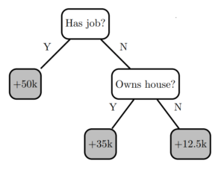
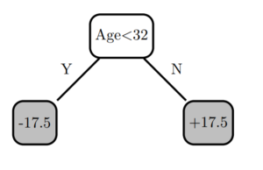
Gradient Boosting Machines in H2O4GPU
Based upon XGBoost
Raw floating point data -> Binned into Quantiles
Quantiles are stored as compressed instead of floats
Compressed Quantiles are efficiently transferred to GPU
Sparsity is handled directly with highly GPU efficiency
Multi-GPU by sharding rows using NVIDIA NCCL AllReduce
https://github.com/h2oai/h2o4gpu/blob/master/examples/py/xgboost_simple_demo.ipynb

Slide 5
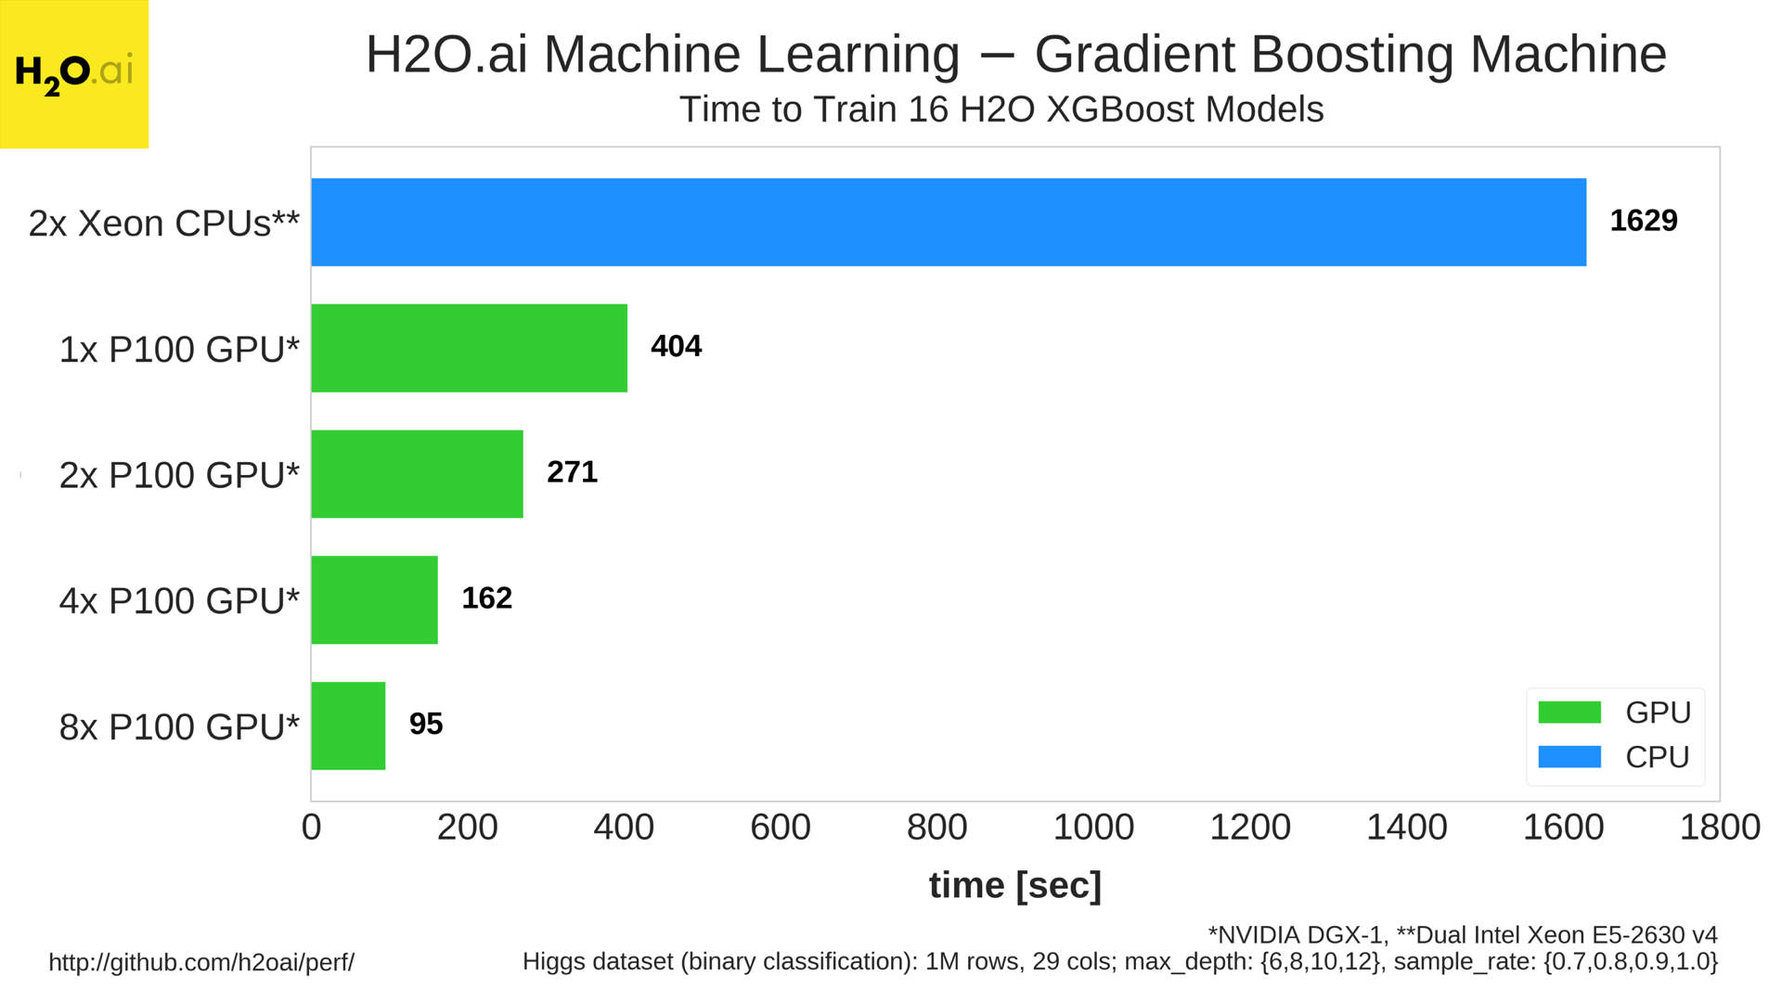
171 with latest solver
87
51
https://www.youtube.com/watch?v=NkeSDrifJdg
5

Slide 6
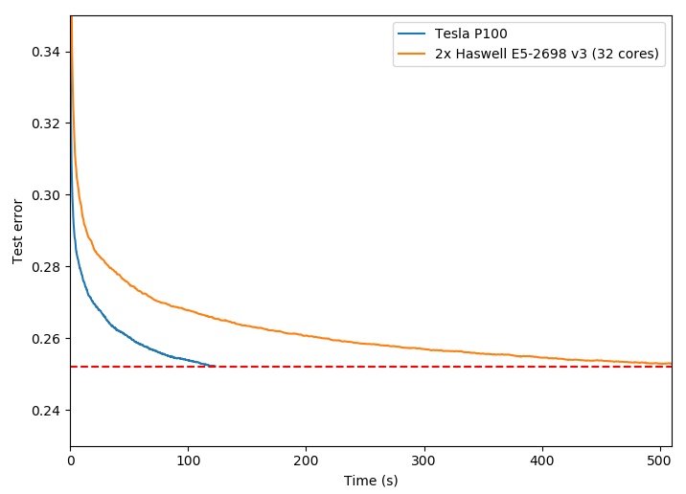
CPU vs. GPU on Higgs (Classification)
https://devblogs.nvidia.com/parallelforall/gradient-boosting-decision-trees-xgboost-cuda/

Slide 7
K-Means on H2O4GPU
Based upon NVIDIA prototype of K-Means algorithm in CUDA
Improvements to original implementation:
Significantly faster than scikit-learn implementation (50x)
Significantly faster than other GPU implementations (https://github.com/src-d/kmcuda) (5x-10x)
Various bug fixes
Supports multiple GPUs

Slide 8
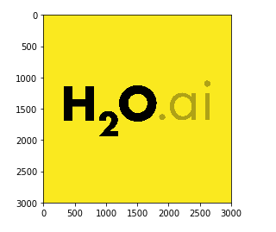
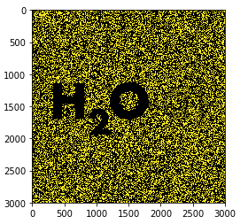
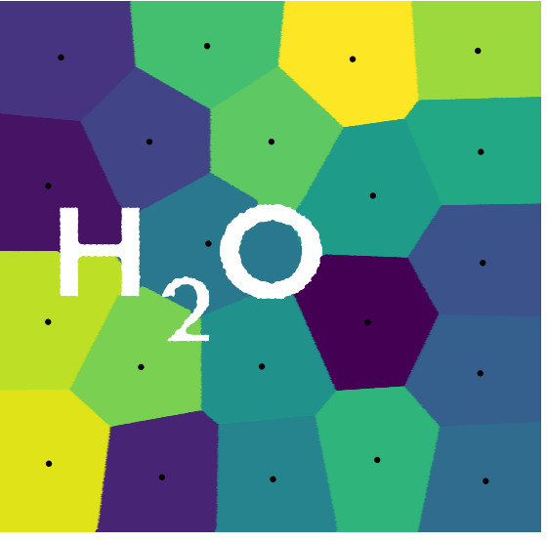
K-Means
https://github.com/h2oai/h2o4gpu/blob/master/examples/py/demos/H2O4GPU_KMeans_Images.ipynb

Slide 9
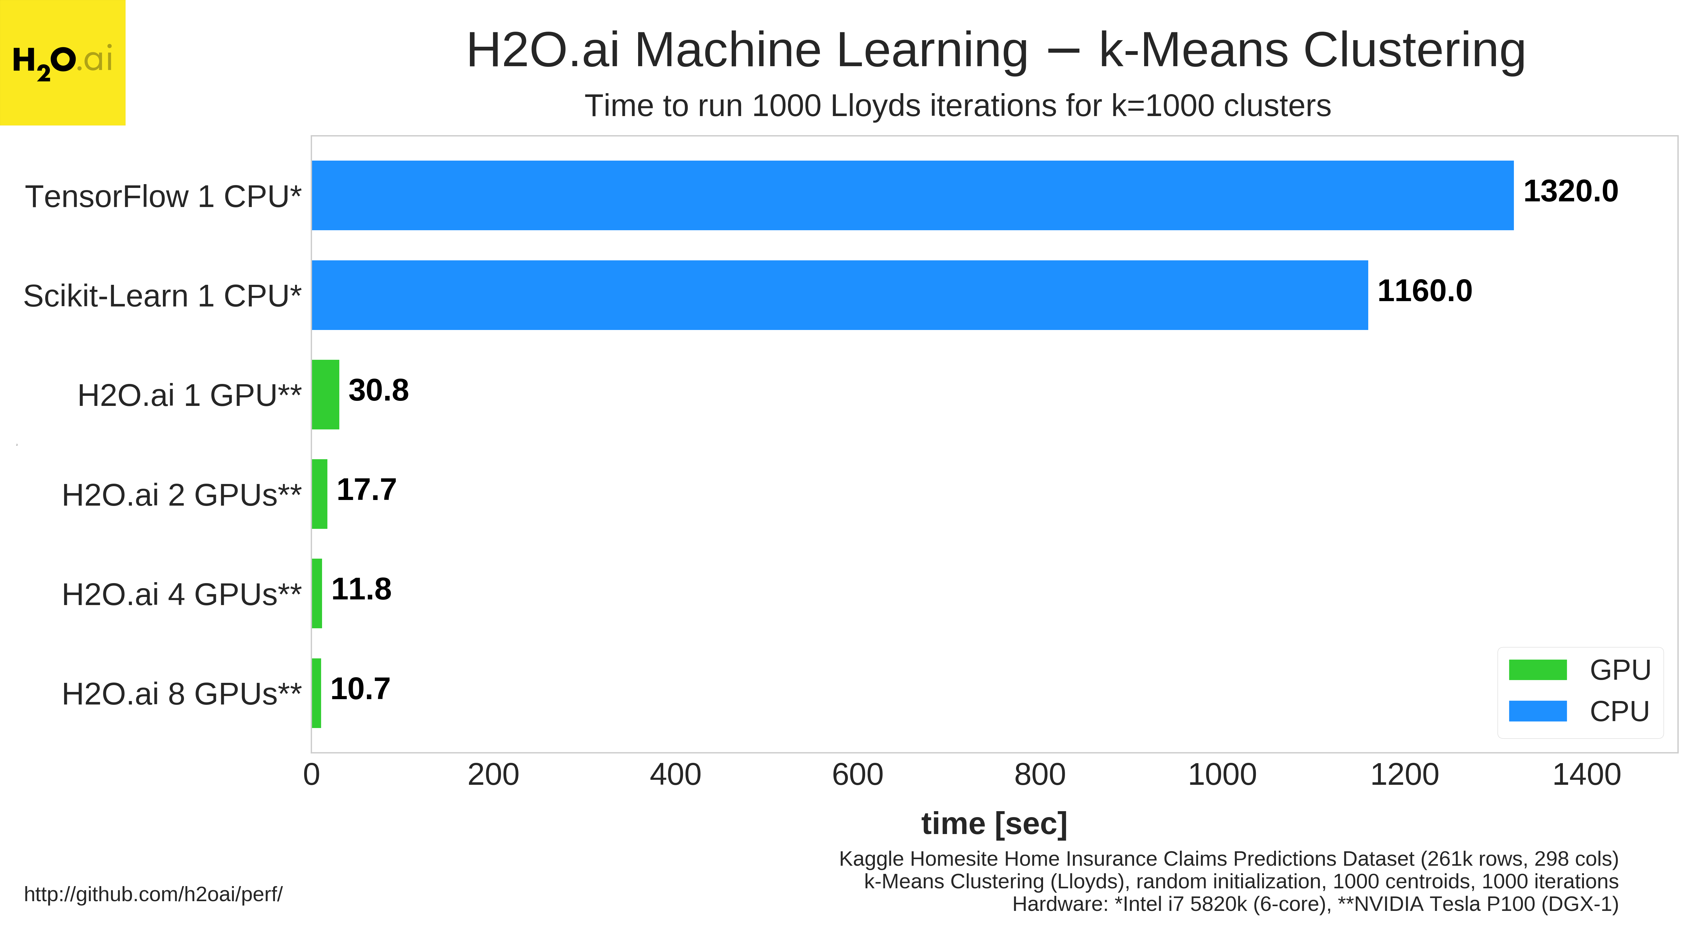
9

