Slide 1

CROP DEAL

Slide 2

PROJECT
OVERVIEW
  Modular 7 Service Based Architecture
  Secure jwt based authentication
  Google OAuth 2.0 login support
  Automatic invoice & receipt generation
  PDF document creation for payments
  Email notification for payment success
  Email attachment of invoice and receipt
  Payment integration with Razorpay
  Scalable identity & Operations Management

Slide 3
CORE
TECHNOLOGY
  Backend: Java 25 / Spring Boot 4.1.1
  Security: Spring Security & JWT
  API Layer: Spring Cloud Gateway
  Service Discovery: Netflix Eureka
  Configuration: Spring Cloud Config Server
  Database: MySQL / Spring Data JPA
  Communication: OpenFeign & RabbitMQ
  Payments: Razorpay Test API
  Notifications: SMTP / Spring Mail
  Documentation: Swagger / OpenAPI 3.0

Slide 4
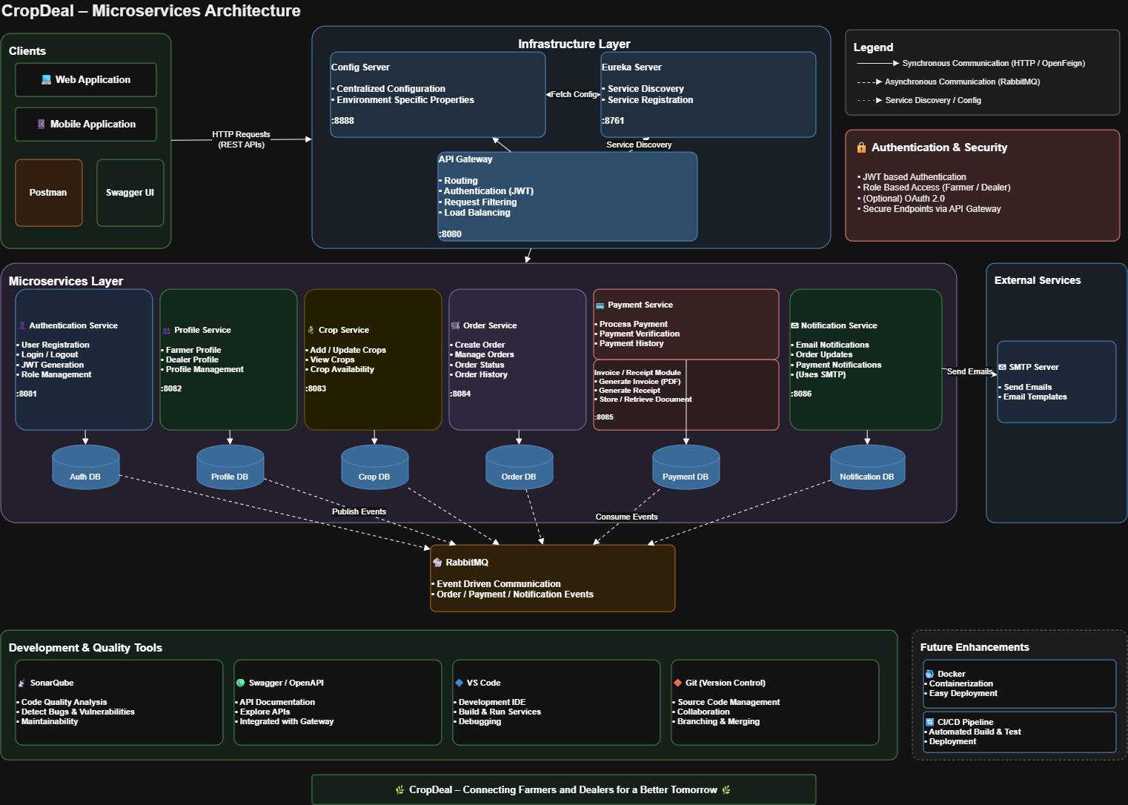

Slide 5
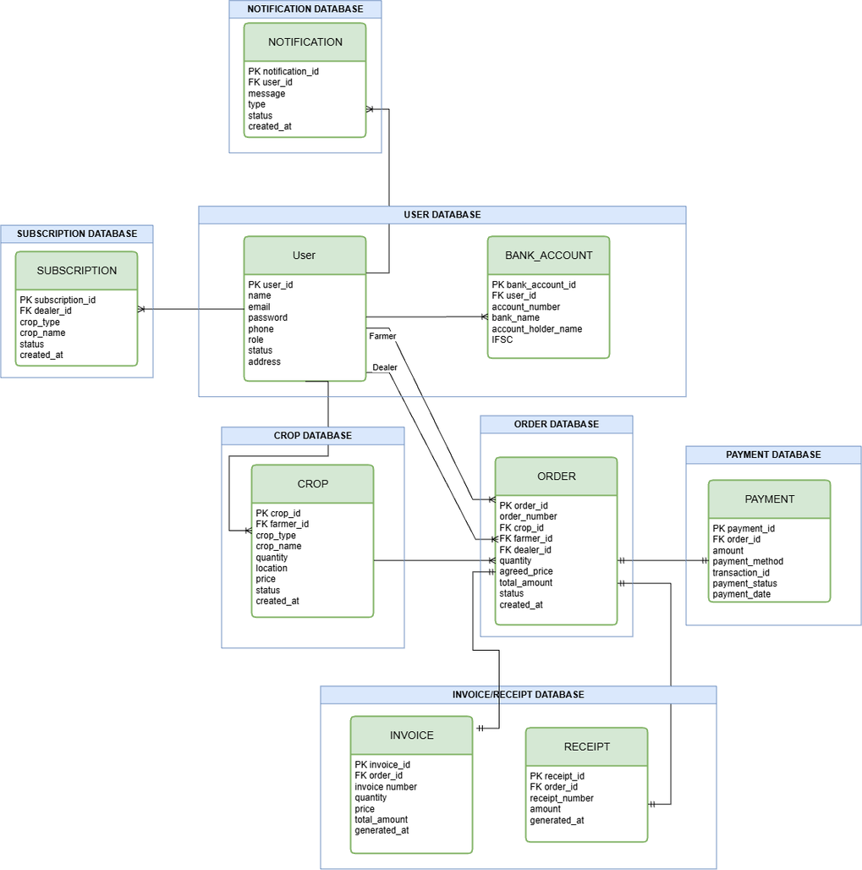
ER/DATABASE
DIAGRAM

Slide 6
SERVICE
ECOSYSTEM
  Authentication Service: Registration, login, JWT, roles, OAuth2
  Profile Service: Farmer and dealer profiles
  Crop Service: Crop creation, search, filtering, and reservation
  Order Service: Order creation and order lifecycle
  Payment Service: Razorpay payments, invoices, receipts, bank accounts, and payouts
  Notification Service: In-app notifications and optional email notifications
  API Gateway: Central request routing and JWT validation
  Eureka Server: Service discovery and registration
  Config Server: Centralized application configuration

Slide 7
SECURITY
ARCHITECTURE
  JWT Authentication: Users register/login through Authentication Service and receive JWT tokens containing email and roles.
  Token Validation: Gateway and each microservice validate the JWT using the shared secret.
  Role-Based Authorization: FARMER, DEALER, and ADMIN roles control access to protected operations.
  Secure Communication: All protected APIs require Authorization: Bearer ; OAuth2 Google login is optional.

Slide 8
FUTURE
ENHANCEMENTS
  Add a frontend dashboard for farmers and dealers.
  Complete production Razorpay webhooks and payout integration and notification service.
  Add stronger monitoring, logging, and distributed tracing.
  Deploy services using Docker and Kubernetes/Azure.

Slide 9

THANK YOU

