Slide 1

lec???ENV-INST-V1.0-2019-09-08
CTI One Corporation
Version: x0.1
Date: 09 08, 2019
Project Lead: Harry Li, Ph.D.
Team member: Prashanth Rajasekar
Company confidential
Notes:
1
1

Slide 2
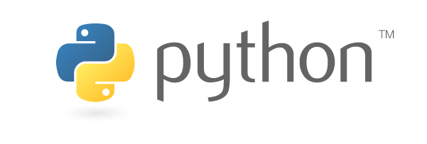

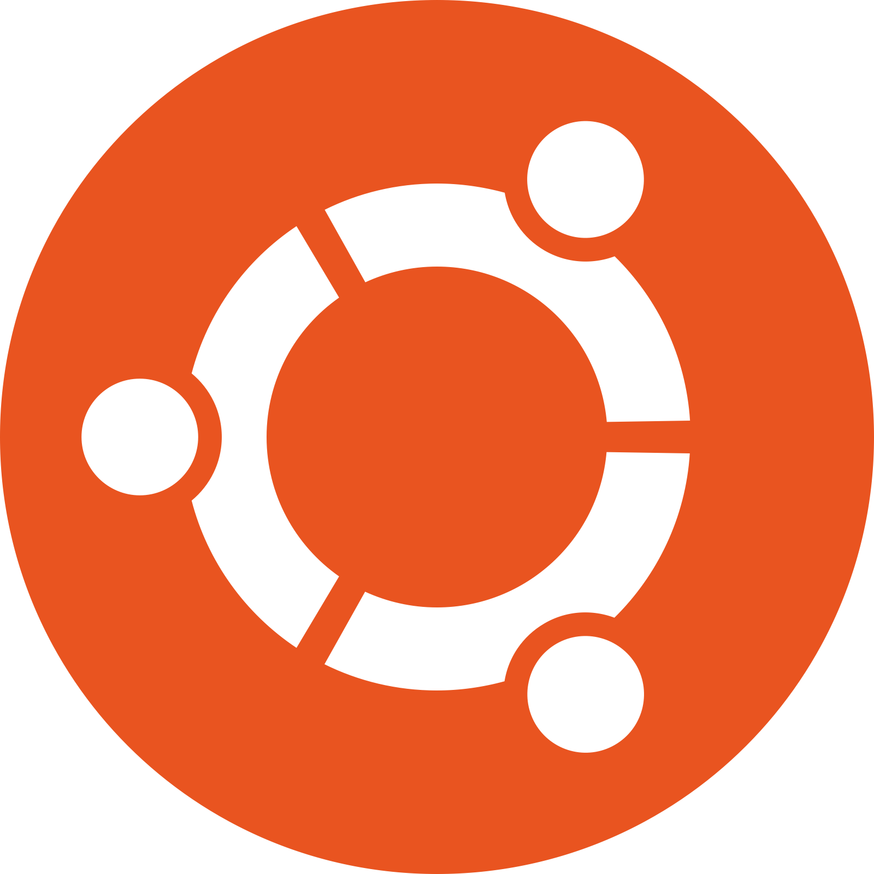
Basic Environment Setup
History
It was initially designed by Guido van Rossum in 1991 and developed by Python Software Foundation. It was mainly developed for emphasis on code readability, and its syntax allows programmers to express concepts in fewer lines of code.
Widely used for Machine Learning and Deep Learning applications.
For today’s tutorial we will be using Python3.
Installation Procedure:
Step 1: “sudo add-apt-repository ppa:jonathonf/python-3.6”
Step 2: “sudo apt-get update”
Step 3: “sudo apt-get install python3.6”
Step 4: “python3 -V”
Step 5: “sudo apt-get update”
Notes:
2
2

Slide 3


Basic Environment Setup
Step 6: “sudo apt-get install python3-pip”
Step 6: “pip3 --version”
Installation Procedure:
Step 1: https://www.python.org/downloads/mac-osx/
or
Step 2: /usr/bin/ruby -e "$(curl -fsSL https://raw.githubusercontent.com/Homebrew/install/master/install)"
Step 3: “brew doctor”
Step 4: “brew install python3”
Step 5: “python3 --version”
Step 6: “sudo easy_install pip3”
Installation Procedure:
Step 1: https://www.pytorials.com/python-download-install-windows/
Step 2: “https://www.liquidweb.com/kb/install-pip-windows/”
Notes:
3
3

Slide 4
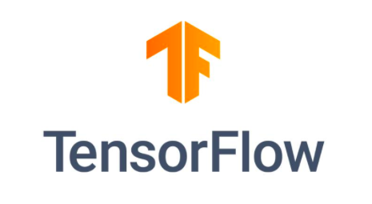


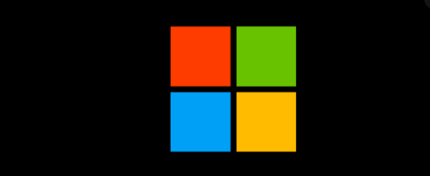
Tensorflow Installation
TensorFlow is a Python-friendly open source library for numerical and floating points computation that makes machine learning faster and easier. Mainly used for dataflow across long range of tasks. – Developed by Google Brain Team
Note : If pip3 installation is confirmed in all the 3 machines, Then the single below command can help in installing the tensorfloe environment.
“pip3 install --user --upgrade tensorflow # install in $HOME”
Notes:
4
4

Slide 5

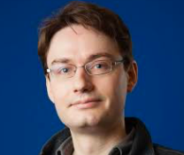
Keras Installation
Keras is a high-level neural networks API, written in Python and capable of running on top of TensorFlow.
Developed by : François Chollet – Google Engineer
Advantages:
Allows for easy and fast prototyping (through user friendliness, modularity, and extensibility).
Supports both convolutional networks and recurrent networks, as well as combinations of the two.
Runs seamlessly on CPU and GPU.
Installation Procedure:
“sudo pip3 install keras”
Notes:
5
5

Slide 6

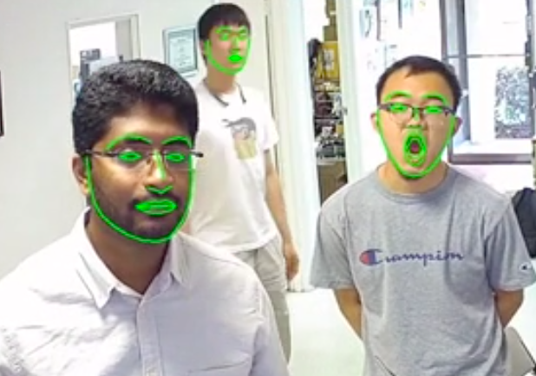
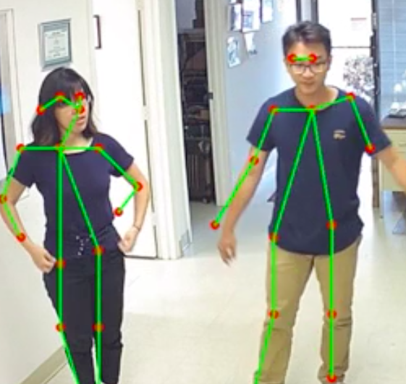
OpenCV Installation
A library for vision based facility and image processing techniques for huge amount of applications.
Applications examples:
Street view image stitching.
Automated inspection and surveillance.
Robot and driver-less car navigation and control.
Medical image analysis.
Video/image search and retrieval.
Movies - 3D structure from motion.
Interactive art installations.
Ubuntu systems:
https://www.pyimagesearch.com/2018/08/15/how-to-install-opencv-4-on-ubuntu/
Mac systems:
https://www.pyimagesearch.com/2018/08/17/install-opencv-4-on-macos/
Windows systems:
https://pysource.com/2019/03/15/how-to-install-python-3-and-opencv-4-on-windows/
Notes:
6
6

Slide 7
Thank You
END

