Slide 1

lec???Read-Disp-V1.0-2019-09-08
CTI One Corporation
Version: x0.1
Date: 09 08, 2019
Project Lead: Harry Li, Ph.D.
Team member: Prashanth Rajasekar
Company confidential
Notes:
1
1

Slide 2
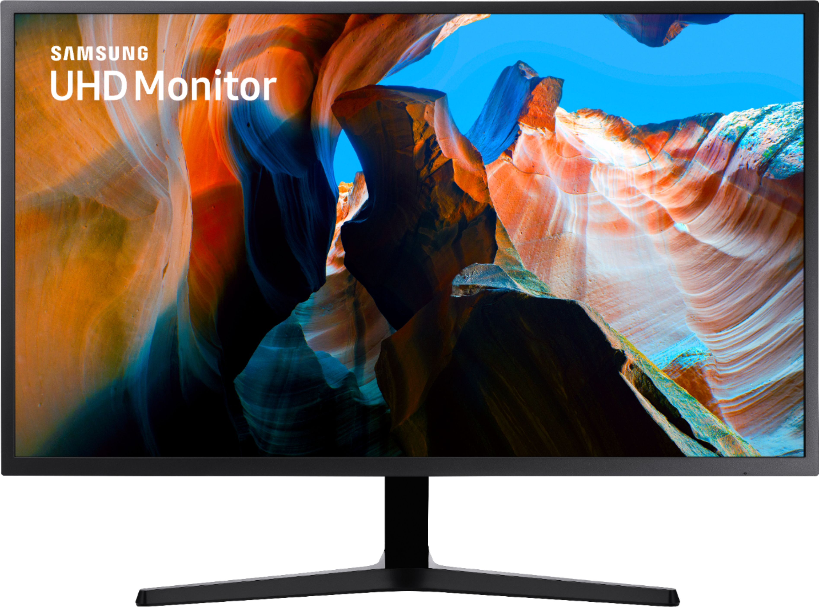
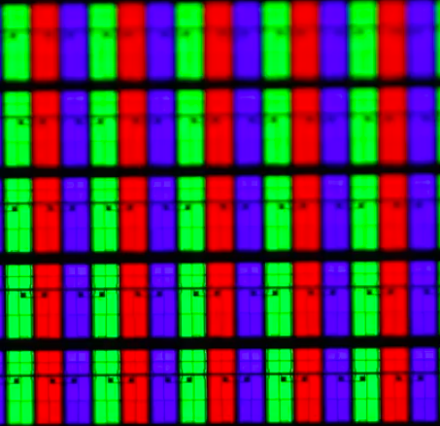
What is an Image ???
Image is nothing but the combination of multiple pixel outputs as we want to see.
In programming and coding, we are actually making the pixels look as we want.
Screen manufacturers are actually tricking our mind with flashing pixels.
Data_in
Data_out
Single pixel
How to calculate the data being used by your LCD/LED screen per second? Very Simple
Data = (Frames/sec) X (total_rows) X (total_cols) X (data_for_each_pixel)
Notes:
2
2

Slide 3
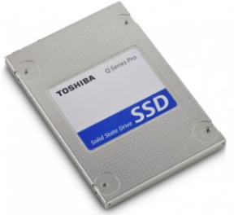
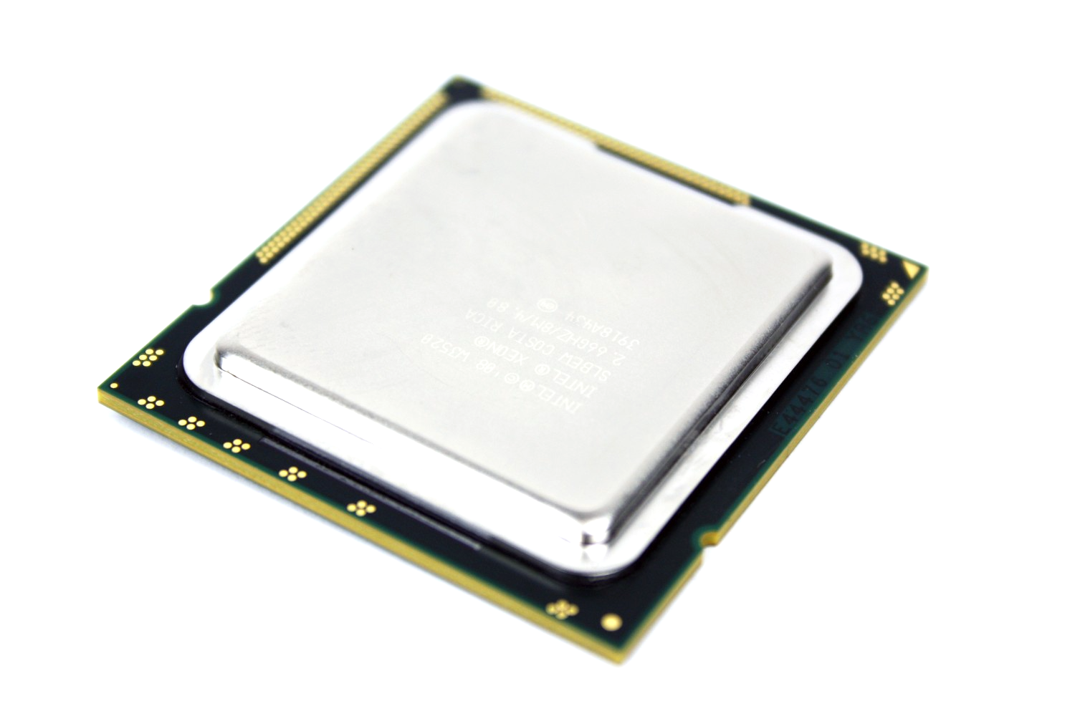
Read and Display Image from HDD using OpenCV
Data Flow architecture:
Source
Processing Pipeline
Output
HDD
Processor
LCD/LED
Steps:
Set the source from where the image is to be picked.
Put the data to the processing pipeline.
Show it as the output.
Notes:
3
3

Slide 4
Sample Source
# Include the OpenCV library
import cv2
# Create a default output window
cv2.namedWindow('frame', cv2.WINDOW_NORMAL)
# Read the image from the disk.
frame = cv2.imread("img_1.png")
### put any function below to do image processing ###
# Here
#####################################################
# Display the resulting frame
cv2.imshow('frame',frame)
# Wait for any key to be pressed.
cv2.waitKey(0)
# When everything done, clear the window.
cv2.destroyAllWindows()
########################## THE END ###################

Slide 5

Read and Display Image from HDD using OpenCV
Data Flow architecture:
Source
Processing Pipeline
Output
Webcam
Processor
LCD/LED
Steps:
Set the source as the webcam, ‘0’ for webcam.
Read one frame from the video stream.
Put the data to the processing pipeline.
Show it as the output.
Notes:
5
5

Slide 6
Sample Source
# Include the OpenCV library
import cv2
# Create a default output window
cv2.namedWindow('frame', cv2.WINDOW_NORMAL)
# Location of the input source.
cap = cv2.VideoCapture(0)
# Read the first Frame from the webcam.
ret, frame = cap.read() # webcam setup time is needed.
ret, frame = cap.read() # clear image is received on the 2nd frame.
### put any function below to do image processing ###
# Here
#####################################################
# Display the resulting frame
cv2.imshow('frame',frame)
# Wait for any key to be pressed.
cv2.waitKey(0)
# When everything done, release the capture
cap.release()
cv2.destroyAllWindows()
########################## THE END ###################

Slide 7
Read Display and Save Image to HDD
Data Flow architecture:
Source
Processing Pipeline
Output
Webcam
Processor
LCD/LED
Steps:
Set the source as the webcam, ‘0’ for webcam.
Read one frame from the video stream.
Put the data to the processing pipeline.
Save the image to HDD.
As well as show it as the output.
Notes:
7
7

Slide 8
Sample Source
# Include the OpenCV library
import cv2
# Create a default output window
cv2.namedWindow('frame', cv2.WINDOW_NORMAL)
# Location of the input source.
cap = cv2.VideoCapture(0)
# Read the first Frame from the webcam.
ret, frame = cap.read() # webcam setup time is needed.
ret, frame = cap.read() # clear image is received on the 2nd frame.
### put any function below to do image processing ###
# Here
cv2.imshow(‘webcam_frame.png',frame)
#####################################################
# Display the resulting frame
cv2.imshow('frame',frame)
# Wait for any key to be pressed.
cv2.waitKey(0)
# When everything done, release the capture
cap.release()
cv2.destroyAllWindows()
########################## THE END ###################
One additional function added.

Slide 9
Read continuous frame from webcam
Data Flow architecture:
Source
Processing Pipeline
Output
Webcam
Processor
LCD/LED
Steps:
Set the source as the webcam, ‘0’ for webcam.
Read one frame from the video stream.
Put the data to the processing pipeline.
Show as the output.
Repeat the process in a loop.
Notes:
9
9

Slide 10
Sample Source
# Include the library
import cv2
# Provide the streaming adress."0" for webcam.
cap = cv2.VideoCapture(0)
# Create a default output window
cv2.namedWindow('frame', cv2.WINDOW_NORMAL)
# Start the loop to receive the frame one by one
while(True):
# Capture frame-by-frame
ret, frame = cap.read()
# Display the resulting frame
cv2.imshow('frame',frame)
# If "q" pressed, the program will end
if cv2.waitKey(1)== ord('q'):
break
# When everything done, release the capture
cap.release()
cv2.destroyAllWindows()
########################## THE END ###################

Slide 11
Read continuous frame from HDD
Data Flow architecture:
Source
Processing Pipeline
Output
HDD
Processor
LCD/LED
Steps:
Set the source as the videofile from HDD.
Read one frame from the video stream.
Put the data to the processing pipeline.
Show as the output.
Repeat the process in a loop.
Notes:
11
11

Slide 12
Source sample
# Include the library
import cv2
import time
# Provide the streaming adress.
cap = cv2.VideoCapture("2-shopfloor.mov")
# Create a default output window
cv2.namedWindow('frame', cv2.WINDOW_NORMAL)
# Start the loop to receive the frame one by one
while(True):
# Capture frame-by-frame
ret, frame = cap.read()
# Delay for slow video reading.
time.sleep(0.1)
# Display the resulting frame
cv2.imshow('frame',frame)
# If "q" pressed, the program will end
if cv2.waitKey(1)== ord('q'):
break
# When everything done, release the capture
cap.release()
cv2.destroyAllWindows()
########################## THE END ###################

Slide 13
Record video stream from webcam
Data Flow architecture:
Source
Processing Pipeline
Output
Write
Webcam
Processor
LCD/LED
Steps:
Set the source as the videofile from HDD.
Read one frame from the video stream.
Put the data to the processing pipeline.
Show as the output.
Write the frame to HDD.
Repeat the process in a loop.
Video writing to HDD
Notes:
13
13

Slide 14
Source Sample
# Include the library
import cv2
# Provide the streaming adress.
cap = cv2.VideoCapture(0)
# Create a default output window
cv2.namedWindow('frame', cv2.WINDOW_NORMAL)
# Pick one frame
ret, frame = cap.read() # for handling the webcam setup time.
# Get the shape of the frame
heigth, width, _ = frame.shape
fourcc = cv2.VideoWriter_fourcc(*'XVID')
video_writer_object = cv2.VideoWriter("edged_output.mov", fourcc, 20.0, (width, heigth))
# Start the loop to receive the frame one by one
while(True):
# Capture frame-by-frame
ret, frame = cap.read()
# Display the resulting frame
cv2.imshow('frame',frame)
video_writer_object.write(frame)
# If "q" pressed, the program will end
if cv2.waitKey(1)== ord('q'):
break
# Release the active writing function
video_writer_object.release()
# When everything done, release the capture
cap.release()
cv2.destroyAllWindows()
########################## THE END ###################

Slide 15
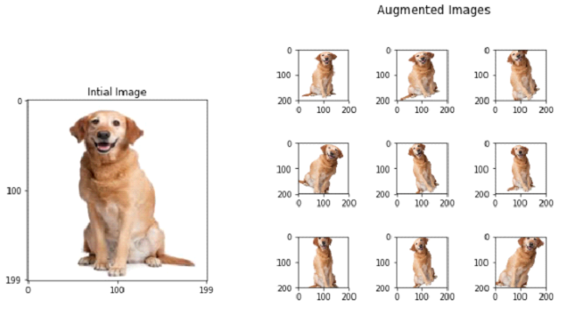
Image Augmentation
Image augmentation is a technique that is used to artificially expand the data-set. This is helpful when we are given a data-set with very few data samples.
Ref: https://towardsdatascience.com/image-augmentation-14a0aafd0498
Image augmentation parameters that are generally used to increase the data sample count are zoom, shear, rotation, preprocessing_function and so on.
Say: we have 100 images, each image is augmented to as 9 different images i.e., total 10.
So the total dataset for training will be around 1000.
We can created ‘n’ number of images using a small amount of dataset.
Notes:
15
15

Slide 16
Image Augmentation using OpenCV
Data Flow architecture:
Source
Processing Pipeline
Output
HDD
Processor
HDD
Steps:
Set the source as the image from HDD.
Read the image.
Put the data to the processing pipeline.
Do the augmentation/Image processing.
Save the output to the drive.
Demo : Another Laptop
Notes:
16
16

Slide 17
Thank You
END

