Slide 1

lec???Canny-V1.0-2019-09-08
CTI One Corporation
Version: x0.1
Date: 09 08, 2019
Project Lead: Harry Li, Ph.D.
Team member: Prashanth Rajasekar
Company confidential
Notes:
1
1

Slide 2
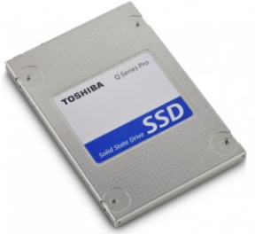
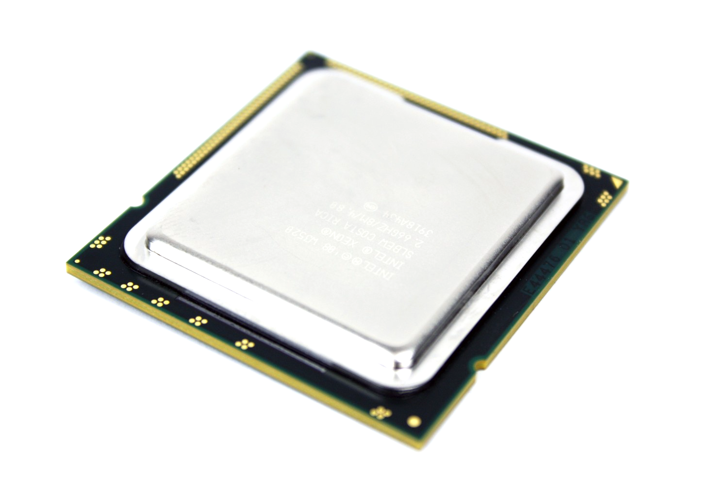

Apply canny on input frame
Data Flow architecture:
Canny()
Source
Processing Pipeline
Output
HDD
Processor
LCD/LED
Steps:
Set the source from where the image is to be picked.
Put the data to the processing pipeline.
Apply canny function to the input image.
Show it as the output.
Notes:
2
2

Slide 3
Canny function on Image and save using OpenCV
Data Flow architecture:
Canny()
Source
Processing Pipeline
Output
HDD
Processor
HDD
Steps:
Set the source as the image from HDD.
Read the image.
Put the data to the processing pipeline.
Apply canny edge detection
Save the output to the drive.
Notes:
3
3

Slide 4

Apply canny on input frame from webcam
Data Flow architecture:
Canny()
Source
Processing Pipeline
Output
Webcam
Processor
LCD/LED
Steps:
Set the source from where the image is to be picked.
Put the data to the processing pipeline.
Apply canny function to the input image.
Show it as the output.
Notes:
4
4

Slide 5
Read Display and Save Image to HDD
Data Flow architecture:
Source
Processing Pipeline
Output
Webcam
Processor
LCD/LED
Steps:
Set the source as the webcam, ‘0’ for webcam.
Read one frame from the video stream.
Put the data to the processing pipeline.
Apply canny edge detection.
Save the image to HDD.
As well as show it as the output.
Notes:
5
5

Slide 6
Apply canny on Videostream from HDD
Data Flow architecture:
Canny()
Source
Processing Pipeline
Output
Write
HDD
Processor
LCD/LED
Steps:
Set the source as the videofile from HDD.
Read one frame from the video stream.
Put the data to the processing pipeline.
Apply canny function to the received frames.
Save the output to the drive.
Show as the output.
Repeat the process in a loop.
Video writing to HDD
Notes:
6
6

Slide 7
Apply canny to the input frames from webcam
Data Flow architecture:
Source
Processing Pipeline
Output
Write
Webcam
Processor
LCD/LED
Steps:
Set the source as the videofile from HDD.
Read one frame from the video stream.
Put the data to the processing pipeline.
Apply canny function to the received frame.
Show as the output.
Write the frame to HDD.
Repeat the process in a loop.
Video writing to HDD
Notes:
7
7

Slide 8
Thank You
END

