Slide 1

Lec??? Pedestrian-face-localization-PR-2018-10-35.ppt
Pedestrian Detection and Face Localisation
CTI One Corporation
Version: x0.1
Date: Jan 2019
Team members: Prashanth Rajasekar
Project Lead: Harry Li, Ph.D.
Company confidential
Notes:
Put the documentation number.

Slide 2
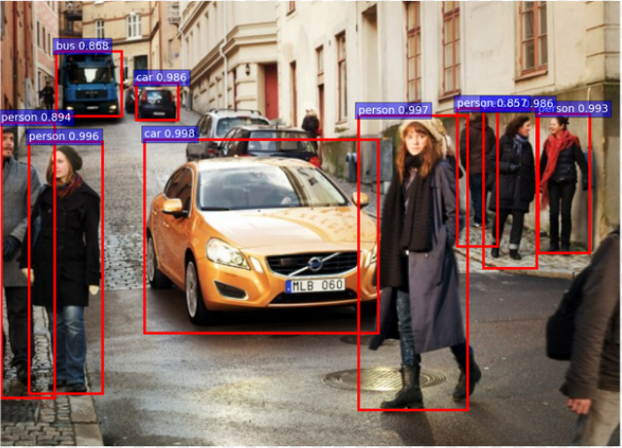
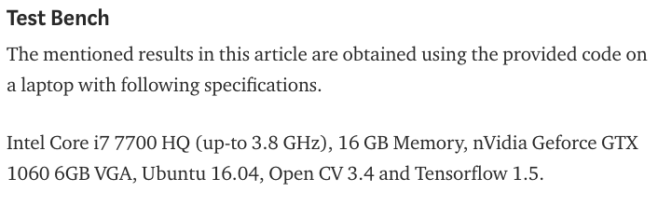
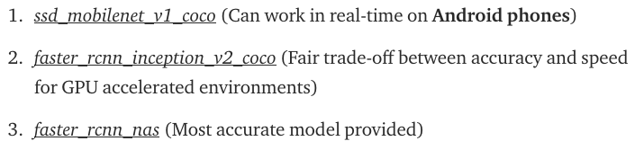
Technical Information
Model Name: “faster_rcnn_inception_v2_coco_2018_01_28”
The “.pb“file extension is a data file format associated to Corel WordPerfect software.
3 Main models available:
What is RCNN?
A convolutional neural network (CNN) is mainly for image classification. While an R-CNN, with the R standing for region, is for object detection. A typical CNN can only tell you the class of the objects but not where they are located.
Incorporated
Notes:
show the summary.
check the RCNN fullform.

Slide 3
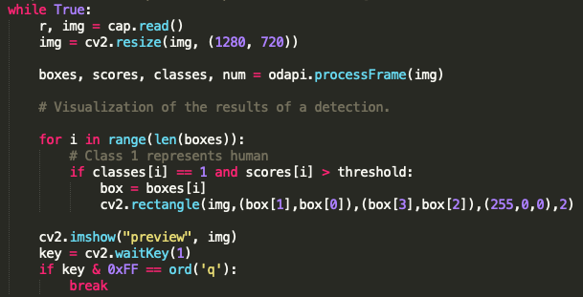
Pedestrian Detection
1.
Load the trained Model to the program:
2.
Define the Input Source:
3.
Read the frames and process the frame for the detection.
Detect Pedestrians in the frame.
Draw boxes around the
pedestrians

Slide 4
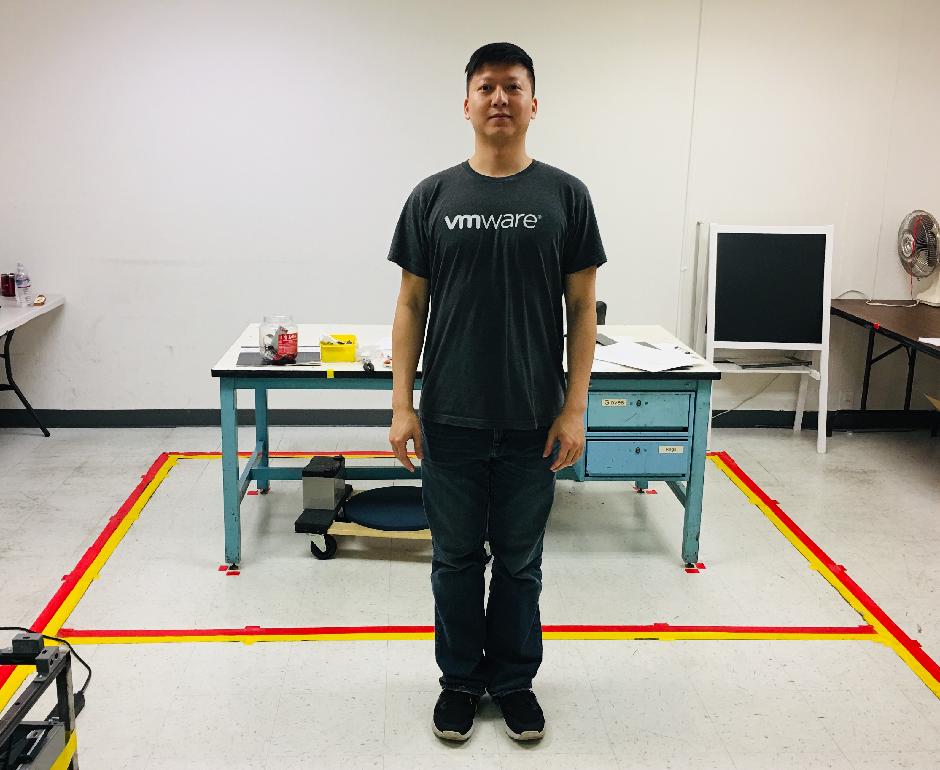
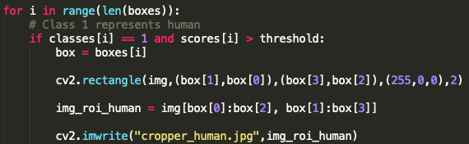

Pedestrian Detection + Face Localization
1.
Incorporate Model for pedestrian detection:
2.
Incorporate Model for Face Localization:
Define the Input Source:
3.
4.
Read the frame one by one using a while loop,
Detection the pedestrian using the same technique used in slide-3,
For the number of pedestrian detected, draw rectangle and crop the image.
5.
6.

Slide 5
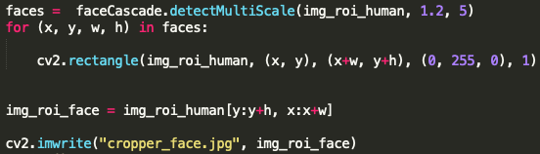

Pedestrian Detection + Face Localization cont…
7.
Once the Pedestrian is detected, detected faces on the image using OpenCV cascade model imported in step 2.
8.
For the number of faces detected, draw rectangle over the faces.
9.
Once the face is detected, write the image to the folder.
10. This can be extended for continuous frames.
Notes:
add behaviour part.

Slide 6
The End
Thank You

