Slide 1

Canny-Edge-Detection-v01-MO-2019-09-04
CTI One Corporation
Version: x0.1
Date: MMM DD, YYYY
Project Lead: Harry Li, Ph.D.
Team members: Minh Duc Ong
Public
Notes:
‹#›
‹#›

Slide 2
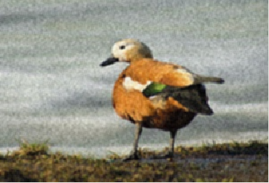
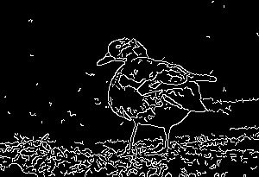
Edge Detection?
The early stage of vision processing identify features in images that are relevant to estimating the structure and properties of objects in scene. Edges are such features. Edges are significant local changes in the image and are important features for analyzing images. Edges typically occur on the boundary between two different regions in an image. Due to its importance, edge detection continues to be an active research area.
Image
Canny Edge Detection

Slide 3

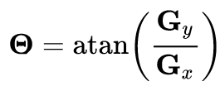


A simple example with Sobel filter
Sobel Filter:
0 | 0 | 0 | 10 | 10 | 10
0 | 0 | 0 | 10 | 10 | 10
0 | 0 | 0 | 10 | 10 | 10
0 | 0 | 0 | 10 | 10 | 10
0 | 0 | 0 | 10 | 10 | 10
0 | 0 | 0 | 10 | 10 | 10
0 | 40 | 40 | 0
0 | 40 | 40 | 0
0 | 40 | 40 | 0
0 | 40 | 40 | 0
-1 | 0 | 1
-2 | 0 | 2
-1 | 0 | 1
*
=
Kernel x
Image
0 | 0 | 0 | 10 | 10 | 10
0 | 0 | 0 | 10 | 10 | 10
0 | 0 | 0 | 10 | 10 | 10
0 | 0 | 0 | 10 | 10 | 10
0 | 0 | 0 | 10 | 10 | 10
0 | 0 | 0 | 10 | 10 | 10
0 | 0 | 0 | 0
0 | 0 | 0 | 0
0 | 0 | 0 | 0
0 | 0 | 0 | 0
-1 | -2 | -2
0 | 0 | 0
1 | 2 | 1
*
=
Kernel y
Image

Slide 4
Canny Edge Detection
Canny Edge Detection is a popular edge detection algorithm. It was developed by John F. Canny in
1.Noise reduction: Gaussian Blur to remove the noise
2.Gradient calculation: Sobel filter to highlight the edge and find gradient
3.Non-maximum suppression: to thin out the edges
4.Edge Tracking by Hysteresis: transform weak pixels into strong ones.

Slide 5

Gaussian Blur
What is noise in images?
100 | 100 | 100 | 100 | 100
100 | 55 | 100 | 100 | 100
100 | 100 | 100 | 100 | 100
100 | 100 | 100 | 100 | 100
100 | 100 | 100 | 100 | 100
Averaging to remove noise:
100 | 100 | 100 | 100 | 100
100 | 55 | 100 | 100 | 100
100 | 100 | 100 | 100 | 100
100 | 100 | 100 | 100 | 100
100 | 100 | 100 | 100 | 100
100 | 100 | 100 | 100 | 100
100 | 95 | 100 | 100 | 100
100 | 100 | 100 | 100 | 100
100 | 100 | 100 | 100 | 100
100 | 100 | 100 | 100 | 100
1 | 1 | 1
1 | 1 | 1
1 | 1 | 1
*
=
Kernel
Image
Blur Image

Slide 6
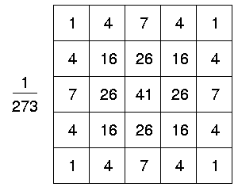
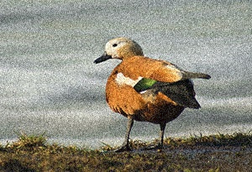

Gaussian Blur
Gaussian filtering is done by convolving each point in the input array with a Gaussian kernel and then summing them all to produce the output array
Gaussian Kernel:
Image
Gaussian Blur Image

Slide 7
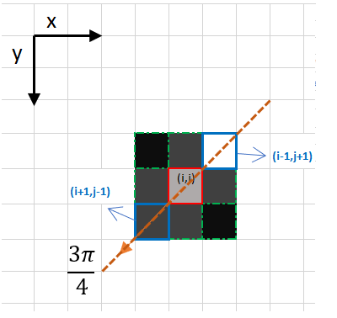
Non Maximum Suppression
https://towardsdatascience.com/canny-edge-detection-step-by-step-in-python-computer-vision-b49c3a2d8123

Slide 8
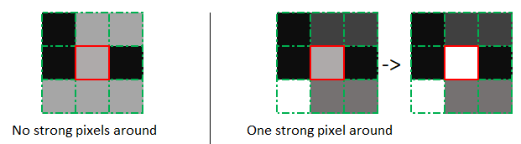
Edge Tracking by Hysteresis
https://towardsdatascience.com/canny-edge-detection-step-by-step-in-python-computer-vision-b49c3a2d8123

Slide 9
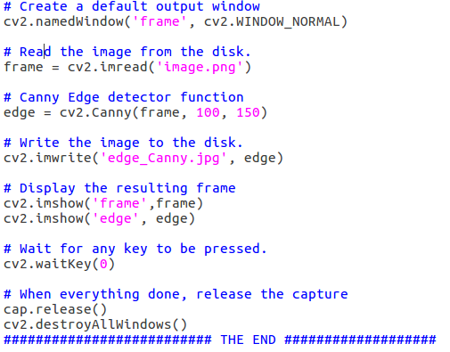
Program

Slide 10
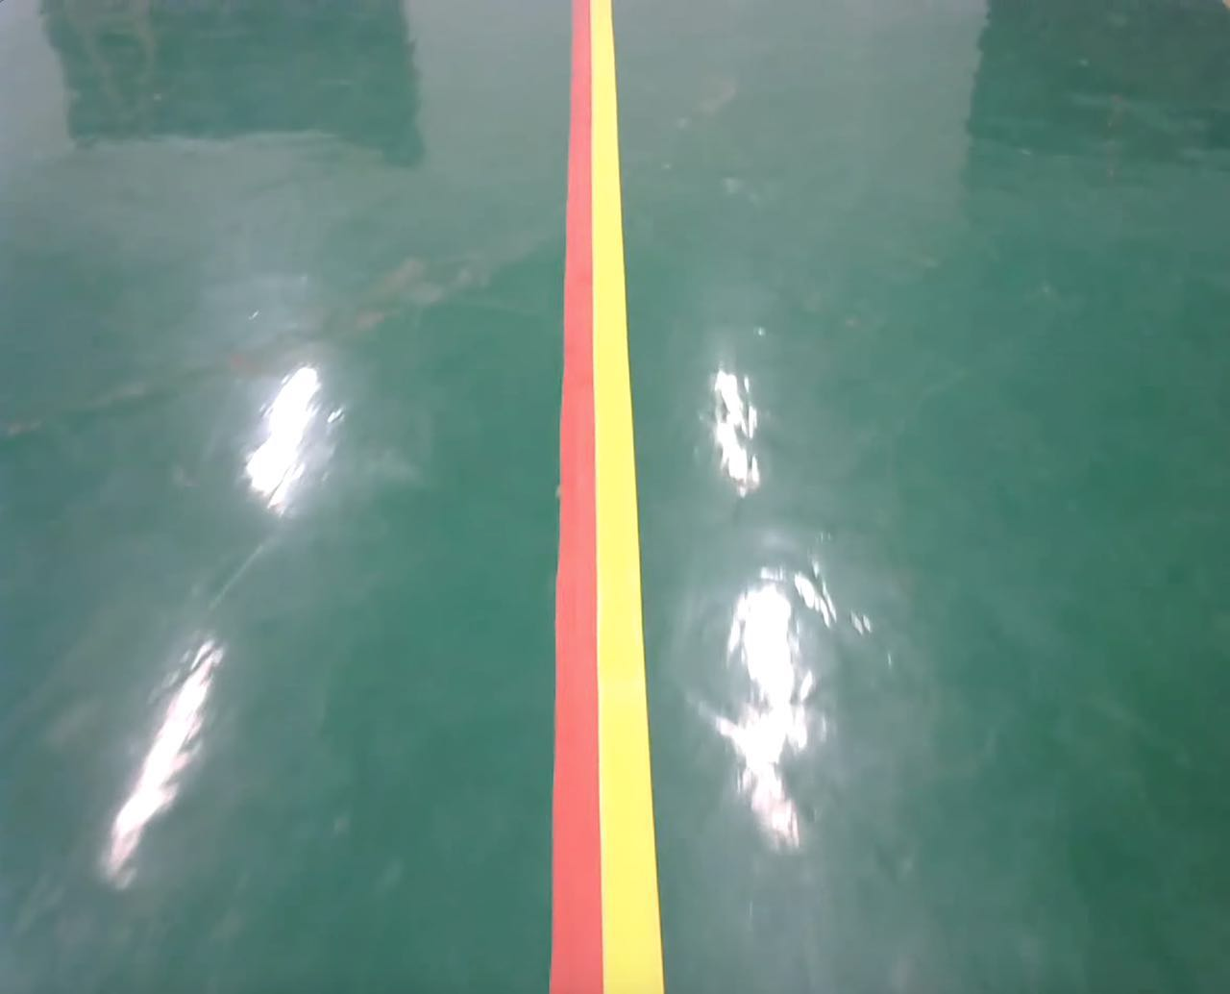
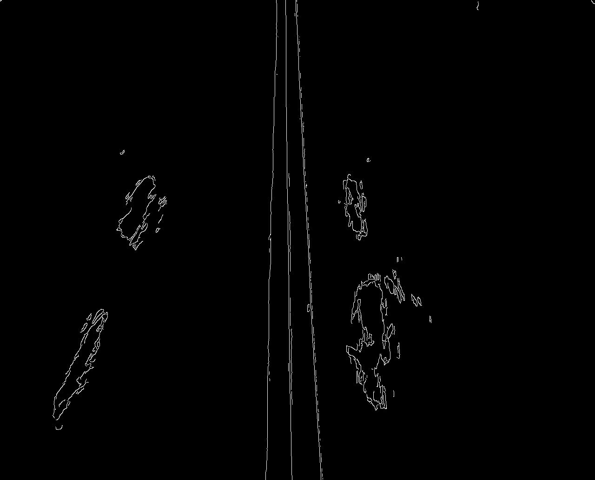
Result
Image1
Canny Edge Detection 1
Canny Edge Detection 1
Image2
Canny Edge Detection 2

Slide 11
Q&A

