Slide 1

Contour-OpenCV
CTI One Corporation
Version: x0.1
Date: Jul 20, 2019
Project Lead: Harry Li, Ph.D.
Team members:
Minh Duc Ong
Company confidential

Slide 2
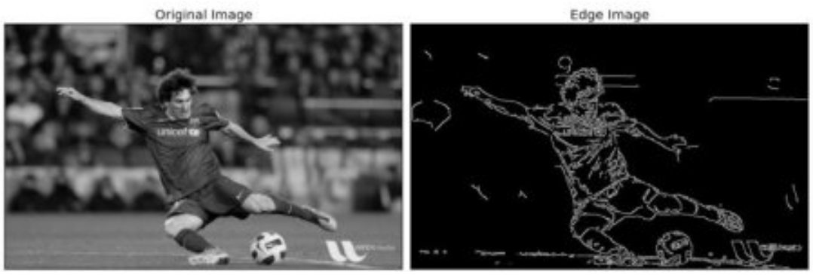
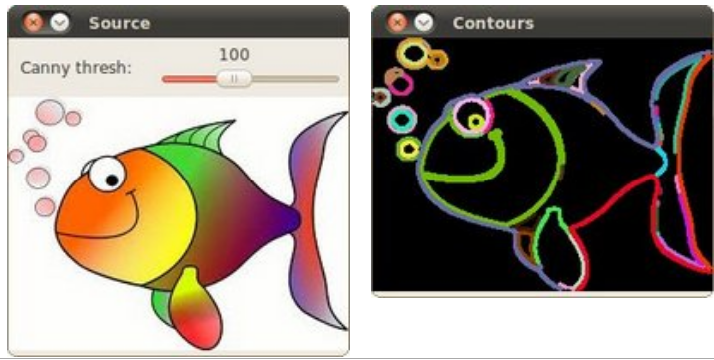
What is contour?
What is Edge Detection?
Similarly, Contour is Edge with 2 more conditions:
1. Closed curve
2. Hierarchy
Edge
+
Closed Curve
+
Hierarchy
=
Contours
Canny Edge Detection
Source: https://docs.opencv.org/3.1.0/da/d22/tutorial_py_canny.html
Canny Edge Detection
Source: https://docs.opencv.org/2.4/doc/tutorials/imgproc/shapedescriptors/find_contours/find_contours.html
Company confidential

Slide 3
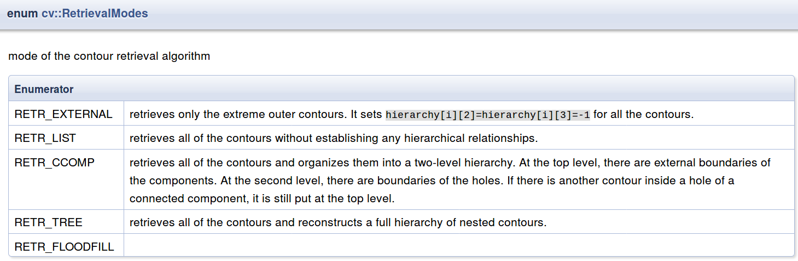
Contour Hierarchy
Refer to: Slide 1-3
https://github.com/hualili/CMPE297/blob/master/2019S/2019S-25-contourAnalysis-2018-9-13.pdf
Source: http://dalab.se.sjtu.edu.cn/docs/opencv_3_1_0/docs.opencv.org/3.1.0/d3/dc0/group__imgproc__shape.html#gga819779b9857cc2f8601e6526a3a5bc71a7d1d4b509fb2a9a8dc2f960357748752
Company confidential

Slide 4
How to find contour?
Read BGR Image
Gaussion Blur
Gray Scale
Binarization
findContour
drawContour
Company confidential

Slide 5
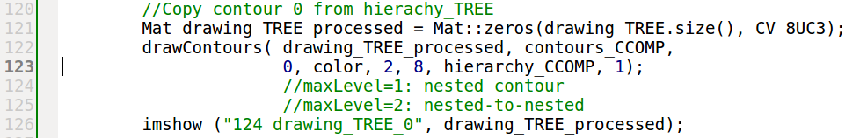
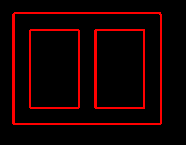



Access Each Contour of CCOMP and TREE hierachy
Contour 0 of TREE Hierarchy
Company confidential
Contour 0 of CCOMP Hierarchy

Slide 6
Reference
1. https://github.com/hualili/CMPE297/blob/master/2019S/2019S-25-contourAnalysis-2018-9-13.pdf
2. https://www.johndcook.com/blog/2009/08/24/algorithms-convert-color-grayscale/
3. https://docs.opencv.org/3.1.0/de/d25/imgproc_color_conversions.html
4.https://docs.opencv.org/2.4/doc/tutorials/imgproc/gausian_median_blur_bilateral_filter/gausian_median_blur_bilateral_filter.html
Company confidential

