Slide 1

Region-of Interest-v01-MO-2019-09-04
CTI One Corporation
Version: x0.1
Date: MMM DD, YYYY
Project Lead: Harry Li, Ph.D.
Team members: Minh Duc Ong
Public
Notes:
‹#›
‹#›

Slide 2
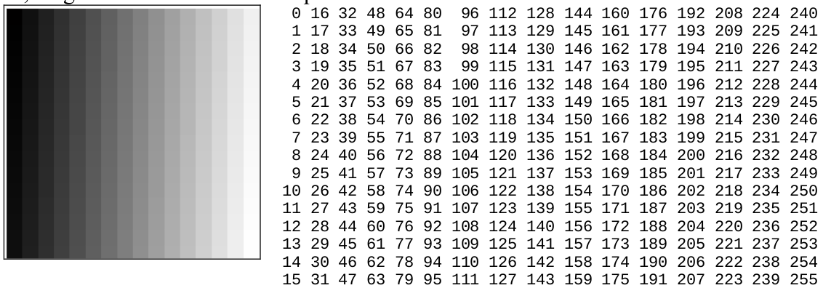
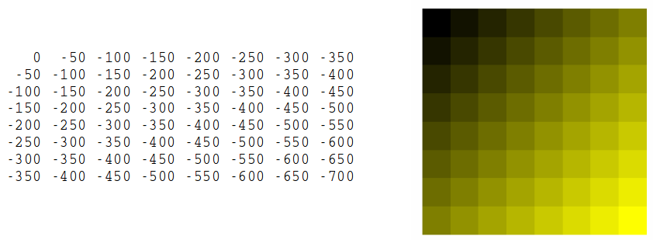
Digital Picture?
What is an image in computer? Image is represented by pixels matrix.

Slide 3
Coordinate system in Opencv?
O
0 1 2 3
x
0
1
2
3
10 | 20 | 100 | 80
40 | 100 | 90 | 80
10 | 100 | 90 | 80
90 | 90 | 90 | 80
y

Slide 4
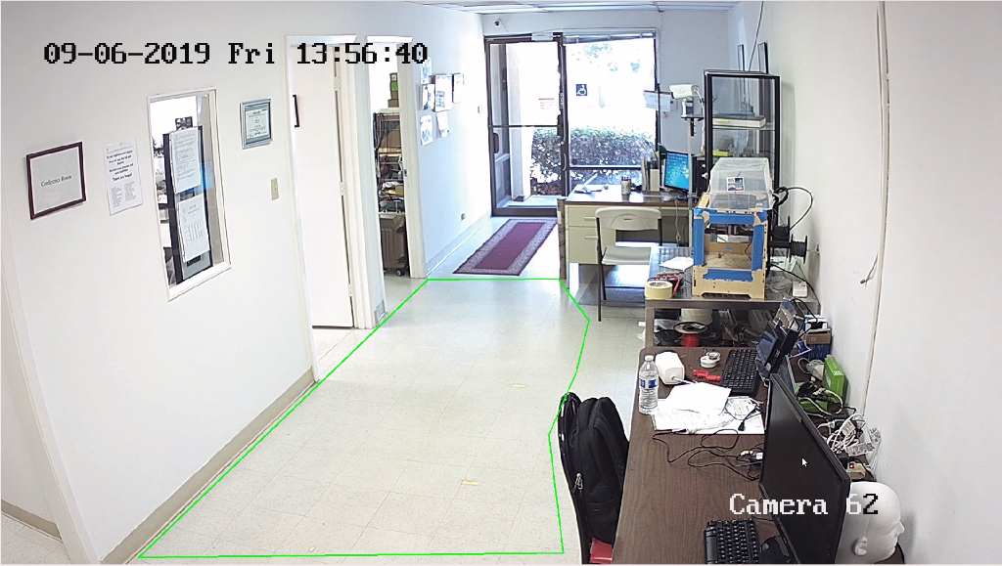
ROI?
A region of interest (ROI) is a portion of an image that you want to filter or perform some other operation on
https://www.pantechsolutions.net/blog/matlab-code-for-region-of-interest-in-image/

Slide 5
To define ROI
We define position of 2 points: Point 1 (0,0), Point2 (2,2)
O
0 1 2 3
x
0
1
2
3
10 | 20 | 100 | 80
40 | 100 | 90 | 80
10 | 100 | 90 | 80
90 | 90 | 90 | 80
Point 1
Point 2
y

Slide 6
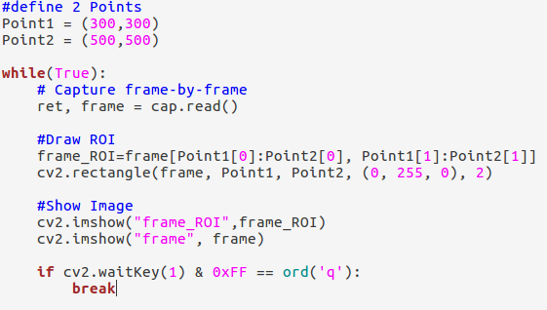
Program
x1 x2 y1 y2

Slide 7
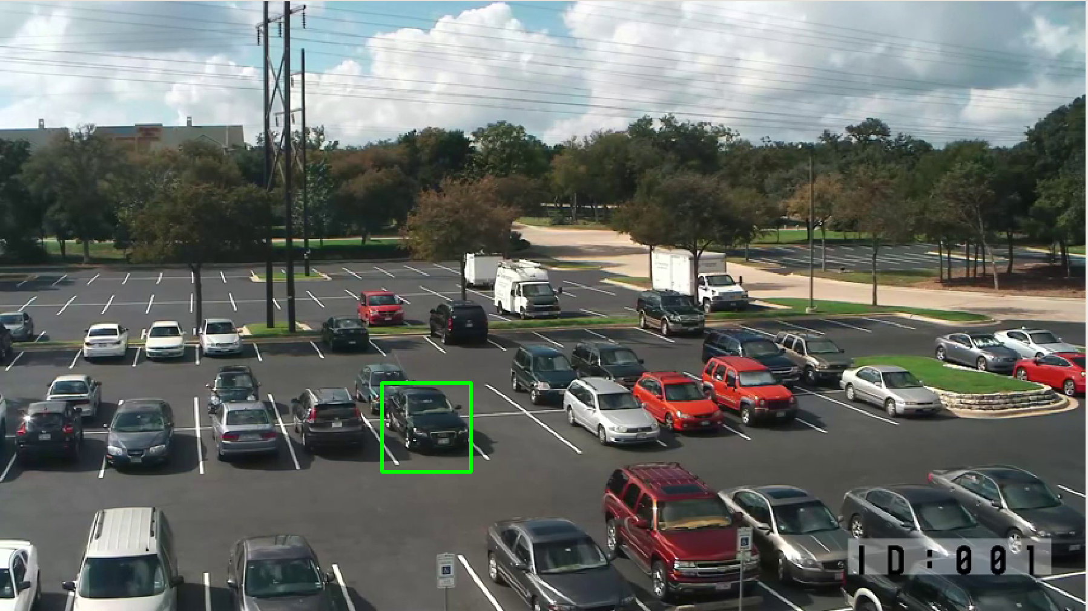
Result

Slide 8
Q&A

