Slide 1

Practical Python For Tensorflow
Tony Xu
9/30/2017

Slide 2
Setup Your Development Env.

Slide 3
Install TensorFlow + OpenCV + Pycharm
Install TensorFlow 2.7 with virtualenv.
You at least install CPU version if you don’t have GPU in the system.
If you have a faster/recent CPU, you can recompile TensorFlow to gain 10X performance usually.
I name my env. as tfcv2 (for TensorFlowComputeVision Python 2.7) or tfcv3 (for Python 3)
Install Opencv
skip virtualenv steps since you have already install it.
When you do cmake configuration, point your python path to tfcv2/bin/python
Copy your cv2.so to tfcv2/lib/python2.7/site-packages

Slide 4
Python Function

Slide 5
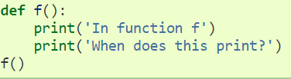
Function in Python
Example:
Keyword: def
Function name
Don’t forget “:”
Indent: block
Invoke the function

Slide 6
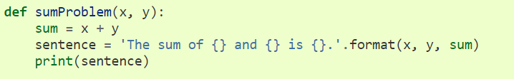
Function with Parameters
Parameters
Name Your Function something meaningful!
How to invoke a function?
sumProblem(2, 3)

Slide 7
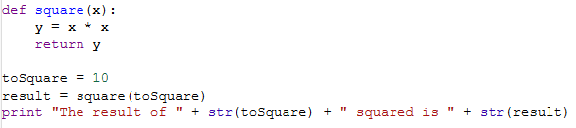
Function with Return
Return from function
Hold return values
Invoke the function

Slide 8

__main__?
Often you will encounter the following code:
When Python interpreter reads in a python script, before it executes the code, it will define a special variable __name__ with value “__main__”.
However if you “import” this code, the value will be script’s name.
Why we do that?
Share your modules with others
Unit test

Slide 9
TensorFlow Basic

Slide 10

Boring?

Slide 11
One Minute on Machine Learning
Y = f(x)
Given enough photos and answers, we try to figure out f()
Let’s first assume f’() and apply Y’ = f’(x). All we need to do is to make |Y – Y’| → 0, therefore f’() is very close to real f().
f’() happens to be a batch of matrices and their operations (CNN e.g.)
Cat or dog
photos
Notes: for supervised learning.

Slide 12
Agenda
TensorFlow’s Two Phases
Tensor
Constant
Variable
Placeholder
Reshape

Slide 13
“Hello World” From TensorFlow
Start your python:
$source yourenv/bin/activate
(yourenv)$python
You first “hello world” :
>>>import tensorflow as tf
>>>hello = tf.constant(‘Hello World’)
>>>with tf.Session() as sess:
>>> sess.run(hello)
Load tensorflow module!
first phase: build a graph
Second phase: execute a graph

Slide 14
Session and Graph
A graph defines how to compute/operation on nodes. It doesn’t compute anything.
A session executes graphs. It allocates resources and holds the actual values of intermediate results and variables.
TensorFlow Core programs as consisting of two discrete phases:
Define computation (graph)
Execute computation (session)

Slide 15
Agenda
TensorFlow’s Two Phases
Tensor
Constant
Variable
Placeholder
Reshape

Slide 16
Understand Tensor and Rank
Tensor: Multi-dimension array
Rank: dimension (order…)
3 # a rank 0 tensor; this is a scalar with shape []
[1., 2., 3.] # a rank 1 tensor; this is a vector with shape [3]
[[1., 2., 3.], [4., 5., 6.]] # a rank 2 tensor; a matrix with shape [2, 3]
1. 2. 3.
4. 5. 6.
[[[1., 2., 3.]], [[7., 8., 9.]]] # a rank 3 tensor with shape [2, 1, 3]
3
2
1
9
8
7

Slide 17
Tensor: Constant, Variable and Placeholder
Constants: initialized when you call tf.constant, and their value can never change.
>>>node1 = tf.constant(3.0, dtype=tf.float32)
>>>node2 = tf.constant(4.0) # also tf.float32 implicitly
Variables: not initialized when you call tf.Variable.
>>>W = tf.Variable([.3], dtype=tf.float32)
Placeholders: similar to variables.
Variables (for weights and bias) are trained over time, placeholders are input data that doesn't change as your model trains (like input images, and class labels for those images)
Notes:
Take for example the simple linear regression WX+B=Y(where W and B stand for the weights and bias and X for the observations' inputs and Y for the observations' outputs). Obviously X and Y are of the same nature which differs from that of W and B. X and Y are values of the samples(observations) and hence need a place to be filled, while W and B are the weights and bias, Variables(the previous value affects the later) in the graph which should be trained using different X and Y pairs. We place different samples to the Placeholders to train the Variables.
It will relate to real hardware implementation with different memory/cache and speed.

Slide 18
Locate Variable, Constant and placeholder
W*x + b + 0.5
0.5
+
constant
*
b
x
W
placeholder
Variable!

Slide 19
Agenda
TensorFlow’s Two Phases
Tensor
Constant
Variable
Placeholder
Reshape

Slide 20
Constants
Definition:
tf.constant(value, dtype=None, shape=None, name=‘Const’,verify_shape=False)
Examples (always give a name to your constants, variables and placeholders!)
tf.constant([[0,1], [2,3]], name= “myconst”)
tf.zeros([2,3], tf.int32, name=“myzeromatrix2x3”)
# create a 2x3 matrix with all elements are zeros
tf.ones([2,3], tf.int32, name=“myonematrix2x3”)
tf.fill([2,3], 8, name =“mymatrix2x3with8”)

Slide 21
More on Constant Sequence
tf.linspace(start, stop, num, name=None)
tf.linspace(10.0, 13.0, 4, name=“seq”)
=>[10.0, 11.0, 12.0, 13.0]
tf.range(start, limit=None, delta=1, dtype=None, name=‘range’)
tf.range(3, 18, 3, name=“myrange”)
=> [3, 6, 9, 12, 15]

Slide 22
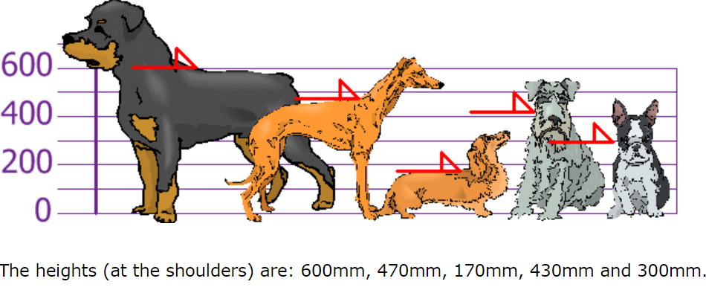

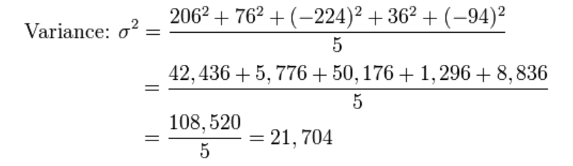
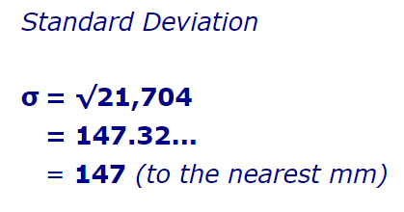
Random Constant
tf.random_normal(shape, mean=0.0, stddev=1.0, dtype=tf.float32, seed=None, name=None)
https://www.mathsisfun.com/data/standard-deviation.html

Slide 23
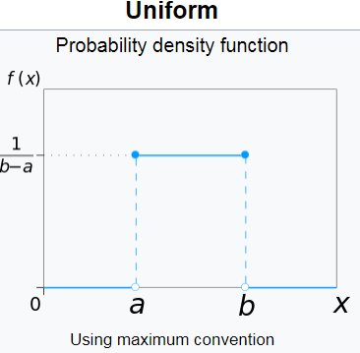
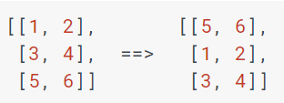
More about Random Tensor

Slide 24
Agenda
TensorFlow’s Two Phases
Tensor
Constant
Variable
Placeholder
Reshape

Slide 25
Variables
Variable can be any tensor
a = tf.Variable(1, name=“scalar”)
b = tf.Variable([1,2], name=“vector”)
c = tf.Variable([[1,2], [3,4]], name=“matrix”)
W = tf.Varaible(tf.zero[784, 10], name=“weights”)
Variable is a class, so it has a few ops.
x.assign(), x.assign_add() etc.

Slide 26
You Have to Initialize Your Variables
For all variables:
init = tf.global_variables_initializer()
In the session: sess.run(init)
For a set of variables:
init_ab=tf.variables_initializer([a,b], name=“init_ab”)
In the session: sess.run(init_ab)
For one variable:
Just use variable’s initializer
In the session: sees.run(W.initializer)

Slide 27
If You Want to See Value
>>> W = tf.Variable(tf.truncated_nomal([700,100]))
>>> with tf.Session() as sess:
>>> sess.run(W.initializer)
>>> print W
>>> #Tensor(“Variable/read:0”, shape=(700,10), dtype=float32)
>>> print W.eval()
>>> #[[-0.76781619 -0.67020458 1.1533688 …]]
What’s W?

Slide 28
Variable Assignment
>>> W = tf.Variable(10)
>>> assign_op = W.assign(100)
>>> with tf.Session() as sess:
>>> sess.run(W.initializer)
>>> print W.eval()
>>> #10 Why?
>>> sess.run(assign_op)
>>> #now we can see 100
What’s W?

Slide 29
Agenda
TensorFlow’s Two Phases
Tensor
Constant
Variable
Placeholder
Reshape

Slide 30

Placeholder
Format: tf.placeholder(dtype, shape=None, name=None)
It is very similar to Variable.
Feed the values to a placeholder using a dictionary at run time.

Slide 31
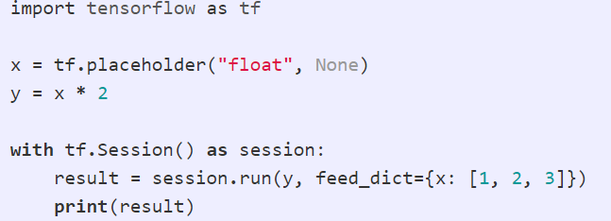
Feed Data into a placeholder
Use feed_dict keyword
A Python dictionary

Slide 32
Agenda
TensorFlow’s Two Phases
Tensor
Constant
Variable
Placeholder
Reshape

Slide 33


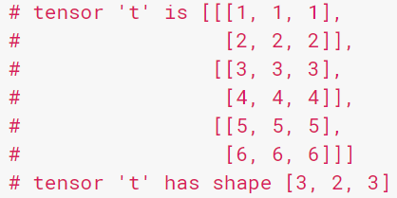
Tensor Shape and Reshape
We always need to manipulate tensor’s shape to meet desire math operations.

Slide 34
Demo

Slide 35

Use a 3x3 kernel to do convolution on a 5 x 5 image.
You implement it with python
You implement it with Tensorflow (optional)

Slide 36
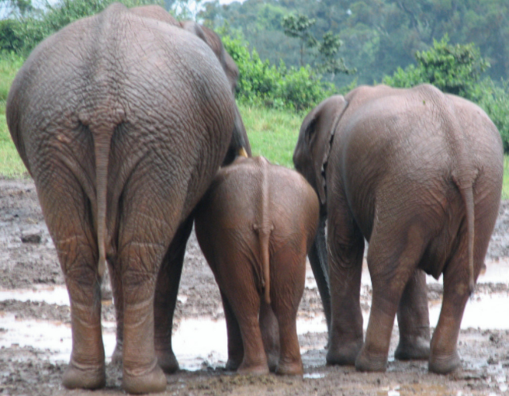
The End

