Slide 1

Practical Python For Tensorflow
Tony Xu
10/21/2017

Slide 2
Numpy Basic
Matlab in Python (Numeric Python)
Very similar to Tensorflow
It is for matrix opertions

Slide 3
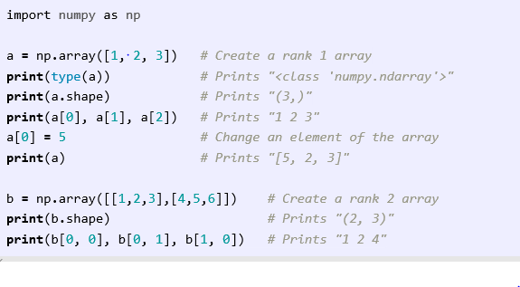
Numpy Array

Slide 4
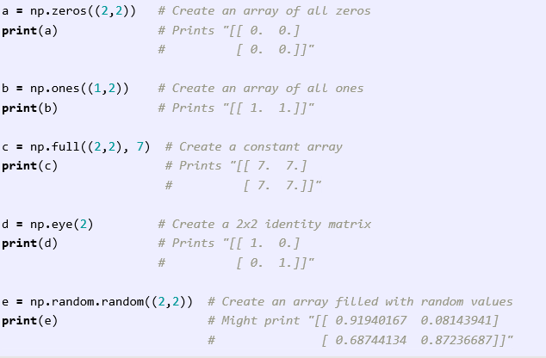
Numpy Special Array

Slide 5
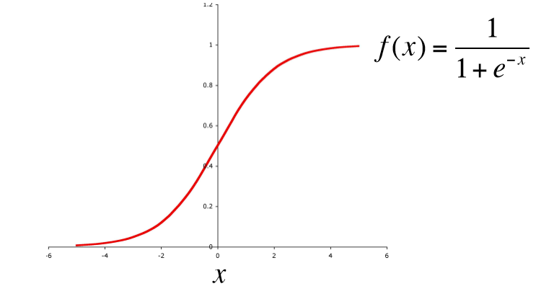
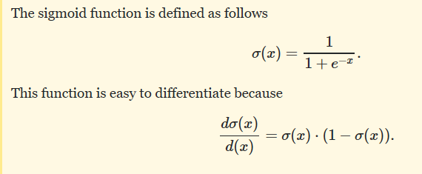
Activation Function: Sigmoid Function
Derivative at every where
Range: [0,1]

Slide 6
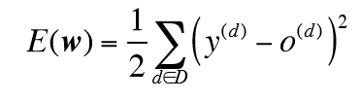
Cost Function
Determine how good our predication to desired values.
Cost function = Loss function = Error function

Slide 7
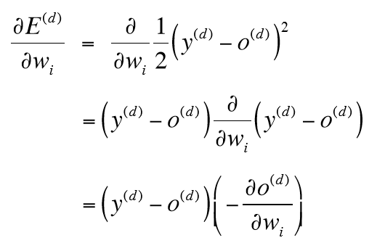
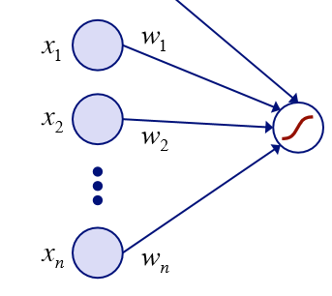

Error GD over Sigmoid

Slide 8
Backpropagation Steps
Calculate error E(i) for output layer node(i)
E(i) = node(i).output * (1 – node(i).output) * (desiredoutput(i) - node(i).output)
You may need to calculate more than one: E(1)…E(i)…E(n)
Calculate ∆ Ws to output layer nodes
∆ Wji (notation: from node(i) to output layer node(j))
= (learning rate) * E(j) * node(i).output
For ∆ Wji
i is from 1 to m nodes in hidden layer
j is from 1 to n nodes in output layer

Slide 9
Backpropagation Steps Continue
Calculate errors for hidden layer node (i)
Node(i) connecting to nodes (1…n) next layer (e.g. output layer)
Node(i) connecting to nodes(1…m) previous layer (e.g. input layer)
Current layer we have nodes (1…k)
E(1),E(2)…E(n) is next layer’s E (assuming we already have)
W1i, W2i…Wni are weights from node(i) to node(1…n) next layer
E(i) = node(i).output * (1 – node(i).output) * (E(1) * W1i + E(2)*W2i + … E(n)*Wni)
You need to do E(1) …E(k)
Calculate ∆Ws coming into hidden layer
∆ Wij (notation: from node(j) in previous layer to note(i))
= learning rate * E(i) * node(j).output
j is from 1 to m
i is from 1 to k

Slide 10
Updating Weights
Gradient Descent update
∆ W = - η * ∂E/∂w
W(t+1) = W(t) + ∆ W
With momentum α (usually converges faster)
∆ W = - η * ∂E/∂w
W(t+1) = W(t) + ∆ W + α∆ W(t-1)

Slide 11

The End

