Slide 1

Practical Python For Tensorflow
Tony Xu
10/14/2017

Slide 2
Agenda
Recap of what we have learned last time
Finish up Last time TensorFlow Solution for 2D Convolution
LoG Kernel Implementation
Python Solution
TensorFlow Solution if applicable

Slide 3
Build a Kernel
A LoG Kernel is/has (important for computer vision)
A square
A odd number in size
Seed is in the center of the Kernel
Values (Weights) inside the Kernel dictated by LoG on its position (x, y)
Is “derived” Kernel – using lots of math: Laplacian of Gaussian
A Learnt Kernel (Machine Learning)
Let your machine/computer/program to figure out values in the Kernel by learning your data.
You still need to know some math ☹, but you don’t have to be a mathematician to build your kernels ☺
We will cover how to do that later on

Slide 4
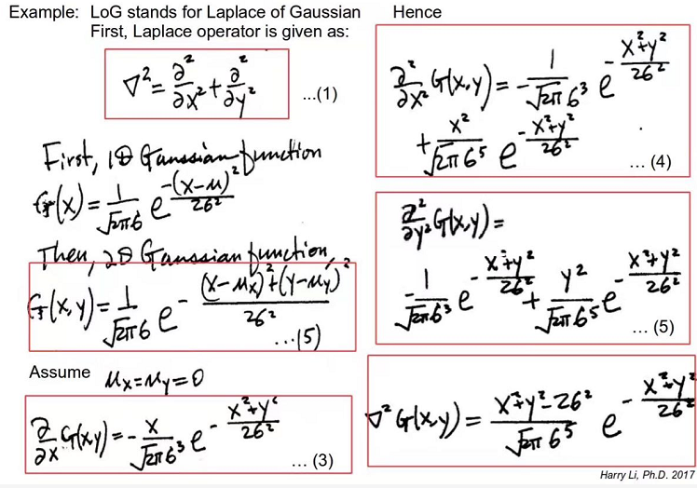
LoG

Slide 5
Agenda
Recap of what we have learned last time
Finish up Last time TensorFlow Solution for 2D Convolution
LoG Kernel Implementation
Python Solution
TensorFlow Solution if applicable

Slide 6
Demo

Slide 7
Agenda
Recap of what we have learned last time
Finish up Last time TensorFlow Solution for 2D Convolution
LoG Kernel Implementation
Python Solution
TensorFlow Solution if applicable

Slide 8
Python Solution
We only use Python primitives to illustrate how to program in Python
We are going to show you step by step with a few small examples before we finalize the solution.

Slide 9
More on Python List
Create a List in Range
>>> for i in range(10)
#0, 1, …,9
>>> for i in range(-2, 2)
#-2, -1, 0, 1 (not include 2!!!)
>>> for i in range(-2, 2+1)
#-2, -1, 0, 1, 2 --symmetric!
Useful to create a symmetric kernel
How to empty a list?
>>> del MyList[:] # : for all element

Slide 10
Python List Quiz
If we have a list=[‘a’,’b’,’c’,’d’]
>>>print list[:]
>>> [‘a’,’b’,’c’,’d’] # : for all element
>>> print list[1:]
>>> [‘b’,’c’,’d’]
>>> print list[:-1]
>>> [‘a’,’b’,’c’]
>>> print list[1:-1]
>>> [‘b’,’c’]
>>> del list[:]

Slide 11
Math in Python
>>> import math # load your math library
math.pi
math.e
math.exp(x) #Return e**x.
math.pow(x, y) #Return x**y
math.sqrt(x) #Return the square root of x.
There are many of them:
https://docs.python.org/2/library/math.html

Slide 12
Demo

Slide 13
Agenda
Recap of what we have learned last time
Finish up Last time TensorFlow Solution for 2D Convolution
LoG Kernel Implementation
Python Solution
TensorFlow Solution if applicable

Slide 14
TensorFlow Solution
Introduce a few TensorFlow functions.
Practices in Convolution
We also show you a small step each time and finally reach to our goal.

Slide 15
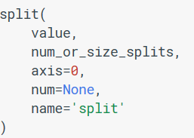
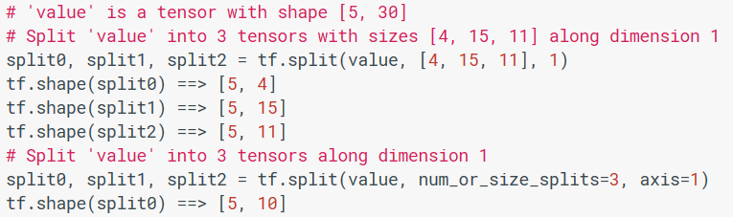
tf.split
Axis: 0 – vertical
1 - horizontal

Slide 16
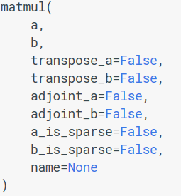
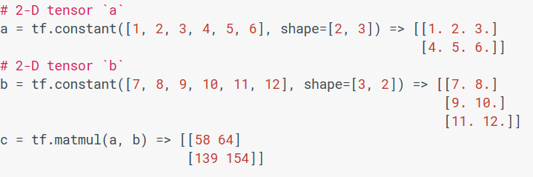
tf.matmul: Matrix Multiple
Also called dot product
If a n x r * r x m, we will get a n x m matrix (2x3 * 3x2 => 2x2)

Slide 17
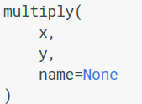
tf.multiply
Element wise multiply (it is not dot product)
It is different than tf.matmul
We will show you in the code

Slide 18
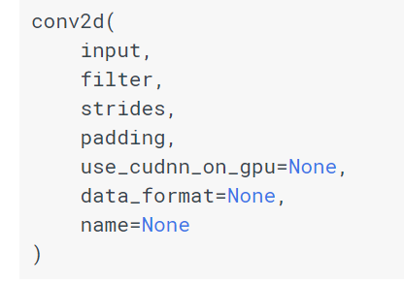
TensorFlow: conv2d
It computes a 2-D convolution given 4-D input and filter tensors
Why 4D?
tf.nn.conv2d vs. tf.layer.conv2d
A 4D Tensor with NHWC format: [100,28,28,1]
A 4D Tensor with HWCC format: [3,3,1,32]
A 1D Tensor with NHWC format:[1,1,1,1]
"SAME", "VALID"
Default “NHWC”

Slide 19
Demo

Slide 20

The End

